Slide 1

Tabaani: AI-Powered Startup Validation
POWERED BY SPARK2SCALE AI

Slide 2


THE $10B STARTUP FAILURE TAX: WHY FOUNDERS STRUGGLE
50%+ of startups falter due to unvalidated ideas and investor hurdles.
Generic tools drain precious time and capital, leaving founders lost.
The critical need: AI-driven guidance from concept to capital.
Notes:
The startup journey is a high-stakes game, and the cost of failure is immense – a staggering $10 billion market tax annually. Founders are drowning in unvalidated ideas and struggling to connect with investors. Current tools are generic, wasting critical time and money. Tabaani cuts through this chaos, providing the specialized AI guidance founders desperately need.

Slide 3

TABAANI: YOUR AI CO-PILOT FOR STARTUP SUCCESS
Tabaani is the AI platform that transforms raw ideas into investor-ready ventures.
Delivering actionable insights and tailored reports to cut through the noise.
Build confidence and secure funding faster with specialized AI.
Notes:
Meet Tabaani – your AI co-pilot engineered for the startup lifecycle. We empower founders by providing AI-driven validation and automating essential investor documents. This isn't just a tool; it's a strategic advantage, cutting through uncertainty and accelerating the path to funding.

Slide 4
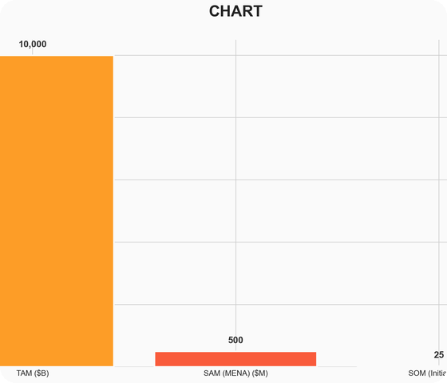
A $10B MARKET RIPE FOR DISRUPTION
Tapping into the global AI startup support market: $10 Billion TAM.
Focusing on MENA's early-stage tech and business startups: $500 Million SAM.
Targeting an initial achievable market of $25 Million SOM.
Notes:
The market opportunity is substantial and growing. We are positioned within the rapidly expanding global market for AI-driven startup support, valued at $10 billion. Our strategic beachhead is the MENA region, where the early-stage ecosystem is vibrant, representing a $500 million Serviceable Addressable Market. Our initial Serviceable Obtainable Market target is $25 million, demonstrating a clear path to significant market capture.

Slide 5

OUR EDGE: SPECIALIZED AI FOR STARTUP INTELLIGENCE
An MVP delivering core AI-driven evaluation and document generation.
Sector-specific AI algorithms provide unparalleled scoring and analysis.
Building a defensible moat with proprietary AI technology and unique insights.
Notes:
Tabaani's core strength lies in its specialized AI. Unlike generic solutions, our models are trained on deep sector-specific data, enabling nuanced analysis and highly accurate scoring. This proprietary technology forms our defensible moat, ensuring a unique and powerful value proposition for founders.

Slide 6
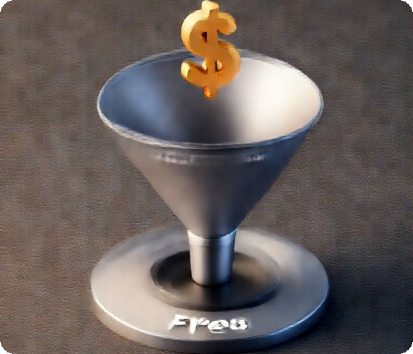
FREEMIUM MODEL: DRIVING ADOPTION & REVENUE
Leveraging a freemium model for maximum user acquisition.
Targeting an average revenue of $400 per customer via premium features like advanced market analysis.
Maintaining a lean operation with a 12-month runway.
Notes:
Our business model is built for rapid adoption and scalability. The freemium approach allows us to attract a broad user base, demonstrating Tabaani's value. Premium features, such as advanced market analysis and investor outreach tools, will drive revenue, with an average ticket price of $400. Our current financial projections and burn rate support a 12-month runway, ensuring focused execution.

Slide 7
VALIDATED DEMAND, READY FOR LAUNCH
'High' solution fit score confirmed by 15 founder interviews.
78/100 pain score highlights urgent market need.
Pre-seed stage: Focused on launch and initial customer acquisition.
Notes:
The market's need is clear and validated. We've achieved a 'High' solution fit score, backed by direct feedback from 15 founders who articulated a significant pain point – a 78/100 score. While we are pre-seed and currently have zero users, this strong validation means we are poised for rapid adoption upon launch.

Slide 8

THE TEAM: EXPERTISE TO EXECUTE
CEO Ahmed Hassan: 5 years as a Startup Consultant, deeply understanding founder challenges.
CTO Mona Ali: 4 years in AI/ML at TechLabs, architecting cutting-edge solutions.
COO Sara Khaled: 6 years of operational excellence, ensuring seamless execution.
Notes:
Our team possesses the ideal blend of market insight, technical prowess, and operational discipline. Ahmed's deep understanding of founder challenges, Mona's advanced AI expertise, and Sara's proven operational leadership create a powerful foundation for Tabaani's success. We are the right team to solve this problem.

Slide 9
THE ASK: $500K TO ACCELERATE GROWTH
Seeking $500,000 to finalize AI development and market launch.
Funds will drive product deployment and initial customer acquisition.
Securing a 12-18 month runway for market leadership.
Notes:
We are seeking $500,000 to finalize our AI development, scale our platform, and execute a targeted go-to-market strategy. This investment will provide a runway of 12-18 months, enabling us to achieve key milestones, capture significant market share, and establish Tabaani as the leader in AI-powered startup evaluation.

