Slide 1

Tabaani: AI-Powered Startup Velocity
POWERED BY SPARK2SCALE AI

Slide 2


THE FOUNDER'S GAUNTLET: IDEA TO INVESTOR-READY
Launching a startup is tough – founders often bet big on ideas that aren't ready for prime time.
Generic tools fail founders, costing them precious time and capital.
We've validated a critical 78/100 pain score among early-stage founders.
Notes:
Launching a startup is incredibly challenging, especially in the early stages. Founders are often caught between validating a nascent idea and preparing compelling documents to attract investment. The current landscape offers generic solutions that simply don't cut it, leading to significant waste of time and money. Our research confirms this is a major pain point, scoring a high 78 out of 100.

Slide 3
TABAANI: YOUR AI CO-FOUNDER FOR STARTUP VELOCITY
Tabaani is the AI co-founder every startup needs, transforming concepts into investor-ready ventures.
Our AI-powered reports slash validation time and dramatically boost investor readiness.
Experience a high solution fit: Tabaani tackles founder confusion head-on, saving critical resources.
Notes:
Tabaani acts as an indispensable AI co-founder, guiding early-stage startups through the complex process of validating their ideas and preparing for investment. Our platform generates tailored evaluation reports and automates essential business documents, providing a high degree of solution fit. This directly alleviates founder pain points, saving them significant time and resources.

Slide 4
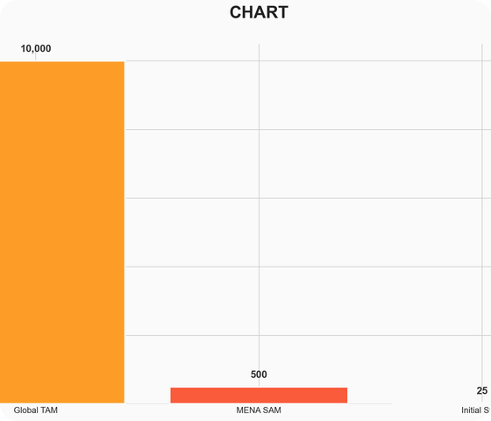
A $10 BILLION GLOBAL MARKET RIPE FOR DISRUPTION
We're tapping into the $10 Billion global market for AI-driven startup support.
Our beachhead is the $500 Million MENA market for specialized AI early-stage evaluation.
We project capturing $25 Million of this market annually, with highly scalable software.
Notes:
The market for AI-powered startup tools is substantial and rapidly expanding globally, estimated at $10 billion. We are strategically targeting the MENA region's early-stage evaluation market, a significant $500 million opportunity. Our initial achievable market (SOM) is projected at $25 million, and our software-centric model allows for rapid, cost-effective global scaling.

Slide 5

AI THAT BUILDS INVESTOR CONFIDENCE
Proprietary AI for pinpoint idea validation and instant investor-ready documents.
Unmatched specialization in startup evaluation, outperforming generic AI solutions.
Our AI-driven reports create deep user stickiness by saving founders hours weekly.
Notes:
Our Minimum Viable Product is built upon proprietary AI algorithms specifically engineered for startup idea scoring and document generation. This specialized focus is our key differentiator. The AI-generated reports and automated documents provide immense value, saving founders significant time and effort, thereby fostering strong user retention.

Slide 6
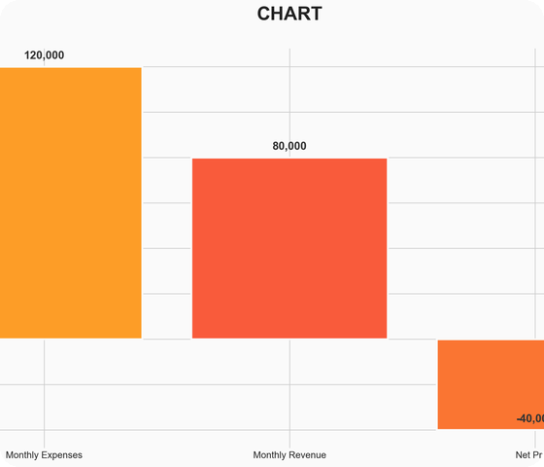
PATH TO PROFITABILITY: ACCELERATING BREAK-EVEN
Our Freemium model is designed for rapid user acquisition and market penetration.
Targeting an average ticket price of $400 for premium features.
While our current model projects break-even in 80 months, this investment will fuel aggressive strategies to achieve profitability within 3-4 years.
Notes:
We employ a Freemium business model to maximize user acquisition and market reach. Our average ticket price for premium features is set at $400. While our current monthly burn is $120,000, leading to an initial 80-month break-even projection, we are aggressively optimizing our conversion funnels and cost efficiencies to significantly shorten this runway. Our strategy focuses on demonstrating clear, quantifiable value in our paid offerings.

Slide 7
VALIDATED DEMAND, PRE-SEED FOCUS
15 founder interviews confirm an urgent need for specialized AI validation.
Pilot feedback highlights the demand for clear evaluation guidance over generic tools.
We are currently pre-seed, focusing on MVP refinement and a targeted GTM strategy to build initial traction.
Notes:
While we are pre-seed with no active users, our traction is grounded in strong qualitative validation. We've conducted 15 in-depth interviews with early-stage founders who unequivocally confirmed the need for our specialized solution. Feedback consistently points to the inadequacy of current generic AI tools and the critical need for clear, actionable evaluation guidance. Our immediate focus is on refining the MVP based on this feedback and developing a precise go-to-market strategy.

Slide 8
THE POWERHOUSE TEAM: AI & MENA STARTUP SAVVY
Led by CEO Ahmed Hassan, a 5-year veteran startup consultant in MENA.
CTO Mona Ali brings 4 years of experience as an ML Engineer at TechLabs.
COO Sara Khaled ensures operational excellence with 6 years of operations management.
Notes:
Our team is exceptionally well-equipped to address this market need. Ahmed Hassan, our CEO, has five years of direct experience as a startup consultant specifically within the MENA region. Our CTO, Mona Ali, is a skilled ML Engineer with four years of experience. Sara Khaled, our COO, brings six years of robust operational management expertise. This blend of technical, operational, and regional market knowledge gives us a significant advantage.

Slide 9

THE ASK: $500K TO FUEL VELOCITY
Seeking $500,000 in Pre-Seed funding.
Funds will accelerate AI model development and platform deployment.
This investment will fuel a targeted customer acquisition strategy to secure early adopters.
Notes:
We are seeking $500,000 in Pre-Seed funding to accelerate Tabaani's growth trajectory. These funds are critical for enhancing our core AI capabilities, ensuring robust platform deployment, and executing a targeted customer acquisition strategy designed to capture our initial market share. Our target close date for this funding round is June 1, 2026.

