Slide 1

Tabaani: AI-Powered Startup Validation
POWERED BY SPARK2SCALE AI

Slide 2


THE FOUNDER'S DILEMMA: LOST IN THE LAUNCH
Founders drown in uncertainty, struggling to validate ideas and craft compelling investor pitches.
Current tools are generic, wasting precious time and resources.
We found founders lose out due to a lack of structured guidance, impacting over 50% of startups that fail early.
Notes:
In today's fast-paced startup world, founders are brilliant but often lack the structured framework to turn a great idea into a validated business. They're spending too much time on manual research and generic AI tools that just don't cut it. This isn't just an inconvenience; it's a critical bottleneck that leads to significant loss of time, money, and ultimately, startup failure.

Slide 3

TABAANI: YOUR AI CO-PILOT FOR STARTUP SUCCESS
We provide an AI platform that validates your startup idea and generates investor-ready documents.
Get actionable insights and a clear roadmap, turning confusion into confidence.
Our specialized AI offers a unique advantage over generic tools.
Notes:
Tabaani is the solution. We've built an AI specifically designed to guide early-stage founders. Think of us as your AI co-pilot. We help you rigorously validate your idea, understand its potential, and automatically generate the essential documents needed to attract investors. This isn't just about saving time; it's about de-risking the early stages of your venture.

Slide 4
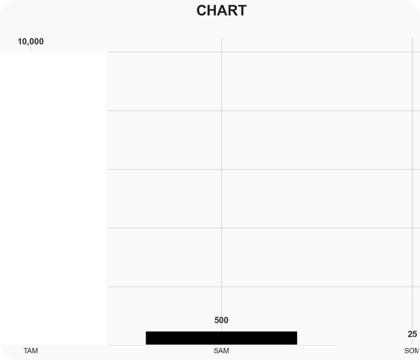
A MASSIVE OPPORTUNITY: MENA'S STARTUP ENGINE
Targeting the $500 Million MENA market for AI startup evaluation tools.
Our vision scales globally, tapping into a $10 Billion TAM for AI support.
We aim to capture $25 Million in our initial years.
Notes:
The market opportunity is substantial. We're initially focusing on the MENA region, a rapidly growing startup ecosystem, with a Serviceable Addressable Market of $500 million for AI-driven startup evaluation. Our long-term vision is global, addressing a Total Addressable Market of $10 billion. We project capturing $25 million within our first few years.

Slide 5
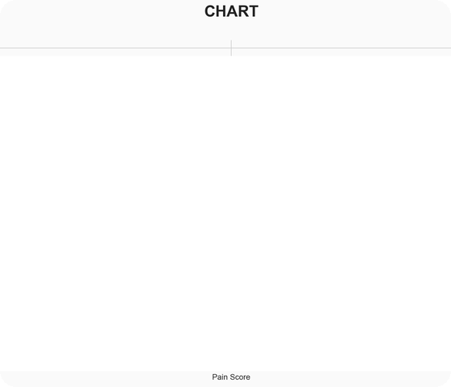
VALIDATED NEED: FOUNDERS AGREE!
Our solution scores a high fit with founder needs.
A 78/100 pain score confirms the urgent demand for structured validation.
15+ founders confirmed: current AI tools are too generic.
Notes:
We didn't just build this in a vacuum. We've validated the need directly with our target users. We achieved a high solution-fit score and a pain score of 78 out of 100, indicating a strong market pull. Our interviews with over 15 early-stage founders revealed a consistent frustration with generic AI tools, reinforcing the need for a specialized solution like Tabaani.

Slide 6

OUR AI: UNIQUE & DEFENSIBLE
We leverage proprietary AI algorithms for startup scoring and document generation.
Our core stickiness is the AI-driven evaluation report.
Specialized for startup needs, offering sector-focused intelligence.
Notes:
What makes Tabaani unique? It's our proprietary AI. We've developed algorithms specifically for scoring startup ideas and generating investor-ready documents. This specialization is our core stickiness and creates a defensible moat. Unlike general AI tools, Tabaani provides sector-focused intelligence tailored for the startup journey.

Slide 7

THE TEAM: DRIVING STARTUP INNOVATION
Led by Ahmed Hassan (CEO, 5 yrs startup consulting), Mona Ali (CTO, ML expert), and Sara Khaled (COO, 6 yrs ops).
A combined 15+ years of experience in startups, AI, and operations.
Deep understanding of the MENA startup landscape and founder challenges.
Notes:
Our team is our strength. I'm Ahmed Hassan, CEO, with 5 years of experience guiding startups. Mona Ali, our CTO, brings 4 years of specialized AI and ML engineering experience. And Sara Khaled, our COO, has 6 years of operational expertise. Together, we have over 15 years of combined experience directly relevant to building and scaling Tabaani, with a deep understanding of the challenges founders face, especially in the MENA region.

Slide 8
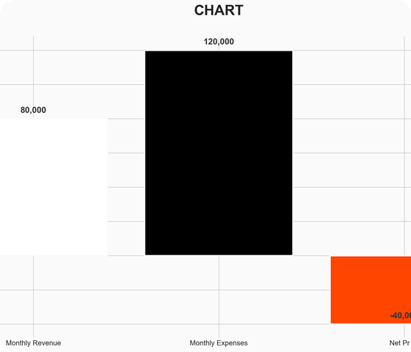
BUSINESS MODEL: SCALABLE & ACCESSIBLE
A Freemium model to attract and onboard founders.
Average revenue per customer projected at $400.
Monthly burn rate of $120K, with a runway requiring strategic investment.
Notes:
Our business model is designed for accessibility and growth. We operate on a freemium basis, allowing founders to experience the value of Tabaani before committing. Our average revenue per customer is projected at $400. While our current monthly burn rate is $120,000, this is a critical phase for scaling customer acquisition and further AI development, which is why we are seeking investment.

Slide 9

THE ASK: FUELING OUR GROWTH
We are seeking $500,000 in Pre-Seed funding.
Funds will accelerate AI model development and customer acquisition.
Join us in empowering the next generation of startups.
Notes:
To accelerate our growth and capitalize on this opportunity, we are seeking $500,000 in Pre-Seed funding. These funds will be strategically deployed to enhance our AI capabilities, scale our marketing efforts to reach more founders, and build out our team. We invite you to join us in building the essential platform for startup success.

