Slide 1

Tabaani: AI for Startup Validation
POWERED BY SPARK2SCALE AI

Slide 2

FOUNDERS ARE STUCK. WE FIX THAT.
Navigating the startup journey is tough. You need to validate ideas and impress investors, but where do you start?
Tabaani provides an AI-powered platform to streamline your startup's early stages.
Get AI-guided evaluation, essential documents, and a clear path to investors.
Notes:
Introduce Tabaani as the AI solution for early-stage founders. Highlight the common struggle of idea validation and investor outreach. Emphasize how Tabaani simplifies this complex process.

Slide 3

THE PROBLEM: LOST TIME, LOST CAPITAL
Early-stage founders spend countless hours on manual research and generic AI tools.
This leads to costly mistakes and missed opportunities, with over 50% of startups failing early.
You need specialized guidance, not just general AI.
Notes:
Dive deeper into the problem Tabaani solves. Quantify the pain with the 78/100 score and the high failure rate. Explain why current solutions fall short.

Slide 4

OUR SOLUTION: AI-POWERED STARTUP CLARITY
Tabaani is your AI co-pilot for startup success.
We generate actionable evaluation reports and investor-ready documents in minutes.
Our specialized AI understands the nuances of early-stage ventures.
Notes:
Present Tabaani's solution. Focus on the AI's ability to provide specific, actionable insights and documents. Highlight the 'solution fit' score.

Slide 5
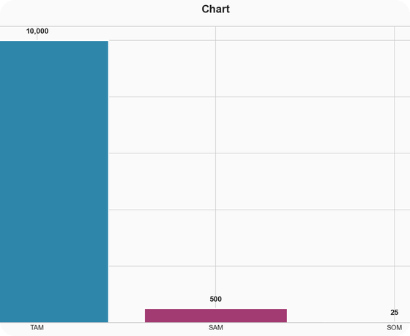
MARKET OPPORTUNITY: A GROWING NEED
We're tapping into a global market of $10 Billion for AI startup support.
Our initial focus on MENA's early-stage AI evaluation tools targets a $500 Million SAM.
We aim to capture $25 Million within our first few years.
Notes:
Detail the market size. Explain TAM, SAM, and SOM. Emphasize the scalability of a software-based AI solution.

Slide 6

VALIDATION: FOUNDERS NEED THIS
We've spoken to 15 founders who confirm the need for structured evaluation.
Their feedback: 'Need clear guidance' and 'Current AI tools aren't specific enough'.
Tabaani's AI reports directly solve this high-impact problem.
Notes:
Reinforce the validation. Share the key takeaways from founder interviews and the 'High' solution fit score.

Slide 7

OUR TRACTION: BUILDING MOMENTUM
We're currently in the MVP stage with 0 active users and $0 early revenue.
Our focus is on AI development, deployment, and acquiring our first customers.
Our go-to-market strategy relies on strong word-of-mouth in startup communities.
Notes:
Be transparent about current traction (pre-seed stage). Outline the immediate focus for development and customer acquisition. Explain the GTM strategy.

Slide 8

THE TEAM: EXPERTISE IN ACTION
Led by Ahmed Hassan (CEO), a startup consultant with 5 years of experience.
Our CTO, Mona Ali, brings 4 years of ML engineering expertise.
Sara Khaled (COO) ensures seamless operations with 6 years of experience.
Notes:
Introduce the core team, highlighting relevant experience and founder-market fit. Emphasize the blend of business, tech, and operations.

Slide 9
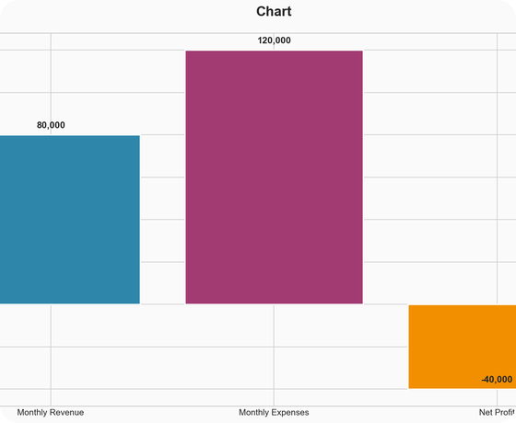
BUSINESS MODEL: FREEMIUM FOR GROWTH
We operate on a freemium model, offering core AI evaluation tools for free.
Our average ticket price for premium features is $400.
With a monthly burn of $120K, we're focused on scaling to profitability.
Notes:
Explain the freemium model and the average revenue per customer. Address the financial situation – high burn rate and negative profit – and the long break-even period (80 months) as an area needing further discussion and strategy.

Slide 10

THE ASK: FUELING OUR GROWTH
We are seeking $500,000 to fuel our growth.
Funds will be allocated to AI model development, platform deployment, and aggressive customer acquisition.
Join us in becoming the leading AI startup evaluator in MENA.
Notes:
Clearly state the funding ask and how it will be used. Reiterate the vision and the opportunity for investors to be part of Tabaani's success.

