Slide 1


Data Exploration Project
DATASET
ANALYSING
USING
SQL
INTRODUCTION
Spotify is a digital music streaming service that provides users access to over 82 million songs, podcasts and audio books.
Spotify is a perfect dataset to measure the popularity of songs against various music elements, across a large set of songs throughout the decades.
In this project we will be analysing the Dynamic music landscape of 2023 through advanced SQL queries on the "Most Streamed Spotify Songs" dataset.

Slide 2
DATASET
ANALYSING
USING
SQL
Data Exploration Project
INTRODUCTION
Spotify is a digital music streaming service that provides users access to over 82 million songs, podcasts and audio books.
Spotify is a perfect dataset to measure the popularity of songs against various music elements, across a large set of songs throughout the decades.
In this project we will be analysing the Dynamic music landscape of 2023 through advanced SQL queries on the "Most Streamed Spotify Songs" dataset.
PROBLEM STATEMENT
By following the principles of effective database design, we aim to provide a solid foundation for managing user interactions, artist information, music albums, playlists, recommendations, and notifications, we seek to extract meaningful insights and trends that shed light on the evolving landscape of music consumption and production. Our primary objectives include:
Most Listened-to Artists
Top songs 10 songs of 2023
Listing the songs according to bpm, key scale, etc.

Slide 3
INTRODUCTION
Spotify is a digital music streaming service that provides users access to over 82 million songs, podcasts and audio books.
Spotify is a perfect dataset to measure the popularity of songs against various music elements, across a large set of songs throughout the decades.
In this project we will be analysing the Dynamic music landscape of 2023 through advanced SQL queries on the "Most Streamed Spotify Songs" dataset.
PROBLEM STATEMENT
By following the principles of effective database design, we aim to provide a solid foundation for managing user interactions, artist information, music albums, playlists, recommendations, and notifications, we seek to extract meaningful insights and trends that shed light on the evolving landscape of music consumption and production. Our primary objectives include:
Most Listened-to Artists
Top songs 10 songs of 2023
Listing the songs according to bpm, key scale, etc.
Data Exploration Project
DATASET
Top songs in the world for year 2023 in Spotify. This dataset has 25 descriptive variables about the songs. Dataset description
Most Listened-to Artists - The Weeknd, Taylor Swift, and Ed Sheeran dominate total streams, showcasing global popularity.
Most Popular Songs on Spotify and Apple Music - Identify current musical trends and preferences across major streaming platforms, including ranks and popularity metrics.
Energy - The energy of a song - the higher the value, the more energetic song.
Speechiness - The higher the value the more spoken word the song contains.
Acousticness - The higher the value the more acoustic the song is.
Liveness - The higher the value, the more likely the song is a live recording.

Slide 4
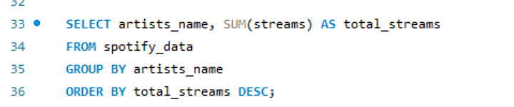
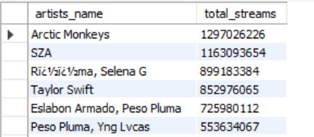
PROBLEM STATEMENT
By following the principles of effective database design, we aim to provide a solid foundation for managing user interactions, artist information, music albums, playlists, recommendations, and notifications, we seek to extract meaningful insights and trends that shed light on the evolving landscape of music consumption and production. Our primary objectives include:
Most Listened-to Artists
Top songs 10 songs of 2023
Songs that has High-Tempo, Energetic, Acoustic and High lyrical content .
DATASET
Top songs in the world for year 2023 in Spotify. This dataset has 25 descriptive variables about the songs. Dataset description
Most Listened-to Artists - The Weeknd, Taylor Swift, and Ed Sheeran dominate total streams, showcasing global popularity.
Most Popular Songs on Spotify and Apple Music - Identify current musical trends and preferences across major streaming platforms, including ranks and popularity metrics.
Energy - The energy of a song - the higher the value, the more energetic song.
Speechiness - The higher the value the more spoken word the song contains.
Acousticness - The higher the value the more acoustic the song is.
Liveness - The higher the value, the more likely the song is a live recording.
Data Exploration Project
Listing the Most Listened-to Artists From The Database:

Slide 5


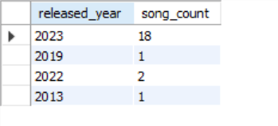
DATASET
Top songs in the world for year 2023 in Spotify. This dataset has 25 descriptive variables about the songs. Dataset description
Most Listened-to Artists - The Weeknd, Taylor Swift, and Ed Sheeran dominate total streams, showcasing global popularity.
Most Popular Songs on Spotify and Apple Music - Identify current musical trends and preferences across major streaming platforms, including ranks and popularity metrics.
Energy - The energy of a song - the higher the value, the more energetic song.
Speechiness - The higher the value the more spoken word the song contains.
Acousticness - The higher the value the more acoustic the song is.
Liveness - The higher the value, the more likely the song is a live recording.
Listing the Most Listened-to Artists From The Database:
Counts Of Songs Released Annually :

Slide 6
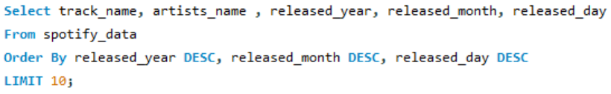
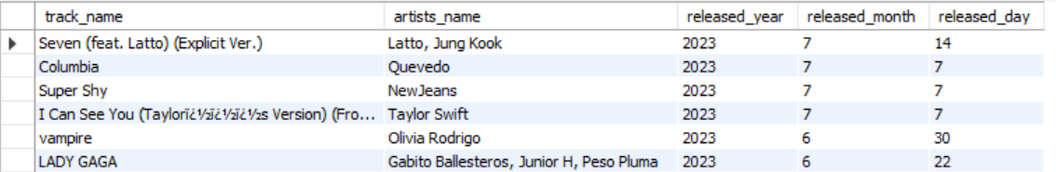
Listing the Most Listened-to Artists From The Database:
Counts Of Songs Released Annually :
New Songs: Lists of the newest songs based on their release date :

Slide 7
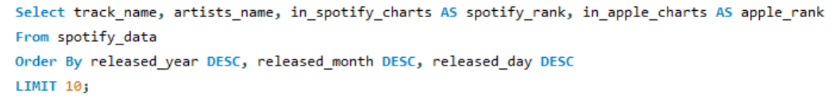
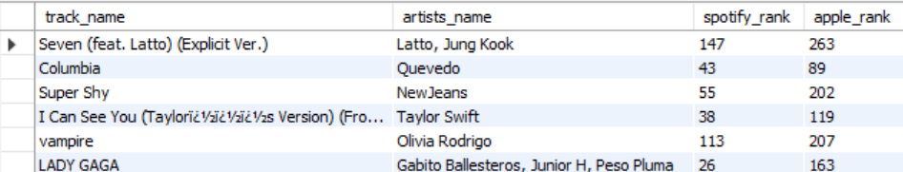
Counts Of Songs Released Annually :
New Songs: Lists of the newest songs based on their release date :
Most Popular Songs on Spotify and Apple Music :

Slide 8
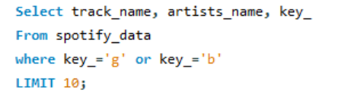
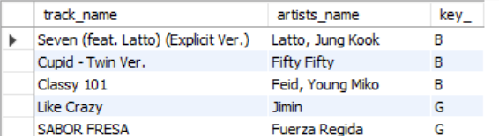
New Songs: Lists of the newest songs based on their release date :
Most Popular Songs on Spotify and Apple Music :
List specific keys of the song :

Slide 9

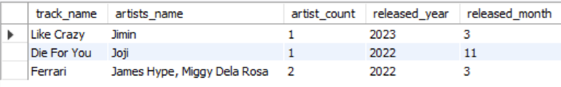
Most Popular Songs on Spotify and Apple Music :
List specific keys of the song :
Filter names that starts with any letter :

Slide 10
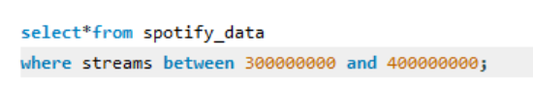
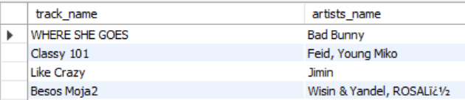
List specific keys of the song :
Filter names that starts with any letter :
Filter data between specific values :

Slide 11
Filter names that starts with any letter :
Filter data between specific values :
thank
you

Slide 12
Filter data between specific values :
Data Exploration Project
thank
you

