Slide 1
SURF in Computer Vision
Speeded-Up Robust Features
Selvamani S
Madras Institute of Technology

Slide 2
Introduction to Feature Detection
Feature detection is a key process in computer vision for identifying important points or patterns in images. These features help in various tasks such as object recognition, image matching, motion tracking, and 3D reconstruction. Algorithms like SIFT, SURF, and ORB are used to detect keypoints that are stable across transformations like scaling, rotation, and illumination changes.

Slide 3
What is SURF?
SURF (Speeded-Up Robust Features) is an algorithm designed for feature detection and description. It was introduced in 2006 by Herbert Bay and his colleagues to offer faster computation compared to SIFT while maintaining robustness. SURF is suitable for real-time applications like object tracking and recognition.

Slide 4
Key Concepts of SURF
1. **Feature Extraction**: Detects keypoints using a Hessian matrix approximation.
2. **Integral Images**: A method for fast computation of pixel sums in a region.
3. **Hessian Matrix**: Used for detecting scale-invariant keypoints.
4. **Scale-space Representation**: Analysis using up-scaled filters for keypoint localization.

Slide 5
Feature Extraction
SURF uses a Hessian matrix approximation to detect interest points in the image. By applying a Gaussian kernel and computing second-order derivatives, SURF identifies stable points across scales. Integral images allow for faster and more efficient computation of these derivatives.

Slide 6
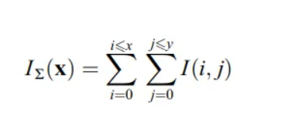
Integral Images
The integral image allows for quick calculation of pixel sums within any rectangular region. It enables fast convolution operations, which are central to the SURF method. This method is computationally efficient and is key to SURF's speed.
They allow for fast computation of box type convolution filters. The entry of an integral image I_∑ (x) at a location x = (x,y)ᵀ represents the sum of all pixels in the input image I within a rectangular region formed by the origin and x.

Slide 7
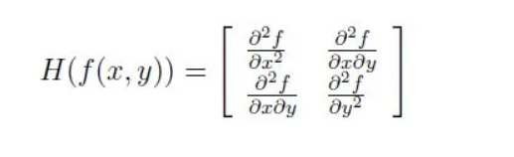
Hessian Matrix-Based Interest Points
SURF uses the determinant of the Hessian matrix to select locations and scales of keypoints. By computing second-order derivatives and approximating them with box filters, SURF achieves computational efficiency while maintaining accuracy.

Slide 8
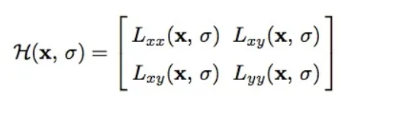
Hessian Matrix-Based Interest Points
For adapt to any scale, we filtered the image by a Gaussian kernel, so given a point X = (x, y), the Hessian matrix H(x, σ) in x at scale σ is defined as:

Slide 9
Hessian Matrix-Based Interest Points
where Lxx(x, σ) is the convolution of the Gaussian second order derivative with the image I in point x, and similarly for Lxy (x, σ) and Lyy (x, σ). Gaussians are optimal for scale-space analysis but in practice, they have to be discretized and cropped. This leads to a loss in repeatability under image rotations around odd multiples of π /4. This weakness holds for Hessian-based detectors in general. Nevertheless, the detectors still perform well, and the slight decrease in performance does not outweigh the advantage of fast convolutions brought by the discretization and cropping.
In order to calculate the determinant of the Hessian matrix, first we need to apply convolution with Gaussian kernel, then second-order derivative. After Lowe’s success with LoG approximations(SIFT), SURF pushes the approximation(both convolution and second-order derivative) even further with box filters. These approximate second-order Gaussian derivatives and can be evaluated at a very low computational cost using integral images and independently of size, and this is part of the reason why SURF is fast.

Slide 10
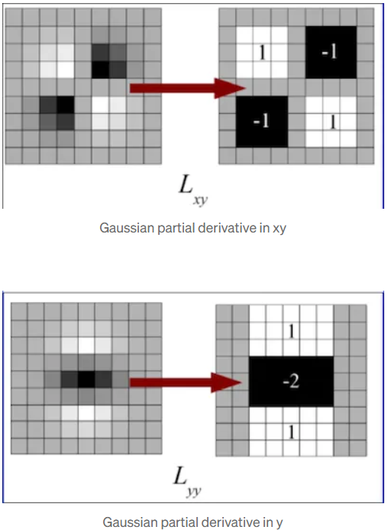
Hessian Matrix-Based Interest Points

Slide 11
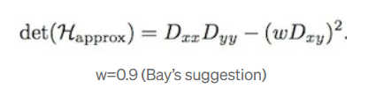
Hessian Matrix-Based Interest Points
The 9 × 9 box filters in the above images are approximations for Gaussian second order derivatives with σ = 1.2. We denote these approximations by Dxx, Dyy, and Dxy. Now we can represent the determinant of the Hessian (approximated) as:

Slide 12
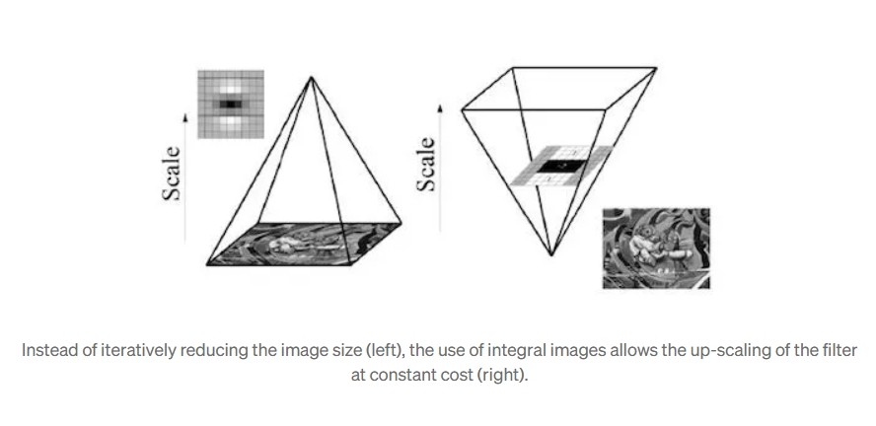
Scale-Space Representation
Scale-space is represented using image pyramids, where the image is repeatedly smoothed and sub-sampled. SURF allows for up-scaling the filter size directly without reducing the image size, making it more efficient than other methods that require iteratively reducing the image.

Slide 13
Feature Description
To make SURF features rotation-invariant, an orientation is assigned to the keypoints based on Haar wavelet responses in a circular region around the keypoint. The SURF descriptor is then constructed by creating a square region around the keypoint, extracting wavelet responses, and forming a descriptor vector.

Slide 14
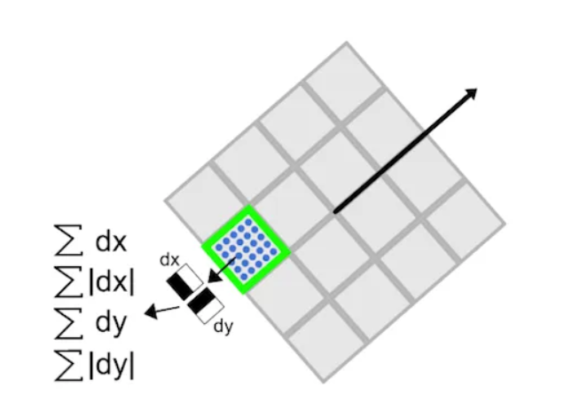
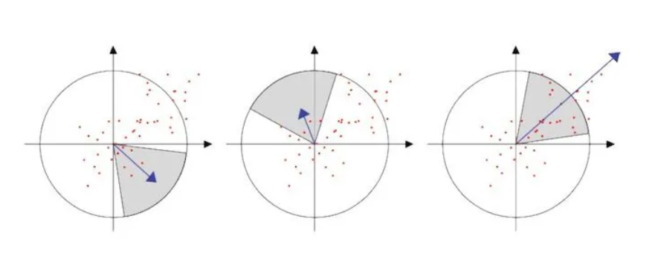
Descriptor Components
Each keypoint descriptor is derived from wavelet responses (dx, dy) and their absolute values. These are summed over small sub-regions to create a 64-dimensional descriptor. The use of integral images helps in computing these descriptors efficiently.

Slide 15
Descriptor Components
Then, the wavelet responses dx and dy are summed up over each subregion and form a first set of entries to the feature vector. In order to bring in information about the polarity of the intensity changes, we also extract the sum of the absolute values of the responses, |dx| and |dy|. Hence, each sub-region has a four-dimensional descriptor vector v for its underlying intensity structure V = (∑ dx, ∑ dy, ∑|dx|, ∑|dy|). This results in a descriptor vector for all 4×4 sub-regions of length 64(In Sift, our descriptor is the 128-D vector, so this is part of the reason that SURF is faster than Sift).

Slide 16
Benefits of SURF
1. **Speed**: Faster than SIFT due to the use of box filters and integral images.
2. **Robustness**: Performs well under various transformations like scale, rotation, and illumination changes.
3. **Real-Time Applications**: Suitable for real-time systems such as object tracking and recognition.

