Slide 1
Snap Session Admin screens related to Social Media

Slide 2
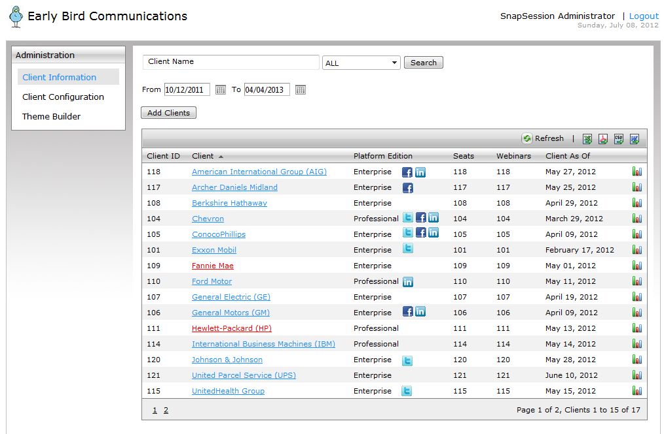

Slide 3
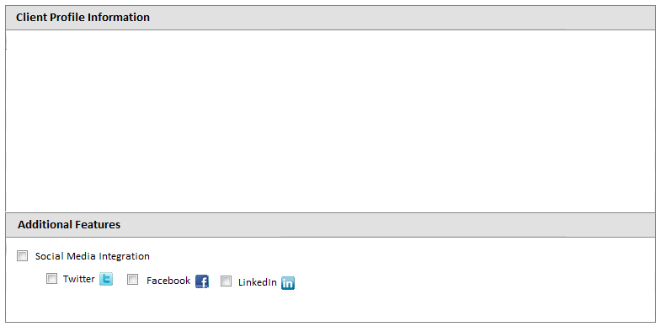
Clicking the client name link in previous screen will bring detail profile of the client along with addition features which could
be enabled (additional billing pointers)

Slide 4
Client Admin screens related to Social Media

Slide 5
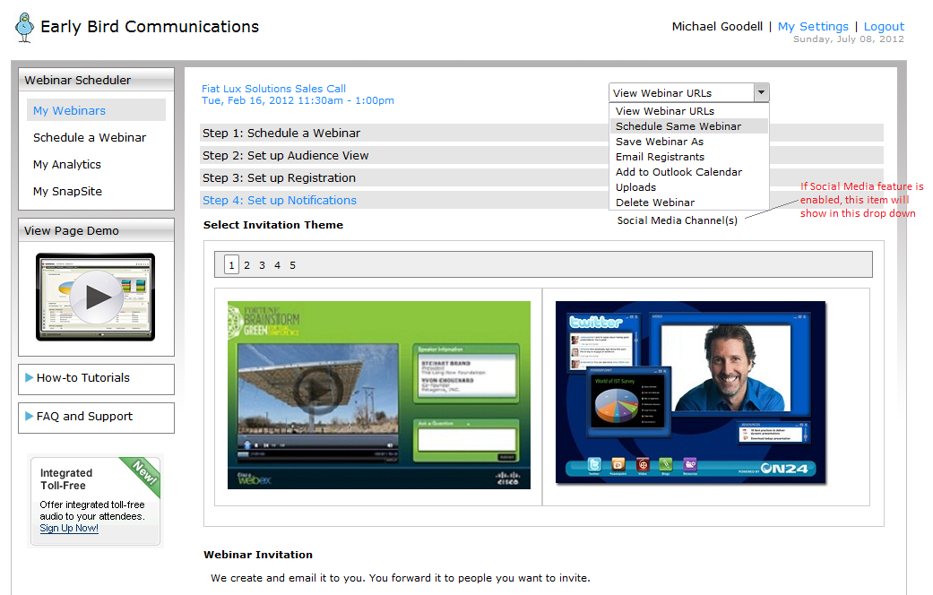

Slide 6
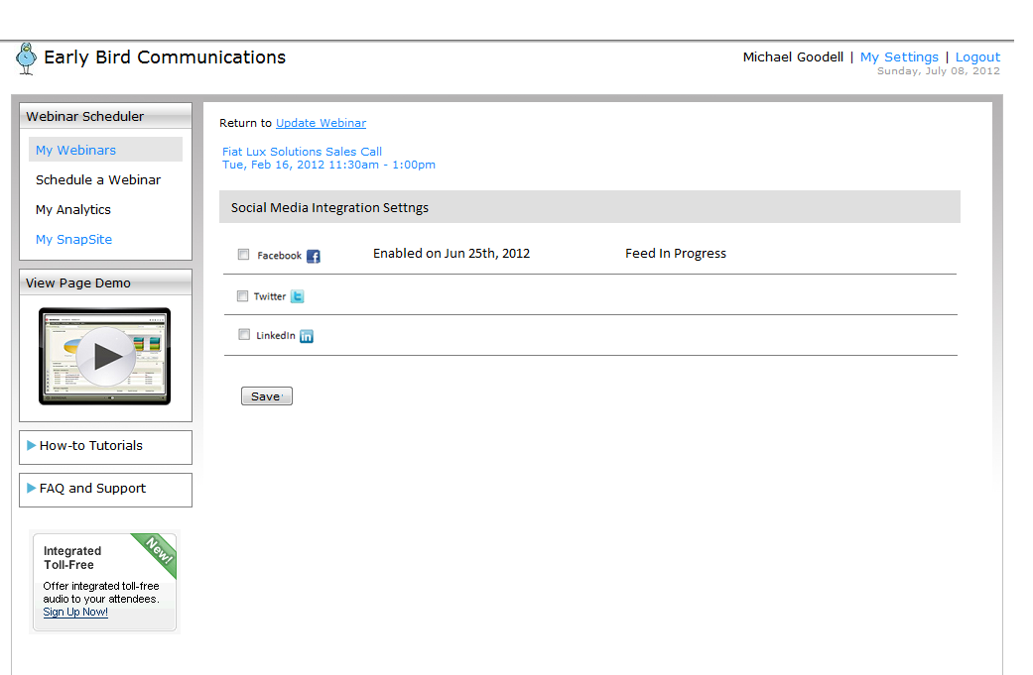
After selecting social media Integration from the drop down the above screen comes up.

