Slide 1
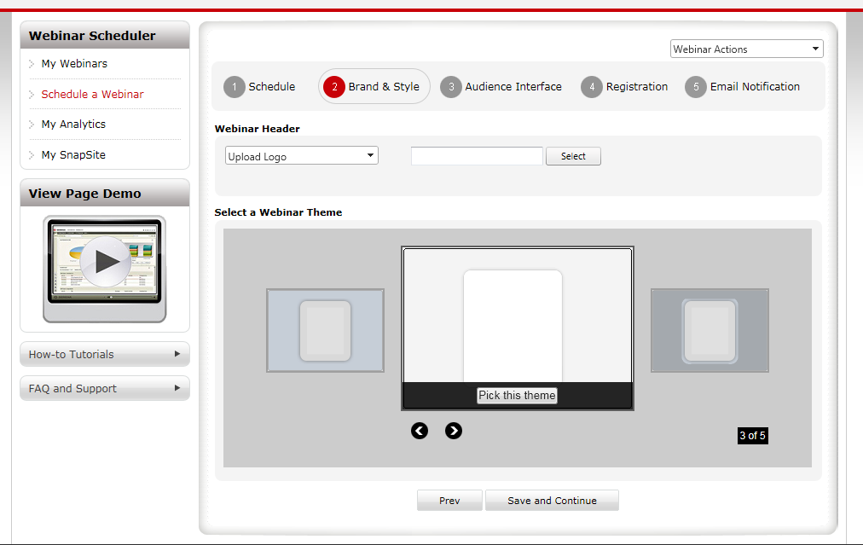
How to control auto scrolling, my idea is if there is no theme selected for this record, than auto scroll is on, else auto-scroll id off, and the theme which is selected will be in focus
1of5 etc part can be removed
The left or right area button should be centered
In the same area as ‘Pick this theme’ section add one more text ‘Preview’. Clicking this preview text should bring pop-up window with actual screen.

