Slide 1



Slide 2
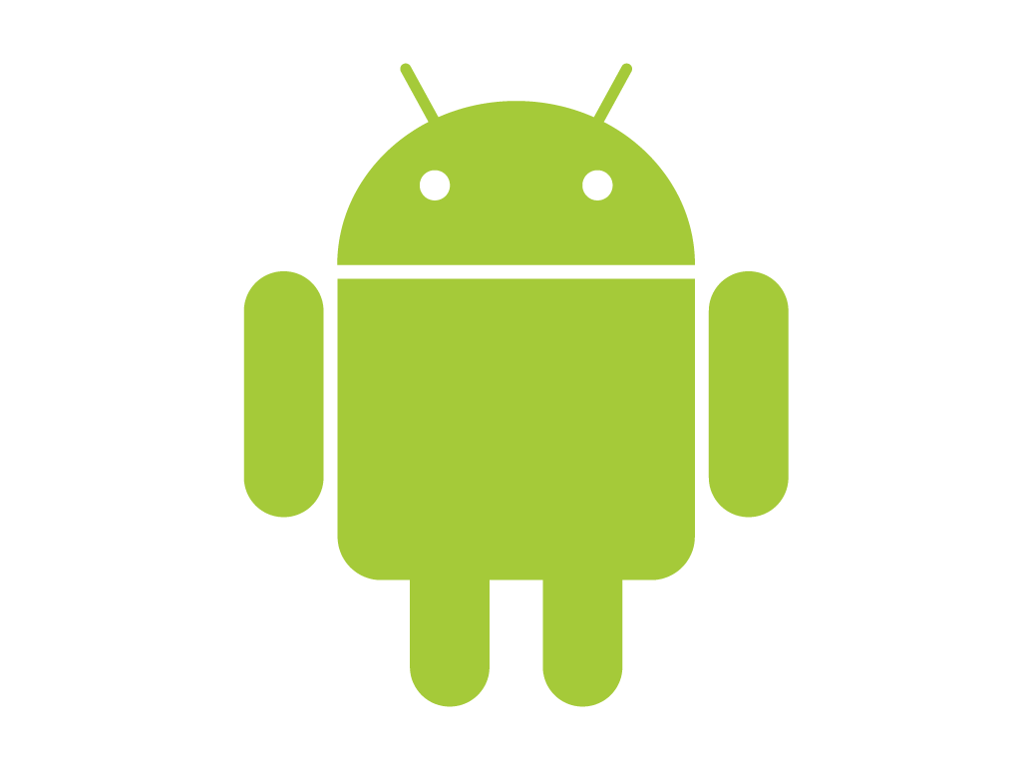
Mobile Application Development (11CS6DCMAD)

Slide 3

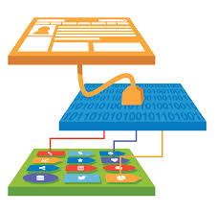
Pictionary
Notes:
Android application layers- Native apps, third party apps and developer apps

Slide 4


Pictionary
Notes:
Android application framework – Location based service, content providers, window manager, Activity manager, Package Manager, Resource Manager..

Slide 5


Pictionary
Notes:
Android Run Time – Android Libraries (graphics, SQLLite, Webkit) and Dalvik Virtual Machine.
Webkit: WebKit is a layout engine software component for rendering web pages in web browsers.

Slide 6

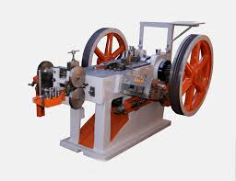
Pictionary
Notes:
Virtual Machine (Dalvik Virtual Machine): One of the key elements of Android is the Dalvik VM. Rather than using a traditional Java VM such
as Java ME, Android uses its own custom VM designed to ensure that multiple instances run effi -
ciently on a single device.
The Dalvik VM uses the device’s underlying Linux kernel to handle low-level functionality, including
security, threading, and process and memory management.

Slide 7

Pictionary
Notes:
SQLite is not a client–server database engine. Rather, it is embedded into the end program.
he SQLite library is linked in and thus becomes an integral part of the application program. The library can also be called dynamically. The application program uses SQLite's functionality through simple function calls, which reduce latency in database access: function calls within a single process are more efficient thaninter-process communication. SQLite stores the entire database (definitions, tables, indices, and the data itself) as a single cross-platform file on a host machine.

Slide 8


Pictionary
By Reto Meier
Notes:
Professional Android 4 Application Development by Reto Meier

Slide 9

Any Guess??

Slide 10

ANDY RUBIN
FORMER CO-FOUNDER AND CEO OF
ANDROID INC.

Slide 11
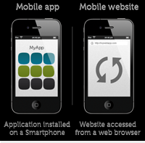
What is the difference between a mobile app vs. web app?

Slide 12
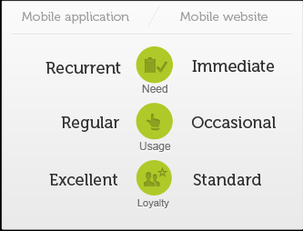
A native app is one that is installed directly onto the smart phone and can work, in most cases, with no internet connectivity depending on the nature of the app.
A web app works via web browser on the smartphone but requires either a cell signal or wi-fi to function.

Slide 13
Mobile Devices – The Good
Always with the user
Typically GPS capable
Typically have accelerometer
Many apps are free or low-cost

Slide 14
Mobile Devices – The Not-So-Good
Limited screen size and colors
Limited battery life
Limited processor speed
Limited and slow network access
Limited or awkward input: soft keyboard, phone keypad, touch screen, or stylus
Limited web browser functionality
Often inconsistent platforms across devices

Slide 15
Mobile Applications
What are they?
Any application that runs on a mobile device
Types
Web apps: run in a web browser
HTML, JavaScript, Flash, server-side components, etc.
Native: compiled binaries for the device

Slide 16

Why Mobile Apps?

Slide 17
A mobile phone replaces a slew of specialized devices.

Slide 18
Native App Development Environments
Java ME
.NET Compact Framework (C++, C#, VB.NET) for Windows Mobile
Qualcomm’s BREW (C or C++)
Symbian (C++)
BlackBerry (Java)
Android (Java)
iPhone (Objective-C)
Is having so many choices a good thing?
Notes:
HTC Zero is the first Android device that supports Flash http://www.adobe.com/devnet/devices/articles/htchero.html
iPhone does not support Flash
Adobe has software that allows developers to convert Flash into iPhone apps
http://mashable.com/2009/10/05/iphone-flash/
BREW: Binary Runtime Environment Wireless
Proprietary mobile device platform developed by Qualcomm.Development
language is C with C++ interfaces.
Certification and development process is expensive.

Slide 19
Development Environments
Most platforms have an SDK that you can download and build against
Every platform has an emulator that you can use to test your apps
Most emulators are configurable to match a variety of mobile devices
Various screen sizes, memory limitations, etc.

Slide 20
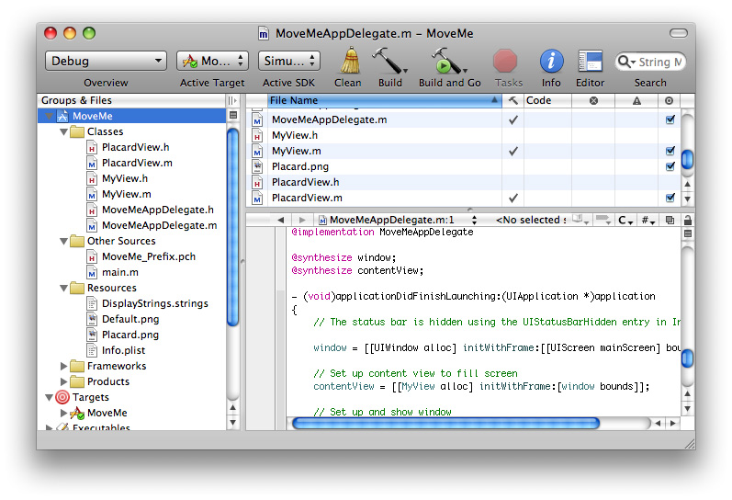
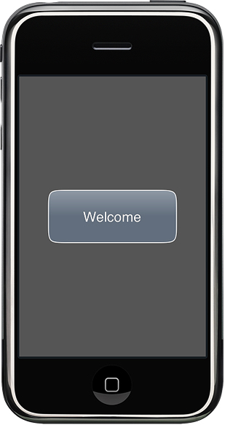
xCode IDE & iPhone Emulator
http://developer.apple.com/iphone/library/referencelibrary/GettingStarted/Creating_an_iPhone_App/index.html

Slide 21
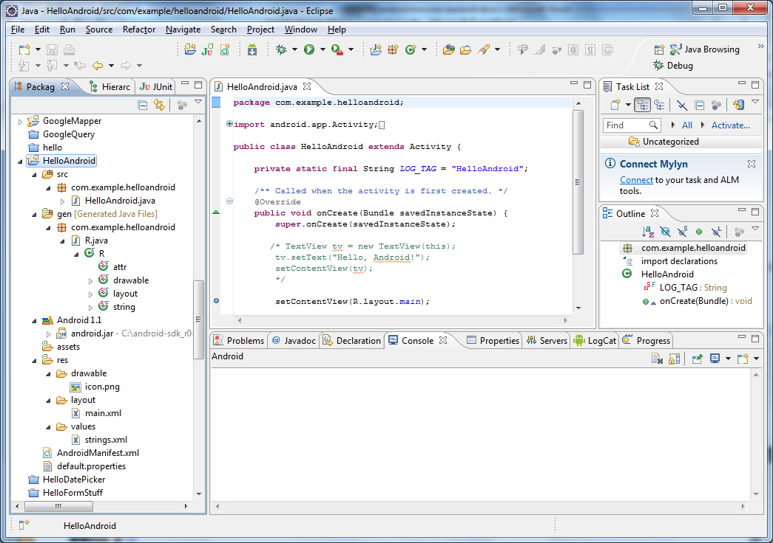
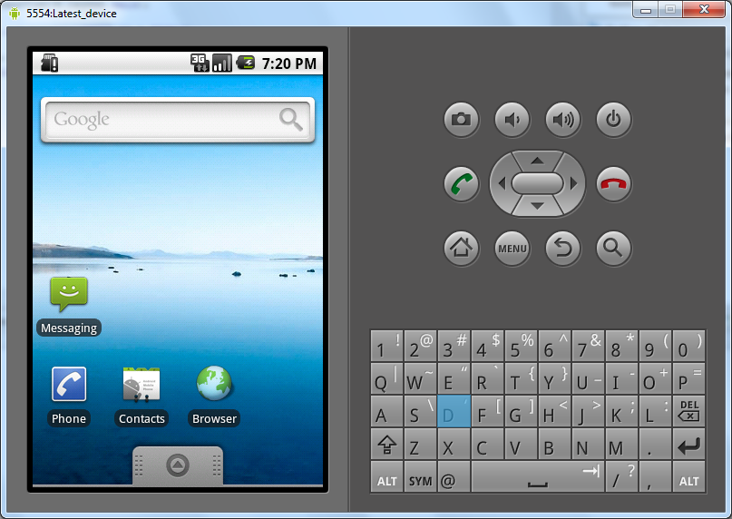
Eclipse and Android Emulator

Slide 22
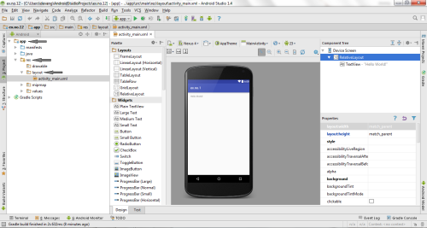
Android Studio

Slide 23
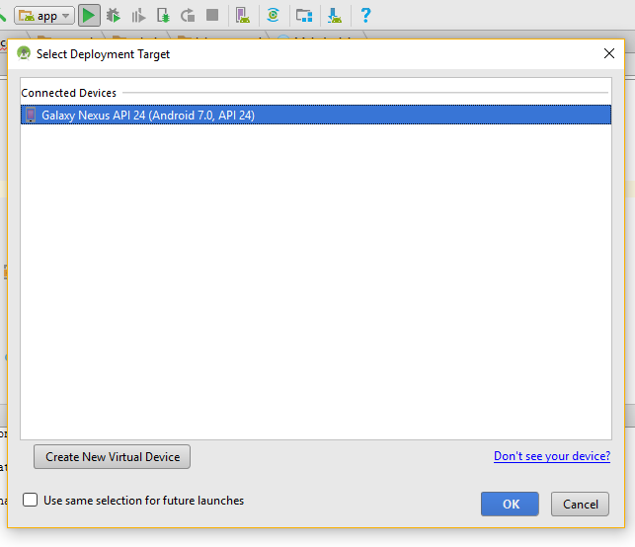
Android Studio (Emulator)

Slide 24
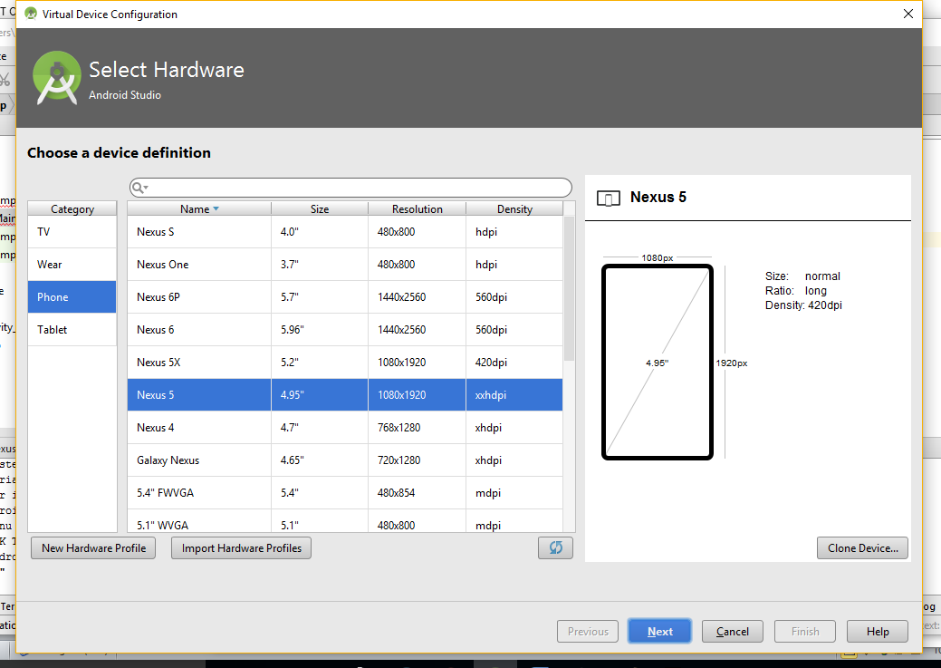
Android Studio (Emulator)

Slide 25
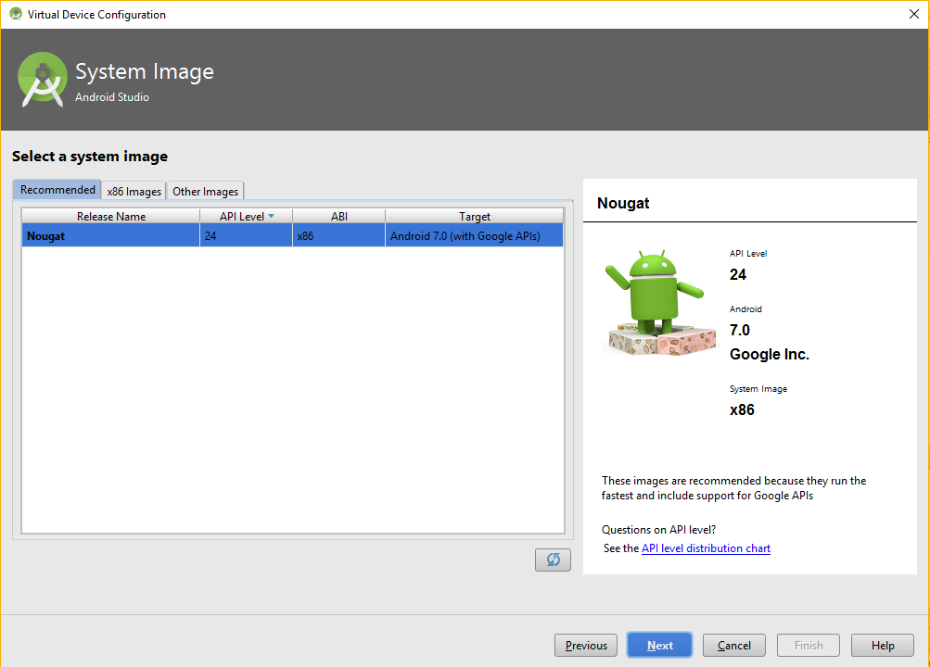
Android Studio (Emulator)

Slide 26
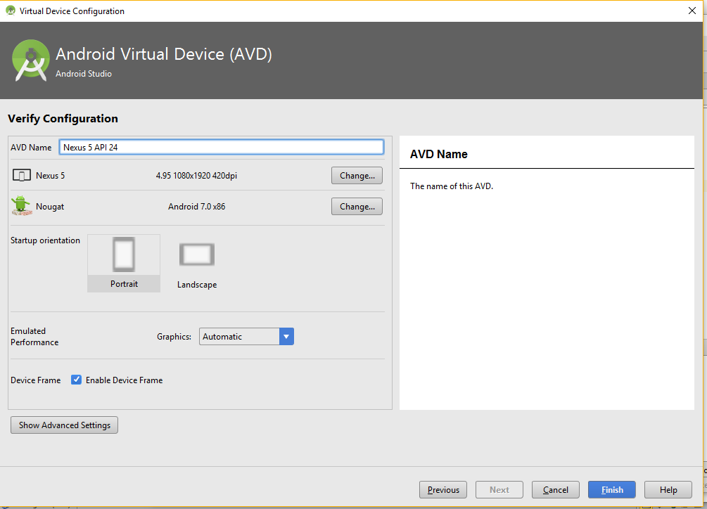
Android Studio (Emulator)

Slide 27
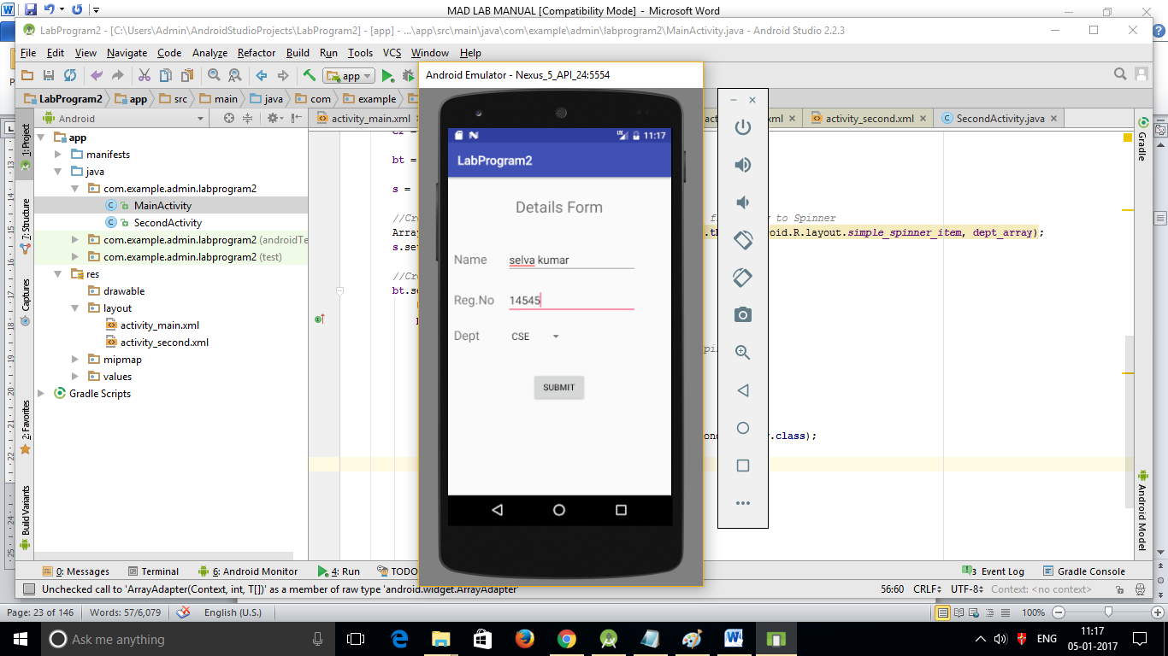
Sample output

