Slide 1
BacnetApiServer User Guide
By Jonathan Kevin Selvadurai

Slide 2
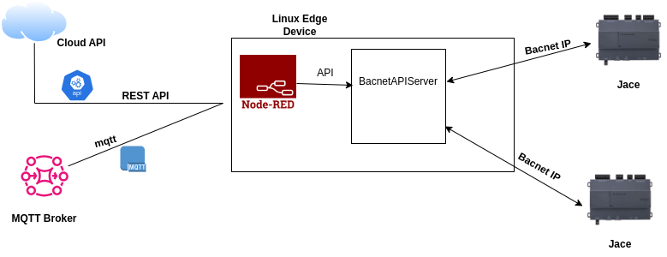
Introduction
BacnetAPIServer is an open-source tool that bridges the gap between REST APIs and BACnet systems. It seamlessly translates API calls into BACnet objects, making them readily available for building automation control. Designed to integrate with NodeRED, BacnetAPIServer simplifies the conversion of NodeRED logic into BACnet Objects, streamlining BACnet integration for developers.

Slide 3
Setup BacnetAPIServer
Link to Setup instructions :
https://github.com/selvadurai/BacnetAPIServer

Slide 4
BacnetAPIServer Storyboard

Slide 5
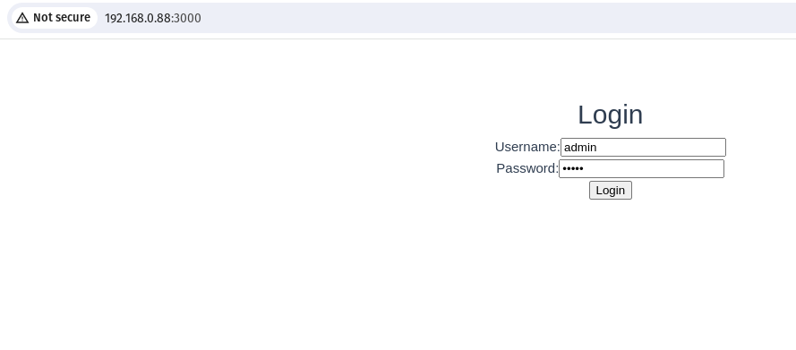
1. Enter http:<IP Address>:3000 in the browser
2. Default username:admin and password:admin

Slide 6
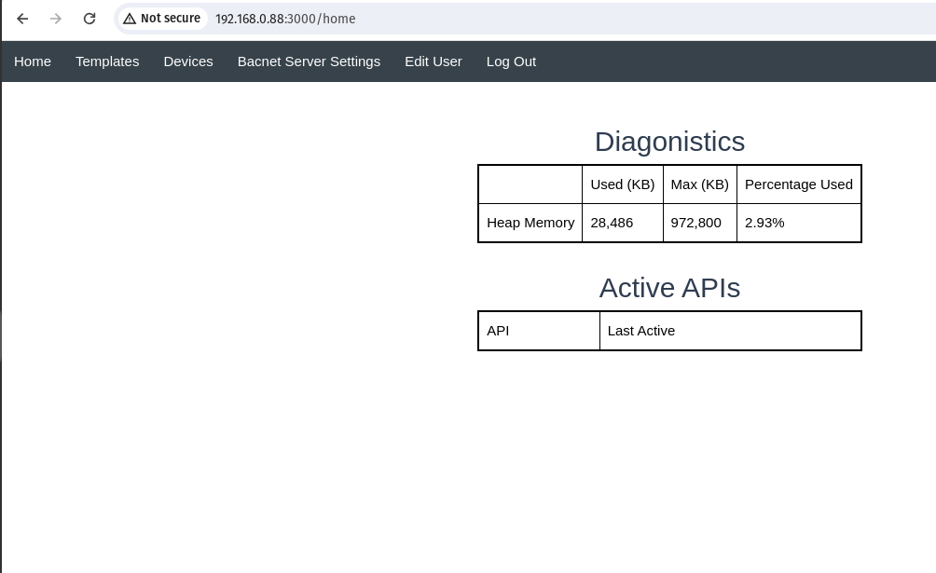
Main Page
Click “Edit User”

Slide 7
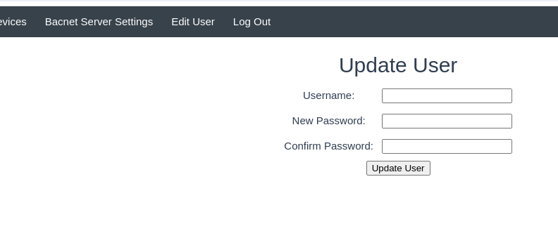
Edit User Page
1. The edit page allow you to change the username and password
For example if I want change my username to linux and password to pokemon
Username:linux
New password:pokemon
Confirm password:pokemon
2. Then click “Update User” and restart the service or restart the edge device

Slide 8
Click “Bacnet Server Settings”

Slide 9
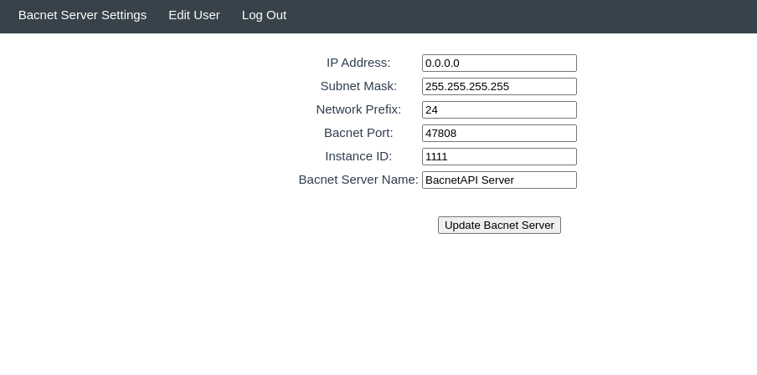
BacnetServer Settings
In the Bacnet Server Settings Page
Users can change:
1. IP Address
2. Subnet Mask
3. Network Prefix
4. Bacnet Port
5. Instance ID
6. Bacnet Server Name

Slide 10
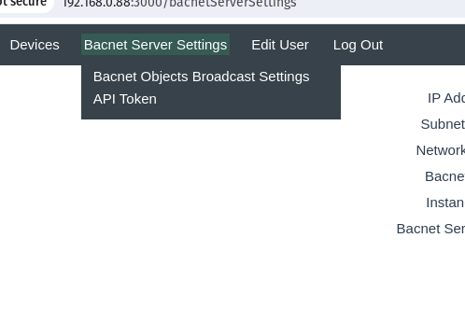
Hoover over Bacnet Server Settings and click “API Token”

Slide 11
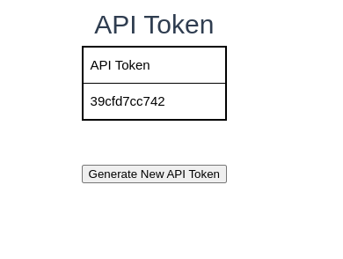
API Token
API Token used in the API

Slide 12
Steps to creating an Bacnet Service
1.Create API Playload Template
2.Create Device (Device API endpoint)
3.Push API Payload to Device API endpoint

Slide 13
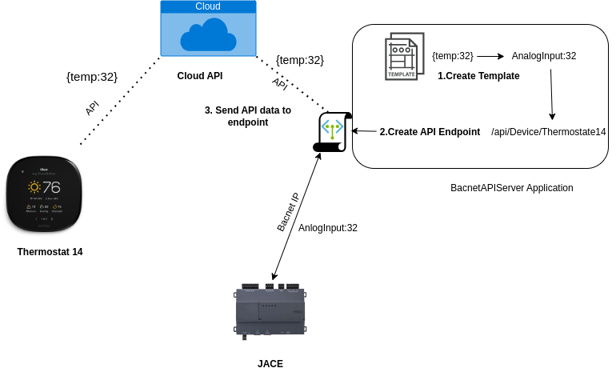

Slide 14
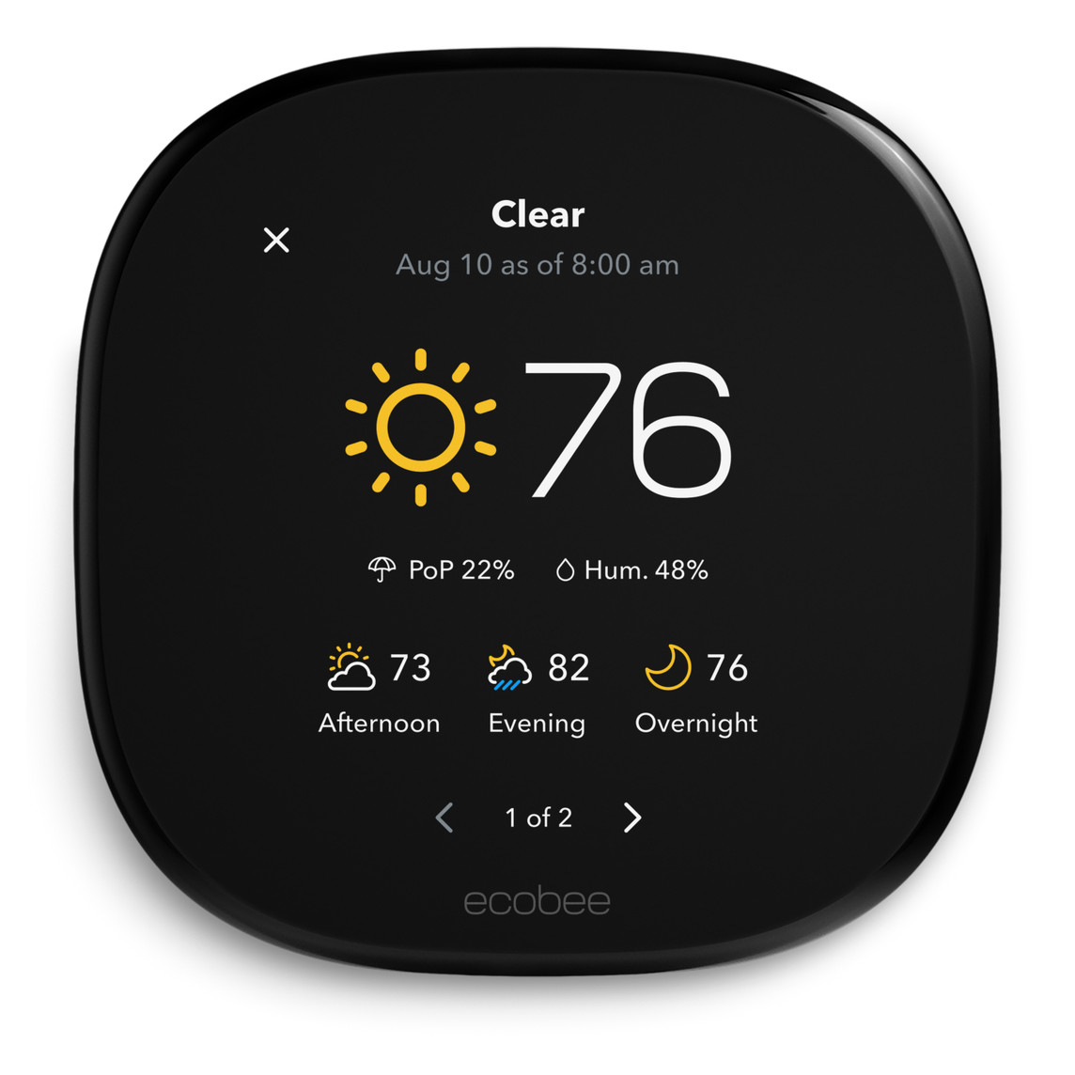
Sensor and Payload used in this tutorial
The sensors name used in this tutorial is called an “EcoSensor” which uses the following payload:
{
“temp”:23,
“hum”:51,
“occ”:true
}
Sensor Name:EcoSensor

Slide 15
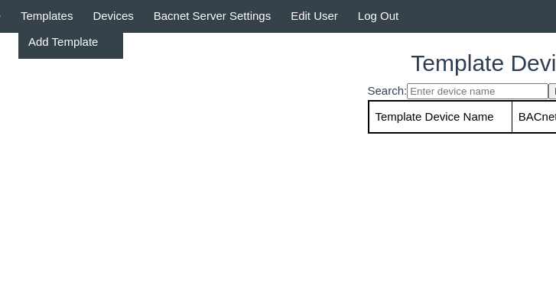
Create Payload Template
Hoover over template and click on “Add Template”

Slide 16
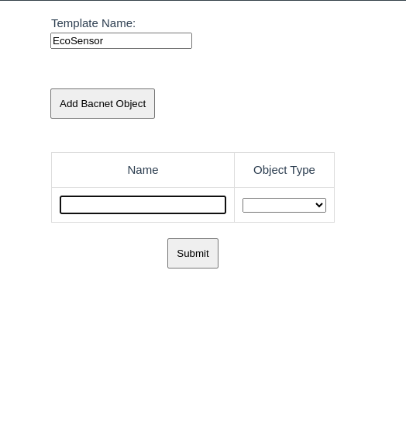
Name of Template Playload for device
1. click
Click “Add Bacnet Object ” to add bacnet Object field
2. Field pops out

Slide 17
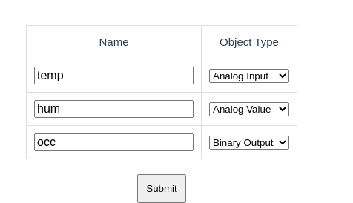
Important Note: make sure the API fields names match template field name!
{
“temp”:23,
“hum”:51,
“occ”:true
}
Analog Object,Analog Value,Analog Input – Use for Numeric Values
Binary Object,Binary Value,Binary Input – Use for Binary Values
Click Submit after your done

Slide 18
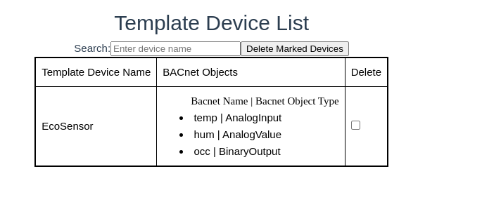
After you click submit you will see it list in template device list

Slide 19
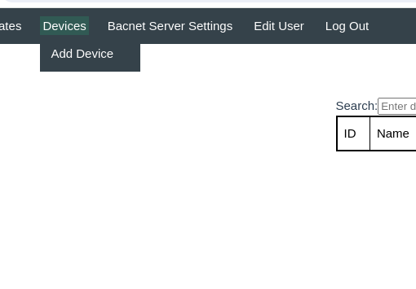
Hoover over template and click on “Add Device”

Slide 20
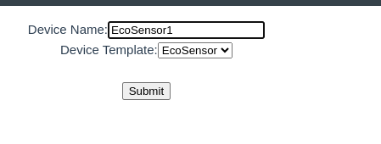
Name of Device/EndPoint
Select Device Template
Click Submit

Slide 21
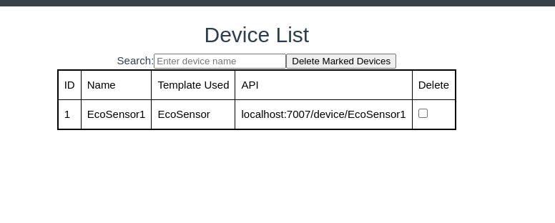
After Click submit it will take you to device list

Slide 22
Using Curl to POST Request to send API Data
curl -X POST -H "Content-Type: application/json" -d '{"temp":91,"hum":52,"occ":true}' http://192.168.0.88:7007/device/EcoSensor1?token=39cfd7cc742

Slide 23
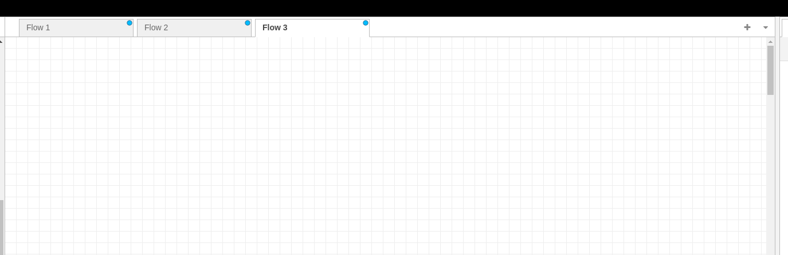
Integrating NodeRed and BacnetAPI Server
1. Login into NodeRed
2. Start a new flow
Click + button to start flow

Slide 24
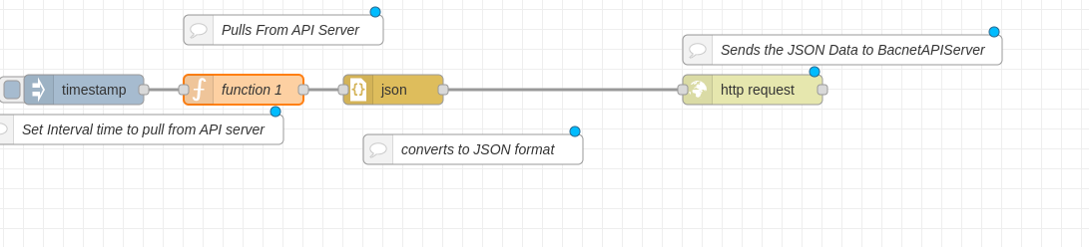
2.Convert the logic to JSON
3. Sends JSON data to BacnetAPI Server endpoint
1. Create NodeRed Logic
NodeRed Logic

Slide 25

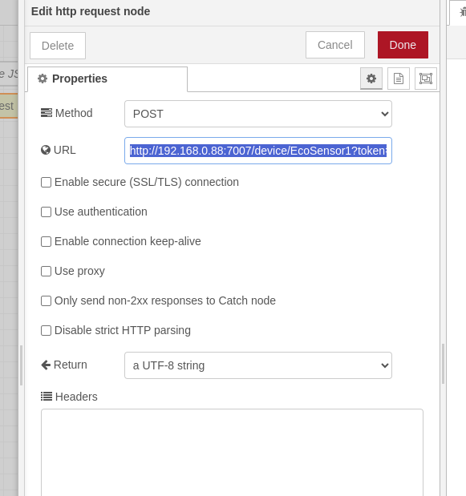
How to send JSON Payload to BacnetAPIServer API endpoint
1.Click “http request”
2. Set Method to POST
3. Enter the URL for the Endpoint,along with the token
URL Format:
http://<IP Address>/device/<deviceName>?token=<key>
Important Note:Get token in “bacnet server settings” →apiToken in BacnetWebPortal
Example:
http://localhost:7007/device/EcoSensor1?token=39cfd7cc742
http://192.168.0.88:7007/device/EcoSensor1?token=39cfd7cc742
4. Click “Done”

Slide 26
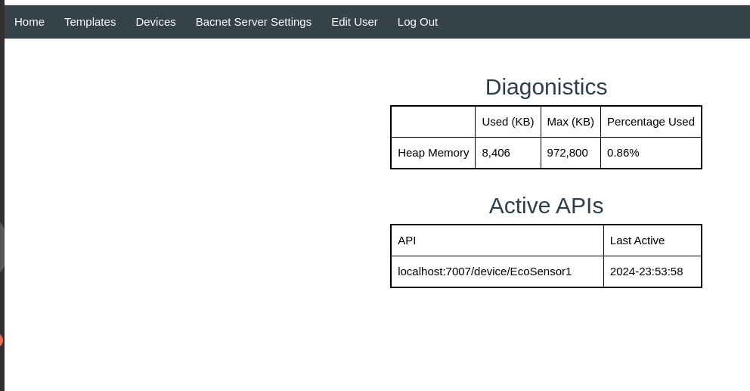
Once the API Data is push to the endpoint, it will appear in the “Active API” table in the homepage

Slide 27
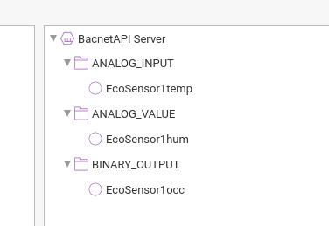
Bacnet Point Format
How it looks like in SkySpark
Bacnet Point Format:
<DeviceName><Measurment>

Slide 28
Thank You

