Slide 1
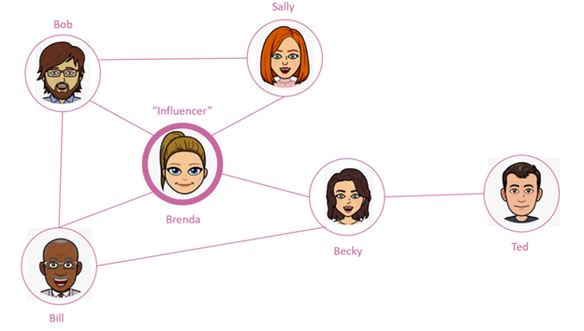
Introduction to Graphs

Slide 2
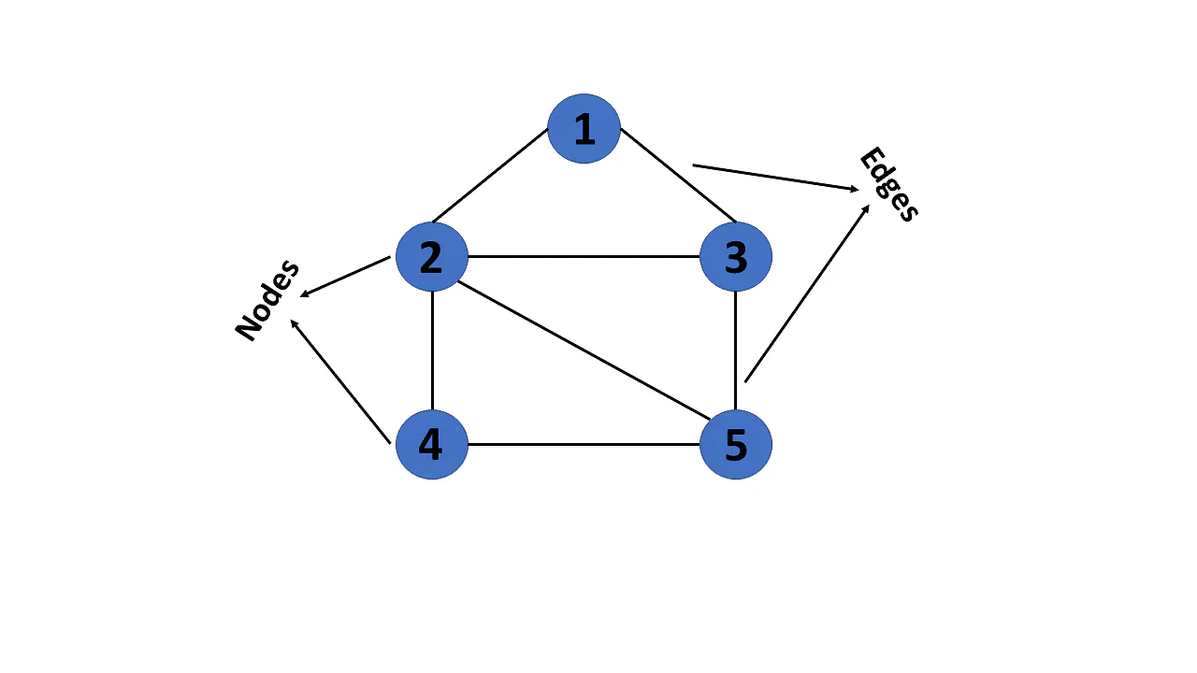
What is Graph a Data Structure?
A graph is a non-linear data structure that consists of vertices(Nodes) and edges, where vertices contain the information or data, and the edges work as a link between pair of vertices.
Another Word for vertices is Nodes

Slide 3
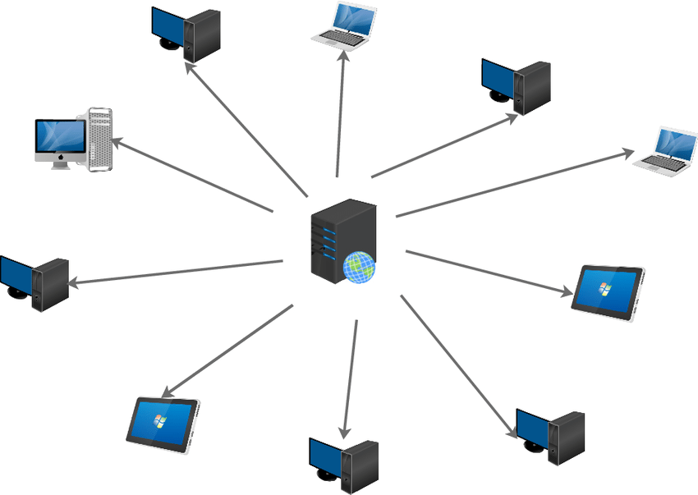




Application use of Graphs
- Social Networking
- Networking
- Maps
- Dating Apps
- Machine Learning/AI
- Ride Sharing Apps

Slide 4
Graph Representation

Slide 5
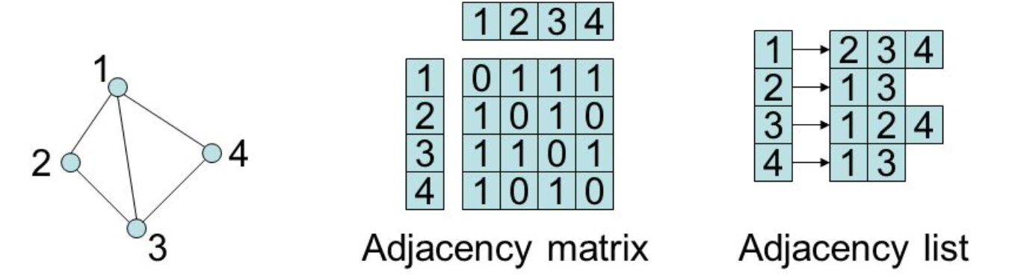
Undirected Graph

Slide 6
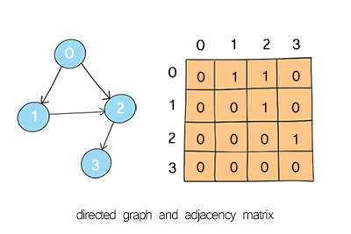
Directed Adjacency Matrix

Slide 7
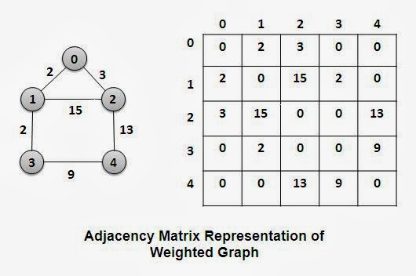
Undirected Weighted Graphs

Slide 8
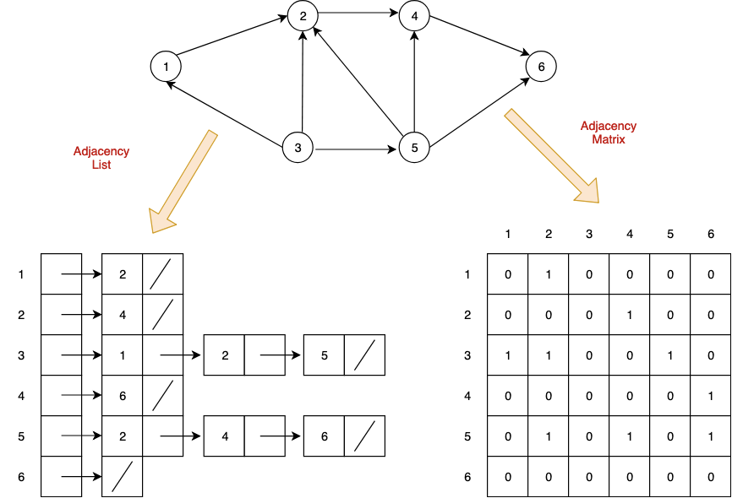
Directed Graph

Slide 9
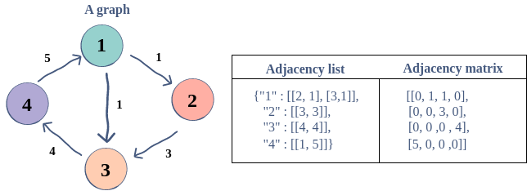
Weighted Directed Graph

Slide 10
Types of Graphs

Slide 11
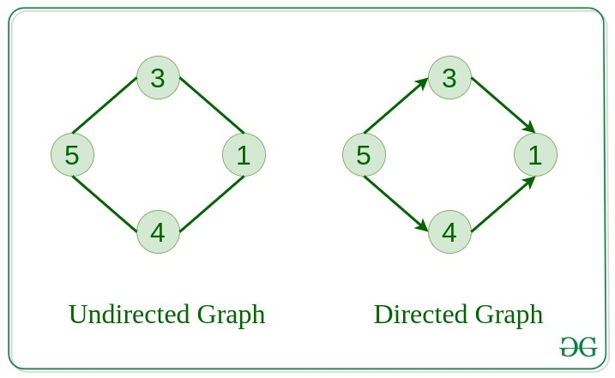

Slide 12
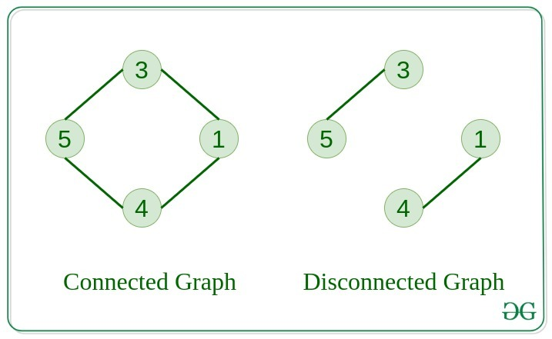
Connected Graph
The graph in which from one node we can visit any other node in the graph is known as a connected graph.
Disconnected Graph
The graph in which at least one node is not reachable from a node is known as a disconnected graph.

Slide 13
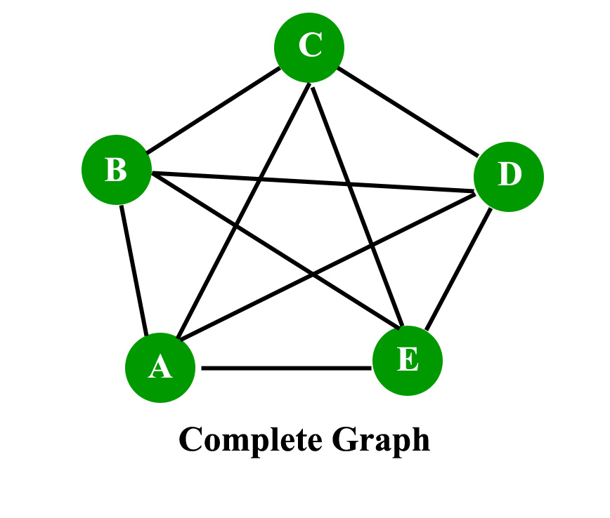
Complete Graph
The graph in which from each node there is an edge to each other node.

Slide 14
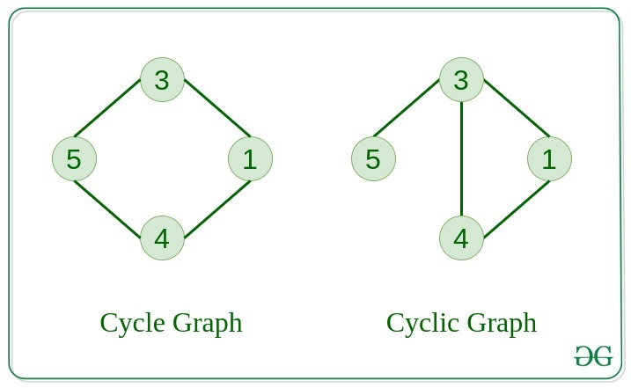
Cycle Graph
The graph in which the graph is a cycle in itself
Cyclic Graph
A graph containing at least one cycle is known as a Cyclic graph.

Slide 15
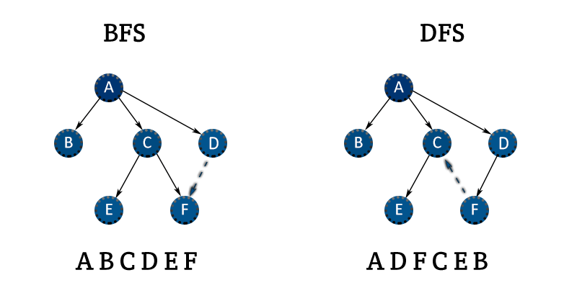
Graph Traversal

Slide 16
Thank you for watching

