Slide 1
What is hunting?
Drivers of Hunting
Toolset and Data sources
Quadrants of Detections
Hunt Maturity Index
Techniques of Hunting
Hunt at Scale – how to orchestrate!
Closing the loop
Myths of Hunting
Challenges
Metrics to be considered

Slide 2
What is Hunting?
The process which incl. manual search of data/machine-enriched-data to detect security threats, which automated tools can’t or failed to detect
Threat hunting is a proactive approach to identifying unknown threats, while threat investigation is a reactive approach to validating and understanding a known threat
You assume that something has already happened (Hypotheses) and begin the hunt.
Choose the ground
Determine the hypothesis
Gather the data to test the hypothesis
Use relevant technique to find unusual activity
Review, Refine & Conclude your hypothesis

Slide 3
Drivers of Hunting
Log Collection and management using Big data analytics platform
Threat intel enriched data to Detect complex and advanced attack types
Identify automation patterns
Visual hunting through hunt dashboards
Hunter with curiosity (objectives - > Hypotheses - > Expertise)

Slide 4
Tool & Data Sources
IP Address
Network Artefacts
Proxies, packet capture, firewall, IDS/IPS
Endpoint artefacts
process, users, services, drivers, registry, files, memory
Vulnerability Data
Behavioural Data
Qualys, Nessus
TI, Firewall, Proxies, IDS/IPS, SIEM
TTP, baselining, outliers

Slide 5
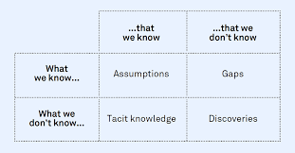
Quadrants of Detections
Known Knowns
Known Unknowns
Unknown knowns
Unknown unknowns
Living of the Lands

Slide 6
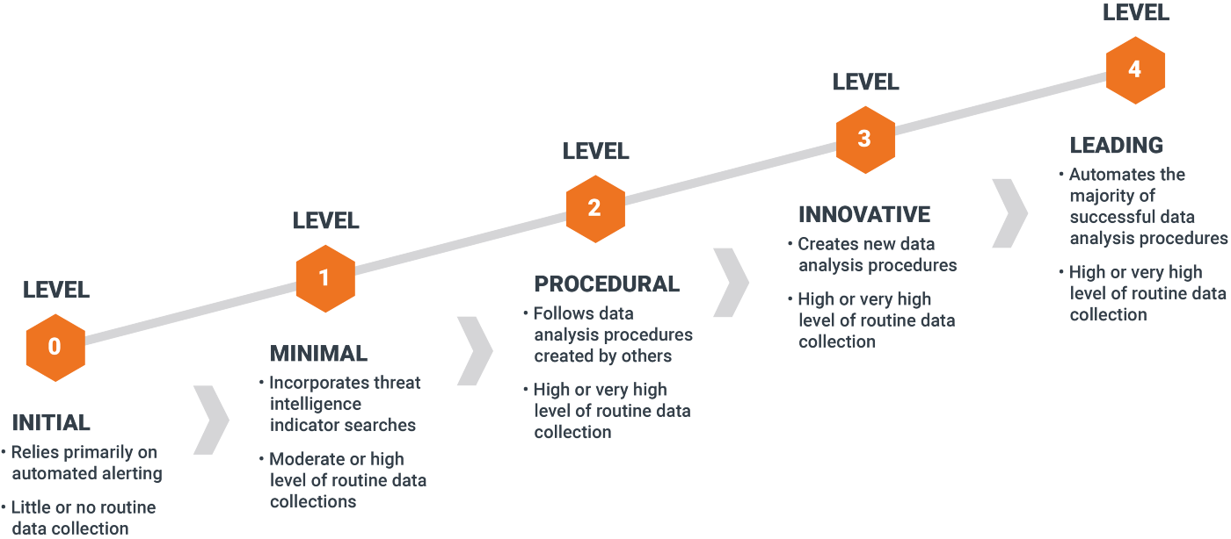
Hunt Maturity Index

Slide 7
Techniques of Hunting
Searching
Filtering
String matching
Visualization
Timeline plotting
Outlier/baselining
Grouping
Clustering
Stacking

Slide 8
Strategies for Hunting
Planning is very important –
Identify pre-hunting strategies (requires 50% of the efforts)
Common Questions – where to start? What to hunt? How to hunt
Strategies 1 – Make the most out of what you already have
Use the existing log management. Logs have key information
Create whitelist/blacklist with your EPP solution
Use user, asset, software inventory to enrich your hunt.
Use proxy logs
Use the IOCs from threat intelligence for Quick wins
Move up the pyramid of pain to understand the adversary TTP’s
Use VM Data

Slide 9
Strategies for Hunting – Contd.
Strategy 2 - Follow a Kill chain
Reconnaissance
Resource Development
Initial Access
Execution
Persistence
Privilege Escalation
Defense Evasion
Credential Access
Discovery
Lateral Movement
Collection
Predict the attack
Incidents/Attacks has already happened
Use Purple team
Plan to test all the techniques under each MITRE tactics.
Document the results. Map the coverage with the organization controls

Slide 10
Closing the loop
Automate the uncovered or enriched patterns
Capture the metrices
Update the hunt-team/stakeholders of the risks identified
Important Question to be answered
Is there any exfiltration
What data do I have and what to look
Are we targeted? Who is our adversary?
Are there any unauthorized connection in my infra
Is there any lateral movement
Create Hypotheses
Investigate via tools & Techniques
Uncover New Patterns & TTPs
Inform & Enrich Analytics
Threat Hunting Loop

Slide 11
Myths of Hunting
Objective is not to find new incidents
It is no different from incident investigation – you need to answer the same question
Was it actually an incident?
Was the adversary successful?
What other resources were involved?
What were the activities from adversary?
What resources were compromised (bypassed)?
Lots of time is spent on planning (pre-hunting) – build a hunt calendar (if it doesn’t work, recraft it)
Hunting is not new! We do it often. Hunting platform can expand your wings. A lot can be done with traditional SIEM & EDR.
Hunting can’t be automated – you only try to automate uncovered patterns (Results)

Slide 12
Challenges on Hunting
Data growth – constant addition of apps and lack of visibility.
Cost
Slow Queries – curiosity is an important factor for any analyst
Context building – because of the new additions
Time consuming with no expected level of outcome

Slide 13
Key Metrics
Key Metrics | Why It’s Important / What to Look For
1. Number of incidents uncovered by severity | You will never be able to know for certain how many incidents are lurking in your network until you find them, but ultimately keeping track of the rate at which, you find incidents is a worthy metric to maintain context.
2. Number of compromised hosts by severity | Measuring the trend of how many hosts are discovered as compromised over time can help orient analysts to the state of endpoint security on their network. This can include hosts that have had misconfigured security settings on them.
3. Dwell time of any incidents discovered | Whenever possible, try to determine how long discovered threats have been active on your network. This can help you determine if there are steps of the kill chain (or other attack model) you may be focusing on too much. Dwell time has 3 metrics: time from infection until detection, time from detection to investigation, and time from investigation to remediation.
4. Number of detection gaps filled | One high-level goal of hunting is to create new automated detections -- identifying and filling detection gaps should be part of the team’s mission.
5. Logging gaps identified and corrected | Gaps in logging or data collection can make it difficult for a SOC to maintain awareness and context, so trying to identify and improve any existing gaps should be an important actionable metric for a hunt team.
6. Vulnerabilities identified | Vulnerabilities can lead to exploitation and exploitation can lead to compromise -- in other words, identifying vulnerabilities is important. It’s always useful to keep track of how many of these you are uncovering.
7. Insecure practices identified and corrected | Insecure practices can lead to unauthorized access and unauthorized access can lead to incidents -- identifying insecure practices can prevent future incidents.
8. Number of hunts transitioned to new analytics | Since you want to create new automated detections, your team should try to transition each hunt into automated detection. Ideally you would want the ratio here to be 1:1. For every successful hunt you carry out you should be attempted to create a new analytic, update a rule, or at least log a new IOC.
9. False positive rate of transitioned hunts | Once you discover a successful way to find something and create a rule or analytic to automate that process, it is useful to keep track of how many false positives have been created by those automated analytics, to see if they require improvements.
10. Any new visibility gained | In addition to discovering an incident and creating new threat intel, a hunt can inform analysts about their own networks, including misconfigurations, and identify friendly intelligence that can be highly useful in future investigations.

Slide 14
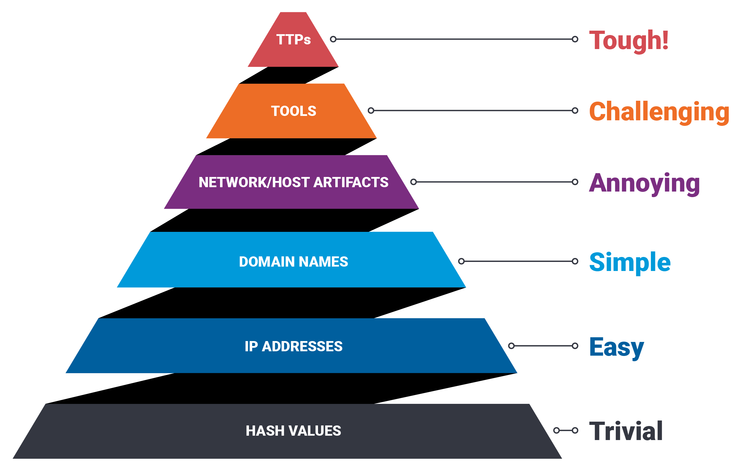
Pyramid of Pain

Slide 15
Hypothesis for Consideration
1 | Finding Known-Bad in Antivirus Logs | String matching
2 | Beacon Detection via Intra-Request Time Deltas | Visualization (Bar graphs)
3 | consistent data upload to storage websites, look for beaconing like activity | Visualization
4 | C2 via Dynamic DNS | Filtering; stack counting
5 | Finding the Unknown with HTTP URIs | Stack counting; String matching; outlier detection; regex
6 | HTTP UserAgent Analysis | Stack counting; String matching; outlier detection
7 | Lateral Movement Detection via Process Monitoring | Counting occurrences within a time window
8 | Windows Lateral Movement via Explicit Credentials | whitelisting / filtering
9 | Finding C2 in Network Sessions | Stacking; baselining
10 | Privileged Group Tracking
11 | PS exec Windows Events | Filtering
12 | Tool Renaming | String matching
13 | Finding Web Shells | Stack counting; String matching
14 | protocol not used for intended purpose | Filtering
15 | fixed fragment size | Visualization
16 | nonstandard data encoding | Filtering
17 | Failed password attempts outside normal patterns | Outlier Detection
18 | uncommon user agent from proxy logs | String Matching; Filtering
19 | infrequent domain names and long/Randomized domain names | Baselining; Outlier detection
20 | Build trend graphs based on the TI feeds (Intel driven) | Visualization
21 | Same host generating same quarantine signature daily/Periodically | Visualization
22 | Heat graph for repeated attackers | Visualization
23 | Service account access to internet | Whitelisting
Example Outlier Detection for C2 Behavior
HTTP post method
No HTTP get method
No referrer
File type analysis
Examples of Filtering
Https content type
File type (by extension and header)
Byte count range (0-100k, 100k-1 MB, etc)
Directionality (inbound, outbound, lateral)
SSL self-signed certs
Https lacking a specific header value
Http direct to IP request
Https with no referrer
Single sided TCP
Traffic over non-standard ports
Transmit/received payload byte size
Ip address exist
Examples of Stacking
Select asset as Domain controller, protocol, count(distinct ip.src)

