Slide 1
Dynamic Interconnection Networks
Buses
Miodrag Bolic

Slide 2
Overview
Basic theory on buses
  Arbitration
  High performance bus protocols
Avalon bus

Slide 3
Big Picture
M
M
M
M
Focus of this lecture
Interconnection Networks
P
P
P
P
P

Slide 4
Interconnection Network Taxonomy [5]
Interconnection Network
Static
Dynamic
1-D
2-D
HC
Bus-based
Switch-based
Single
Multiple
SS
MS
Crossbar

Slide 5
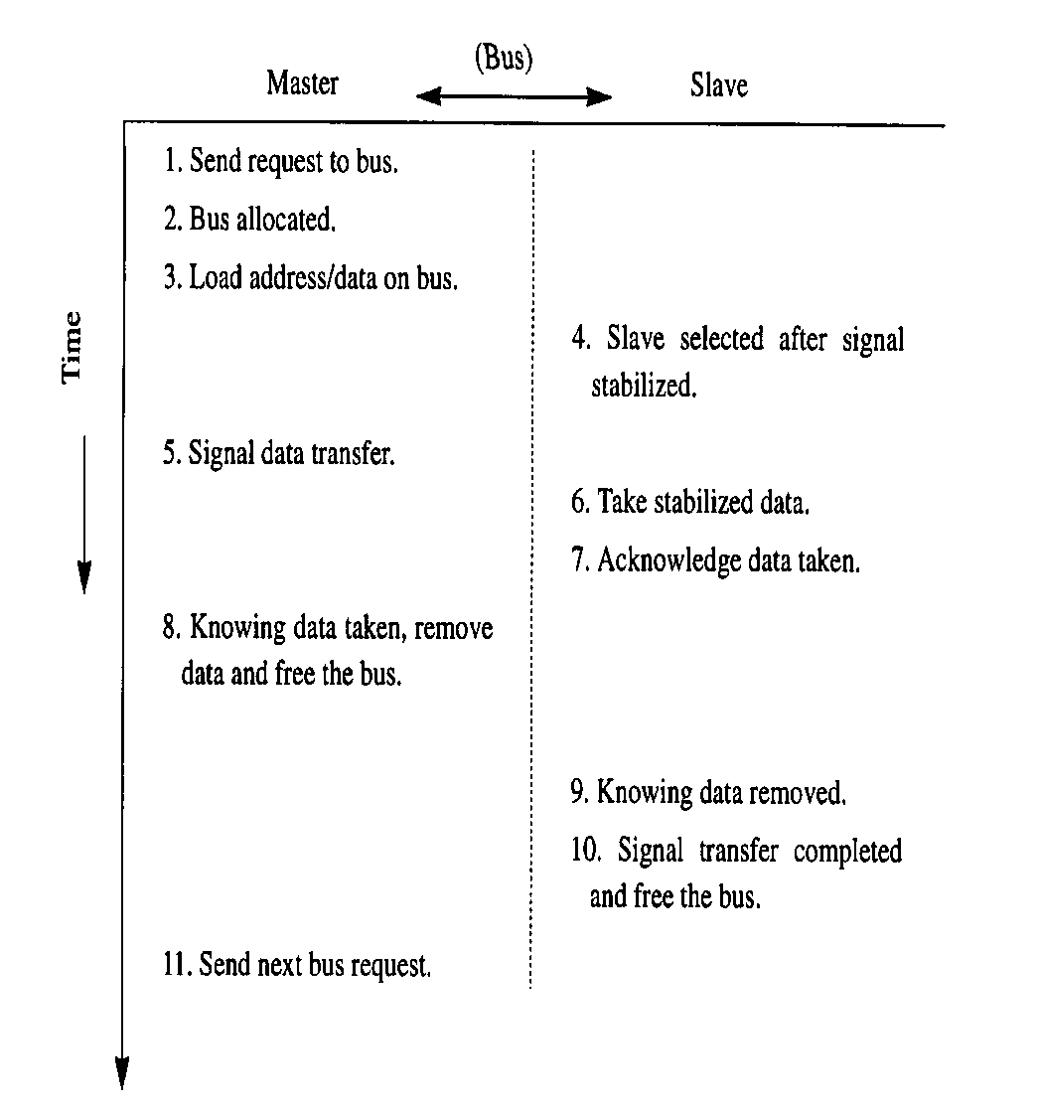
Addressing and Timing [2]
Bus Addressing
Broadcast:
  write involving multiple slaves
Synchronous Timing:
  All bus transaction steps take place at a fixed clock edges
  simple to control
  suitable for connecting devices having relatively the same speed
Asynchronous Timing:
  based on a handshaking
  offers better flexibility via allowing fast and slow devices to be connected in the same bus.
Typical time sequence when information
is transferred from the master to slave.

Slide 6
Bus arbitration
Bus arbitration scheme:
  A bus master wanting to use the bus asserts the bus request
  A bus master cannot use the bus until its request is granted
  A bus master must signal to the arbiter the end of the bus utilization
Bus arbitration schemes usually try to balance two factors:
  Bus priority: the highest priority device should be serviced first
  Fairness: Even the lowest priority device should be allowed to access the bus
Bus arbitration schemes can be divided into several broad classes:
  Daisy chain arbitration (not used nowadays)
  Arbitration with the independent request and grant
  Distributed arbitration
Notes:
A more aggressive approach is to allow multiple potential bus masters in the system.
With multiple potential bus masters, a mechanism is needed to decide which master gets to use the bus next. This decision process is called bus arbitration and this is how it works.
A potential bus master (which can be a device or the processor) wanting to use the bus first asserts the bus request line and it cannot start using the bus until the request is granted.
Once it finishes using the bus, it must tell the arbiter that it is done so the arbiter can allow other potential bus master to get onto the bus.
All bus arbitration schemes try to balance two factors: bus priority and fairness. Priority is self explanatory. Fairness means even the device with the lowest priority should never be completely locked out from the bus.
Bus arbitration schemes can be divided into four broad classes. In the fist one:
(a) Each device wanting the bus places a code indicating its identity on the bus.
(b) By examining the bus, the device can determine the highest priority device that has
made a request and decide whether it can get on.
In the second scheme, each device independently requests the bus and collision will result in garbage on the bus if multiple request occurs simultaneously.
Each device will detect whether its request result in a collision and if it does, it will back off for an random period of time before trying again.
The Ethernet you use for your workstation uses this scheme.
We will talk about the 3rd and 4th schemes in the next two slides.
+3 = 38 min. (Y:18)

Slide 7
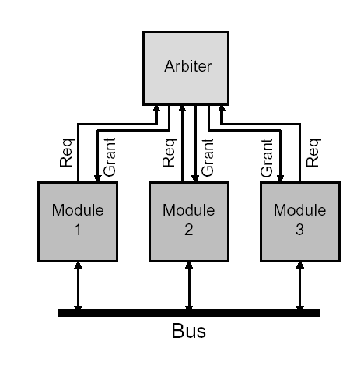
Independent Request and Grant [1]
Multiple bus-request and bus-grant signal lines are provided for each master
Any priority-based or fairness based bus allocation can be used.
Advantages
  flexibility
  faster arbitration time
Disadvantages:
  large number of arbitration lines

Slide 8
Bus allocation techniques [1]
Round-robin
  The request that was just served should have the lowest priority on the next round
TDMA
  Fixed allocation of the slot to the master
Unequal-priority protocol
  Each processor is assigned a unique priority.
  Additional procedures are required to establish fairness

Slide 9
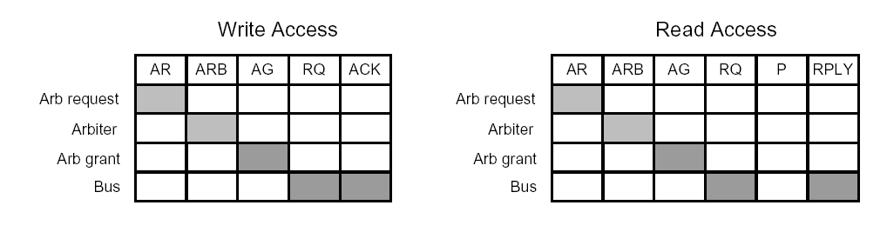
Bus Pipelining [1]
Several cycles are needed to read or write one data
Since the bus is not used in all cycles, pipelining can
be used to increase the performance
  AR – Arbitration request,
  ARB cycle for processing inside the arbiter,
  AG – Grant signal is set
  RQ – request signal is set
  P- pause
  RPLY – reply from the memory or I/O

Slide 10
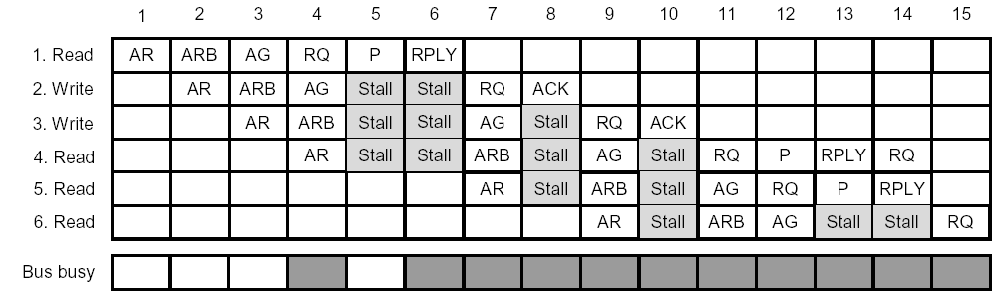
Bus Pipelining [1]

Slide 11
Split Transactions [1]
In a split-transaction bus a transaction is divided into a two transactions
  request-transaction
  reply-transaction
Both transactions have to compete for the bus by arbitration

Slide 12
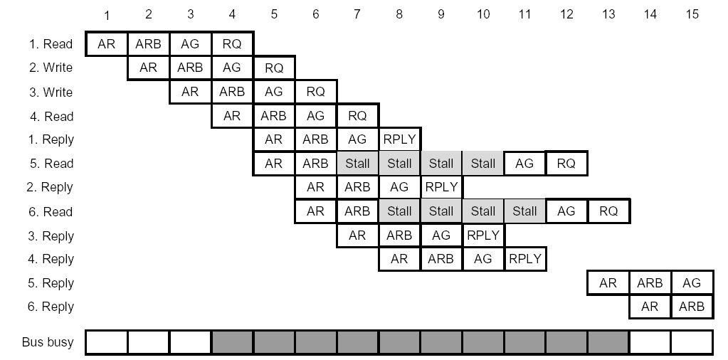
Split Transactions [1]

Slide 13
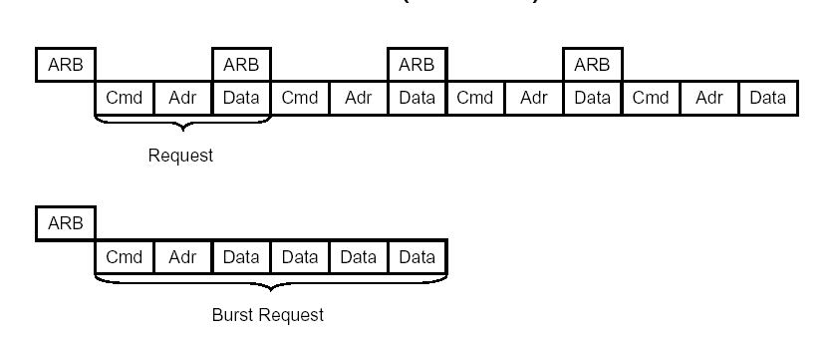
Burst Messages [1]

Slide 14
Avalon Bus
Proprietary bus specification used with Nios II
Principal design goals of the Avalon Bus
  Address Decoding
  Data-Path Multiplexing
  Wait-State Insertion
  Arbitration for Multi-Master
  Systems
Transfer Types
  Slave Transfers
  Master Transfers
  Pipelined Transfers
  Burst transfers
Nios Processor
Switch PIO
32-Bit
Nios
Processor
Address (32)
Read
Avalon Bus
Write
LED PIO
Data In (32)
Data Out (32)
7-Segment
LED PIO
IRQ
IRQ #(6)
PIO-32
ROM
(with Monitor)
UART
Timer
User-Defined Interface

Slide 15
Traditional Multi-Masters
Direct Memory Access (DMA)
  Processor Waits For Bus During DMA
Masters
System CPU
(Master 1)
100Base-T
(Master 2)
Bottleneck
Arbiter Determines Which Master Has Access To Shared Bus
Control direction
DMA Bus Arbiter
DMA Arbitor
System Bus
Program
Memory
I/O
1
I/O
2
Data
Memory
Slaves

Slide 16
Simultaneous Multi-Master Bus
Master 1
(Nios CPU)
Master 2
(100Base-T)
I
D
Masters
Control direction
Avalon Bus
Avalon Bus
Slaves
Arbiter
Uses Fairness Arbitration
I/O
1
I/O
2
Data
Memory
1
Program
Memory

Slide 17
Master Arbitration Scheme
Nios Multi-Master Avalon Bus utilizes Fairness arbitration scheme
  Each Master/Slave pair is assign an integer “shares”
  Upon conflict Master with most shares takes bus until all shares are used
  Master with least shares then takes bus until all shares are used
  Assuming all Masters continuously request the bus, they will each be granted the bus for a percentage of time equal to the percentage of total master shares that they own

Slide 18
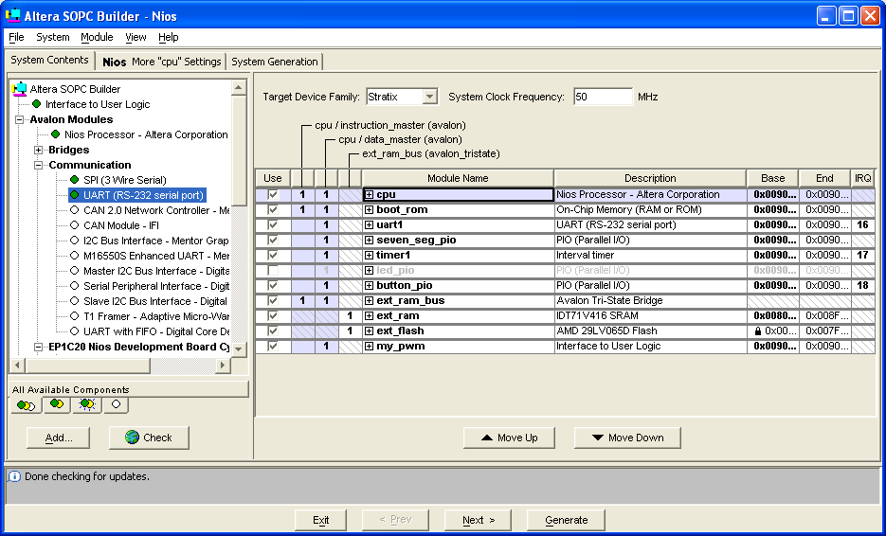
Set Arbitration Priority
View => Show Arbitration Priorities

Slide 19
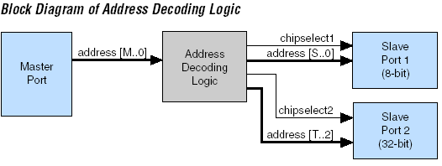
Address Decoding [4]

Slide 20
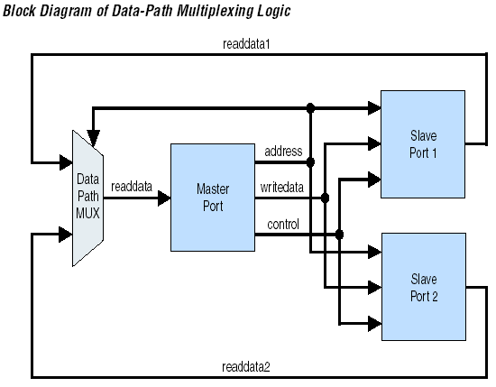
Data-Path Multiplexing [4]

Slide 21
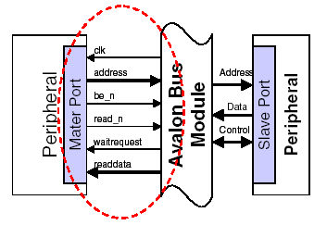
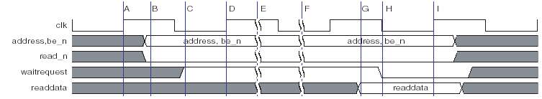
Master Read Transfer [3]
Assert addr, be, read
Wait for waitrequest = ‘0’
Read in Data
End of transfer

Slide 22
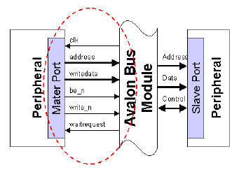
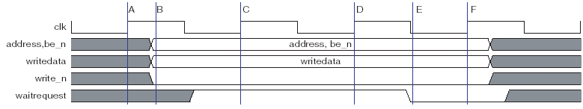
Master Write Transfer [3]
Assert addr, be, read
Assert Write Data
Wait for waitrequest = ‘0’
End of transfer

Slide 23
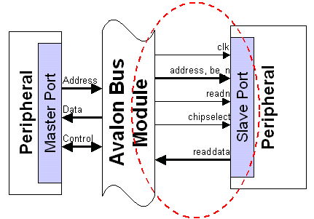
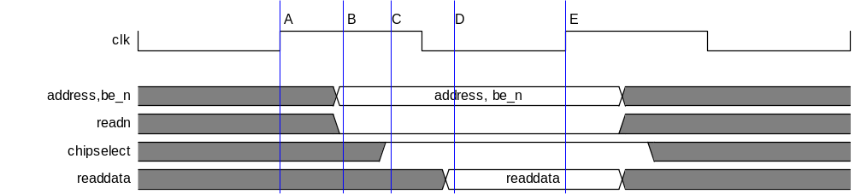
Slave Read Transfer [3]
0 Setup Cycles
0 Wait Cycles

Slide 24
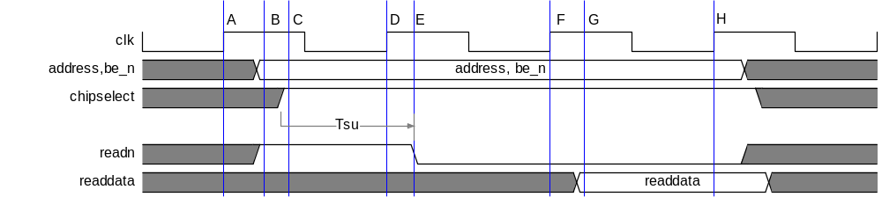
Slave Read Transfer [3]
1 Setup Cycle
1 Wait Cycle

Slide 25
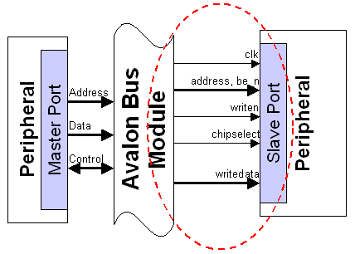
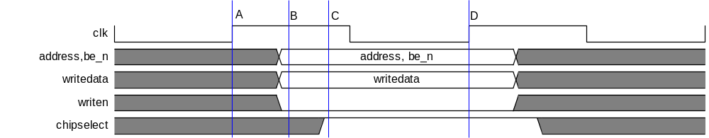
Slave Write Transfer [3]
0 Setup Cycles
0 Wait Cycles
0 Hold Cycles

Slide 26
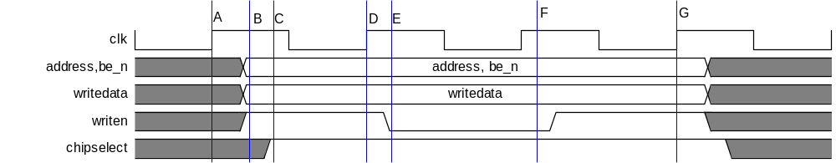
Slave Write Transfer [3]
1 Setup Cycle
0 Wait Cycles
1 Hold Cycle

Slide 27
References
W. Dally, B. Towles, Principles And Practices Of Interconnection Networks, Morgan Kauffman, 2004.
K. Hwang, Advanced Computer Architecture Parallelism, Scalability, Programmability, McGraw-Hill 1993.
Altera Corp., Avalon Interface Specification, 2005.
Altera Corp., Quartus II Handbook, Volume 4, 2005
H. El-Rewini and M. Abd-El-Barr, Advanced Computer Architecture and Parallel Processing, John Wiley and Sons, 2005.

