Slide 1
Bus Specification
Embedded Systems Design and Implementation
Witawas Srisa-an

Slide 2
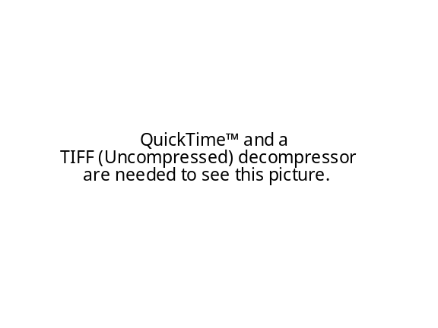



Agenda
What is a bus?
  Bus history
Look at bus design and implementation
  Avalon bus used by Altera is the example
    Built for configurable computing
    Simple and efficient
    Support multiple masters and slaves

Slide 3
Bus
Used to connect major components
  CPU
  DMA
  Memory modules
  Peripheral devices, etc.
Can be synchronous or asynchronous

Slide 4
Bus (cont.)
History
  ISA bus, an 8-bit bus running at 4.77 MHz on PC XT (1982)
    16 bit with 8 MHz with PC AT
  EISA bus, 8, 16 and 32-bit operating at 8 MHz
  PCI bus, 32 or 64-bit operating at 33 MHz
  PCIX bus, 32 or 64-bit operating at 66/133 MHz
  AGP bus, 32 bit operating at 133 MHz

Slide 5
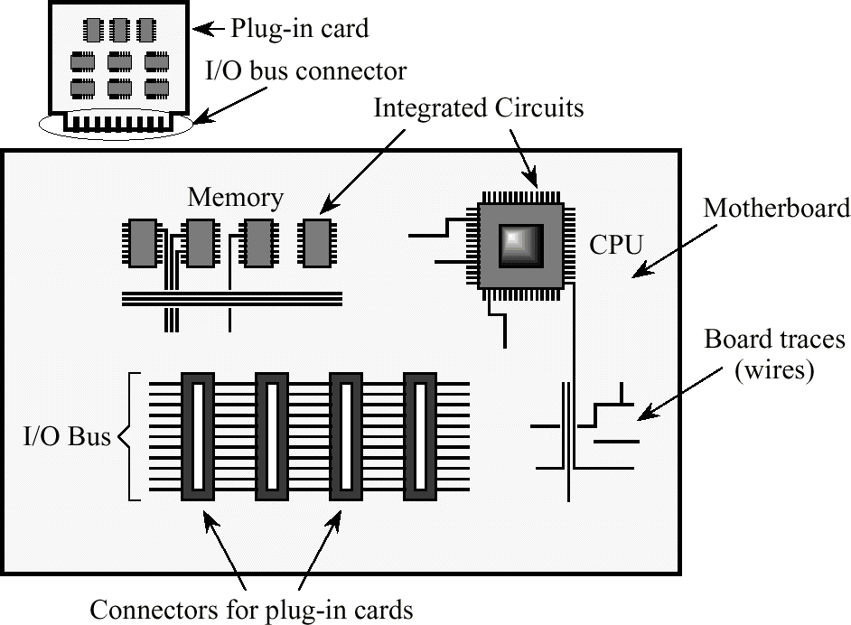
Bus (cont.)
From Principles of Computer Architecture by M. Murdocca and V. Heuring

Slide 6
Bus (cont.)
Arbitration is used to decide who has the access to the bus at a particular time
  Simple centralized
  Prioritized centralized
  Decentralized

Slide 7
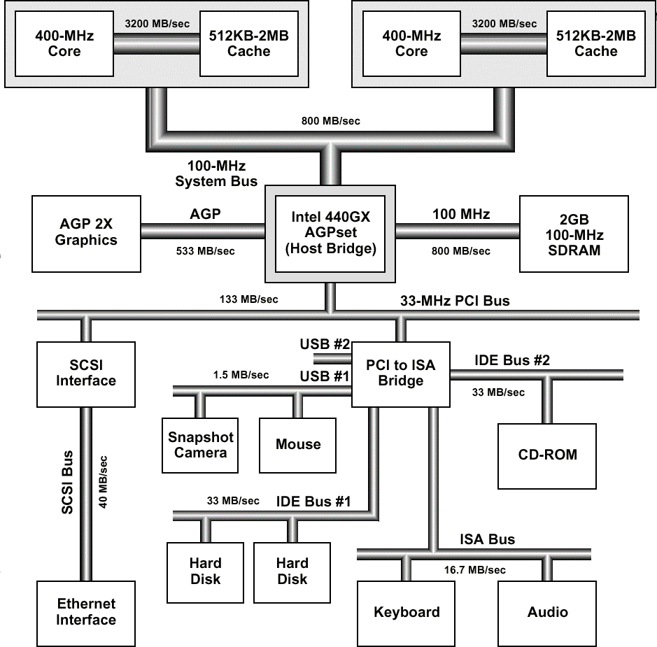
Bridge Based Bus

Slide 8
Avalon Bus
Bus module located on the chip
Basic principles
  Simplicity—easy to understand protocol with a short learning curve
  Optimized resource utilization for logic
  Synchronous operation—easy integration with existing synchronous devices

Slide 9
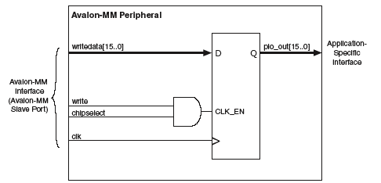
Masters and Slaves
Masters: initiate a transaction (e.g. DMA or Nios II processor)
Slaves: respond to request from masters, cannot initiate transactions (e.g. a memory controller, a video controller)
  peripherals are mostly slaves

Slide 10
Master/Slave Port
A Master port is a collection of ports
  Connect directly to the Avalon bus module
    A master peripheral may have more than one master ports as well as slave ports
A Slave port is a collection of ports
  Also connect directly to the Avalon bus module
    Accept transfer from other master ports on the bus

Slide 11
Bus Transaction
Transfer bytes, half-words, words between master and slave peripherals
  Available on the next clock after the transaction is completed
  Use slave-side arbitration
  Support 32-bit address space
  Separate data, address, and control lines
  Dynamic bus sizing to allow communication between mismatched data widths

Slide 12
Streaming Transfer
Data can flow between master and slave pair as data become available
  Master doesn’t have to continuously check the status register in the slave
  Maximize throughput between master and slave
  Useful for DMA transfer

Slide 13
Peripheral
Can be on-chip or off-chip
  Memory devices
  Processors
  PIO
  Timer
  Bridge
Classified as either master or slave
  Master can initiate bus transfer
    Has at least on master port
  Slave only accepts bus transfer

Slide 14
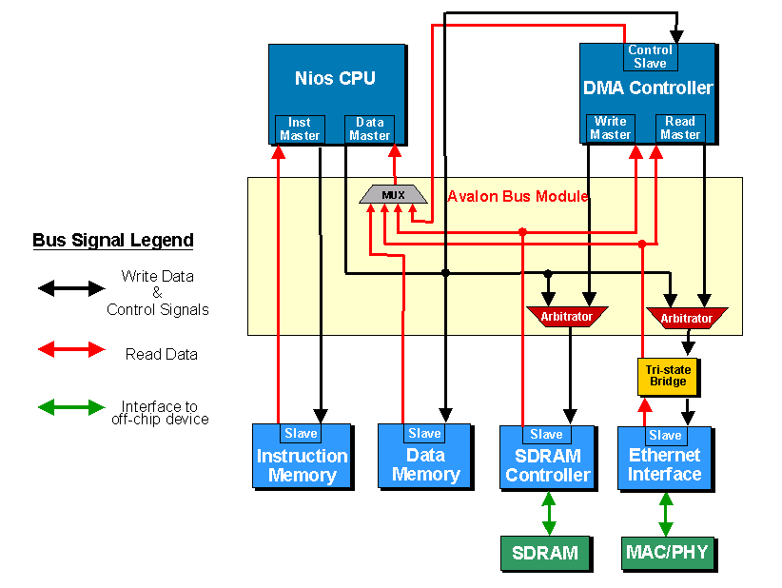
Block Diagram

Slide 15
Connection
On-chip peripherals
  Automatically connect at configuration time
Off-chip peripherals
  Connect to pins on the chip
Master port’s control and data signals pass through the bus module and interact with slave port

Slide 16
Bus Interface
Master port initiates the transaction
  Bus module relays the signals which may have been modified (arbitration)
Synchronous interface clocked by a master bus clock
  All transfer occur simultaneously with the bus clock

Slide 17
Slave Port Signals
A basic slave port contains
  clock
  address
  read,write
  readdata,writedate
  begintransfer
  chipselect
  byteenable

Slide 18
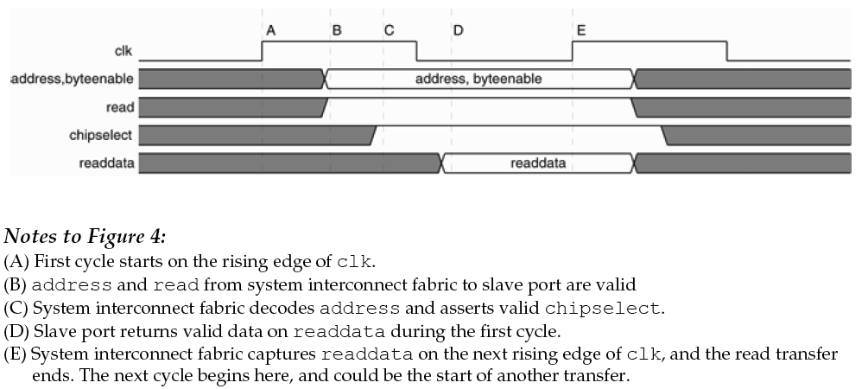
Slave Read Transfer

Slide 19
Wait State
Extend read transfer
  give a slave port one or more clock cycles to capture address and/or return valid read data

Slide 20
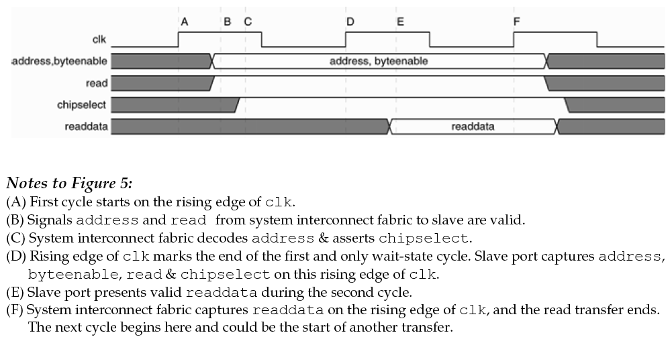
Slave Read Transfer (single wait state)

Slide 21
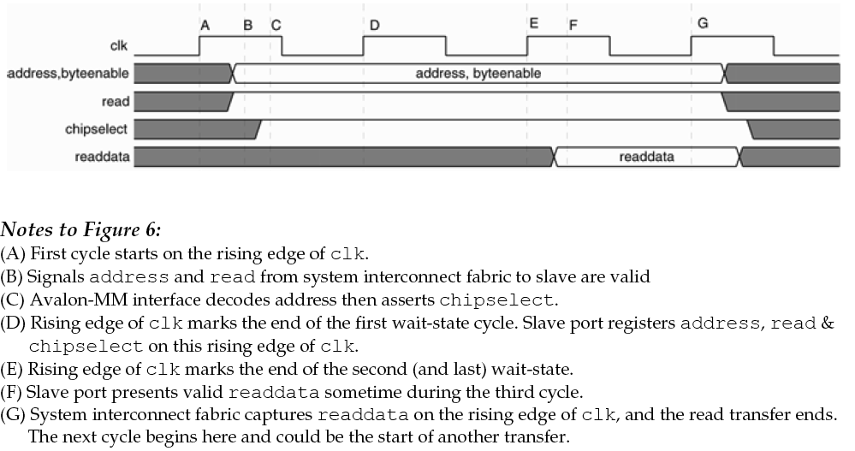
Slave Read Transfer (multiple wait states)

Slide 22
Bus Contention
Arbitration is needed when multiple master ports want to access a slave port at the same time
  Resolve in the bus module
    Hidden from the slave and master completely
    Simplify peripheral design

Slide 23
Master Port Signals
A basic slave port contains
  waitrequest
  address
  read,write
  readdata,writedata
  byteenable

Slide 24
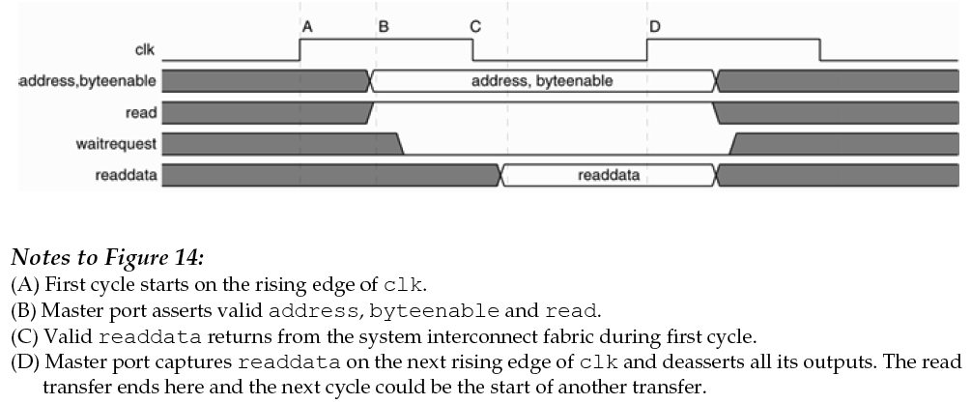
Master Read Transfer

Slide 25
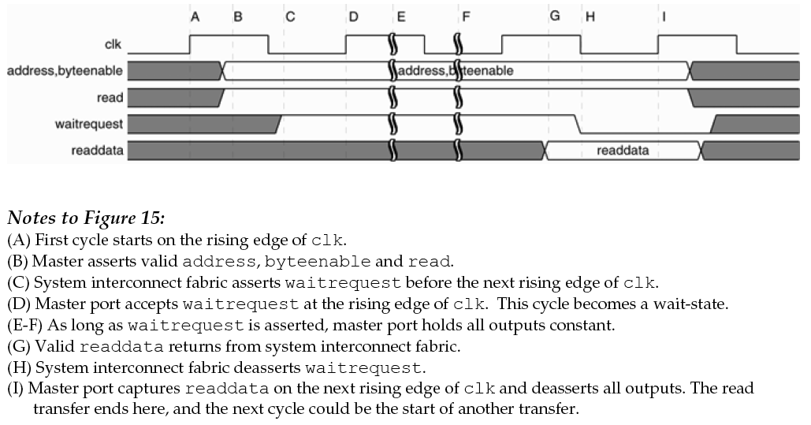
Master Read Transfer (with wait states)

Slide 26
Summary
For more information about Avalon bus, please refer to accompanying note from Altera
Bus is simple but can be complicated as more devices are attached to the system

