Slide 1
SystemVerilog
An Introduction to RTL Design, Simulation & Synthesis
Abarajithan, 2020 abarajithan07@gmail.com
Reference:
Stuart Sutherland, E 2017,
RTL Modeling with SystemVerilog for Simulation and Synthesis: Using SystemVerilog for ASIC and FPGA Design
Code: github.com/abarajithan11/entc_missing_semester

Slide 2
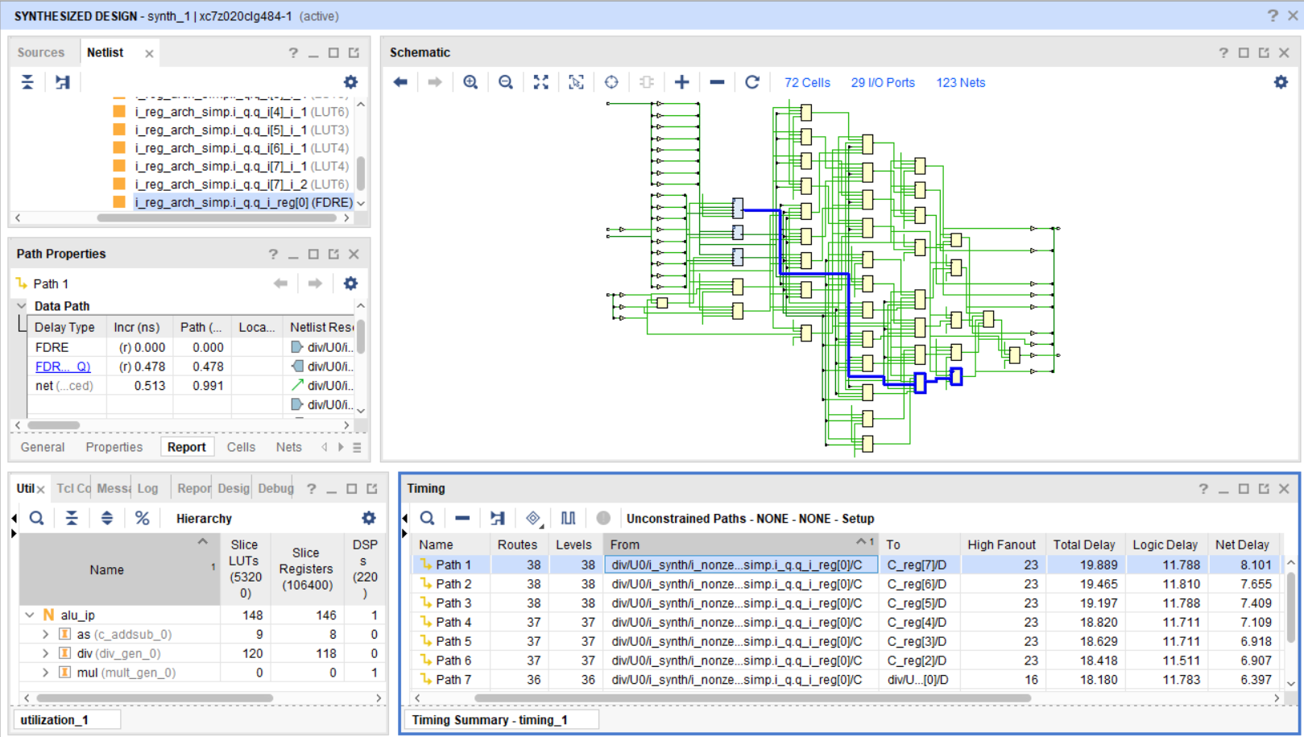
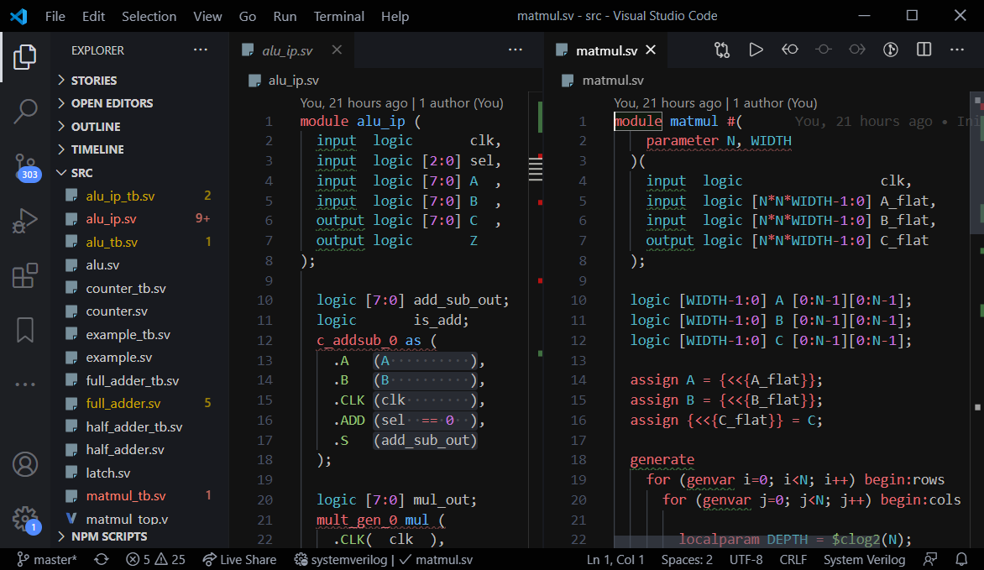
Pre-requisites
Abarajithan, 2020 abarajithan07@gmail.com
Software: install and set them up before starting
I will be using Xilinx Vivado Design Suite - HLx Editions 2018.2
Download from here (5.88 GB) and install as WEBPACK
Why 2018.2? Later use advanced boards with university license server
Instead, you can do the examples in the following, if you can figure out how to do simulation and synthesis
Xilinx ISE (used for older Xilinx FPGAs, depreciated now)
Altera Quartus (used for Intel Altera FPGAs)
Text editor (Not important)
Vivado/ISE/Quartus have their own basic editors.
I use VS Code with Material theme / One Dark Pro Monokai Darker.
Pre-requisite modules / knowledge – None expected.

Slide 3
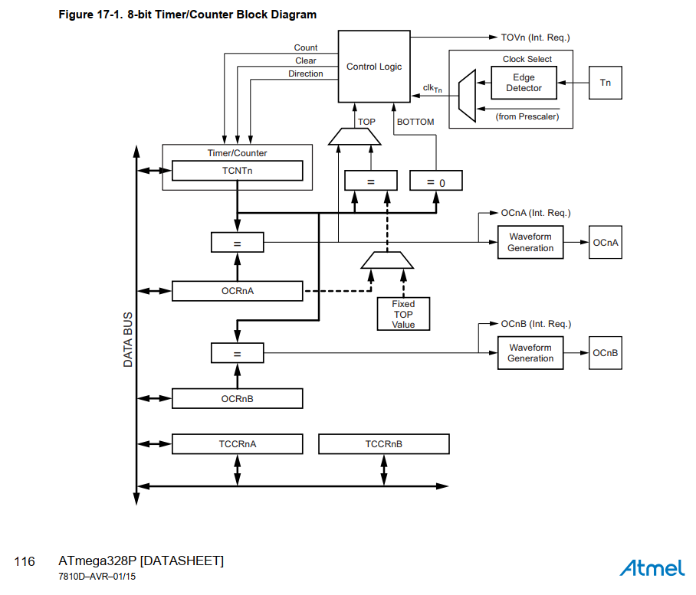
Why SystemVerilog?
Abarajithan, 2020 abarajithan07@gmail.com
Processors, GPUs, ASICs are digital circuits
Fabricated in silicon, doped to form transistors → gates → multiplexors, registers…etc.
RTL Design: Need a language to accurately describe a digital circuit in high level (registers, mux, bus) as a text file
Verification: Need a language to writes tests to simulate the functionality of designed circuits.

Slide 4
ASIC vs FPGA
Abarajithan, 2020 abarajithan07@gmail.com
Specification
ASIC
Cheaper to manufacture at high volume
Silicon only includes logic needed for that circuit
Backend development takes a long time
FPGA
Field-programmable
Dynamically implement any digital circuits using look up tables and switches.
Can change the designs quickly
Silicon includes generic, routing logic
Cheaper in low volume: Network routers, video encode/decode, satellites, scientific instruments, signal processing
RTL Design
Simulation
RTL Design
Simulation
Synthesis
for FPGA
Synthesis
for ASIC
Place & Route
for FPGA
Place & Route
for ASIC
Program FPGA with Bitstream
Send to
Fabrication
FPGA implementation
IC Design Flow
(Simplified)

Slide 5
Why FPGAs?
Abarajithan, 2020 abarajithan07@gmail.com

Slide 6
A Tale of Three HDLs
Abarajithan, 2020 abarajithan07@gmail.com
1952: Irving S. Reed built the first HDL to physically realize electronic circuits from Boolean algebraic equations, as reduced by Claude Shannon in his 1940 master’s thesis.
1974 : Over 50 HDLs were available
VHDL (IEEE 1987)
US Dept of Defense funded IBM & TI to develop VHDL (VHISC-HDL) as the government standard for VHISC (Very High-Speed Integrated Circuit) project
Strongly typed: verbose, but less gotchas
Now: Old designs in Europe, few new code.
Verilog (IEEE 1995)
From Gateway Design Automation, later acquired by Cadence, now evolved into SystemVerilog
SystemVerilog (IEEE 2005)
Verilog was discontinued and SystemVerilog replaced Verilog as the IEEE standard in 2012.
All major tools support SystemVerilog now
HLS – C/C++ for Hardware Description
Reference: “Language Wars in the 21st Century: Verilog versus VHDL - Revisited”, by Steve Golson and Leah Clark.
Presented at the 2016 Silicon Valley Synopsys Users Group Conference (SNUG)

Slide 7
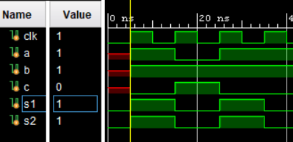
It’s NOT a programming language
Abarajithan, 2020 abarajithan07@gmail.com
Programming Language | Hardware Description Language (HDL)
a = True
b = False
c = a and b
print(c)
a = True
b = True
print(c)
s1 = 0
for i in range(3):
s1 = s1 + 1
print(s1)
s2 = 0
for i in range(2):
s2 = s2 + 1
print(s2)
module example(input logic clk,a,b,
output logic c,
output logic s1=0,
output logic s2=0);
assign c = a + b;
always_ff@(posedge clk)
s1 <= s1 + 1;
always_ff@(posedge clk)
s2 <= s2 + 1; endmodule
>> False
>> False
>> 1
2
3
a
c
b
1
+
>> 1
2
s1
s1
clk
1
+
s2
s2

Slide 8
It’s NOT a programming language
Abarajithan, 2020 abarajithan07@gmail.com
Programming Language | Hardware Description Language (HDL)
Step by step instructs an existing processor what to do | Describe a digital circuit via text You can design your own processor, and make it execute a programming language you created.
Control flow: Read and executed line by line | Tells the synthesis tool how to make the circuit. Data Flow: After implementation, you can give signals and get outputs
Compiling: Translating to a low-level, processor friendly programming language | Compiling (Synthesis): Translating a high-level design (RTL) into a low-level, target-specific design (netlist)

Slide 9
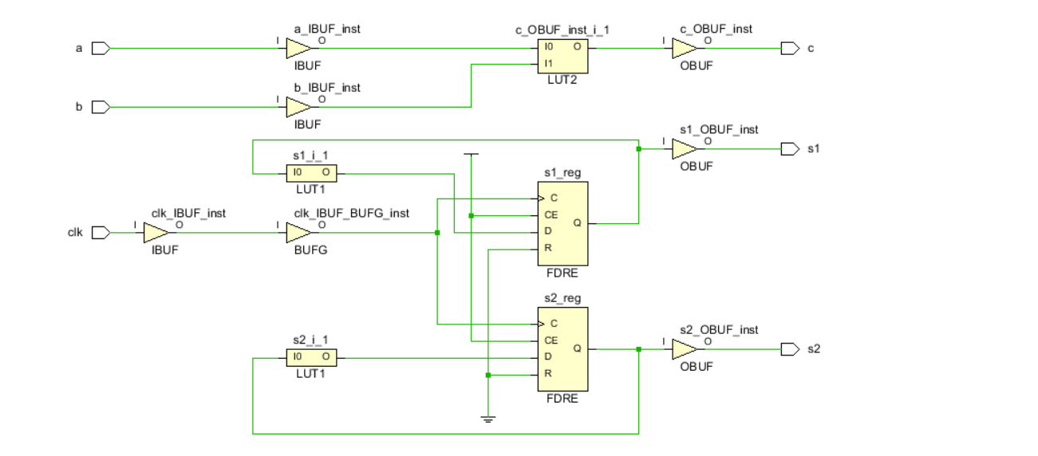
But, two objectives
Abarajithan, 2020 abarajithan07@gmail.com
RTL Design (Hardware Description) | Verification (Simulation)
module example(input logic clk,a,b,
output logic c,
output logic s1=0,
output logic s2=0);
assign c = a + b;
always_ff@(posedge clk)
s1 <= s1 + 1;
always_ff@(posedge clk)
s2 <= s2 + 1; endmodule
module example_tb();
timeunit 1ns;
timeprecision 1ps;
logic clk = 0;
localparam CLK_PERIOD = 10;
logic a,b,c,s1,s2;
example ex (.*);
initial begin
forever begin
#(CLK_PERIOD/2);
clk <= ~clk;
end
end
initial begin
@(posedge clk);
a <= 1;
b <= 1;
@(posedge clk);
a <= 0;
b <= 1;
@(posedge clk);
a <= 1;
b <= 1;
end
endmodule;
always_ff @(posedge clk);
IS SYNTHESIZABLE!
forever, #DELAY, @(posedge clk);
NOT SYNTHESIZABLE!

Slide 10
But, two objectives
Abarajithan, 2020 abarajithan07@gmail.com
RTL Design | Verification (Simulation)
Describes a circuit | Feeds inputs to the designed circuit step by step and gets outputs from the circuit
Synthesizable into a digital circuit. | Not synthesizable, testbenches are only simulated.
Read by the synthesis compiler (Vivado synthesis, Synopsys Design Compiler) | Read by the simulator Qsim (Altera Quartus), ModelSim, Vivado Simulator

Slide 11
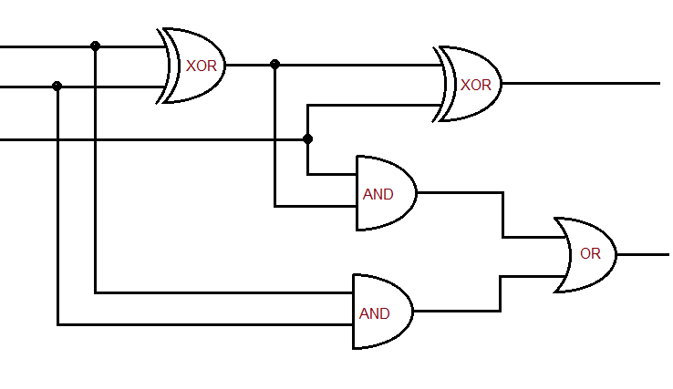
RTL Design: 1-bit Full Adder
Abarajithan, 2020 abarajithan07@gmail.com
/*
This code describes a full_adder circuit
*/
module full_adder
(
input logic a,
input logic b,
input logic c_in,
output logic sum,
output logic c_out
); logic wire_1, wire_2, wire_3;
assign wire_1 = a ^ b ; // bitwise XOR
assign wire_2 = wire_1 & c_in ; // bitwise AND
always_comb begin
wire_3 = a & b ; // bitwise AND
end
assign sum = wire_1 ^ c_in ;
assign c_out = wire_2 | wire_3; // bitwise OR
endmodule
full_adder module
Port
declaration
a
wire_1
b
sum
c_in
Declaring intermediate
wires (nets / variables)
wire_2
c_out
wire_3
Two types of combinational assignments

Slide 12
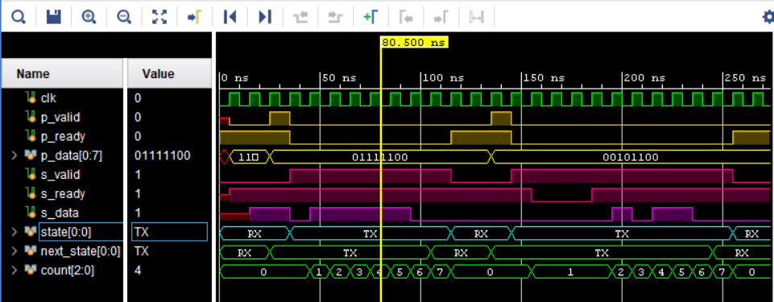
What’s a Testbench?
Abarajithan, 2020 abarajithan07@gmail.com
We use non-synthesizable constructs of SystemVerilog to test (verify) our RTL design in simulation
#delay, randomize(), $fdisplay(), $fopen()
Each initial block starts independently (in parallel) and runs sequentially
Simulators: Qsim (Altera Quartus), ModelSim, Vivado Simulator
Display waveforms to debug clock by clock
File input / output for complex
Our testbench program
(non-synthesizable SystemVerilog)
clk
RTL design under test
(synthesizable SystemVerilog)
give
inputs
get
outputs

Slide 13
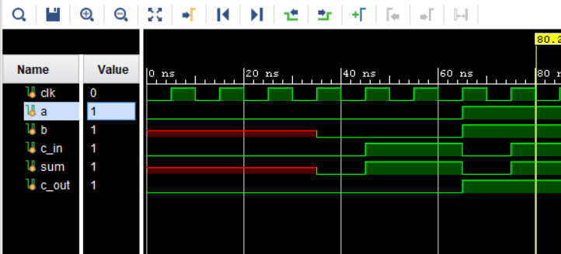
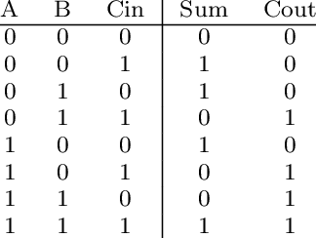
Testbench & Simulation: 1-bit Full Adder
Abarajithan, 2020 abarajithan07@gmail.com
module full_adder_tb ();
timeunit 1ns;
timeprecision 1ps;
localparam CLK_PERIOD = 10;
logic clk = 0;
logic a = 0;
logic b ;
logic c_in = 0;
logic sum ;
logic c_out ;
full_adder fa (.*);
initial begin
forever begin
#(CLK_PERIOD/2);
clk <= ~clk;
end
end
initial begin
// Simulation starts
@(posedge clk);
#(CLK_PERIOD*3);
@(posedge clk);
a <= 0;
b <= 0;
c_in <= 0;
@(posedge clk);
a <= 0;
b <= 0;
c_in <= 1;
#(CLK_PERIOD*2);
@(posedge clk);
a <= 1;
b <= 1;
c_in <= 0;
@(posedge clk);
a <= 1;
b <= 1;
c_in <= 1; end
endmodule
0
Time units
1
X: undefined
2
0
1
2
3
4
Module
instantiation
delay
1
3
2
4
3
Clock generation
4
Notes:
Verification Testbench: Not synthesizable
Time units
Timeunit = meaning of #1
Timeprecision = smallest step simulator takes. Doesn’t matter much, because simulator only evaluates at certain points.
Module instantiation
Can instantiate by order, name, or all
This way, ports of same name get connected together
Clock generation
Logic type: 0, 1, X, Z
Two types of variables / nets: logic, bit
Logic can take 4 values, bit can take 2
Better to use logic everywhere.
We can catch errors like not connecting a wire.
Note: X of b propagates into sum
Step by step simulation to check with truth table
All statements of each step happens instantaneously
Combinational circuit
Output comes without a clock cycle delay

Slide 14
N-bit Full Adder
module n_adder
#(
parameter N
)(
input logic [N-1:0] A ,
input logic [N-1:0] B ,
input logic c_in ,
output logic [N-1:0] S ,
output logic c_out
);
logic [N:0] C;
assign C[0] = c_in;
assign c_out = C[N];
generate
for (genvar i=0; i<N; i++) begin:add
full_adder fa (
.a (A[i ]),
.b (B[i ]),
.c_in (C[i ]),
.c_out (C[i+1]),
.sum (S[i ])
);
end
endgenerate
endmodule
Abarajithan, 2020 abarajithan07@gmail.com
Parameterized module
N-bit, little endian
wire (vector)
A[i]
B[i]
A[7]
A[6]
A[5]
A[4]
A[3]
A[2]
A[1]
A[0]
A[7]
B[7]
B[6]
B[5]
B[4]
B[3]
B[2]
B[1]
A[0]
B[0]
B[7]
B[0]
fa₇
fa₆
fa₅
C[i+1]
fa_{i}
C[i]
fa₄
fa₃
fa₂
fa₁
fa₀
C[8]
fa₇
C[7]
C[6]
C[5]
C[4]
C[3]
C[2]
C[1]
fa₀
C[0]
C[8]
C[1]
C[0]
c_in
c_out
c_in
c_out
(N+1)-bit, little endian
Wire (vector)
S[7]
S[6]
S[5]
S[4]
S[3]
S[2]
S[1]
S[0]
S[7]
S[i]
S[0]
Referencing certain bits
Generating submodules
LITTLE ENDIAN | BIG ENDIAN
Use this to represent numbers Read left to right (→) LSB is rightmost 0000_1110₂ = 14₁₀ N-bit vector (wire) declared as: logic [N-1 : 0] wire_1; | Read right to left (←) LSB is leftmost 0000_1110₂ = 112₁₀ N-bit vector (wire) declared as: logic [0 : N-1] wire_1;
Module
Instantiation
(named)
Chaining

Slide 15
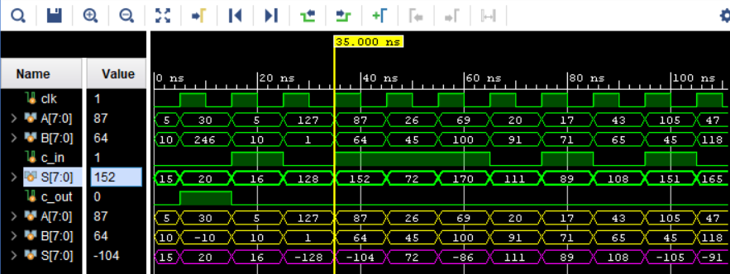
Testbench & Simulation: 8-bit Full Adder
Abarajithan, 2020 abarajithan07@gmail.com
module n_adder_tb();
timeunit 1ns;
timeprecision 1ps;
localparam CLK_PERIOD = 10;
localparam N = 8 ;
logic clk =0;
logic signed [N-1:0] A ;
logic signed [N-1:0] B ;
logic c_in ;
logic signed [N-1:0] S ;
logic c_out ;
n_adder #(.N(N)) dut (.*);
initial begin
forever begin
#(CLK_PERIOD/2);
clk <= ~clk;
end
end
initial begin
A <= 8'd5 ;
B <= 8'd10;
c_in <= 0 ;
@(posedge clk);
A <= 8'd30;
B <= -8'd10;
c_in <= 0 ;
@(posedge clk);
A <= 8'd5 ;
B <= 8'd10;
c_in <= 1 ;
@(posedge clk);
A <= 8'd127;
B <= 8'd1 ;
c_in <= 0 ;
repeat(10) begin
@(posedge clk);
std::randomize(A) with {
A inside {[-128:127]};
};
std::randomize(B) with {
B inside {[-128:127]};
};
std::randomize(c_in);
end
end
endmodule
Localparam
repeat loop
Radix
Signal colors
Parameterized module instantiation
Randomize with constraints
Notes:
Verification Testbench: Not synthesizable
Time units
Timeunit = meaning of #1
Timeprecision = smallest step simulator takes. Doesn’t matter much, because simulator only evaluates at certain points.
Module instantiation
Can instantiate by order, name, or all
This way, ports of same name get connected together
Clock generation
Logic type: 0, 1, X, Z
Two types of variables / nets: logic, bit
Logic can take 4 values, bit can take 2
Better to use logic everywhere.
We can catch errors like not connecting a wire.
Note: X of b propagates into sum
Step by step simulation to check with truth table
All statements of each step happens instantaneously
Combinational circuit
Output comes without a clock cycle delay

Slide 16
Combinational ALU - RTL
module alu #(
parameter N
)(
input logic [ 2 :0] sel,
input logic [N-1:0] A ,
input logic [N-1:0] B ,
output logic [N-1:0] C ,
output logic Z
); always_comb begin
if (sel == 3'b000) C = A + B;
else if (sel == 3'b001) C = A - B;
else if (sel == 3'b010) C = A * B;
else if (sel == 3'b011) C = A / B;
else if (sel == 3'b100) C = A % B;
else C = A ;
end
assign Z = (C==0);
endmodule
module alu #(
parameter N
)(
input logic [ 2 :0] sel,
input logic [N-1:0] A ,
input logic [N-1:0] B ,
output logic [N-1:0] C ,
output logic Z
); always_comb begin
unique case(sel)
3'b000 : C = A + B;
3'b001 : C = A - B;
3'b010 : C = A * B;
3'b011 : C = A / B;
3'b100 : C = A % B;
default: C = A ;
endcase
end
assign Z = (C==0);
endmodule
Abarajithan, 2020 abarajithan07@gmail.com
ALU
A
C
B
Z
sel
+
000
-
001
A
*
010
C
if-else -> multiplexer
B
case -> multiplexer
/
011
%
100
else
sel
Notes:
No need to build adders. Verilog supports arithmetic operators
Multiplexers can be built by case statement

Slide 17
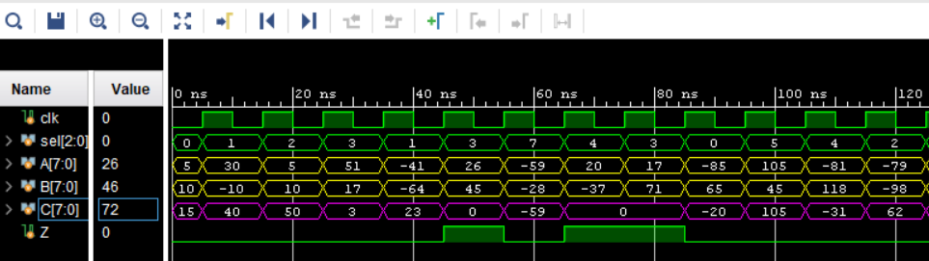
Combinational ALU - Simulation
Abarajithan, 2020 abarajithan07@gmail.com
module alu_tb ();
timeunit 1ns;
timeprecision 1ps;
logic clk = 0;
localparam CLK_PERIOD = 10;
initial begin
forever begin
#(CLK_PERIOD/2);
clk <= ~clk;
end
end
localparam N = 8 ;
logic [ 2:0] sel;
logic signed [N-1:0] A ;
logic signed [N-1:0] B ;
logic signed [N-1:0] C ;
logic Z ;
alu #(.N(N)) dut (.*);
initial begin
A <= 8'd5 ;
B <= 8'd10 ;
sel <= 3'b000;
@(posedge clk);
A <= 8'd30;
B <= -8'd10;
sel <= 3'b001;
@(posedge clk);
A <= 8'd5 ;
B <= 8'd10 ;
sel <= 3'b010;
@(posedge clk);
A <= 8'd51 ;
B <= 8'd17 ;
sel <= 3'b011;
repeat(10) begin
@(posedge clk);
std::randomize(A );
std::randomize(B );
std::randomize(sel);
end
end
endmodule

Slide 18
Why do we need a clock?
Abarajithan, 2020 abarajithan07@gmail.com
y = (a * b) + (c / d)
Each signal should stabilize before next posedge.
We sample / change values at each posedge
a
*
m
a
*
r1
m
b
b
+
+
y
y
y
c
/
c
/
r2
d
d
d
d
clk
Different delays in multiplier and divider
m, d stabilize at different times
We are not sure:
when to sample y
when to change a,b,c,d
clk
a
2
2
b
3
7
c
10
12
d
5
3
r1
6
14
r2
2
4
y
8
18

Slide 19
Sequential Circuits – Counter
Abarajithan, 2020 abarajithan07@gmail.com
Register,
Made of flip flops
Synchronous storage
Edge sensitive
module counter #(parameter N = 8)
(
input logic clk ,
input logic rst ,
input logic incr ,
output logic [N-1:0] count
);
always_ff @(posedge clk) begin
if (rst ) count <= 0 ;
else if (incr) count <= count + 1'b1;
else count <= count ;
end
endmodule
N-bit counter
count
+
count
1
0
non-blocking assignment
{incr, rst}
clk
always_ff,
on posedge clk

Slide 20
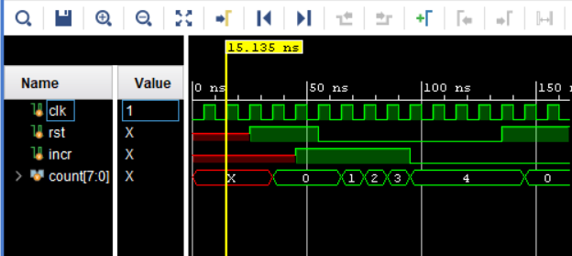
Counter - Simulation
Abarajithan, 2020 abarajithan07@gmail.com
module counter_tb();
timeunit 1ns;
timeprecision 1ps;
logic clk = 0;
localparam CLK_PERIOD = 10;
initial begin
forever begin
#(CLK_PERIOD/2);
clk <= ~clk;
end
end
localparam N = 8;
logic rst ;
logic incr ;
logic [N-1:0] count;
counter #(.N(N)) dut (.*);
initial begin
#(CLK_PERIOD * 2);
@(posedge clk);
rst <= 1;
#(CLK_PERIOD * 2);
@(posedge clk);
incr <= 1;
@(posedge clk);
rst <= 0;
incr <= 1;
#(CLK_PERIOD * 4);
@(posedge clk);
incr <= 0;
#(CLK_PERIOD * 4);
@(posedge clk);
rst <= 1;
end
endmodule
Reset has priority
if() … else …
priority case () …
unique case() …
Makes all parallel
No priority
Assumes the FSM won’t go to any other state
Synchronous reset (for FPGAs)

Slide 21
State Machine – Parallel to Serial Converter
Abarajithan, 2020 abarajithan07@gmail.com
p_ready
shift_reg <= p_data
p_ready = 1
s_valid = 0
p_data [7:0]
P2S
s_data
shift_reg
RX
p_valid
s_valid
p_data
p_ready
s_ready
count==7
&
s_ready
p_valid
clk
s_data
TX
s_valid
THREE-PROCEDURE CODING STYLE
state
s_valid = 1
p_ready = 0
if (s_ready)
SHIFT
count <= count + 1
else
DON’T SHIFT
count <= count
Next state
Decode
Logic
Output
Decode
Logic
State
Sequencer
Logic
state_next
p_valid
count
s_ready
s_data
s_valid
count
p_ready
clk

Slide 22
State Machine – Parallel to Serial Converter
Abarajithan, 2020 abarajithan07@gmail.com
module p2s #(parameter N = 8)
(
input logic clk ,
input logic [N-1:0] p_data ,
input logic p_valid,
output logic p_ready,
output logic s_data ,
output logic s_valid,
input logic s_ready
);
typedef enum logic [0:0] {
RX = 1'b0,
TX = 1'b1
} states_t;
// Inital values
// when FPGA power ups
localparam N_BITS = $clog2(N);
logic[N_BITS-1:0] count = 0 ;
states_t state = RX ;
// NEXT STATE DECODER LOGIC
states_t next_state;
always_comb begin
unique case(state)
RX: begin
if (p_valid) next_state = TX;
else next_state = RX;
end
TX: begin
if (count == N-1 && s_ready)
next_state = RX;
else
next_state = TX;
end
endcase
end
// STATE SEQUENCER LOGIC
always_ff @(posedge clk) begin
state <= next_state;
end
// OUTPUT DECODE LOGIC
logic [N-1:0] shift_reg ;
assign s_data = shift_reg[0] ;
assign p_ready = (state == RX);
assign s_valid = (state == TX);
always_ff @(posedge clk) begin
unique case(state)
RX: shift_reg <= p_data;
TX: begin
if (s_ready) begin
shift_reg <= {1'd0, shift_reg[N-1:1]};
count <= count + 1'd1;
end
else begin
shift_reg <= shift_reg;
count <= count;
end
end
endcase
end
endmodule
MUX
Sequential &
Combinational
Use enums
for states
Vector slicing & concat
Sequential
Only for FPGA
Use async rstn for ASIC

Slide 23
Simulation
Abarajithan, 2020 abarajithan07@gmail.com
module p2s_tb();
timeunit 1ns;
timeprecision 1ps;
logic clk = 0;
localparam CLK_PERIOD = 10;
initial begin
forever begin
#(CLK_PERIOD/2);
clk <= ~clk;
end
end
parameter N = 8;
logic [N-1:0] p_data ;
logic p_valid;
logic p_ready;
logic s_data ;
logic s_valid;
logic s_ready;
p2s #(.N(N)) dut (.*);
1
2
3
4
5
6
initial begin
@(posedge clk) ;
p_data <= 8'd7;
p_valid <= 0 ;
s_ready <= 1 ;
#(CLK_PERIOD*2) ;
@(posedge clk) ;
p_data <= 8'd62;
p_valid <= 1 ;
@(posedge clk) ;
p_valid <= 0 ;
#(CLK_PERIOD*10);
@(posedge clk) ;
p_data <= 8'd52;
p_valid <= 1 ;
@(posedge clk) ;
p_valid <= 0 ;
@(posedge clk) ;
s_ready <= 0 ;
#(CLK_PERIOD*3) ;
@(posedge clk) ;
s_ready <= 1 ;
end
endmodule
2
4
6
5
3
1

Slide 24
Processor as a State Machine
Abarajithan, 2020 abarajithan07@gmail.com

Slide 25
ALU with IPs
module alu_ip (
input logic clk,
input logic [2:0] sel,
input logic [7:0] A ,
input logic [7:0] B ,
output logic [7:0] C ,
output logic Z
); logic [7:0] add_sub_out;
logic is_add;
c_addsub_0 as (
.A (A ),
.B (B ),
.CLK (clk ),
.ADD (sel == 0 ),
.S (add_sub_out)
); logic [7:0] mul_out;
mult_gen_0 mul (
.CLK( clk ),
.A ( A ),
.B ( B ),
.P (mul_out)
);
logic [2:0] sel_delay;
logic [7:0] A_delay ;
always_ff @(posedge clk) begin
sel_delay <= sel ;
A_delay <= A ;
end
logic [15:0] div_out;
div_gen_0 div (
.aclk ( clk ),
.s_axis_divisor_tvalid ( 1 ),
.s_axis_divisor_tdata ( B ),
.s_axis_dividend_tvalid ( 1 ),
.s_axis_dividend_tdata ( A ),
.m_axis_dout_tdata (div_out)
);
logic [7:0] quotient, modulo;
assign {quotient, modulo} = div_out;
logic [7:0] C_next ;
logic Z_next ;
always_comb begin
unique case(sel_delay)
3'b000 : C_next = add_sub_out;
3'b001 : C_next = add_sub_out;
3'b010 : C_next = mul_out ;
3'b011 : C_next = quotient ;
3'b100 : C_next = modulo ;
default: C_next = A_delay ;
endcase
Z_next = (C==0);
end
always_ff @(posedge clk) begin
C <= C_next;
Z <= Z_next;
end
endmodule
Abarajithan, 2020 abarajithan07@gmail.com
ALU
A
C
B
Z
Vivado divider IP with latency = 1
sel
Each IP is configured with one clock latency (delay)
clk
Vivado fixed-point add_sub IP
+
000
-
001
A
clk
*
010
C
B
Vivado fixed-point multiplier IP
Combinational Mux
/
011
%
100
else
Output is registered
sel
Registering output
Delay by one clock to match IPs
Notes:
No need to build adders. Verilog supports arithmetic operators
Multiplexers can be built by case statement

Slide 26
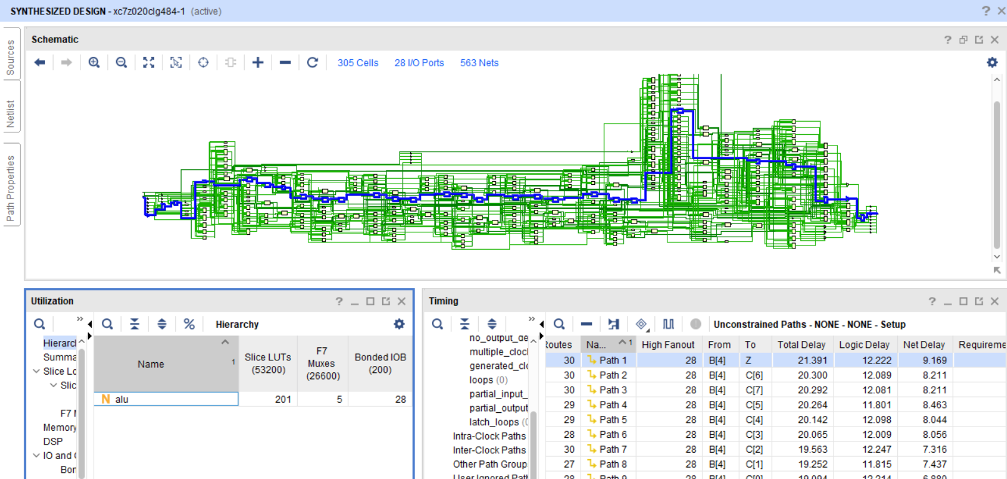
Combinational ALU with operations – Synthesis
Abarajithan, 2020 abarajithan07@gmail.com

Slide 27
ALU with IPs: Synthesis
Abarajithan, 2020 abarajithan07@gmail.com

Slide 28
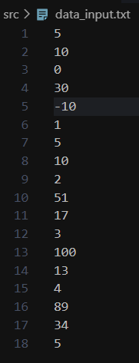
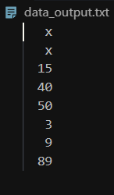
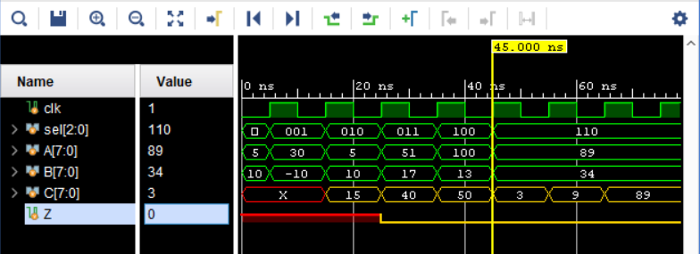
Testbench – File I/O
Abarajithan, 2020 abarajithan07@gmail.com
module alu_ip_tb (); timeunit 1ns;
timeprecision 1ps;
logic clk = 0;
localparam CLK_PERIOD = 10;
initial begin
forever begin
#(CLK_PERIOD/2);
clk <= ~clk;
end
end
localparam N = 8 ;
logic [ 2:0] sel;
logic signed [N-1:0] A ;
logic signed [N-1:0] B ;
logic signed [N-1:0] C ;
logic Z ;
alu_ip dut (.*);
File handles
int status, file_out, file_in;
// paths W.R.T to "project.sim/sim_1/behav/xsim" folder
string path_in ="../../../../../../data/data_input.txt" ;
string path_out ="../../../../../../data/data_output.txt";
initial begin
file_in = $fopen(path_in, "r");
file_out = $fopen(path_out, "w");
end
initial begin
while(!$feof(file_in)) begin
@(posedge clk); #1;
status = $fscanf(file_in,"%d\r", A );
status = $fscanf(file_in,"%d\r", B );
status = $fscanf(file_in,"%d\r", sel);
end #(CLK_PERIOD*3);
$fclose(file_in);
$fclose(file_out);
end
always @ (posedge clk) begin
#(CLK_PERIOD/2);
$fdisplay(file_out, "%d", C);
end
endmodule
Path relative to simulation directory
or absolute path.
String (non synthesizable)
Opening file in read & write modes
Load 1 ns after posedge
Read from file and load wires
Independent, write output into file

Slide 29

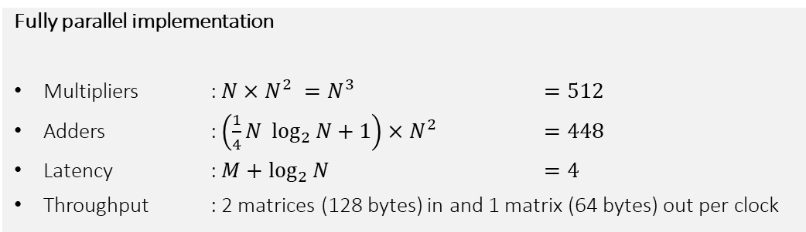

Matrix Multiplication
Abarajithan, 2020 abarajithan07@gmail.com
Multiplier Array x N²
Adder Tree x N²
DEPTH = log₂(8) = 3
k
j
d=0
d=1
d=2
×₀
+
(0,0)
+
(1,0)
+
(2,0)
tree[DEPTH][0] = C[i][j]
i
k
×₁
+
(0,1)
+
(1,1)
x
A[i][k]
×_{k}
+
(0,2)
B[k][j]
+
(0,3)
×_{N-1}
A_{8x8}
B_{8x8}
N x (DEPTH+1)
grid of wires declared
Unassigned wires won’t be synthesised
Fully parallel implementation
Multipliers : $N×N^{2} =N^{3}$ $=512$
Adders : $\left(\frac{1}{4}N \log_{2}{N}+1\right)×N^{2}$ $=448$
Latency : $M+$ $\log_{2}{N}$ $=4$
Throughput : 2 matrices (128 bytes) in and 1 matrix (64 bytes) out per clock
Adder Tree Design
a = {0,1…$\left(\frac{N}{2^{m+1}}\right)$}
tree[m][2a ]
+
(d,m)
tree[m][2a+1]
tree[m+1][a]
m = {0,1…DEPTH}

Slide 30
Matrix Multiplier
generate
for (genvar i=0; i<N; i++) begin:rows
for (genvar j=0; j<N; j++) begin:cols
localparam DEPTH = $clog2(N);
logic [WIDTH-1:0] tree [0:DEPTH][0:N-1];
for (genvar k=0; k<N; k++) begin:mul
mult_gen_0 mul (
.CLK(clk ),
.A (A [i][k]),
.B (B [k][j]),
.P (tree[0][k])
);
end for (genvar d=0; d<DEPTH; d++) begin: depth
for (genvar a=0; a<N/(2**(d+1)); a++) begin: add
c_addsub_1 add (
.A (tree[d][2*a ]),
.B (tree[d][2*a+1]),
.CLK (clk ),
.S (tree[d+1][a ])
);
end
end assign C[i][j] = tree[DEPTH][0];
end
end
endgenerate
endmodule
Abarajithan, 2020 abarajithan07@gmail.com
clk
C_{(N,N)}[i][j]
C_{(N*N)}[n]
Multiplier output truncated to 8 bits: error prone
A_{(N*N)}[n]
A_{(N,N)}[i][j]
B_{(N*N)}[n]
B_{(N,N)}[i][j]
module matmul #(
parameter N, WIDTH
)(
input logic clk,
input logic [N*N*WIDTH-1:0] A_flat,
input logic [N*N*WIDTH-1:0] B_flat,
output logic [N*N*WIDTH-1:0] C_flat
);
logic [WIDTH-1:0] A [0:N-1][0:N-1];
logic [WIDTH-1:0] B [0:N-1][0:N-1];
logic [WIDTH-1:0] C [0:N-1][0:N-1];
assign A = {<<{A_flat}};
assign B = {<<{B_flat}};
assign {<<{C_flat}} = C;
Packed arrays
Unpacked arrays
Adder tree design
Truncates to W bits at every step. Error prone
Unconnected wires will not be synthesized, so no problem
Streaming
operators
(packing/unpacking)

Slide 31
Wrapping SystemVerilog in Verilog
Abarajithan, 2020 abarajithan07@gmail.com
// matmul_top.v
module matmul_top #(
parameter N = 8,
parameter WIDTH = 8
)(
input wire clk,
input wire [N*N*WIDTH-1:0] A_flat,
input wire [N*N*WIDTH-1:0] B_flat,
output wire [N*N*WIDTH-1:0] C_flat
);
matmul #(
.N (N),
.WIDTH(WIDTH)
) matmul_0 (
.clk (clk ),
.A_flat (A_flat),
.B_flat (B_flat),
.C_flat (C_flat)
);
endmodule
Some tools (Xilinx Vivado) support only Verilog / VHDL in block design (integration with other large IPs)
SystemVerilog is supported for:
Simulation
Synthesis of internal modules
Ports:
Can use multidimensional unpacked array ports for internal modules (SV)
Flatten to packed array before bringing to the Verilog top module
Wrap it in a thin Verilog wrapper as shown
logic → wire
Only packed arrays
Wildcard instantiation (.*) not supported. Use named instantiation
VERILOG WRAPPER (TOP MODULE)
Unpacked
array
Unpacked
array
Packed
arrays
SYSTEMVERILOG MODULES

Slide 32
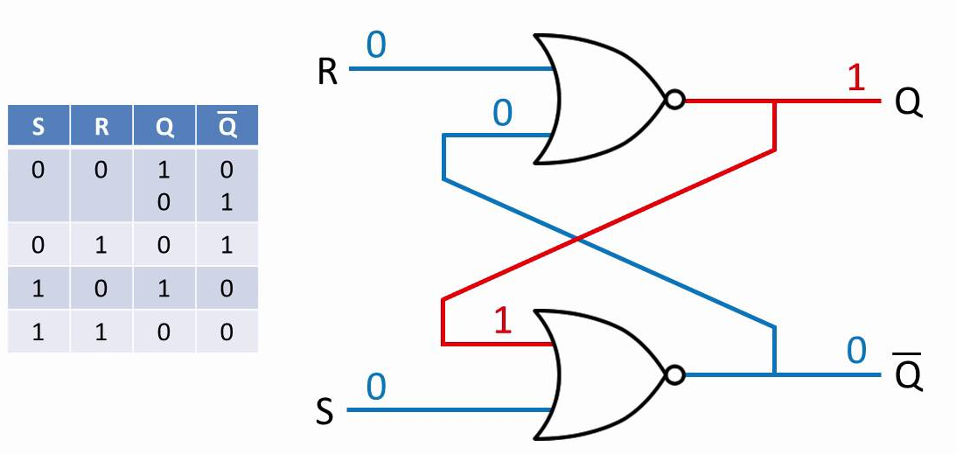
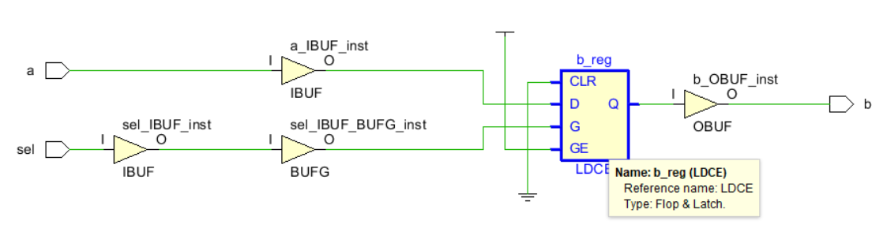

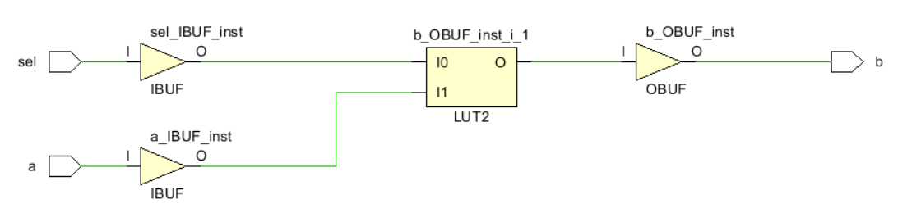
Avoiding Latches
Abarajithan, 2020 abarajithan07@gmail.com
Latch is a combinational storage unit. Unintentional inference can lead to race conditions, meta-stability and inefficient resource usage
LATCH INFERRED IN SYNTHESIS
module latch(
input logic sel,
input logic a ,
output logic b
);
always_comb
if (sel) b = a;
// else b = 0;
endmodule
MUX INFERRED AS LUT IN SYNTHESIS

Slide 33


RTL: Best practices
Abarajithan, 2020 abarajithan07@gmail.com
clk = ~clk ;
clk_reg = sel & clk;
Avoid modifying the clock signal in RTL. Use clock enables instead.
Avoid combinational feedback
Always use always_ff, always_comb, always_latch over always
Blocking (=) for combinational, Non-blocking (<=) for flip flops
If using always, include all changing signals in sensitivity list
Avoid latch inference: always have a default for case() and else for an if
Beware of vector size mismatch!
always_ff @(posedge clk)
if (sel)
data_reg <= something;
else
data_reg <= data_reg;
assign a = a + b;
always_comb
a = a + b;
FPGA | ASIC
Initialize registers at power-up as following. Global resets are expensive. If necessary, use synchronous resets. logic [7:0] word = 8'b0 ; logic [7:0] data [0:3][0:3] = '{default:0}; | Power-up initialization is not possible. Use asynchronous, global, active-low resets always_ff @(posedge clk or negedge rstn) begin if (~rstn) data <= 0; else // do something end

Slide 34
TCL Scripting
Abarajithan, 2020 abarajithan07@gmail.com
set PROJ_NAME sv_examples
set PROJ_FOLDER sv_examples
set SOURCE_FOLDER ../src
# Create project
create_project $PROJ_NAME ./$PROJ_FOLDER -part xc7z020clg484-1
set_property board_part xilinx.com:zc702:part0:1.4 [current_project]
# Add sources
add_files $SOURCE_FOLDER
# add_sub IP
set IP_NAME c_addsub_0
create_ip -name c_addsub -vendor xilinx.com -library ip -version 12.0 -module_name $IP_NAME
set_property -dict [list CONFIG.A_Width {8} CONFIG.B_Width {8} CONFIG.Add_Mode {Add_Subtract} CONFIG.Latency_Configuration {Manual} CONFIG.CE {false} CONFIG.Out_Width {8} CONFIG.Latency {1} CONFIG.B_Value {00000000}] [get_ips $IP_NAME]
generate_target {instantiation_template} [get_files $PROJ_FOLDER/$PROJ_NAME.srcs/sources_1/ip/$IP_NAME/$IP_NAME.xci]
set_property generate_synth_checkpoint 0 [get_files $PROJ_FOLDER/$PROJ_NAME.srcs/sources_1/ip/$IP_NAME/$IP_NAME.xci]
export_ip_user_files -of_objects [get_files $PROJ_FOLDER/$PROJ_NAME.srcs/sources_1/ip/$IP_NAME/$IP_NAME.xci] -no_script -sync -force -quiet
export_simulation -of_objects [get_files $PROJ_FOLDER/$PROJ_NAME.srcs/sources_1/ip/$IP_NAME/$IP_NAME.xci] -directory $PROJ_FOLDER/$PROJ_NAME.ip_user_files/sim_scripts -ip_user_files_dir $PROJ_FOLDER/$PROJ_NAME.ip_user_files -ipstatic_source_dir $PROJ_FOLDER/$PROJ_NAME.ip_user_files/ipstatic -lib_map_path [list {modelsim=$PROJ_FOLDER/$PROJ_NAME.cache/compile_simlib/modelsim} {questa=$PROJ_FOLDER/$PROJ_NAME.cache/compile_simlib/questa} {riviera=$PROJ_FOLDER/$PROJ_NAME.cache/compile_simlib/riviera} {activehdl=$PROJ_FOLDER/$PROJ_NAME.cache/compile_simlib/activehdl}] -use_ip_compiled_libs -force -quiet

Slide 35
Version control tips
Abarajithan, 2020 abarajithan07@gmail.com
Don’t get lost in project files
Keep your tcl scripts and sources (.v, .sv) separate
And track only them
.gitignore
Sample directory structure
*
!*.gitignore
!*.md
!**/build_*.tcl !**/src/**
examples/
.git
.gitignore
src/
module.sv
module_top.sv
module_top_tb.sv
module_top_wrapper.v
projects/
build_example.tcl
sys_50hz/

Slide 36
That was a lot!
github.com/abarajithan11/entc_missing_semester
Abarajithan, 2020 abarajithan07@gmail.com
General Topics
Programming Language vs HDL
Is it synthesizable?
X wires in waveform
Big / little endian
Avoiding latch inference
Why do we need clocks?
State machines
Registers, simple pipelining
Synthesis: longest path, delay, utilization
Best practices
TCL scripting
Version control
Example Designs
1-bit full adder
N-bit full adder
Combinational ALU with arithmetic operators
Pipelined ALU with IPs
Counter
Parallel to Serial converter as a 2-state machine
Matrix Multiplier with IPs
Synthesizable SystemVerilog for RTL Design
Ports
parameter, localparam
Module instantiation: (.named()), wildcard (.*)
assign, always_comb
Blocking(=), non-blocking(<=) assignments
Vector slici[n:g] and {con,cat,enate}
Operators: logical, arithmetic, streaming
Multiplexers: if-else, unique/priority case()
generate for loops
enums for states
Using vendor IPs
File handling: $fopen, fscanf, fdisplay…
Unpacked multidimensional arrays
Wrapping in Verilog
Interfaces (advanced)
SystemVerilog for Verification
Time units
Clock generation in testbench
#DELAY
std::randomize()
for(), while(), repeat()
OOP in SystemVerilog (advanced)

