Slide 1
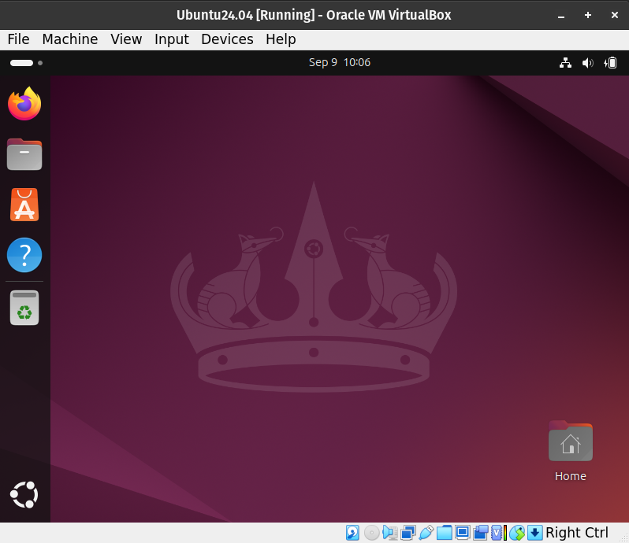

Ubuntu 26.04 LTS for the Spatial Ecology courses
Mastering several
Open Source software
in a Linux OS

Slide 2
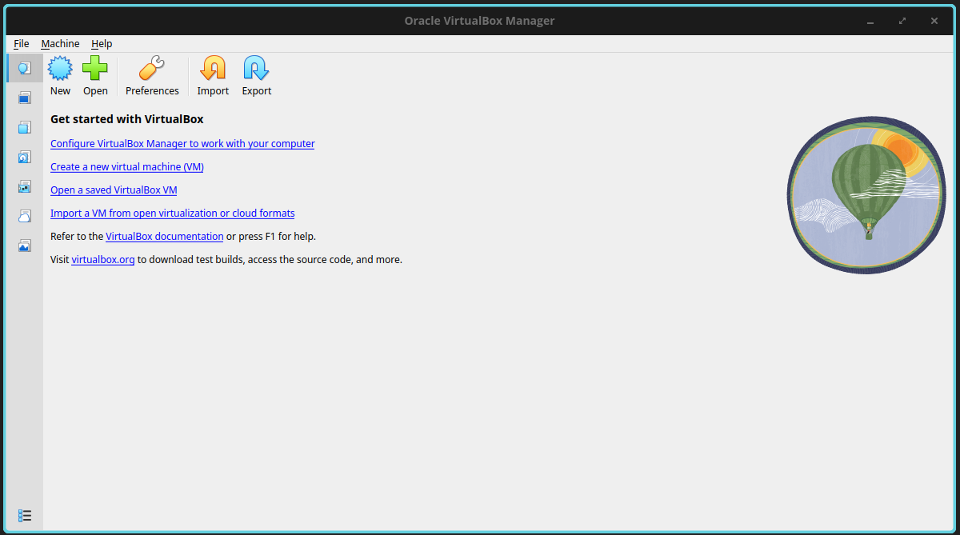
VirtualBox
Start the VirtualBox application and click on the New button to create a new VM, and then Next.

Slide 3
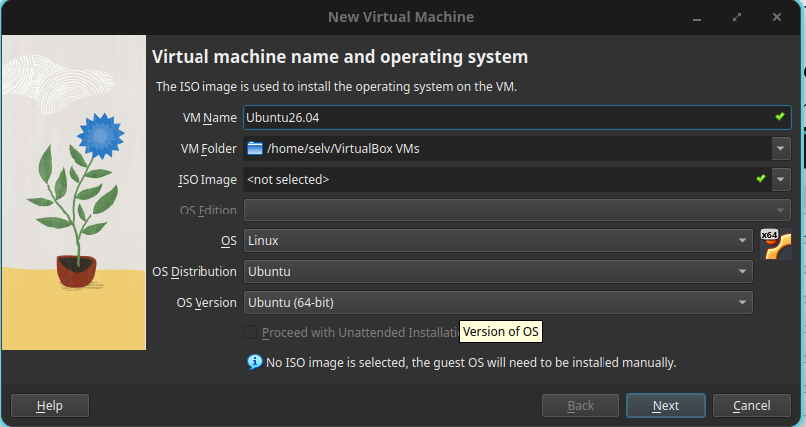
Create Virtual Machine
Enter a name such as Ubuntu26.04, and choose Linux as the “Operating system”, and Ubuntu (64bit) as “Version”.
Pay attention if you do not see Ubuntu (64bit) but only Ubuntu (32bit) means that your BIOS is not set for virtualization. Enter BIOS according to your PC configuration and enable virtualization ( see example at https://goo.gl/Zgq14A)
Leave the default
path of your OS

Slide 4
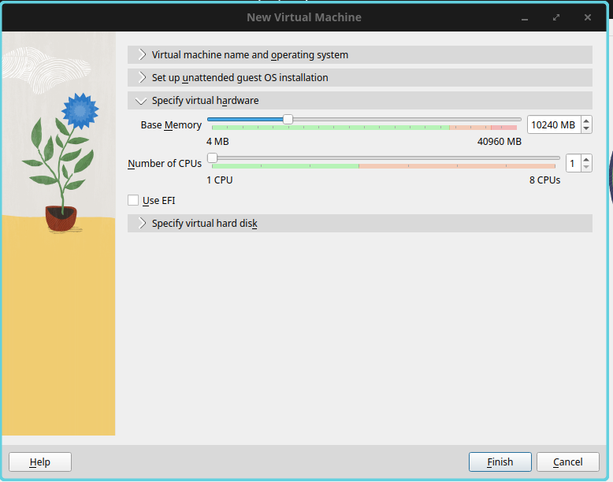
Set memory size
Set the memory Size (4-6G). The dedicate RAM for the VM can change according to the RAM of your host-pc. Do not overpass the green area! Increase the processors (2CPUs) only if your VM is too slow.
Remember you can change these options only when the VM has been shout-down.

Slide 5
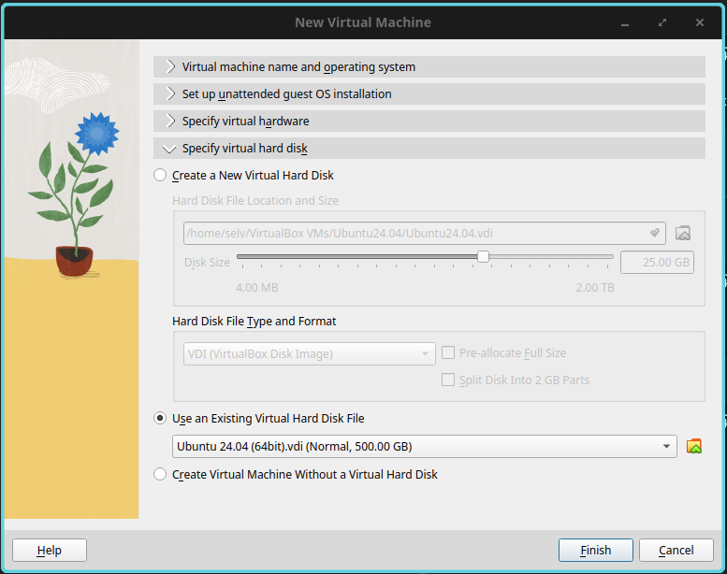
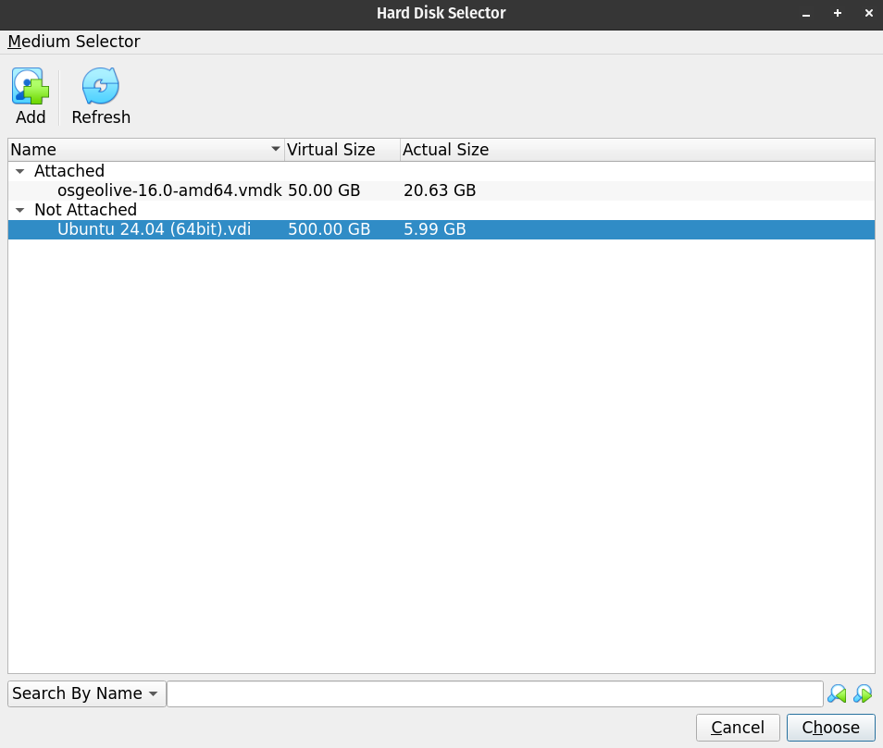
Load the vdi file
Choose “Use existing virtual hard disk file”.
Now click on the button (a folder yellow icon) to browse to where you saved the Ubuntu 26.04 (64bit) file.
Select the file, press Next and Create.

Slide 6
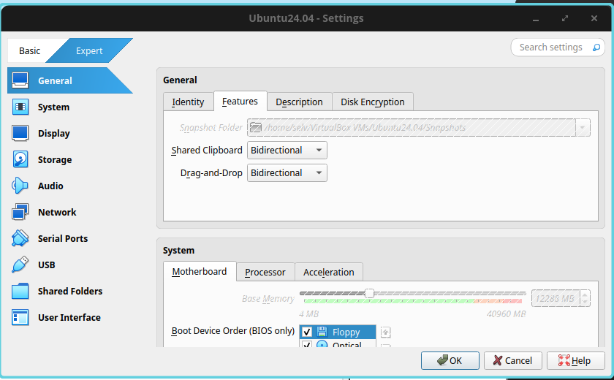
Virtual Machine settings
In VirtualBox → setting → General
Set Shared Clipboard and Drag and Drop to Bidirectional Optional.
Do not change the Snapshot Folder

Slide 7
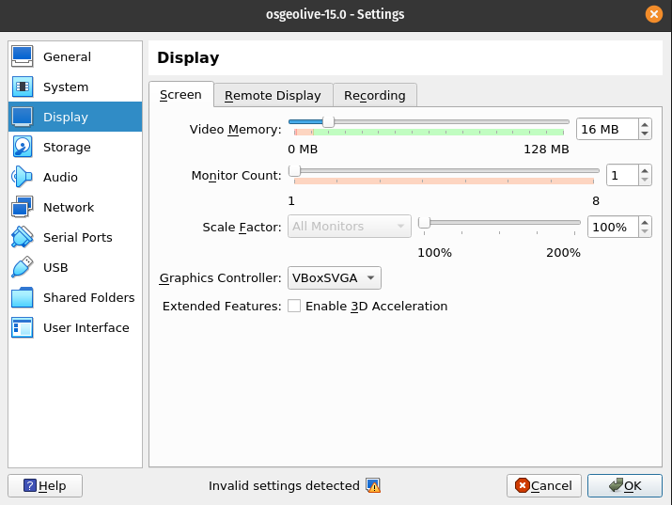
Virtual Machine settings
In VirtualBox → setting → General
Set the Graphics Controller to allow the “Auto-resize Guest Display”.
If the VM screen resolutions will be too small try to change the Graphics Controller to adjust the “Auto-resize Guest Display”.
Select VBoxSVGA

Slide 8
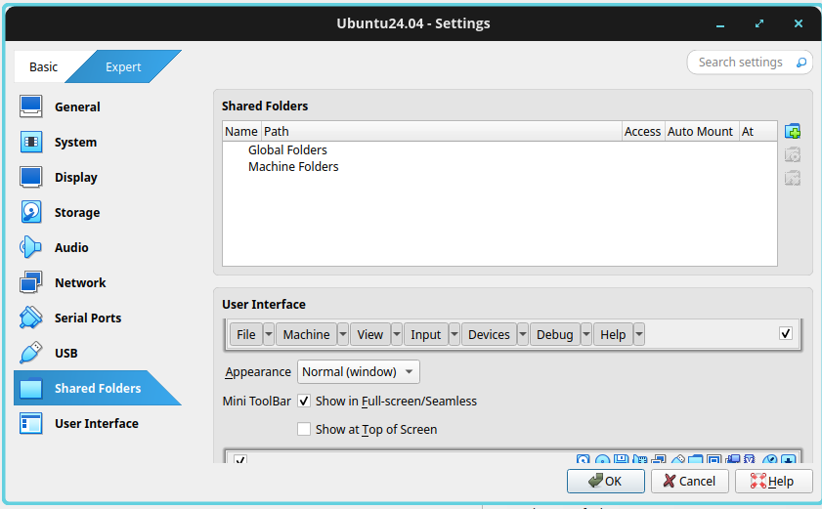
Sharing folder
Create an empty folder named LVM_shared in your OS
MAC OS X: /Users/yourname/LVM_shared
Windows OS: C:\Users\yourname\Documents\LVM_shared
Linux: /home/yourname/LVM_shared

Slide 9
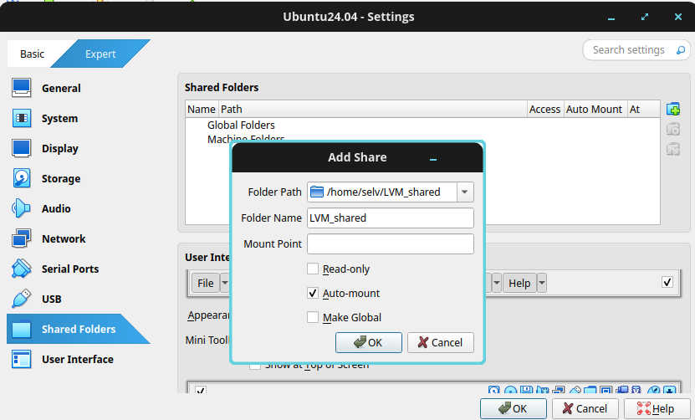
Sharing folder
Add new shared folder in VirtualBox → setting → shared folders →
Navigate to the host OS LVM_shared folder.
Activate the Auto-mount option and click OK

Slide 10
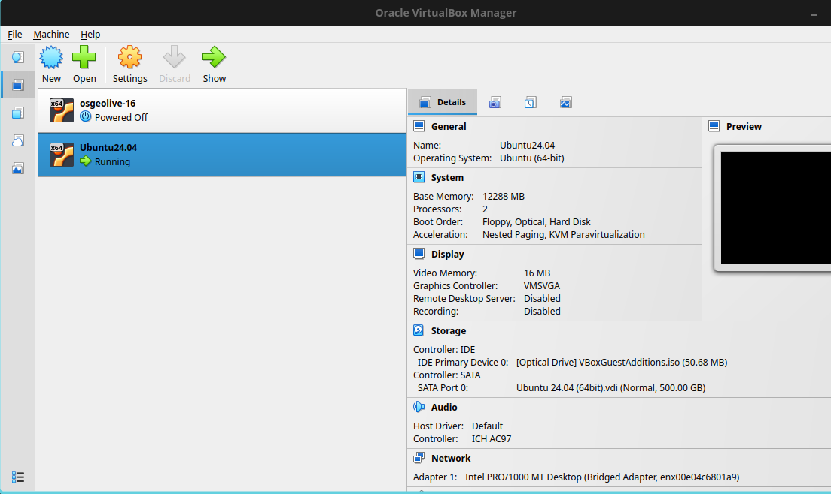
Start the Virtual Machine
At this point you can press the start arrow to boot the Linux Virtual Machine

Slide 11
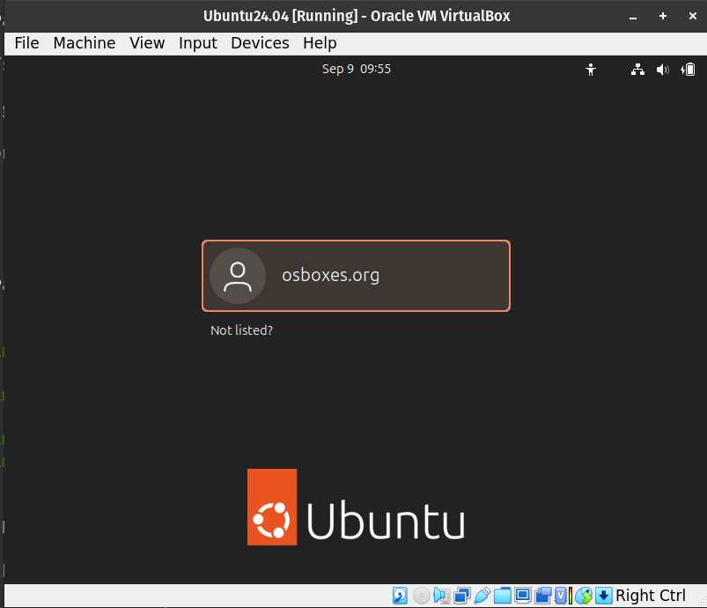
Select osboxes.org
Then press enter

Slide 12
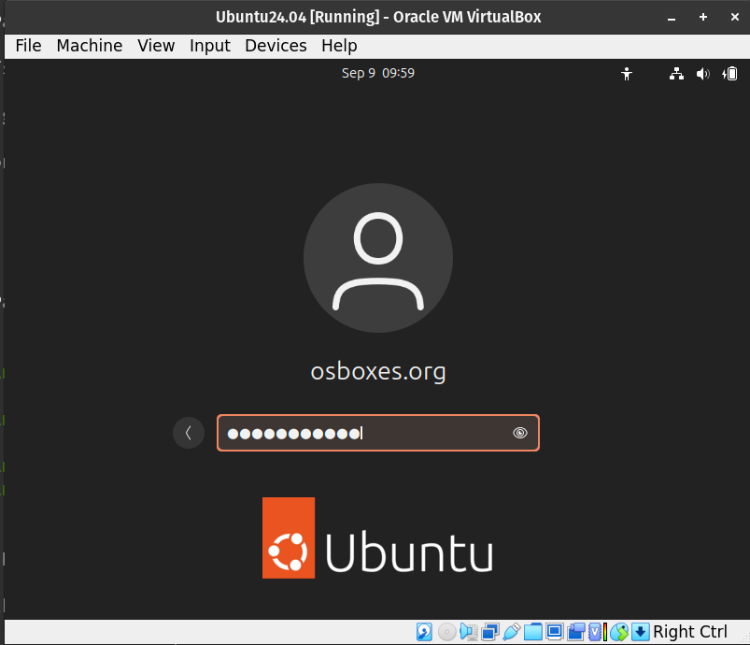
The OS password is:
osboxes.org
Then press enter

Slide 13
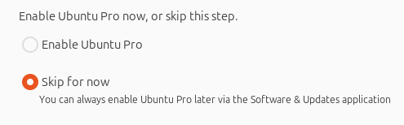
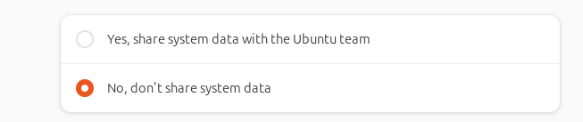
At the en of the installation a welcome message will appear.
Press nex and select the following options.

Slide 14
Final view.
Adjust the screen size

Slide 15
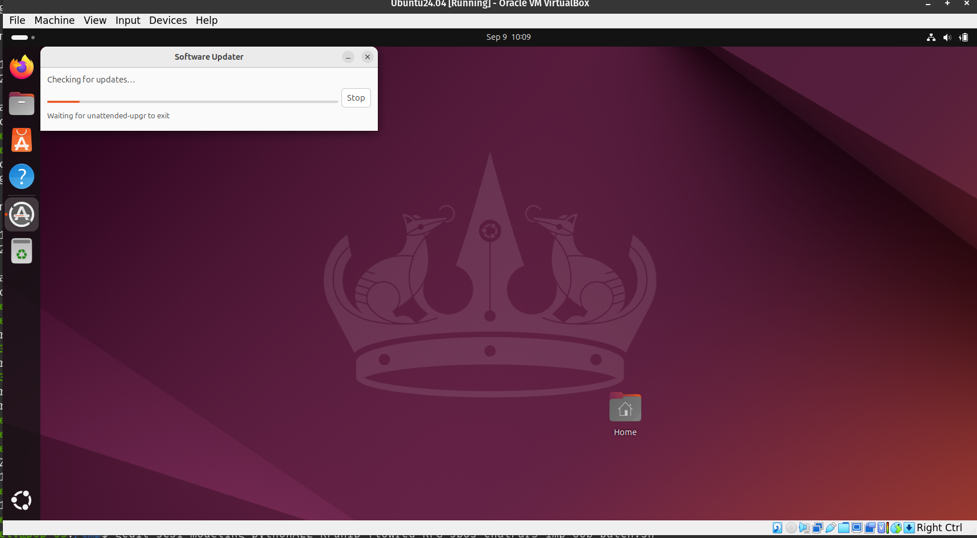
At this point the Ubuntu 26.04 LTS VM has been properly installed.
An update will start automatically. This operation will take 30 min so be patient.

Slide 16
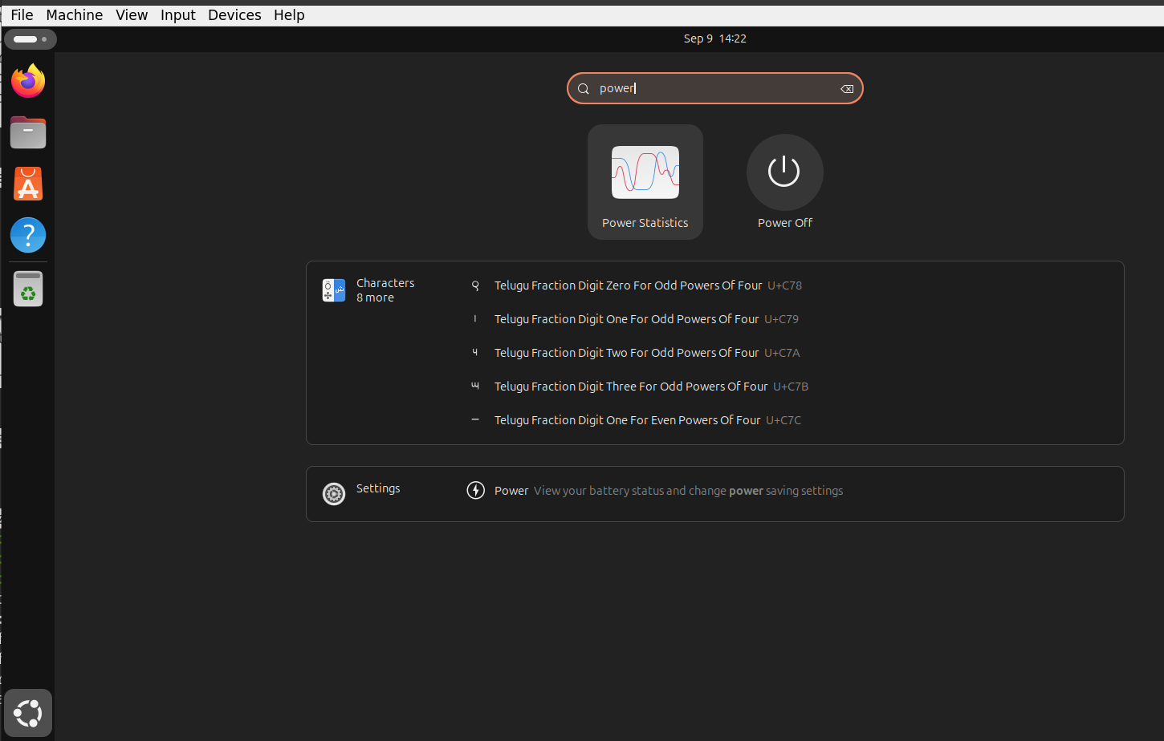
Always shutdown the VM clicking:
Spiral Icon > type power > Press Power of

