Slide 1
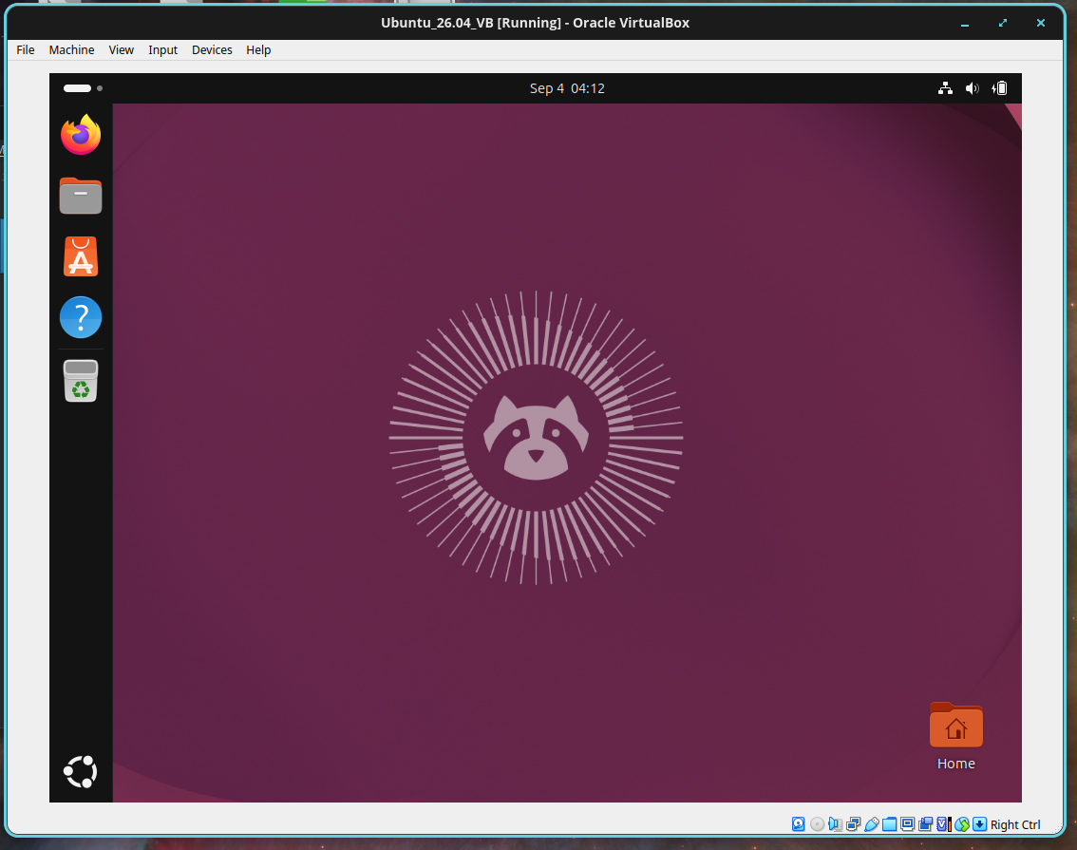

Ubuntu 26.04 LTS for the Spatial Ecology courses
Mastering several
Open Source software
in a Linux OS

Slide 2
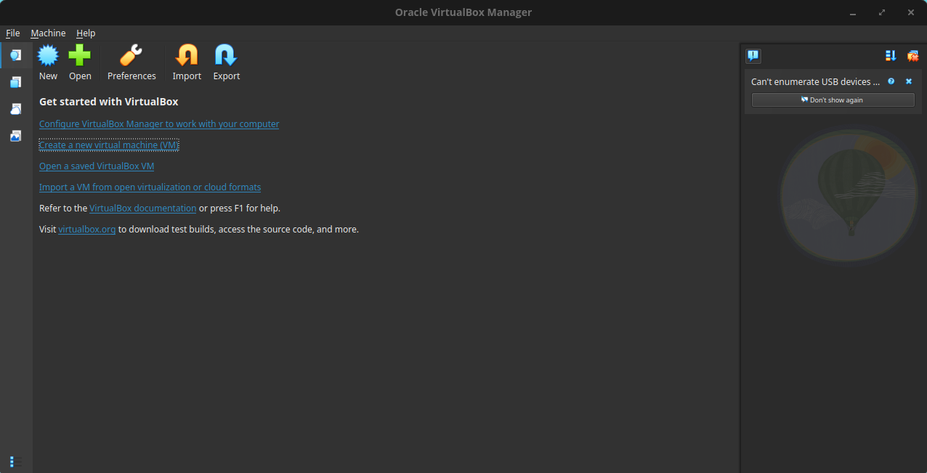
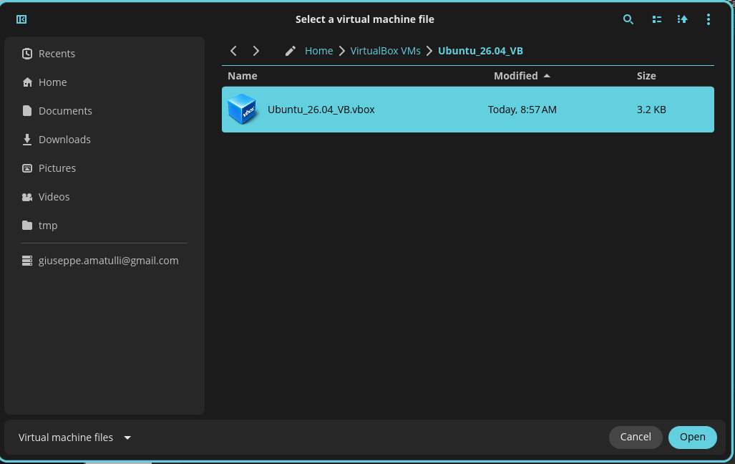
VirtualBox
Start the VirtualBox application and click on the “Open a saved Virtual Box”. Locate the the Ubunt_26.04_VB.vbox

Slide 3
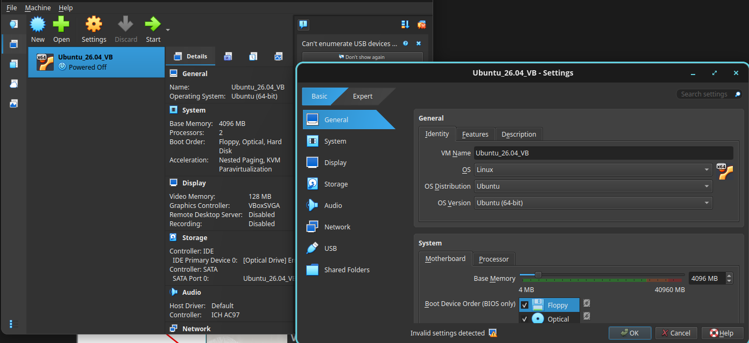
VM Settings
Click on the Settings icon.
Pay attention if you do not see Ubuntu (64bit) but only Ubuntu (32bit) means that your BIOS is not set for
virtualization. Enter BIOS according to your PC configuration and enable virtualization ( see example at
https://goo.gl/Zgq14A)

Slide 4
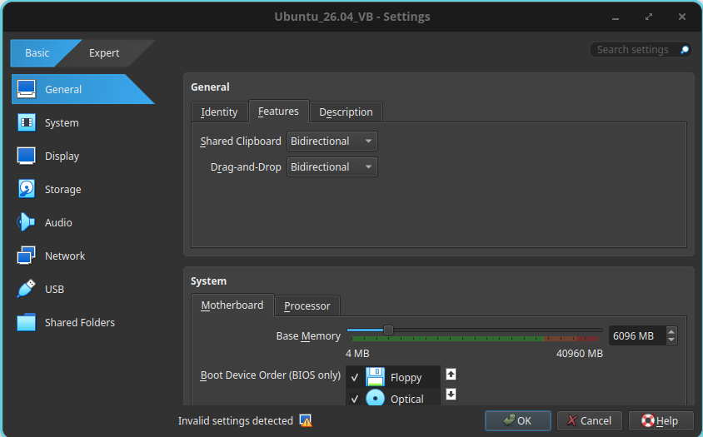
Virtual Machine settings
In VirtualBox → setting → General
Set Shared Clipboard and Drag and Drop to Bidirectional Optional.
Do not change the Snapshot Folder

Slide 5
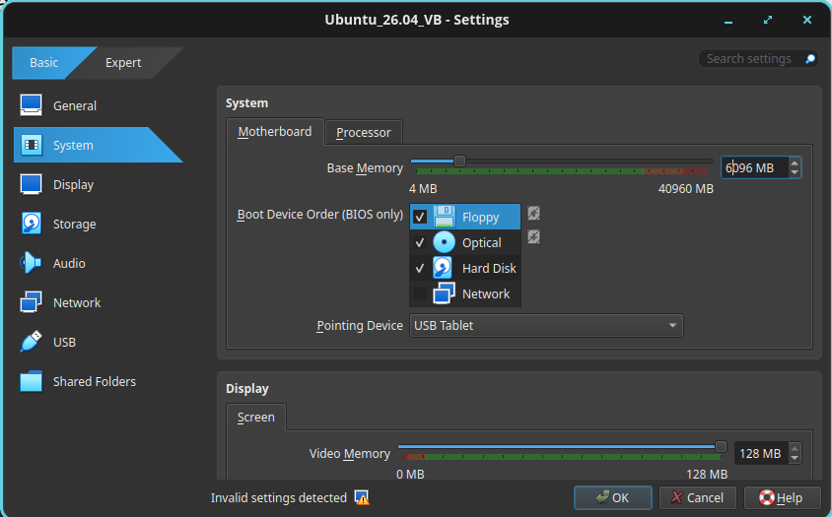
Set memory size
Set the memory Size (6G). The dedicate RAM for the VM can change according to the RAM of your host-pc. Do not overpass the green area!
Increase the processors (2CPUs) only if your VM is too slow.
Remember you can change these options only when the VM has been shout-down.

Slide 6
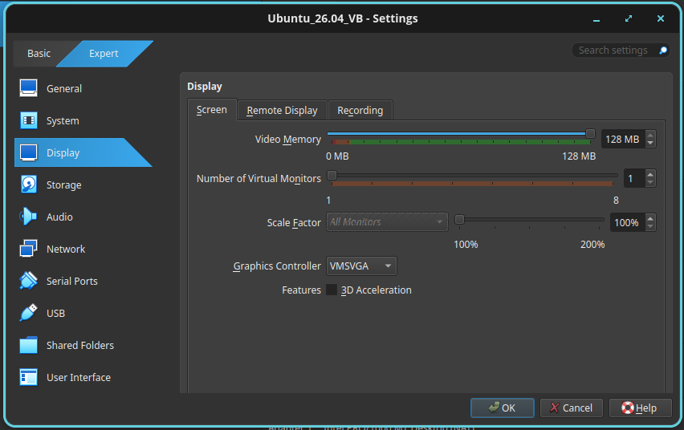
Set display
Set the Graphics Controller to VMSVG
(in case the View → Autoresize Guest Display is not working properly try to test the other options)

Slide 7
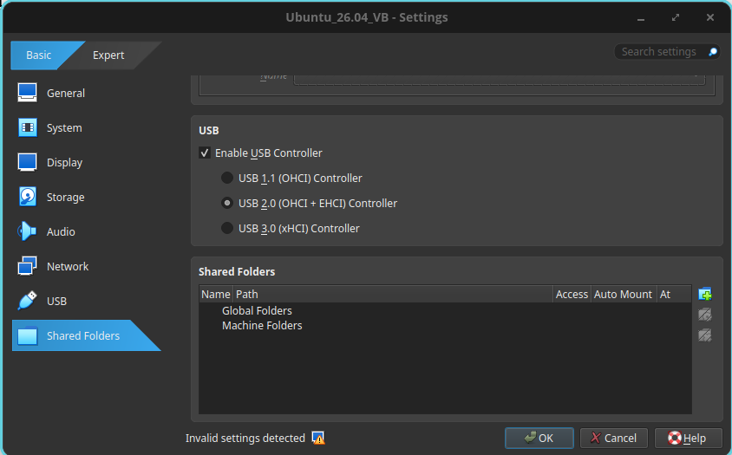
Sharing folder
Create an empty folder named LVM_shared in your OS
MAC OS X: /Users/yourname/LVM_shared
Windows OS: C:\Users\yourname\Documents\LVM_shared
Linux: /home/yourname/LVM_shared

Slide 8
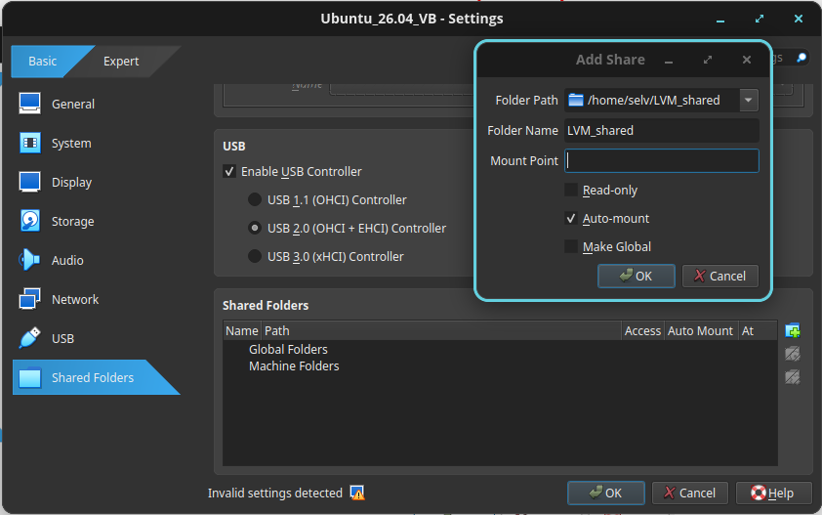
Sharing folder
Add new shared folder in VirtualBox → setting → shared folders →
Click “Machine Folders” and navigate to the host OS LVM_shared folder.
Activate the Auto-mount option and click OK

Slide 9
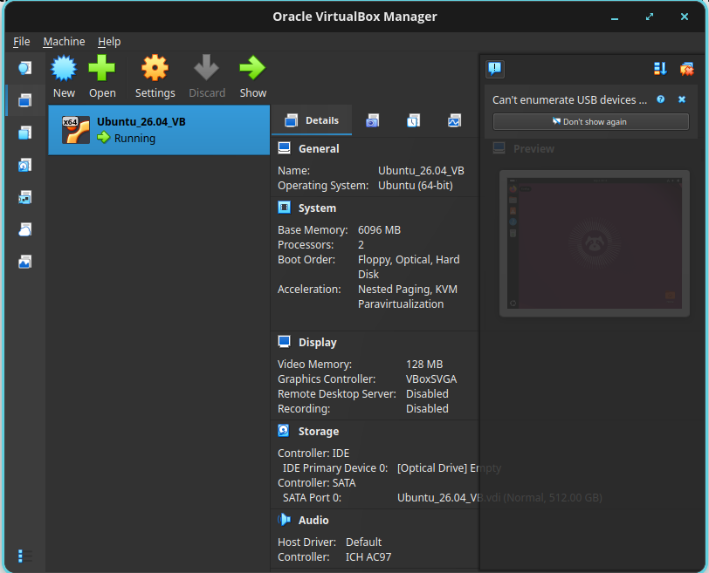
Start the Virtual Machine
At this point you can press the start arrow to boot the Linux Virtual Machine

Slide 10
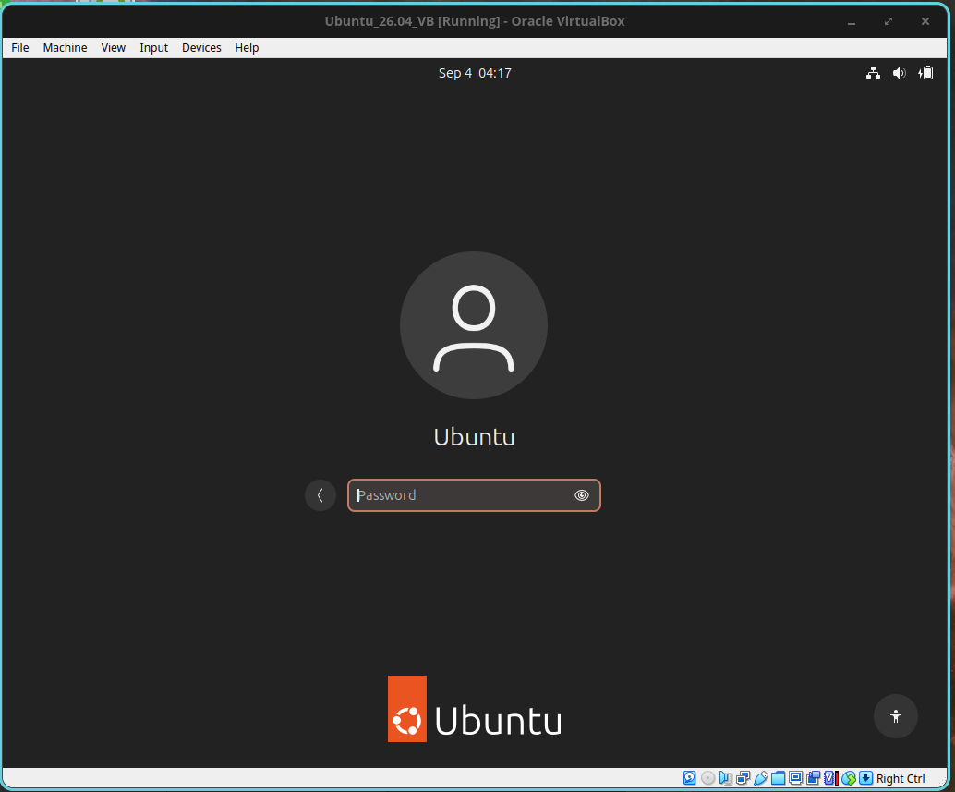
Select Ubuntu
password ubuntu
Then press enter

Slide 11
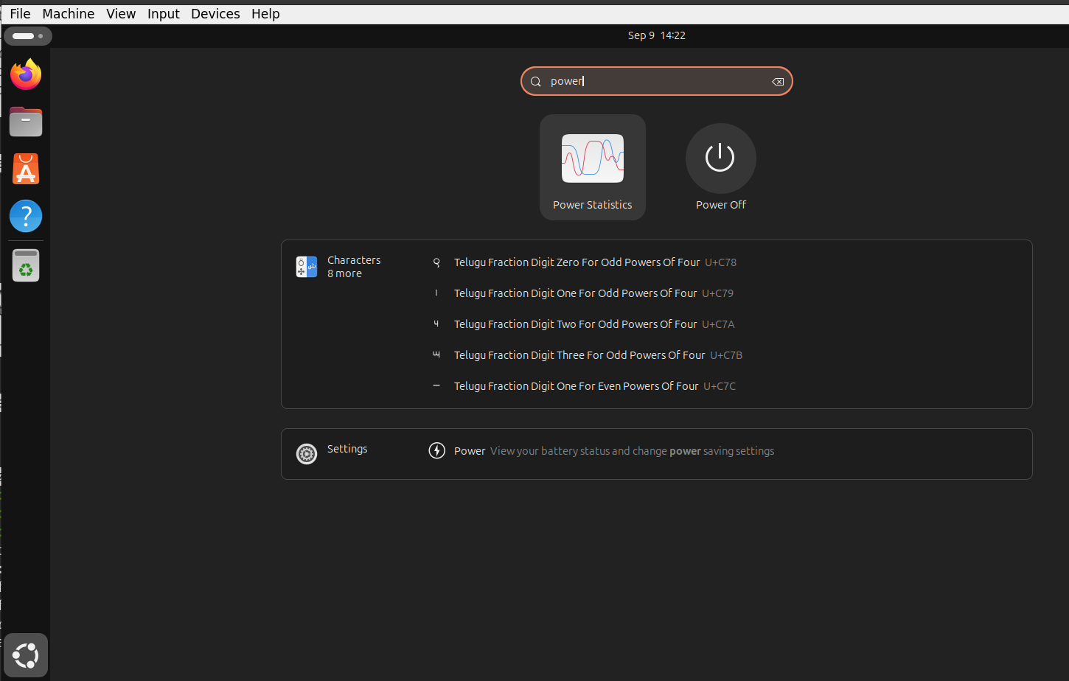
Always shutdown the VM clicking:
Spiral Icon > type power > Press Power of

