Slide 1

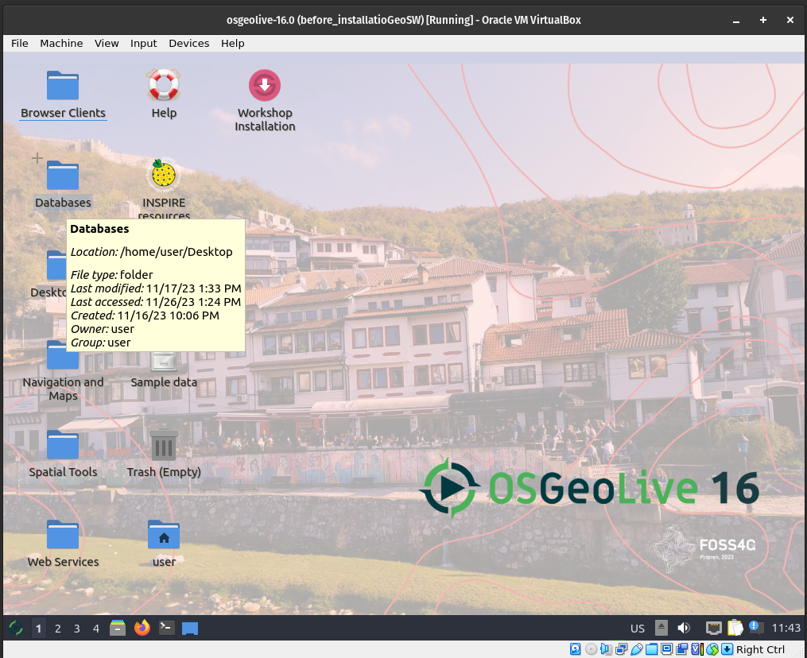

for the Spatial Ecology courses
Mastering several
Open Source software
in a Linux OS

Slide 2
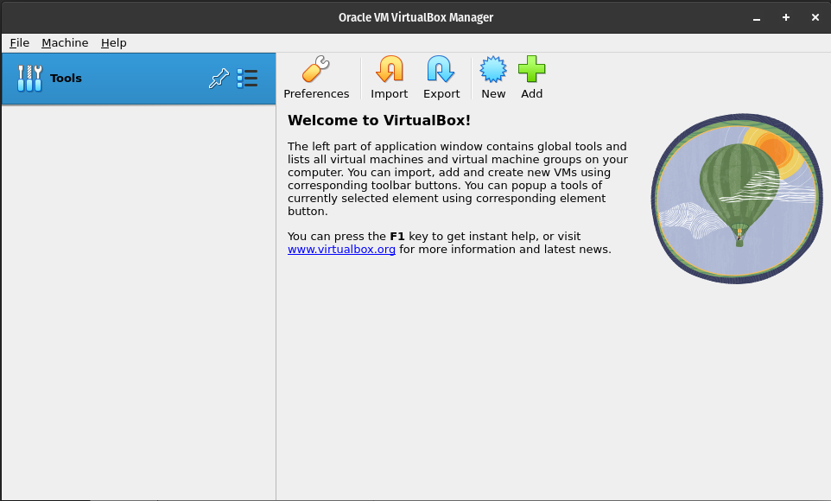
VirtualBox
Start the VirtualBox application and click on the New button to create a new VM, and then Next.

Slide 3
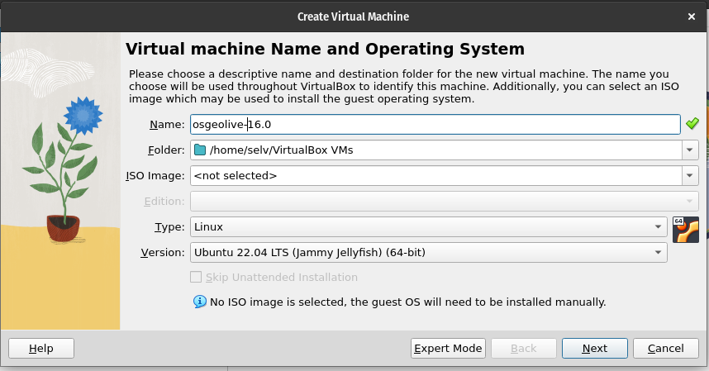
Create Virtual Machine
Enter a name such as osgeolive-16, and choose Linux as the “Operating system”, and Ubuntu (64bit) as “Version”.
Pay attention if you do not see Ubuntu (64bit) but only Ubuntu (32bit) means that your BIOS is not set for virtualization. Enter BIOS according to your PC configuration and enable virtualization ( see example at https://goo.gl/Zgq14A)
Leave the default
path of your OS

Slide 4
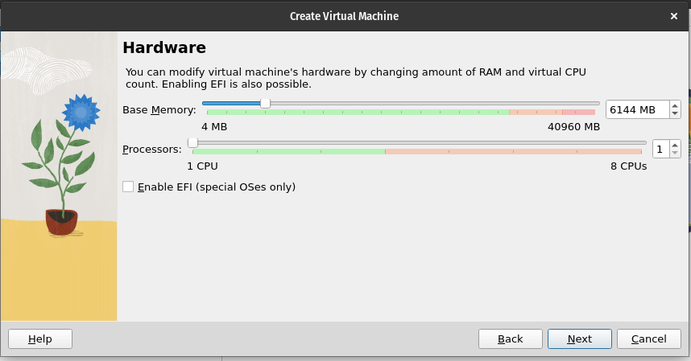
Set memory size
Set the memory Size (4-6G). The dedicate RAM for the VM can change according to the RAM of your host-pc. Do not overpass the green area! Increase the processors (2CPUs) only if your VM is too slow.
Remember you can change these options only when the VM has been shout-down.

Slide 5
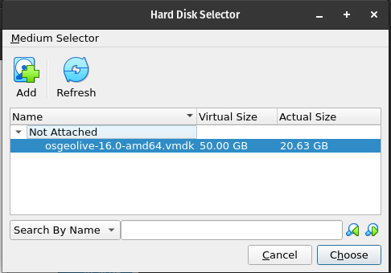
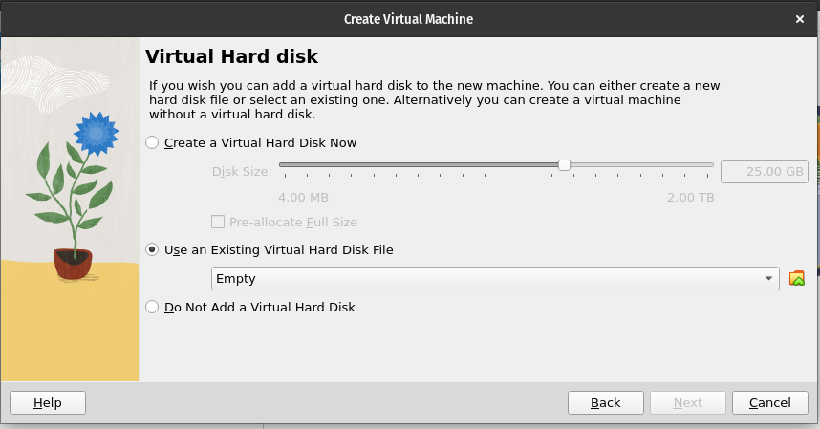
Load the vmdk file
Choose “Use existing virtual hard disk file”.
Now click on the button (a folder yellow icon) to browse to where you saved the osgeolive-16.0-amd64.vmdk file. Select the file, press Next and Create.

Slide 6
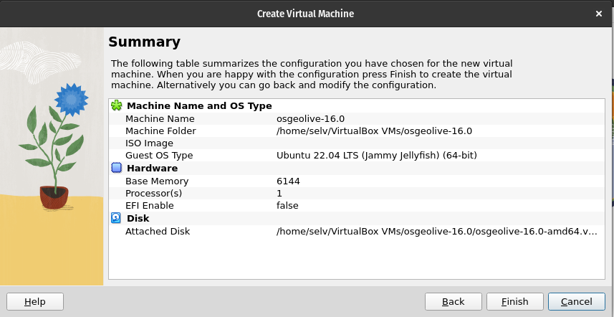
Overview
Check if everything is correct

Slide 7
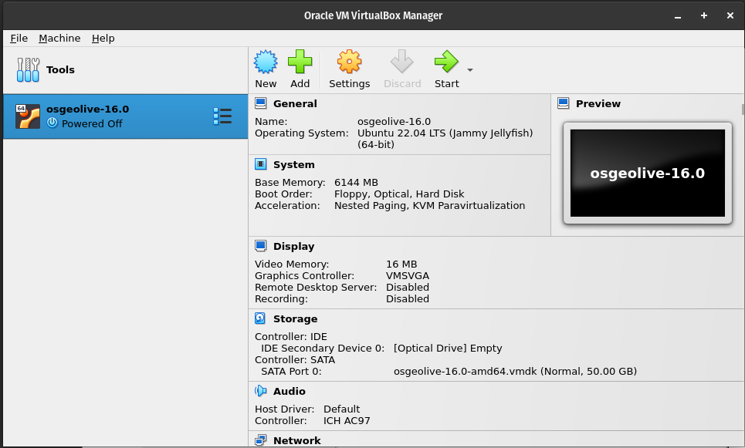
Setup
Adjust the settings

Slide 8
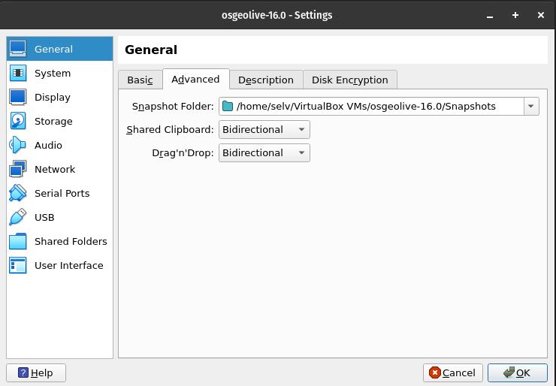
Virtual Machine settings
In VirtualBox → setting → General
Set Shared Clipboard and Drag and Drop to Bidirectional Optional.
Do not change the Snapshot Folder

Slide 9
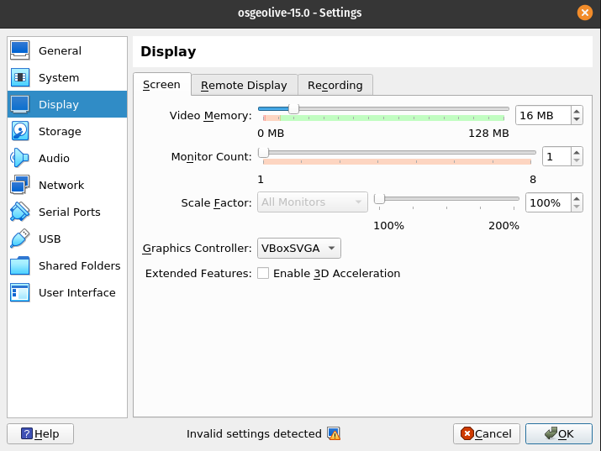
Virtual Machine settings
In VirtualBox → setting → General
Set the Graphics Controller to allow the “Auto-resize Guest Display”.
If the VM screen resolutions will be too small try to change the Graphics Controller to adjust the “Auto-resize Guest Display”.
Select VBoxSVGA

Slide 10
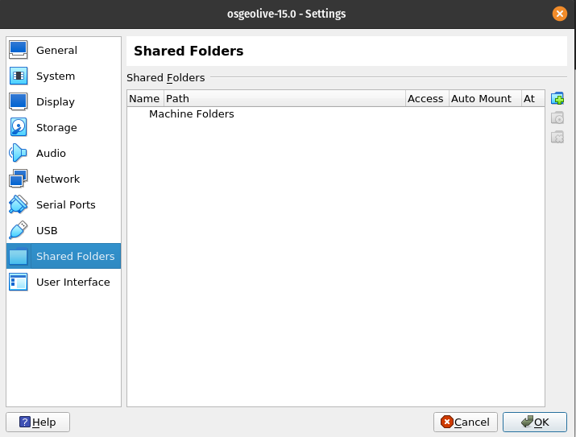
Sharing folder
Create an empty folder named LVM_shared in your OS
MAC OS X: /Users/yourname/LVM_shared
Windows OS: C:\Users\yourname\Documents\LVM_shared
Linux: /home/yourname/LVM_shared

Slide 11
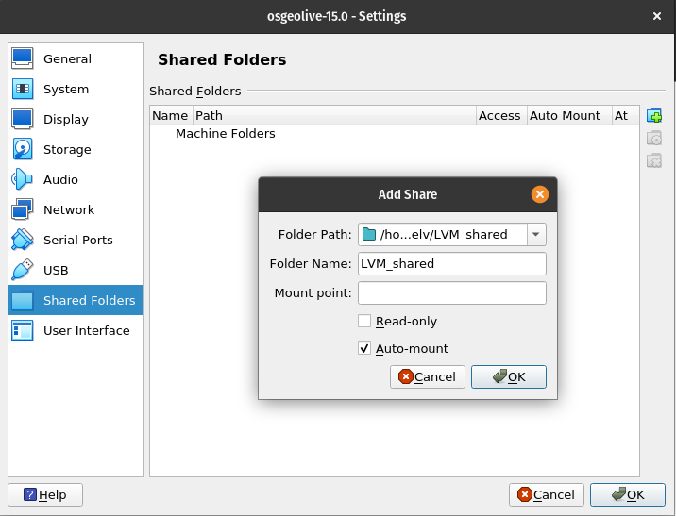
Sharing folder
Add new shared folder in VirtualBox → setting → shared folders →
Navigate to the host OS LVM_shared folder.
Activate the Auto-mount option and click OK

Slide 12
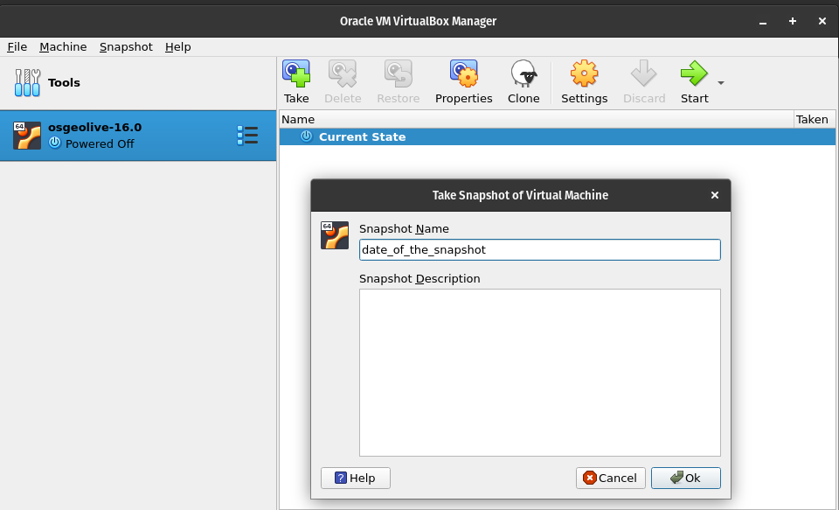
Snapshots
Create a snapshots of the current version. It will be useful for going back if something is not working

Slide 13
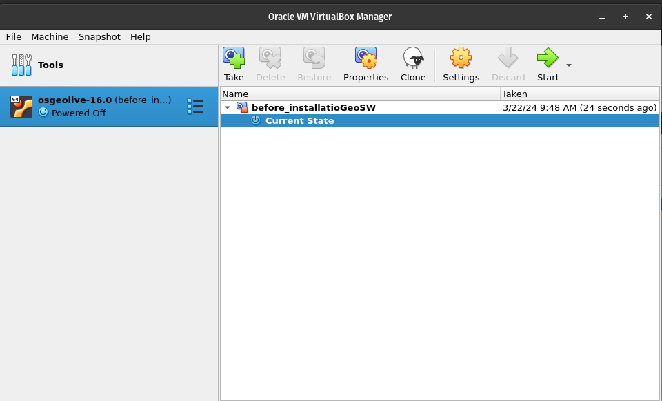
Start the Virtual Machine
At this point you can press the start arrow to boot the Linux Virtual Machine

Slide 14
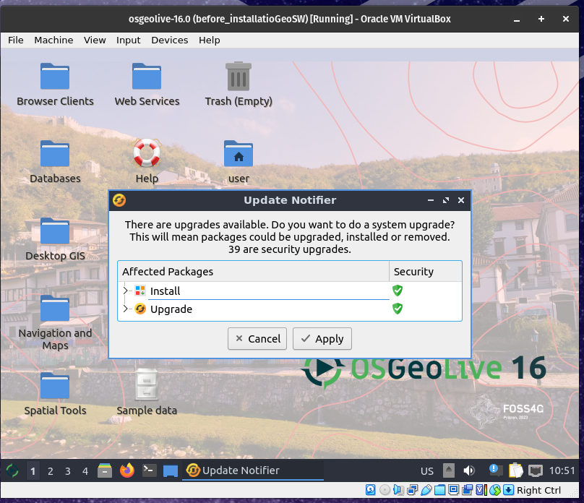
At this point the VM has been properly installed.
Proceed with the update of the OS.
The OS password is: user

Slide 15
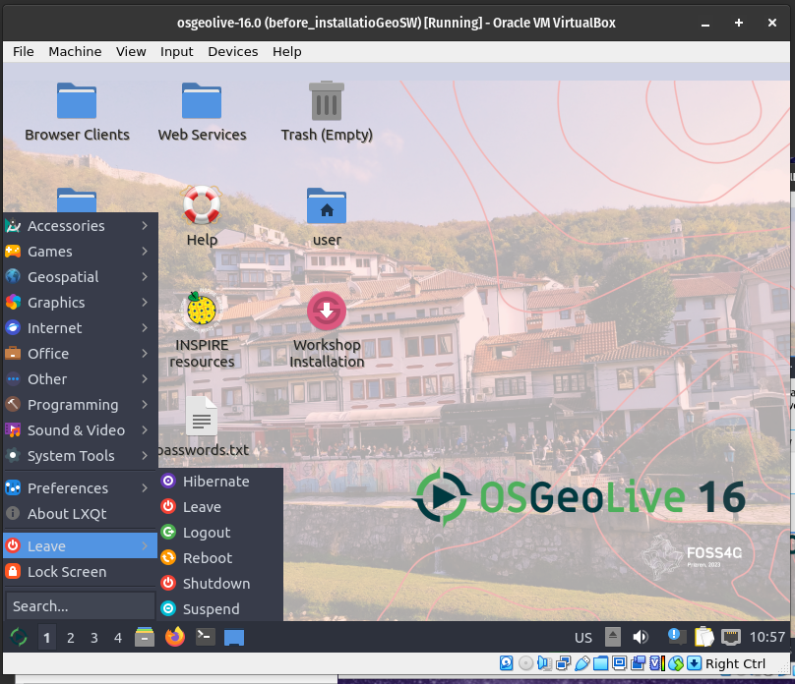
Always shutdown the VM clicking:
Green Icon > Leave > Shutdown

