Slide 1
PACKER
Packer is an open source tool created by Hashicorp that allows you to create machine images or containers for multiple platforms from a single configuration.
This means that you can write your configuration and easily create images that can run on Amazon Web Services, Google Cloud and Azure.
Installing packer
https://releases.hashicorp.com/packer/1.3.2/packer_1.3.2_linux_amd64.zip
Unzip pack file
PACKER FILE
The download will be in the .zip format and contains a single executable binary. After extracting the binary file, I came across a few permission issues with this file.
To overcome these issues and to allow us to call the ‘packer’ command system-wide, we need to move it using the following command:
sudo mv /…/packer /usr/local/bin

Slide 2
CONFIGURATION TEMPLATE
Packer requires a configuration template to create its images or containers, it uses this as its single source of truth. The configuration template is in the JSON format and is made up of multiple sections:
BUILDERS
Code: builders
Required: Yes
The ‘builders’ section tells Packer which builder will be used to create the machine image or template.
An example for AWS would be to use the “amazon-ebs” builder option which creates an Amazon Machine Image (AMI) backed by an EBS volume to be used by an EC2 instance.

Slide 3
DESCRIPTION
Code: description
Required: No
The ‘description’ section allows you to write some information about the Packer template. This information can be seen when the “packer inspect” command is run.
MIN PACKER VERSION
Code: min_packer_version
Required: No
The ‘min_packer_version’ section allows you to specify a minimum version of Packer that can parse the template.
It may be that you have tested your configuration with Packer version 0.12.0, and it works, but there are issues with Packer version 0.11.0, so in this case you can set the minimum version to 0.12.0._version’ section allows you to specify a minimum version of Packer

Slide 4
POST PROCESSORS
Code: post-processors
Required: No
The ‘post-processors’ section allows you to tell Packer what to do after the machine images or containers have been created. The ‘post-processors’ section can be seen as the housekeeping part.
For example, you may need to compress a file
PROVISIONERS
Code: provisioners
Required: No
The ‘provisioners’ section allows you to tell Packer how to provision the machine image or container. An example of a provisioner would be a shell script that updates the system then installs and configures software.

Slide 5
VARIABLES
Code: variables
Required: No
The ‘variables’ section allows you to define variables to be used. An example of this could be creating a variable for your AWS access key and AWS secret key which will be used later by the AWS builder.
{
"variables": {
"aws_access_key": "",
"aws_secret_key": ""
}
}
Packer has checked our config.json file
"builders": [{
"type": "amazon-ebs",
"access_key": "{{user `aws_access_key`}}",
"secret_key": "{{user `aws_secret_key`}}",
"region": "us-east-1",
"source_ami": "ami-fce3c696",
"instance_type": "t2.micro",
"ssh_username": "ubuntu",
"ami_name": "packer-example {{timestamp}}"
}]

Slide 6
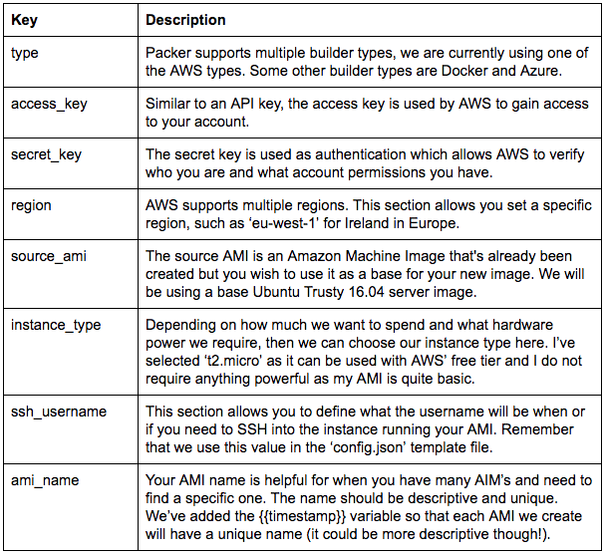

Slide 7
$ packer validate config.json
now we know the configuration template is good to go, so we can actually build our image. We can do this by running the following command;
packer build -var “aws_access_key=[YOUR ACCESS KEY]” -var “aws_secret_key=[YOUR SECRET KEY]” config.json
This command can be broken down into three sections;
We instruct Packer to run its ‘build’ function
We pass two variables into the function using the -var flag followed by the variable name and its value. We set those values earlier in the configuration template.
We finish off the command by telling packer which configuration template we want to use, and in this case it is ‘config.json’.
You will now see some green output in your terminal and see Packer’s step by step process. If everything is successful, then you should see a similar message:

Slide 8

You have successfully built your first machine image using Packer. This is an Amazon machine image to be used with the Amazon Web Services platform.
This image does not really do anything at the moment so let’s add in a provisioner and get our application setup. Add the following provisioners block into your config.json file:
"provisioners": [{
"type": "shell",
"execute_command": "sudo -S bash '{{.Path}}'",
"script": "provision.sh"
}]
packer validate config.json
packer build -var “aws_access_key=[YOUR ACCESS KEY]” -var “aws_secret_key=[YOUR SECRET KEY]” config.json

Slide 9
{
"variables": {
"aws_access_key": "",
"aws_secret_key": ""
},
"builders": [{
"type": "amazon-ebs",
"access_key": "{{user `aws_access_key`}}",
"secret_key": "{{user `aws_secret_key`}}",
"region": "us-east-1",
"source_ami_filter": {
"filters": {
"virtualization-type": "hvm",
"name": "zzzxy",
"root-device-type": "ebs"
},
"owners": ["857954186733"],
"most_recent": true
},
"instance_type": "t2.micro",
"ssh_username": “ec2-user",
“subnet_id” : “”,
"ami_name": "packer-example {{timestamp}}"
}]
}

Slide 10
Buiders with Provisioner Examples
{
"variables": {
"aws_access_key": "",
"aws_secret_key": ""
},
"builders": [{
"type": "amazon-ebs",
"access_key": "{{user `aws_access_key`}}",
"secret_key": "{{user `aws_secret_key`}}",
"region": "us-east-1",
"source_ami_filter": {
"filters": {
"virtualization-type": "hvm",
"name": "dev_kannan_image",
"root-device-type": "ebs"
},
"owners": ["889166750058"],
"most_recent": true
},
"instance_type": "t2.micro",
"ssh_username": "ec2-user",
"ami_name": "packer-example {{timestamp}}"
}],
"provisioners": [
{
"type": "shell-local",
"script":"/home/ec2-user/packer/provisioner.sh"
}
]
}

Slide 11
provisioner.sh
sudo zypper addrepo 'http://download.opensuse.org/tumbleweed/repo/oss/' nodejs
sudo zypper --non-interactive refresh
sudo zypper install -y nodejs

Slide 12
{
"variables": {
"aws_access_key": "",
"aws_secret_key": ""
},
"builders": [{
"type": "amazon-ebs",
"access_key": "{{user `aws_access_key`}}",
"secret_key": "{{user `aws_secret_key`}}",
"region": "us-east-1",
"source_ami_filter": {
"filters": {
"virtualization-type": "hvm",
"name": "GoldenAMI-Dev-Encrypted",
"root-device-type": "ebs"
},
"owners": ["889166750058"],
"most_recent": true
},
"instance_type": "t2.micro",
"ssh_username": "ec2-user",
"ami_name": "packer-example {{timestamp}}"
}],
"provisioners": [
{
"type": "shell",
"inline": [
"echo 'Ensure updates, patches, and additional security software are installed'",
"sleep 30",
"sudo zypper install -y unzip"
]
}
]
}

Slide 13
Packer with Terraform Integration
Pack.json
{
"variables": {
"aws_access_key": "",
"aws_secret_key": ""
},
"builders": [{
"type": "amazon-ebs",
"access_key": "{{user `aws_access_key`}}",
"secret_key": "{{user `aws_secret_key`}}",
"region": "us-east-1",
"source_ami_filter": {
"filters": {
"virtualization-type": "hvm",
"name": "terraformAmi",
"root-device-type": "ebs"
},
"owners": ["063223919194"],
"most_recent": true
},
"instance_type": "t2.micro",
"ssh_username": "ec2-user",
"ami_name": "packer-example {{timestamp}}"
}],
"provisioners": [
{
"type": "shell",
"inline": [
"echo 'Ensure updates, patches, and additional security software are installed'",
"sleep 30",
"sudo yum install -y unzip"
]
}
]
}

Slide 14
instance.tf
provider "aws" {
region = "us-east-1"
}
data "aws_ami" "bastion" {
filter {
name = "state"
values = ["available"]
}
filter {
name = "tag:Name"
values = ["terraformAmi"]
}
most_recent = true
}
resource "aws_instance" "bastion" {
ami = "${data.aws_ami.bastion.id}"
key_name = "terraformpackers"
instance_type = "t2.micro"
associate_public_ip_address = true
}
terraform-pack.sh
#!/bin/bash
PACKER_LOG=1 packer build -machine-readable pack.json | tee packbuild.log
terraform init
terraform validate
terraform plan
terraform apply

Slide 15
Packer Commands
$ packer – fix packer.json > packer-new.json → fixes templates from old versions of packer
packer fix command takes a template and finds backwards incompatible parts of it and brings it up to date so it can be used with the latest version of Packer. After you update to a new Packer release, you should run the fix command to make sure your templates work with the new release.
$ packer inspect packer.json → see components of a template
packer inspect → command takes a template and outputs the various components a template defines.
$ PACKER_LOG=1 packer validate packer.json
$ PACKER_LOG=1 packer build packer.json

Slide 16
Reference Urls
https://www.packer.io
https://www.youtube.com/watch?v=jdDKjWZ2qbk
Docker-bench-security is inspired by CIS
Github.com/docker/docker-bench-security

