Slide 1
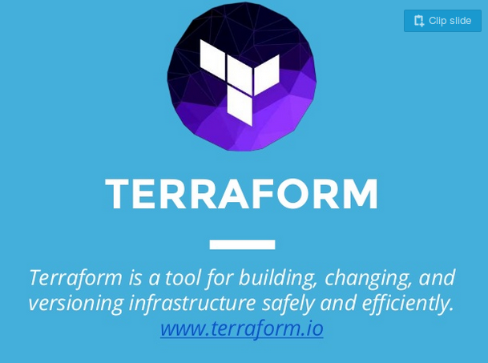
Terraform

Slide 2
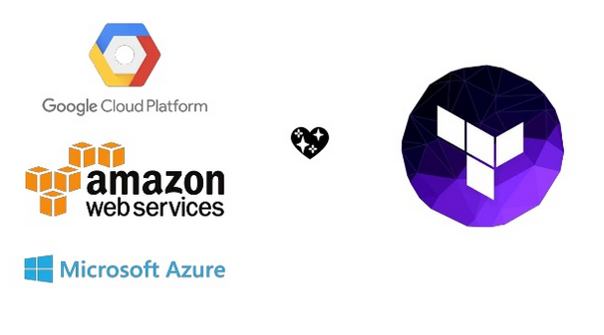

Slide 3
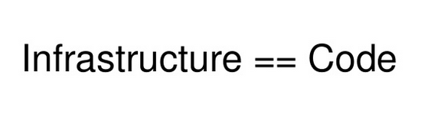

Slide 4
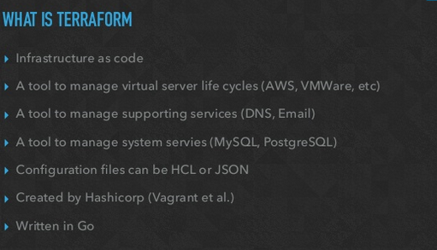

Slide 5
Terraform Commands ( CLI )
terraform init
terraform validate
terraform plan
terraform apply
terraform show
terraform refresh
terraform import
terraform fmt
terraform destory

Slide 6
Import
Terraform is able to import existing infrastructure
The current implementation of Terraform import can only import resources into the state. It does not generate configuration. A future version of Terraform will also generate configuration. ( current State only ).
State
This state is stored by default in a local file named "terraform.tfstate", but it can also be stored remotely, which works better in a team environment. Terraform must store state about your managed infrastructure and configuration.
Provider
A provider is responsible for understanding API interactions and exposing resources. Providers generally are an IaaS (e.g. AWS, GCP, Microsoft Azure, OpenStack), PaaS (e.g. Heroku), or SaaS services (e.g. Terraform Enterprise, DNSimple, CloudFlare).
Provisioners
Provisioners are used to execute scripts on a local or remote machine as part of resource creation or destruction.
resource "aws_instance" "web" {
# ... provisioner "local-exec"
{
command = "echo ${self.private_ip} > file.txt“
} }

Slide 7
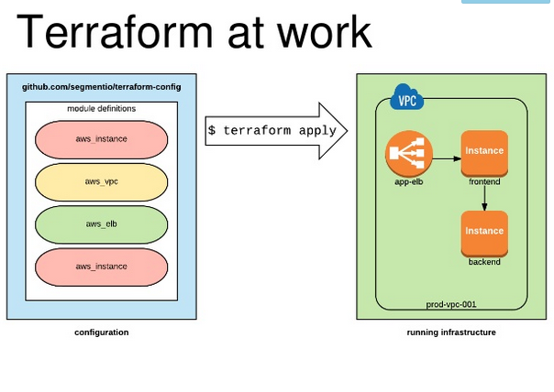

Slide 8
Modules
Modules in Terraform are self-contained packages of Terraform configurations that are managed as a group.
Modules are used to create reusable components in Terraform as well as for basic code organization
Plugins
Terraform is built on a plugin-based architecture.
All providers and provisioners that are used in Terraform configurations are plugins, even the core types such as AWS and Heroku.
Users of Terraform are able to write new plugins in order to support new functionality in Terraform

Slide 9
Advantages
Advantages
Advantages
Advantages
Formatting – This is far and away the strongest advantage of Terraform.
JSON is not a coding language, and it shows. It’s common for CFTs to be 3000 lines long, and most of that is just JSON braces and bracket
Managing State
Multi-Provider Support – Depending on how you utilize AWS and other providers, this can be a very big deal. Terraform gives you a centralized location to manage multiple providers.
Short learning curve – While they did introduce custom formatting for Terraform templates, the CFT and API nomenclature is *mostly* preserved.
Open Source – The general terraform tool is open source, which brings all the good and bad to the table that you normally associate with open source.
Disadvantages
Cost – The free version of Terraform is free, but the enterprise version is expensive.
No Rollback – Rolling back a CFT deployment or upgrade is sometimes a blessing and sometimes a curse, but with CFT at least you have an option.

Slide 10


Slide 11
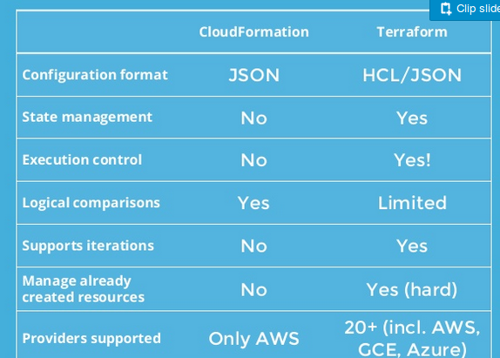

Slide 12
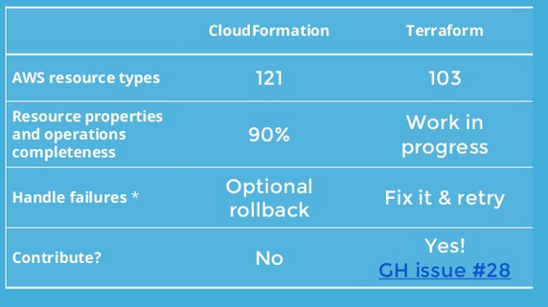

Slide 13
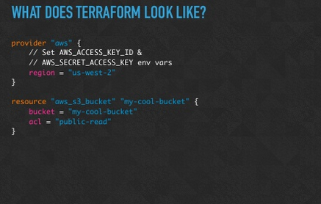

Slide 14
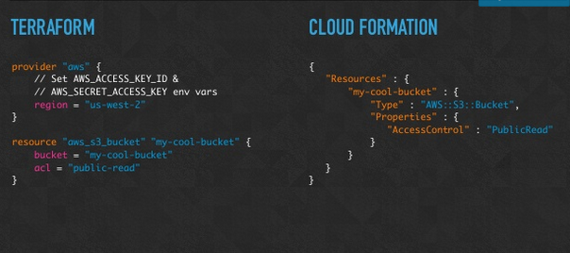

Slide 15
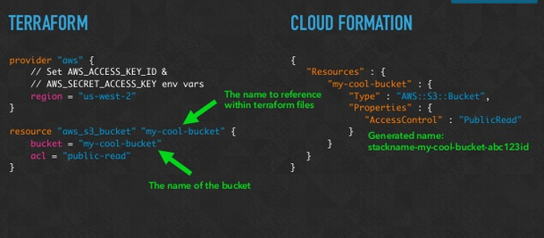

Slide 16
Terraform Commands
terraform init
terraform validate
terraform plan
terraform apply
terraform show
terraform refresh
terraform import
terraform fmt
terraform destory

Slide 17
Terraform Commands
sudo yum install -y zip unzip
wget https://releases.hashicorp.com/terraform/0.11.8/terraform_0.11.8_linux_amd64.zip
unzip terraform_0.9.8_linux_amd64.zip
sudo mv terraform /usr/local/bin/
Confirm terraform binary is accessible: terraform --version

