Slide 1
Stock inventory application
TASK 3

Slide 2
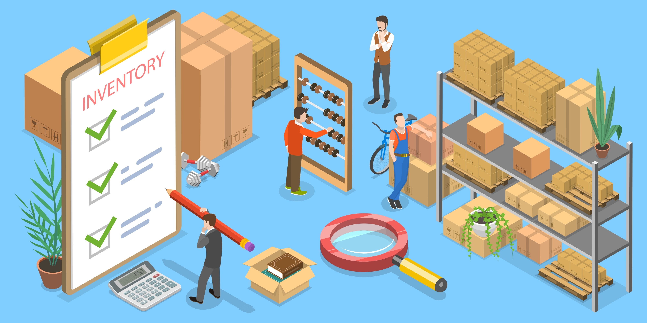
STOCK INVENTORY APPLICATION
LMS NUM | NAME | BATCH
au910420104024 | N.RAGHUL | NM_0.2 CC3
au910420104029 | S.SELVAKUMAR | NM_0.2 CC3
au910420104034 | S.SYED KASIM | NM_0.2 CC3

Slide 3
Task - 3
Creation of Interactive front end
Creation of a reactive front end using react
Evaluation Metric:
100% Completion of the above tasks
Learning Outcomes:
Creating intreactive front end

Slide 4
Step Wise Description:
Create a html page for portfolio website
Write a css file for styling
Add necessary contents
Summary of your task:
Html page is created, css file is written for styling, interactive front end is created

Slide 5
GIT HUB LINK:
https://github.com/selvakumar4458p/Java-with-Fullstack-NM/tree/main/Task_3

Slide 6


