Slide 1
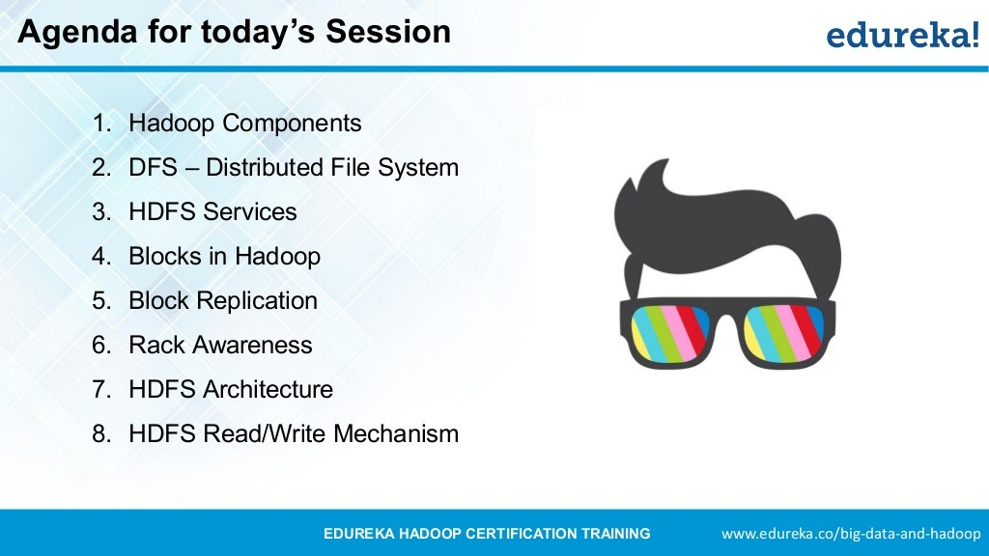


Slide 2


Slide 3


Slide 4
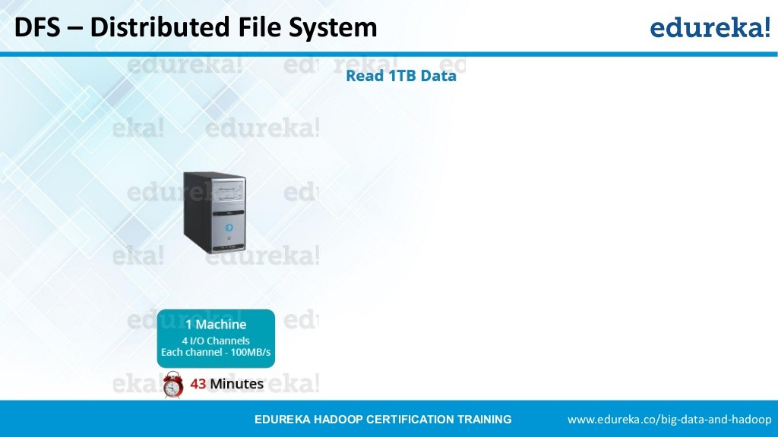

Slide 5
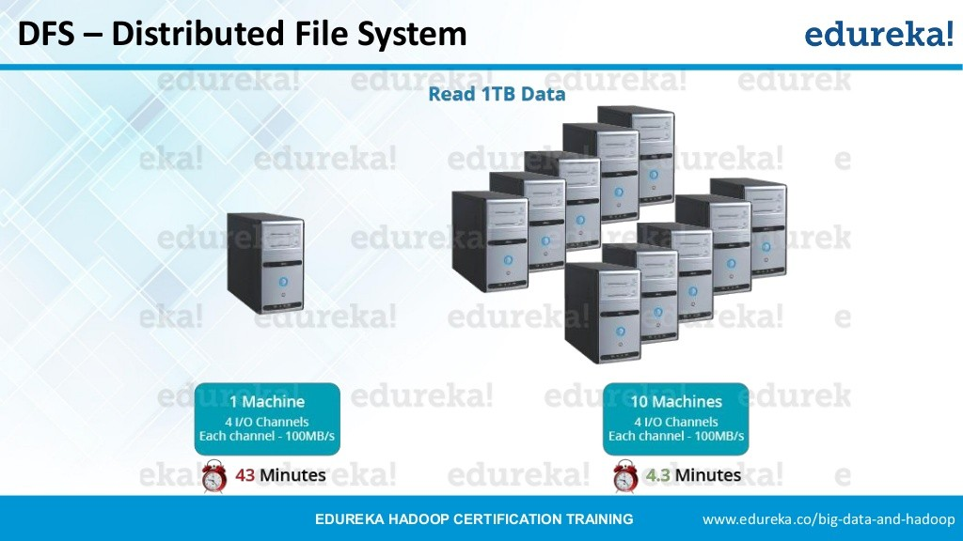

Slide 6
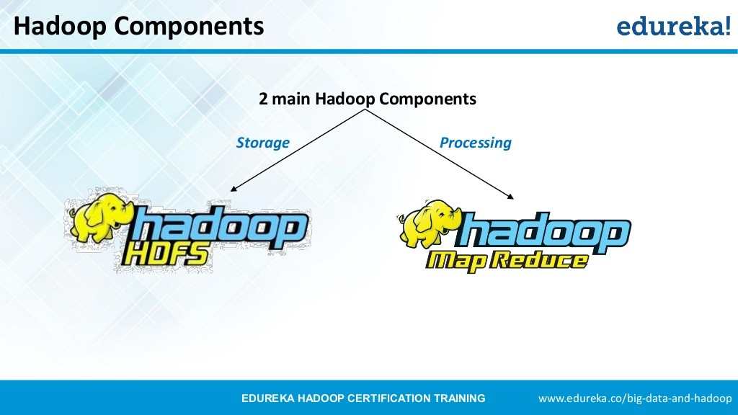

Slide 7
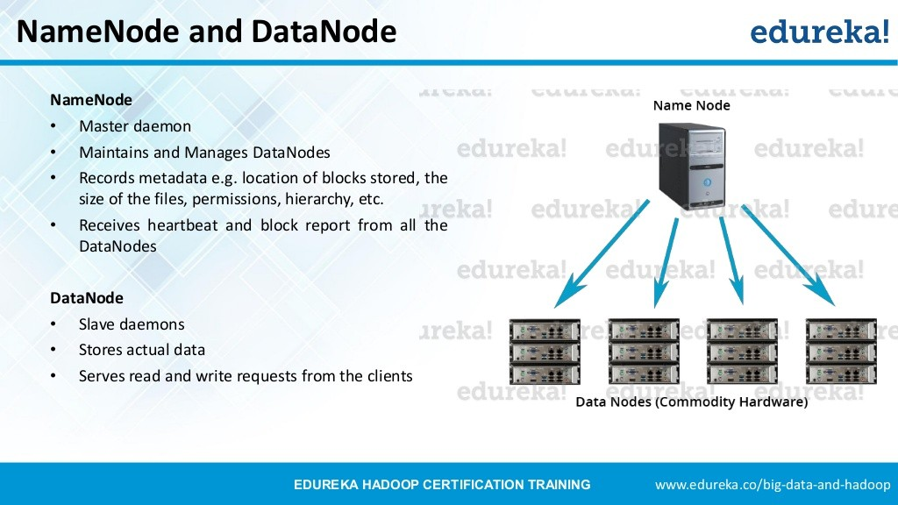

Slide 8


Slide 9
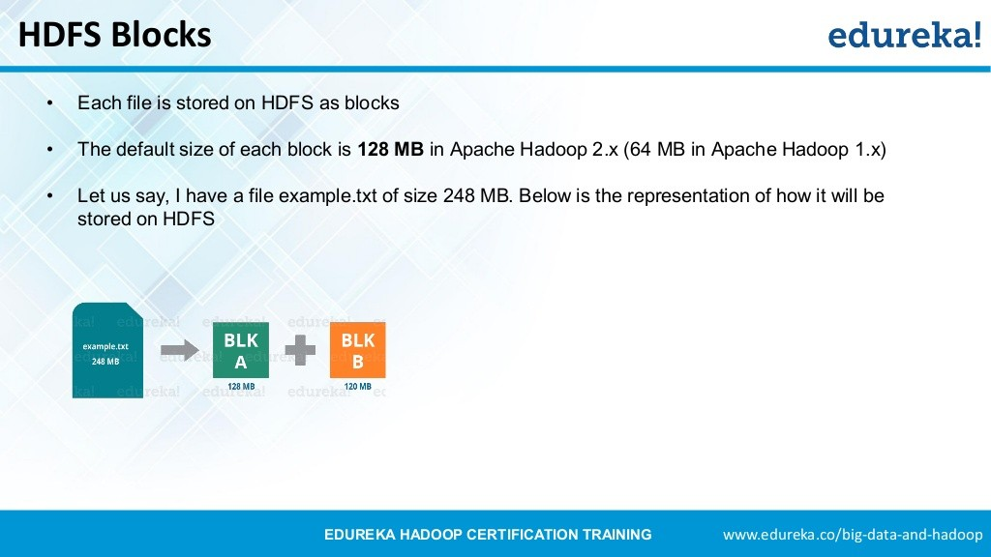

Slide 10
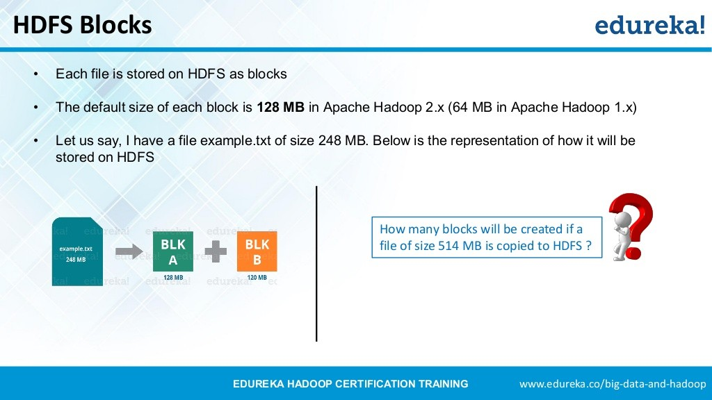

Slide 11
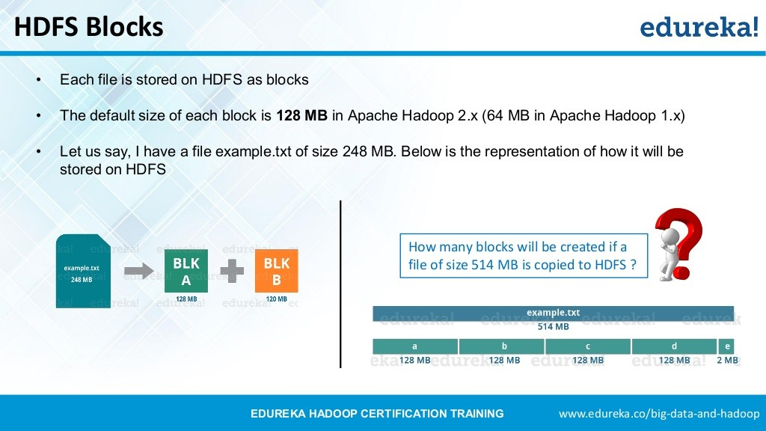

Slide 12


Slide 13
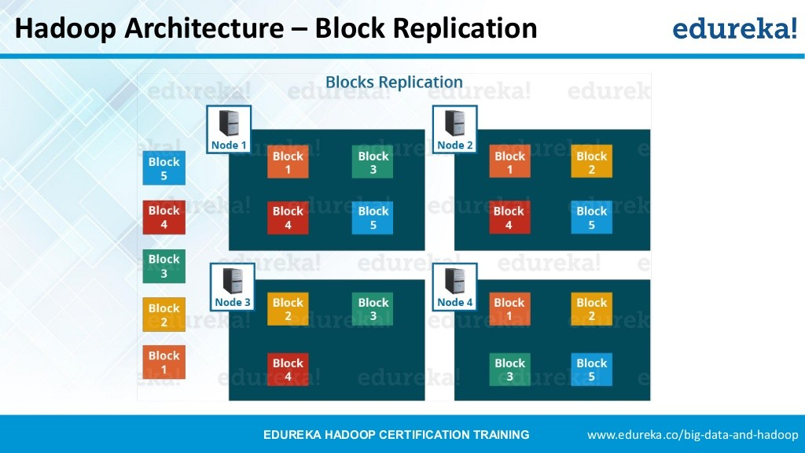

Slide 14


Slide 15
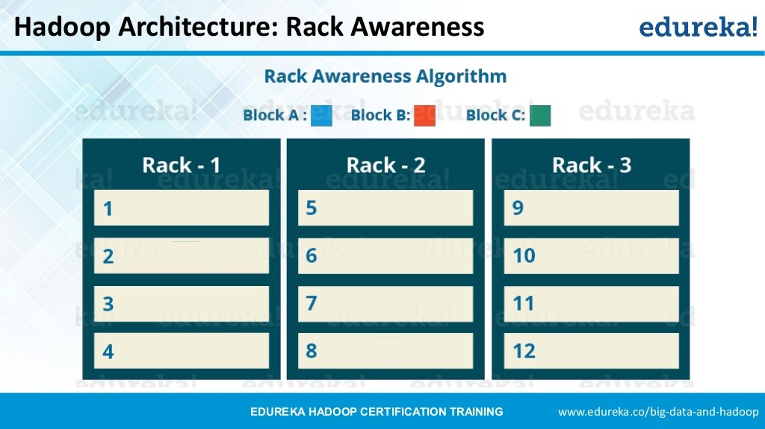

Slide 16
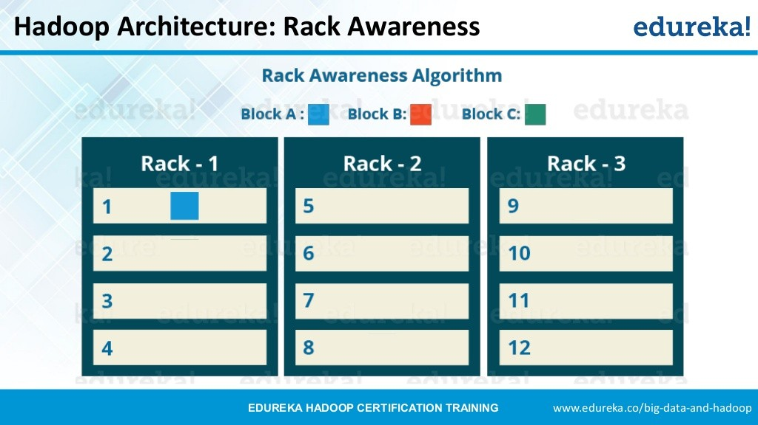

Slide 17
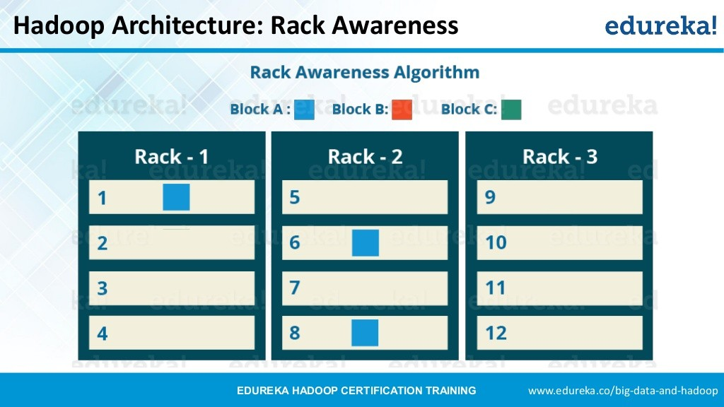

Slide 18
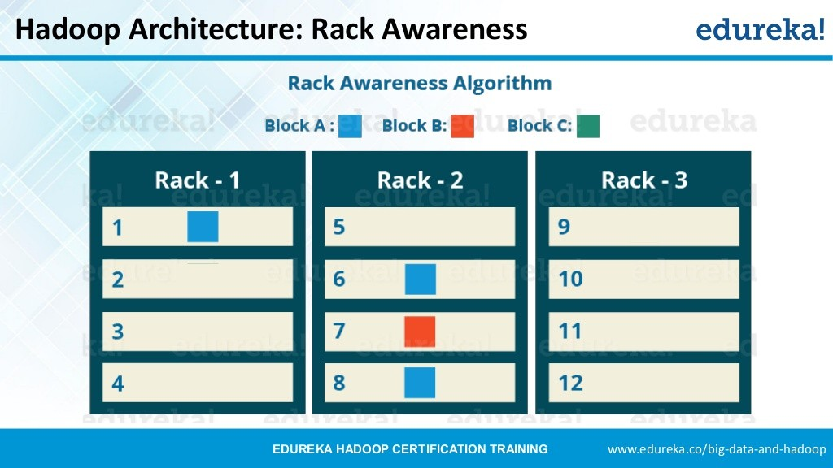

Slide 19
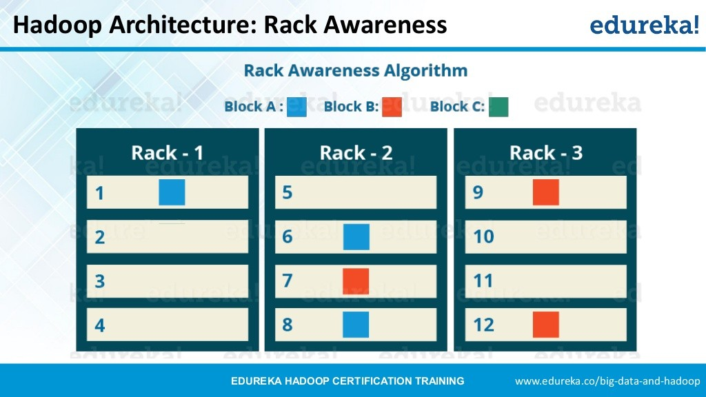

Slide 20
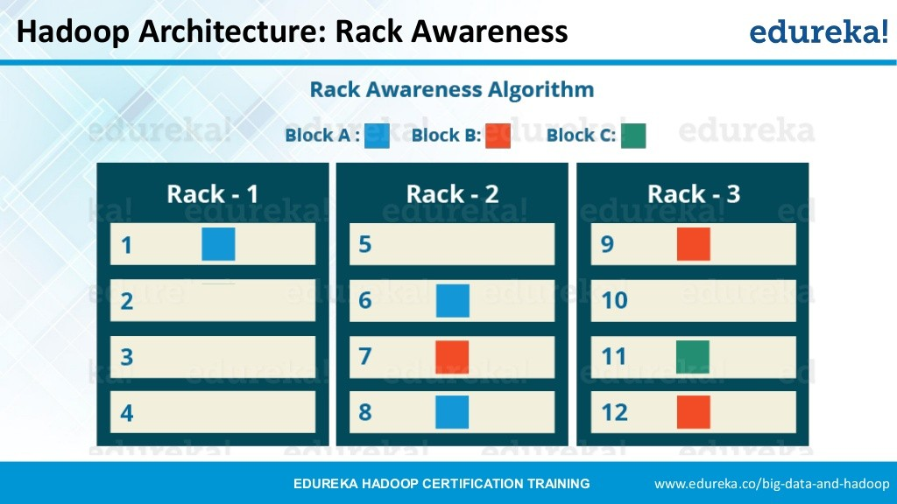

Slide 21
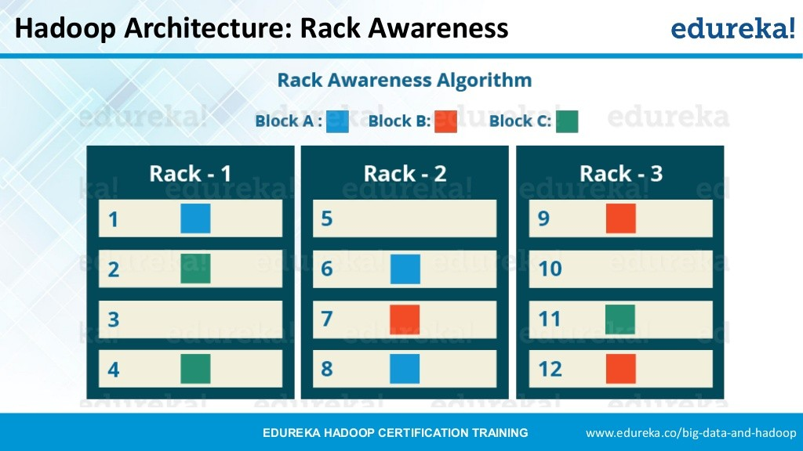

Slide 22


Slide 23
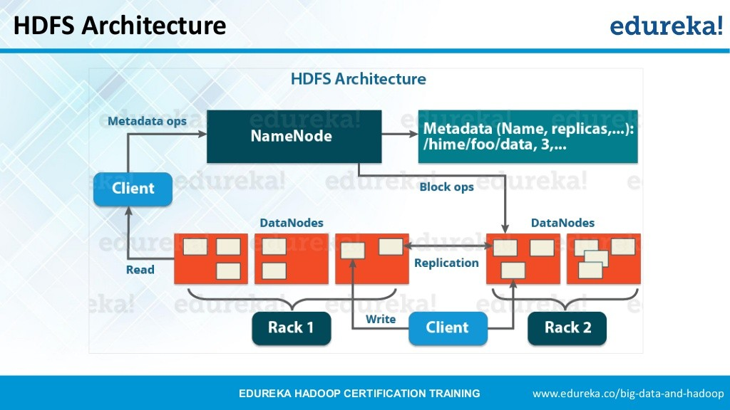

Slide 24


Slide 25
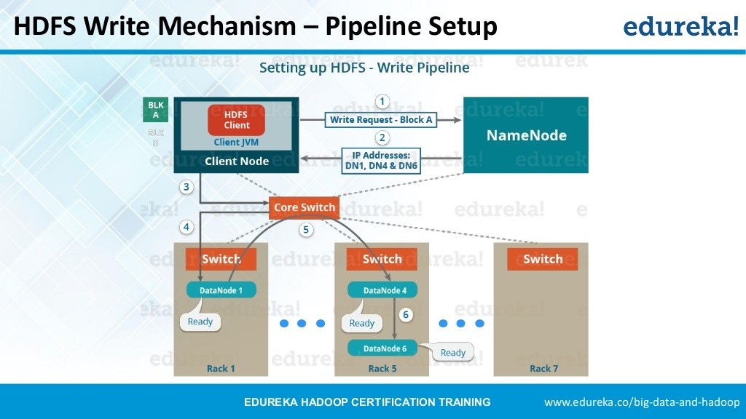

Slide 26
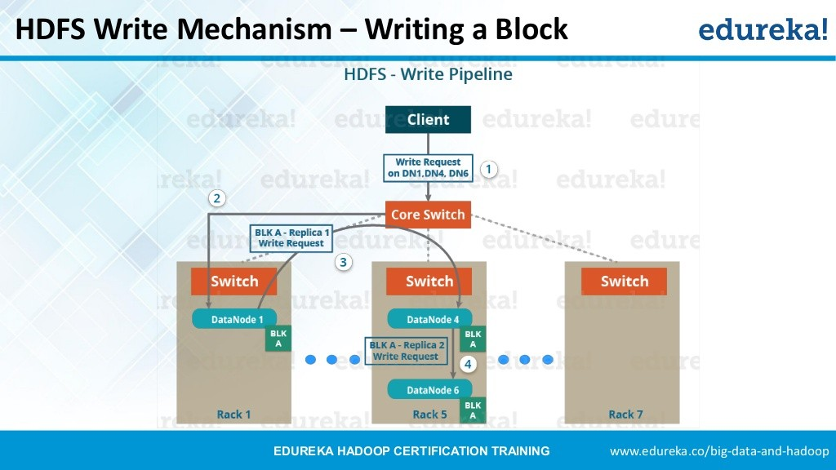

Slide 27
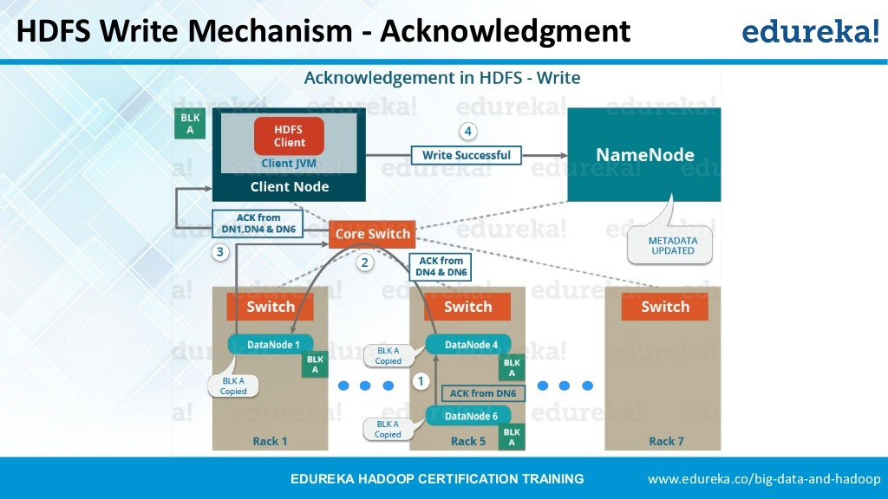

Slide 28
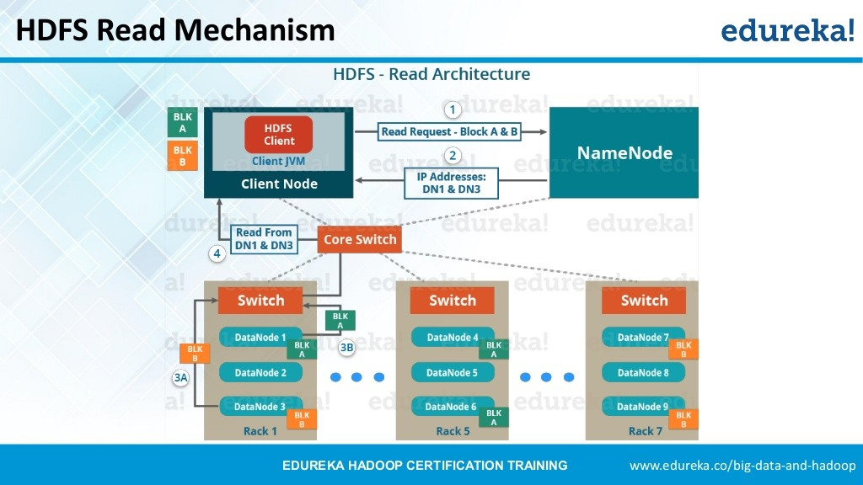

Slide 29
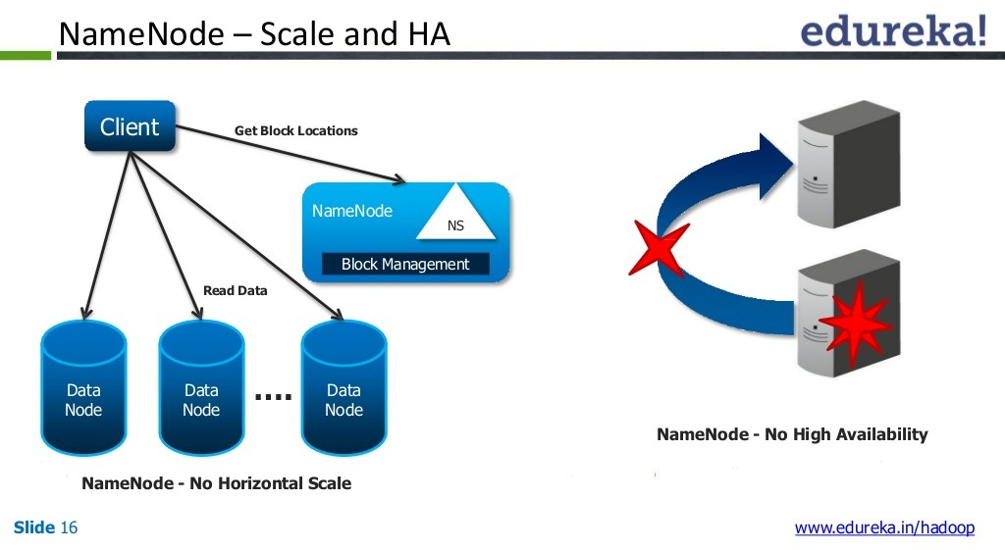

Slide 30
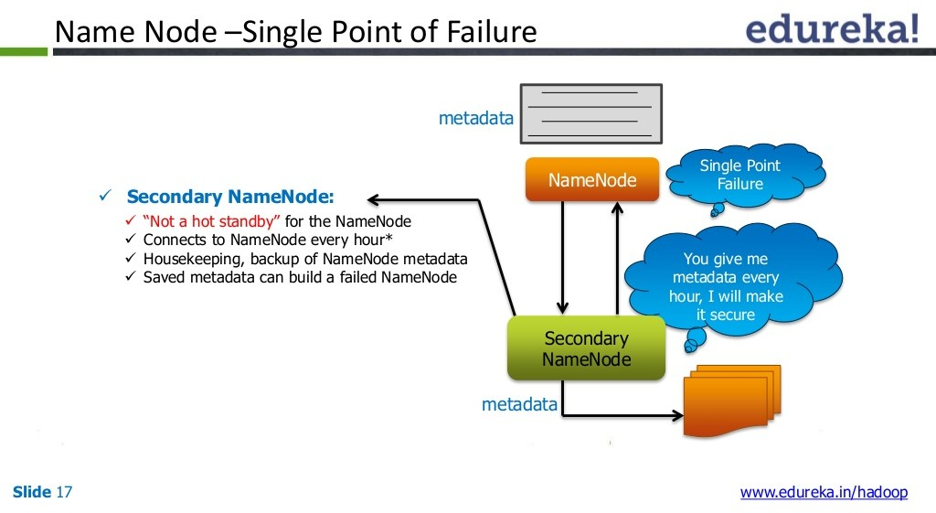

Slide 31
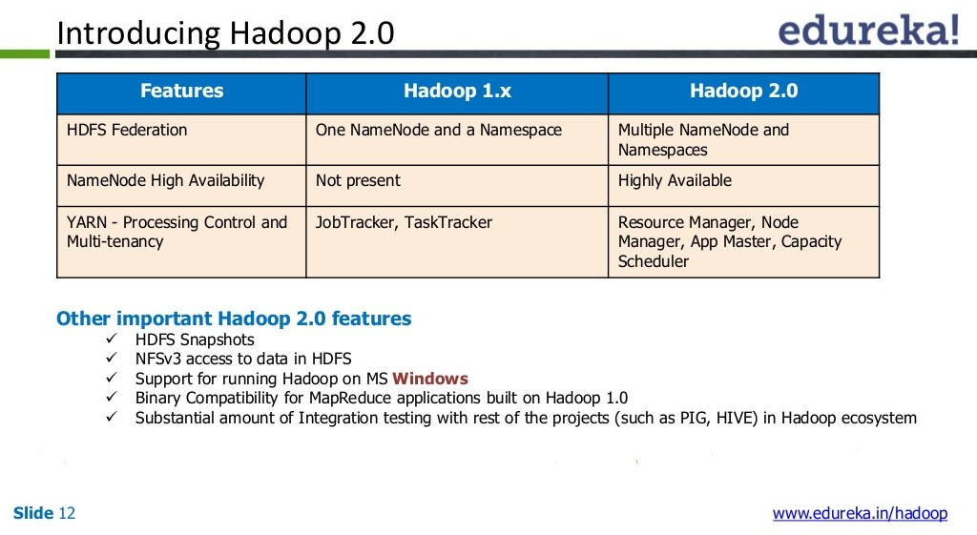

Slide 32
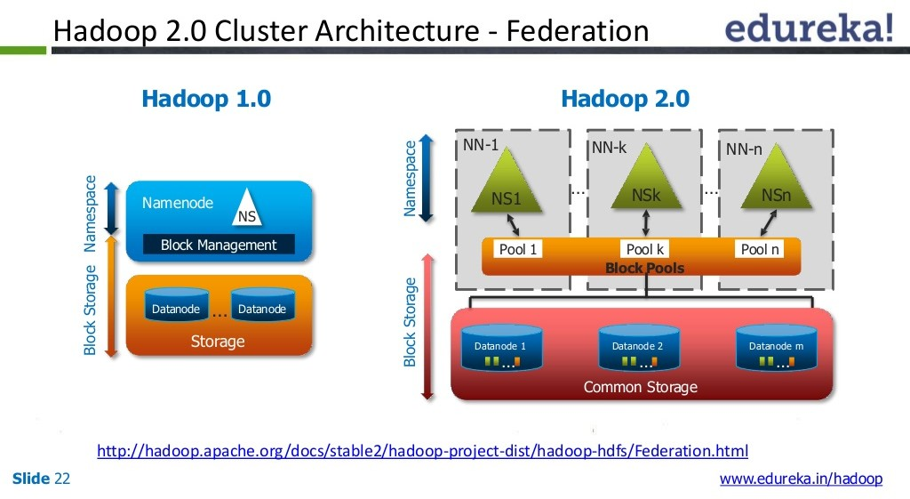

Slide 33
Metadata – Metadata consists of file name, creation date, file block locations, permission etc.
Namespace– It consists of files, directories and file block locations. Namespace operation are creation of files, deletion of files, renaming of files, listing of files etc. It maintain at NameNode. Suppose we have two machines acting as namenodes as first namenode (NN1) handles all files under namespace /finance, ie all data of finance department. Similarly second namenode(NN2) handles data of accounts department under namespace /accounts.
Block Management – It manages file blocks stored in DataNodes. It perform block addition, block deletion, listing of blocks, block replication etc. Also all DataNodes are registered here. It maintain at NameNode.
Block Storage – It stores all physical file blocks. Block storage maintain at DataNode.
Block Pool – A Block Pool is a set of blocks that belong to a single namespace. Each DataNode store all the block pools for all NameNodes in the cluster. Each Block Pool is managed independently. This allows a namespace to generate Block IDs for new blocks without the need for coordination with the other namespaces. A NameNode failure does not prevent the DataNode from serving other NameNodes in the cluster.

Slide 34
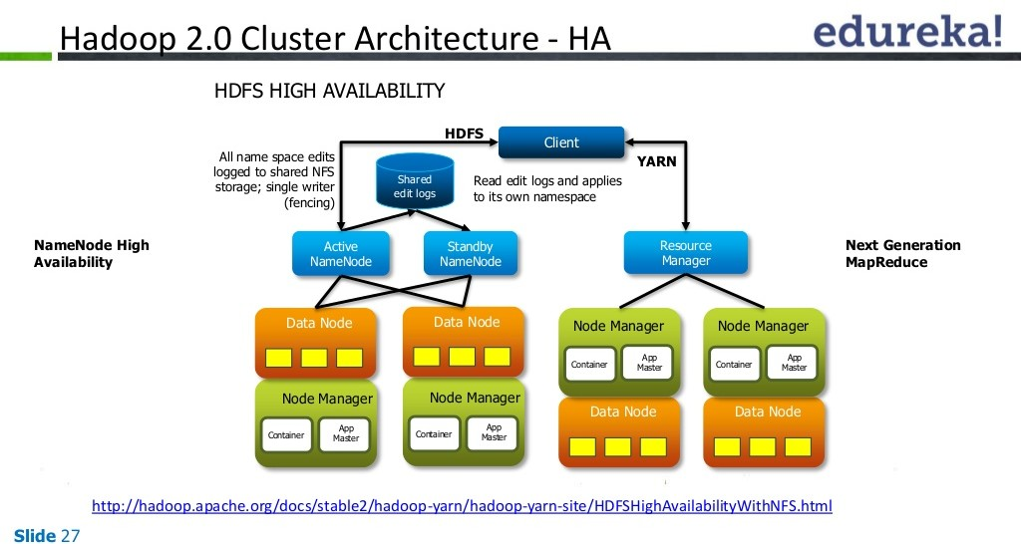

Slide 35
