Slide 1



DESIGN AND IMPLEMENTATION OF AN AUTOMATED SORTING SYSTEM USING MECHATRONICS PRINCIPLES
DEPARTMENT OF ELECTRONICS AND COMMUNICATION ENGINEERING
PRESENTED BY
THARUNKUMAR S
SIVANESAN S
SELVAKUMAR C
GUIDED BY
Dr.K.KAVIN KUMAR
AP(Sr.G)/ECE

Slide 2
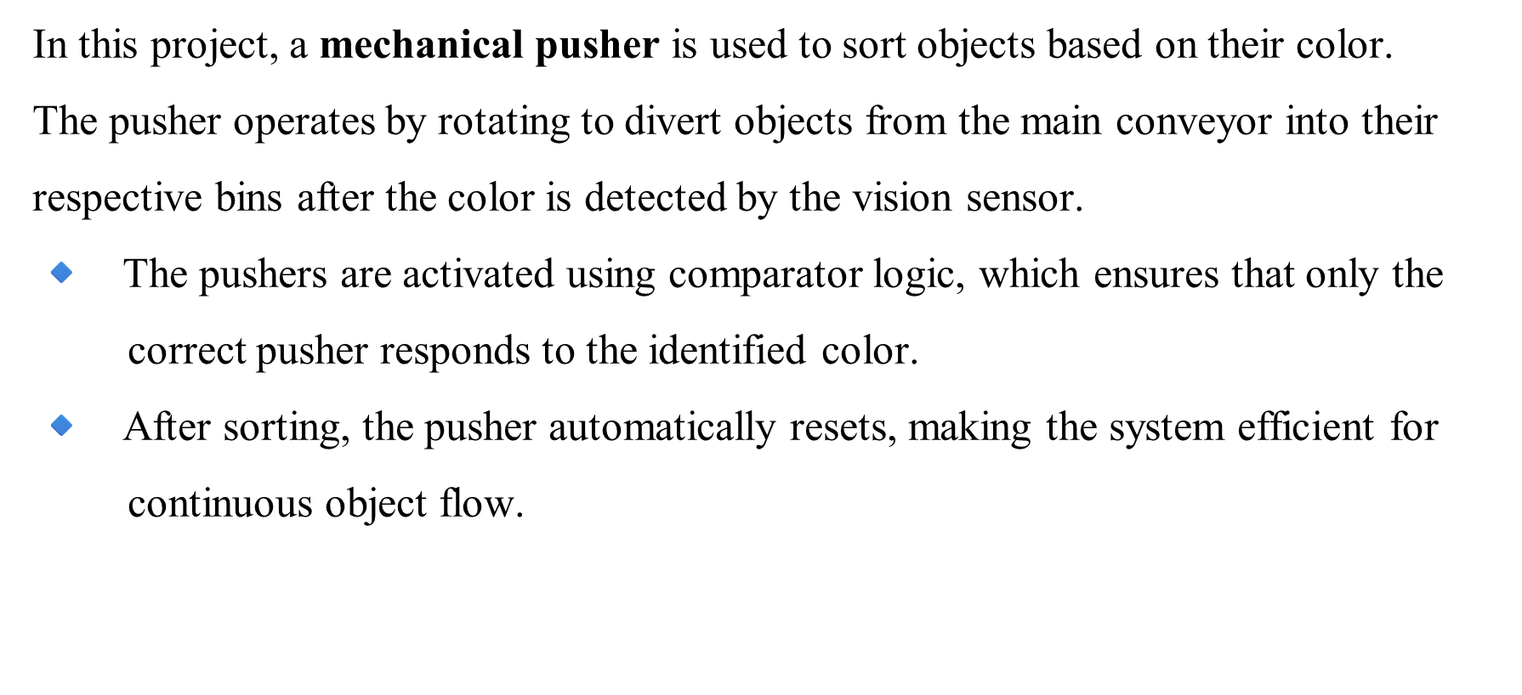
INTRODUCTION

Slide 3
PROBLEM STATEMENT
Manual object sorting based on color is inefficient and prone to human error in fast-paced industrial set-ups. It slows down production, requires constant supervision, and cannot maintain accuracy during continuous operation.
A system is needed that can detect object color, process the data logically, and activate sorting mechanisms without manual involvement.
Such a system must ensure high accuracy, low latency, and minimal complexity while working continuously.

Slide 4
OBJECTIVE
The objective of this project is to design and implement an automated color-based object sorting system using vision sensors and logical control through Factory I/O and Control I/O. The system aims to accurately identify objects of different colors and activate pushers to sort them into their respective categories. This eliminates manual intervention, increases sorting efficiency, and reduces error in industrial environments.

Slide 5
EXISTING METHOD
Traditional sorting systems rely on manual labor or basic sensors like proximity or capacitive sensors that only detect the presence of objects, not their color.
These systems are not capable of distinguishing between different colored items, limiting their use in advanced sorting operations.
Advanced systems may use external image processing units, but they increase cost, complexity, and require longer setup times.
Manual or semi-automated systems are prone to human errors and are inefficient for fast-paced, continuous industrial environments.

Slide 6
PROPOSED METHOD
Vision sensors are used to detect and classify objects on a conveyor belt based on their color (blue, green, or white).
Comparator blocks convert the vision sensor outputs into control signals to activate specific pneumatic pushers for sorting.
Logic circuits using SR latches and gates manage the activation and deactivation of pushers to ensure accurate object placement.
A second vision sensor resets the system once the object has passed, allowing continuous and automated sorting.

Slide 7
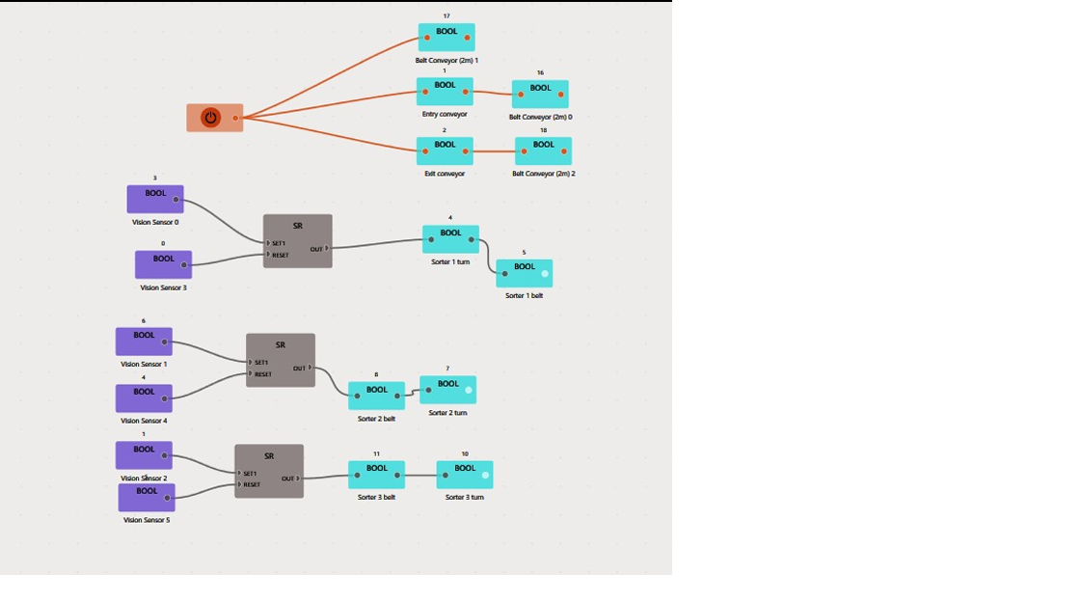
PROPOSED BLOCK DIAGRAM

Slide 8
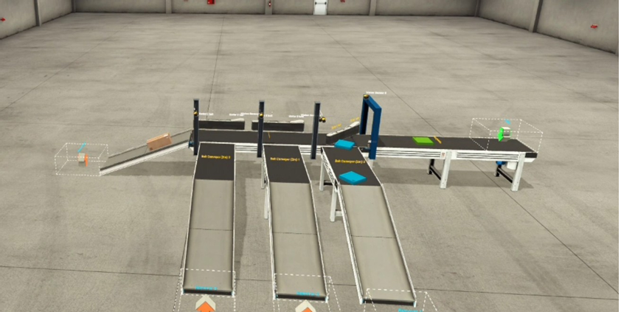
OUTPUT
When a blue object is detected by the first vision sensor, a control signal is generated which activates the corresponding pusher mechanism, diverting the blue object onto its designated conveyor path for accurate sorting.

Slide 9
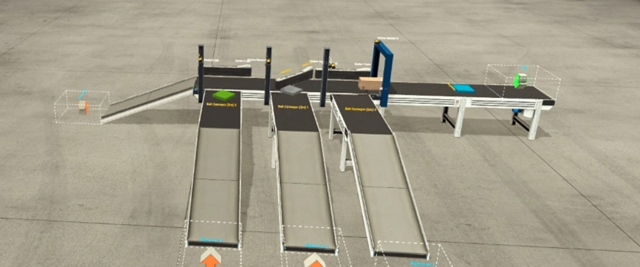
OUTPUT
Upon detection of a white object by the vision sensor, the system triggers the designated pusher, which promptly redirects the object to its assigned conveyor belt, ensuring precise and efficient color-based sorting.

Slide 10
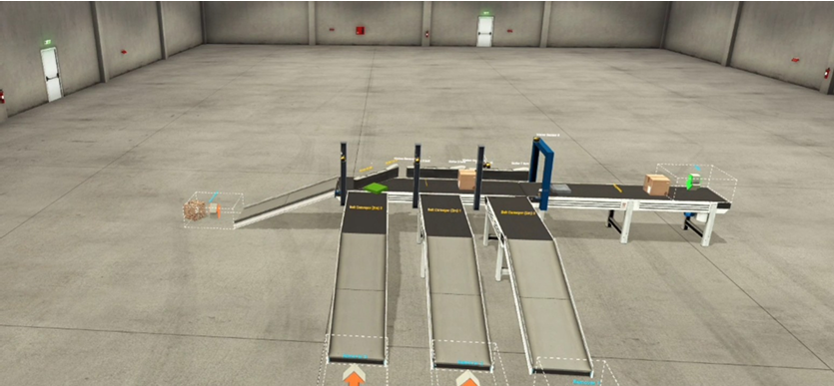
OUTPUT
When a green object is detected by the vision sensor, the comparator validates the color code and activates the corresponding pusher. This action accurately diverts the green object to its dedicated section, maintaining organized and efficient sorting across the conveyor system.

Slide 11
THANK YOU

