Slide 1
Concurrency using Active Objects Architectural Pattern

Slide 2
Architectural Pattern vs Design Patterns
Architectural Patterns^{[1]}
Design Patterns^{[1]}
An architectural pattern expresses a fundamental structural organization schema for software systems. It provides a set of predefined subsystems, specifies their responsibilities, and includes rules and guidelines for organizing the relationships between them
Eg- MVC, Layers pattern, Microkernel pattern
A design pattern provides a scheme for refining the subsystems or components of a software system, or the relationships between them. It describes a commonly-recurring structure of communication components that solves a general design problem within a particular context.
Eg- Observer, Command, Factory, Singleton
Active Object is an Architectural
Pattern

Slide 3
Let Us Do A System Design

Slide 4
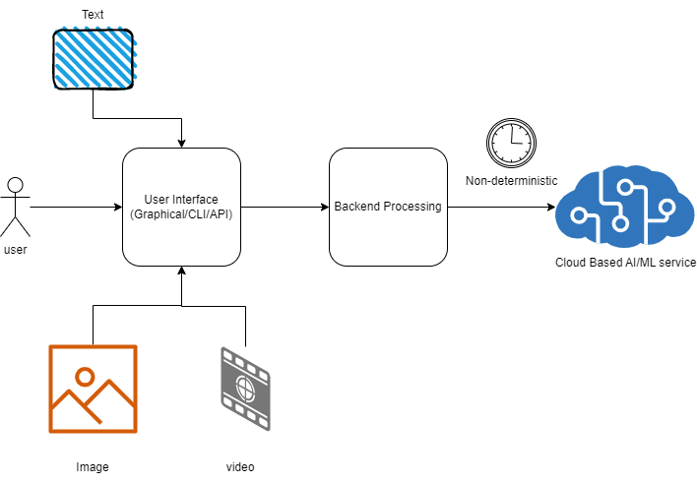

Slide 5
Design Challenge
UI facing thread cannot block
The AI/ML service response times are unpredictable
Backend and the UI threads can have multiple threads
Easy to program and understand the design
Adhere to SOLID principles

Slide 6

Active Object Architectural Pattern
The Active Object design pattern decouples method execution from method invocation to enhance concurrency and simplify synchronized access to objects that reside in their own threads of control.

Slide 7
Method invocation should occur in the client’s thread of control, whereas method execution should occur in a separate thread. Moreover, design the decoupling so the client thread appears to invoke an ordinary method.

Slide 8
Components Involved in Active Object Design
Proxy
Provides Interface to users
Command Request Interface
Defines methods, which commands should implement
Concrete Command
Implements the specific command
Activation List
Scheduler
Executer
Future
Create Command Request
Maintains Command requests which are pending for execution
Examines activation list and schedules the commands ready for execution
Implements and Runs the Command request Object.
Holds the result of execution.
Provides rendezvous point to the client

Slide 9
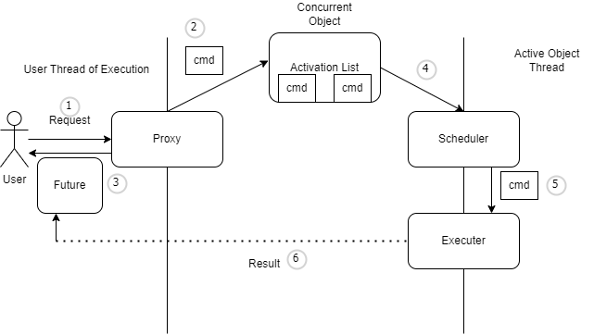
Active Object Dynamics

Slide 10
Observations
Only one Concurrent Object – Activation list
Clear separation of Concerns- Single Responsibility Principle
Easy to Understand and maintain
Can be extended and customized for different needs.

Slide 11
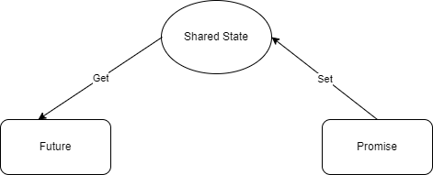
Promise and Future

Slide 13
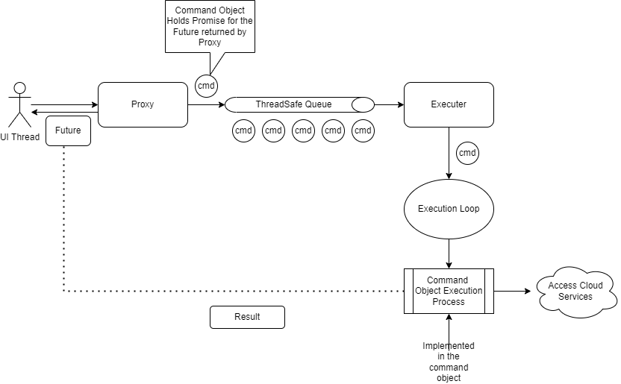
Our System Design

Slide 14
struct CommandInterface {
virtual std::future<Result> GetFuture() = 0;
virtual void Execute() = 0;
virtual ~CommandInterface() = default;
};
struct Result {
std::string data;
bool valid = false;
std::string err_reason;
};

Slide 15
struct CommandInterface {
virtual std::future<Result> GetFuture() = 0;
virtual void Execute() = 0;
virtual ~CommandInterface() = default;
};
class RecommendationCmd : public CommandInterface {
public:
explicit RecommendationCmd(std::string inp) :
input(std::move(inp)){}
std::future<Result> GetFuture() override;
void Execute() override;
private:
// Some other methods and data to help generate the results.
std::promise<Result> async_result;
std::string input;
};

Slide 16
template <typename T>
class ConcurrentQueue {
public:
void enqueue(T data) noexcept
{
std::lock_guard<std::mutex> guard(mtx);
queue.push(std::move(data));
}
std::optional<T> dequeue() noexcept
{
std::lock_guard<std::mutex> guard(mtx);
if (queue.empty()) {
return std::nullopt;
}
auto data = std::move(queue.front());
queue.pop();
return data;
}
private:
std::queue<T> queue;
std::mutex mtx;
};

Slide 17
using CommandQ = ConcurrentQueue<std::unique_ptr<CommandInterface>>;
using AsyncResult = std::future<Result>;
using CommandExecutor = Executor<std::unique_ptr<CommandInterface>>;
class Proxy
{
public:
Proxy();
AsyncResult GetPrediction(std::string inp_data);
AsyncResult GetRecommendation(std::string inp_data);
~Proxy();
private:
CommandQ cmd_q;
std::atomic<bool> running;
CommandExecutor executor;
std::thread executor_task;
};

Slide 18
Proxy::Proxy() :
running(true),
executor(cmd_q, running)
{
executor_task = std::thread(&CommandExecutor::Run, &executor);
}
AsyncResult Proxy::GetPrediction(std::string inp_data)
{
auto prediction_cmd = std::make_unique<PredictionCmd>(std::move(inp_data));
AsyncResult result = prediction_cmd->GetFuture();
cmd_q.enqueue(std::move(prediction_cmd));
return result;
}
Proxy::~Proxy()
{
running = false;
if (executor_task.joinable())
{
executor_task.join();
}
}

Slide 19
template<typename T>
class Executor
{
void Run() {
while(keep_running) {
std::optional<T> cmd_opt = queue_ref.dequeue();
if (!cmd_opt.has_value()) {
using namespace std::chrono_literals;
std::this_thread::sleep_for(5ms);
continue;
}
auto cmd = std::move(cmd_opt.value());
if constexpr (std::is_pointer<T>::value || is_smart_ptr<T>::value) {
cmd->Execute();
} else {
cmd.Execute();
}
}
}
private:
ConcurrentQueue<T>& queue_ref;
std::atomic<bool>& keep_running;
};

Slide 20
int main()
{
active_object::Proxy client_proxy;
auto result_future = client_proxy.GetPrediction("Some Input");
auto result = result_future.get(); // This Blocks
std::cout << "Result = " << result.data << '\n';
return 0;
}

Slide 21
Some Improvements
Can have a better concurrent Queue
Use thread pool for execution if needed.
Use Activation List and Scheduler if needed
USE CRTP or Type ERASURE FOR COMMAND INTERFACE

Slide 22
Extending the Design
Add new commands
Add API in Proxy for the new commands

Slide 23
Links
https://www.oreilly.com/library/view/pattern-oriented-software-architecture/9781118725177/
https://github.com/selvakumarjawahar/active_object

Slide 24
Thank You

