Slide 1
Exploratory Data Analysis
Laptop DATASET
Name :K.Selvalakshmi
Data analytics and data science
Batch number:4
Online
Milestone 1
Date 22/7/2024

Slide 2
Indroduction: The project contains data cleaning,preprocessing and analyse the dataset
Tasks :
1. Data Cleaning and Preprocessing
2. Exploratory Data Analysis (EDA)
3. Visualization
4. Feature Engineering
5. Analysis and Interpretation

Slide 3
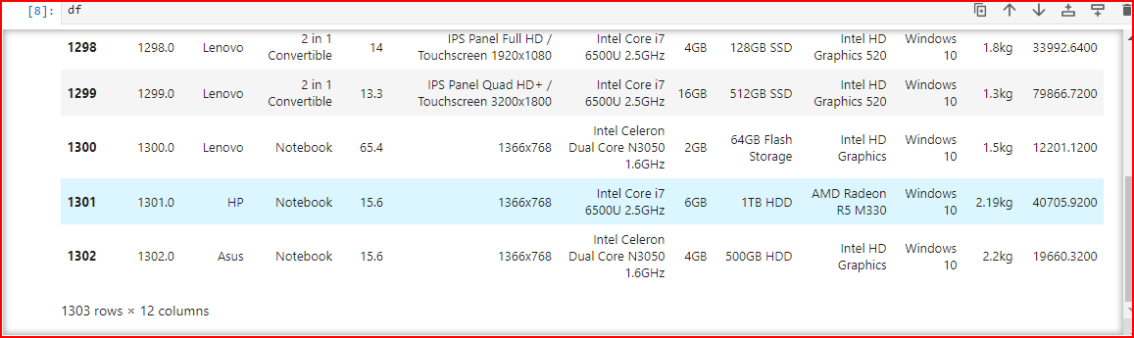

Data Understanding
The no of rows and columns and data types are
The rows and columns are : 1303rows and 12columns
The datatypes are :Pandas.core.frame.DataFrame

Slide 4
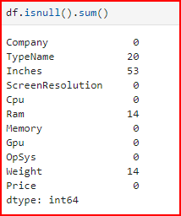




Summary statistics

Slide 5
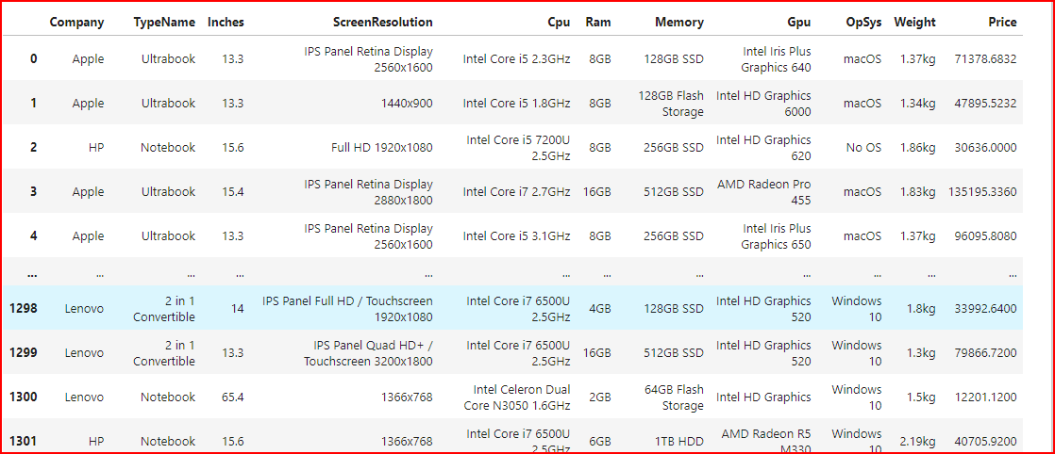
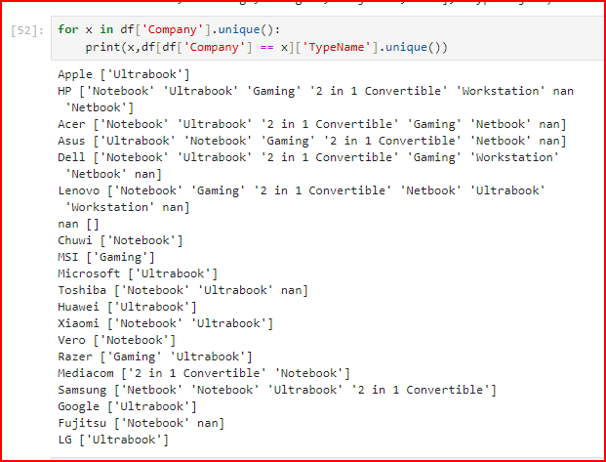
Initial Exploration

Slide 6
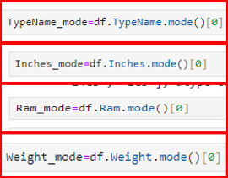
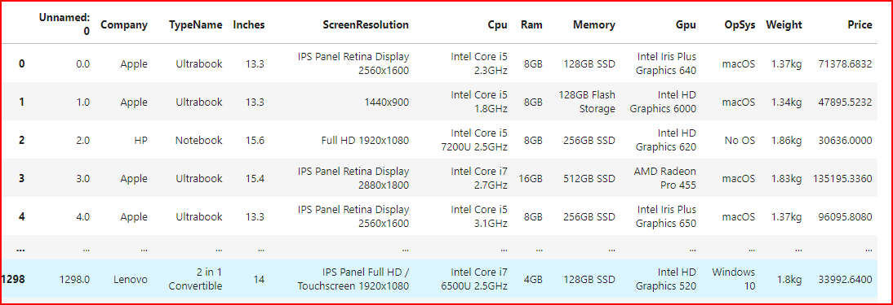
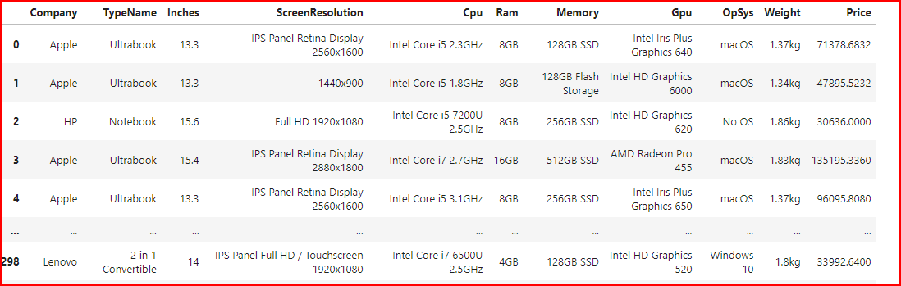
Missing Values Handling
To replacing the missing values using measureof tendency
Before-and-after comparison

Slide 7
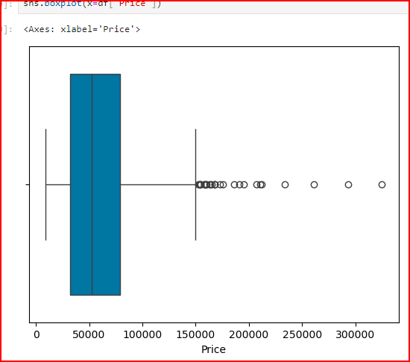
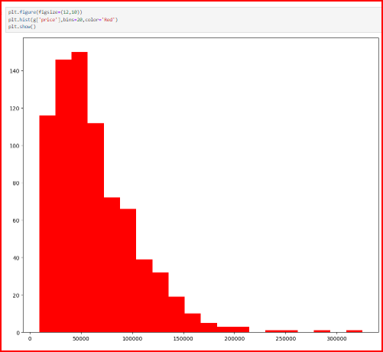
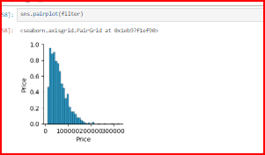
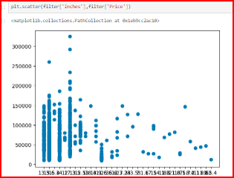
Outlier Handling

Slide 8
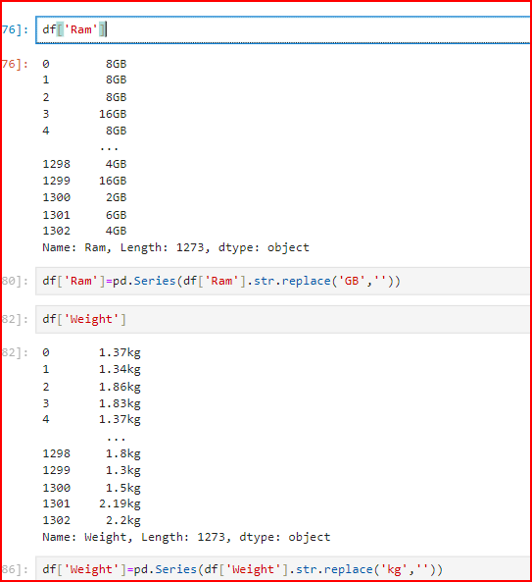
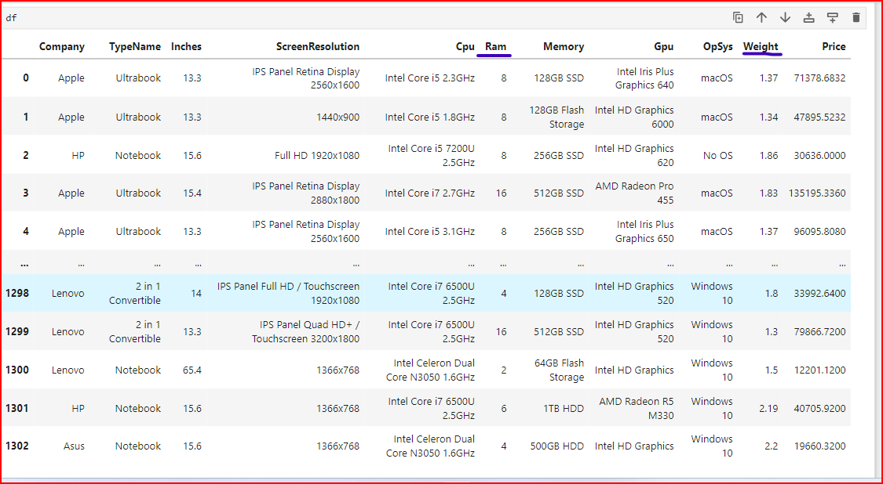
Fixing rows and columns

Slide 9
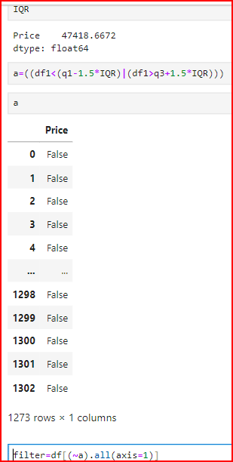
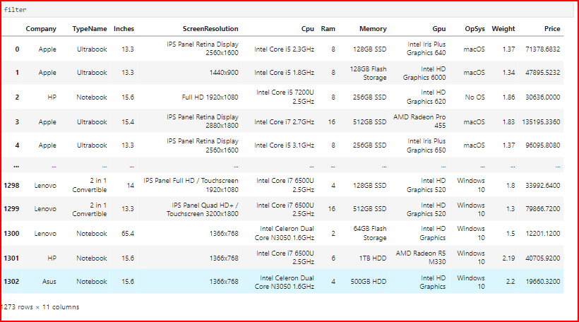
Derived Metrics
Using Boxplot method to find the Q1 and Q3 and also find IQR=q3-q1 after the to find outlier using a=((df1<(q1-1.5*IQR)|(df1>q3+1.5*IQR))) to filter the outlier using filter=df[(~a).all(axis=1)]
After the filter the dataset is :

Slide 10
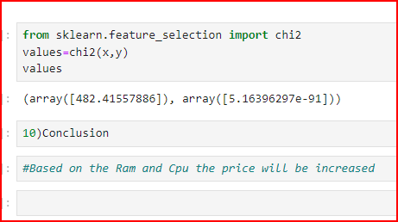
Conclusion
Based on the Ram and Cpu the price will be increased
Thankyou

