Slide 1
🎬 CineMaster Pro
Database ER Model
November 4, 2025

Slide 2
Database Design Overview
The CineMaster Pro database is designed to efficiently store and manage all movie-related information including:
• User accounts and authentication
• Movie metadata and descriptions
• User collections and favorites
• Movie reviews and ratings
• Actor and director information
• Genre classification
Key Features:
✓ Normalized schema for data integrity
✓ Supports complex relationships
✓ Scalable design for future enhancements

Slide 3
ER Diagram Legend
Primary Key
Foreign Key
Relationship
1
—
N
One-to-Many Relationship

Slide 4
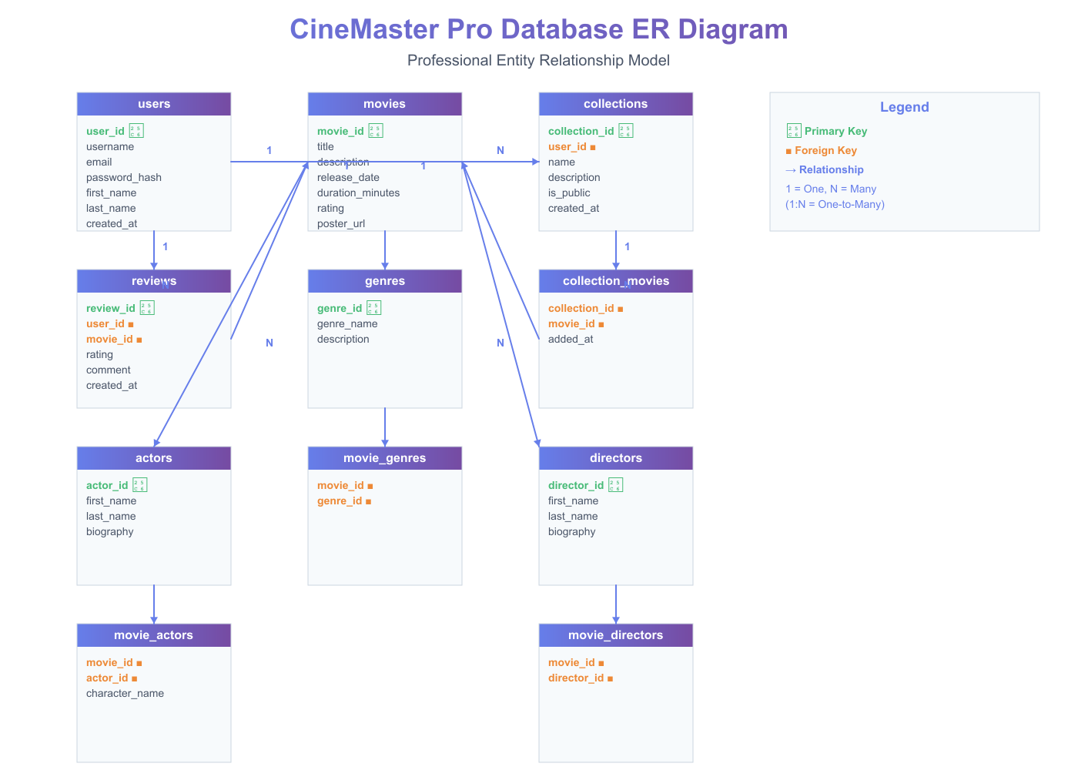
Entity Relationship Diagram

Slide 5
Table: users
Column Name
Data Type
user_id ◆
UUID
username
VARCHAR(50)
email
VARCHAR(100)
password_hash
VARCHAR(255)
first_name
VARCHAR(50)
last_name
VARCHAR(50)
created_at
TIMESTAMP
updated_at
TIMESTAMP
is_active
BOOLEAN

Slide 6
Table: movies
Column Name
Data Type
movie_id ◆
UUID
title
VARCHAR(200)
description
TEXT
release_date
DATE
duration_minutes
INTEGER
rating
DECIMAL(3,1)
poster_url
VARCHAR(500)
trailer_url
VARCHAR(500)
created_at
TIMESTAMP
updated_at
TIMESTAMP

Slide 7
Table: collections
Column Name
Data Type
collection_id ◆
UUID
user_id ■
UUID
name
VARCHAR(100)
description
TEXT
is_public
BOOLEAN
created_at
TIMESTAMP
updated_at
TIMESTAMP

Slide 8
Table: collection_movies
Column Name
Data Type
collection_id ■
UUID
movie_id ■
UUID
added_at
TIMESTAMP

Slide 9
Table: reviews
Column Name
Data Type
review_id ◆
UUID
user_id ■
UUID
movie_id ■
UUID
rating
INTEGER
comment
TEXT
created_at
TIMESTAMP
updated_at
TIMESTAMP

Slide 10
Table: genres
Column Name
Data Type
genre_id ◆
UUID
genre_name
VARCHAR(50)
description
TEXT
created_at
TIMESTAMP

Slide 11
Table: movie_genres
Column Name
Data Type
movie_id ■
UUID
genre_id ■
UUID

Slide 12
Table: actors
Column Name
Data Type
actor_id ◆
UUID
first_name
VARCHAR(50)
last_name
VARCHAR(50)
biography
TEXT
birth_date
DATE
photo_url
VARCHAR(500)

Slide 13
Table: movie_actors
Column Name
Data Type
movie_id ■
UUID
actor_id ■
UUID
character_name
VARCHAR(100)

Slide 14
Table: directors
Column Name
Data Type
director_id ◆
UUID
first_name
VARCHAR(50)
last_name
VARCHAR(50)
biography
TEXT
birth_date
DATE
photo_url
VARCHAR(500)

Slide 15
Table: movie_directors
Column Name
Data Type
movie_id ■
UUID
director_id ■
UUID

Slide 16
Database Relationships Summary
users ◆ —1—→N— collections ◆
collections ◆ —1—→N— collection_movies ■
collection_movies ■ —N—→1— movies ◆
users ◆ —1—→N— reviews ◆
reviews ■ —N—→1— movies ◆
movies ◆ —1—→N— movie_genres ■
movie_genres ■ —N—→1— genres ◆
movies ◆ —1—→N— movie_actors ■
movie_actors ■ —N—→1— actors ◆
movies ◆ —1—→N— movie_directors ■
movie_directors ■ —N—→1— directors ◆

Slide 17
Thank You
Questions & Discussion

