Slide 1
🎬 CineMaster Pro
Ultimate Movie Management System
Technical Overview: Frontend, Backend & Database
CineMaster Pro Presentation

Slide 2
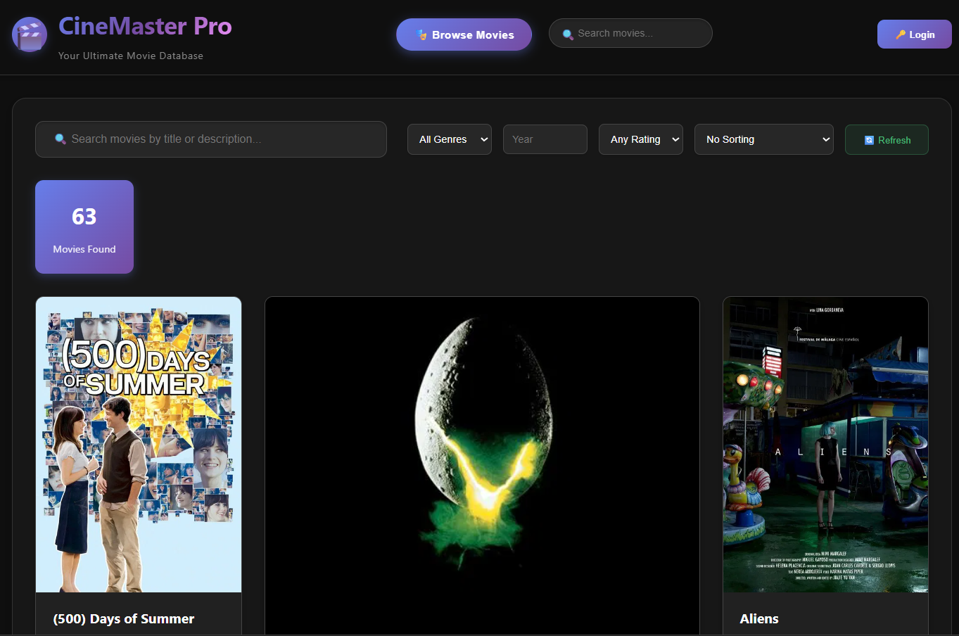
2
Introduction to CineMaster Pro
CineMaster Pro is a complete, production-ready movie management system designed for movie enthusiasts, collectors, and critics. It combines a powerful backend with an intuitive frontend interface, featuring user authentication, movie database, collections, and advanced search capabilities.
Built with modern technologies, CineMaster Pro offers a seamless experience across all devices with its responsive design and dark mode interface.
📸
IMAGE
PLACEHOLDER
Application Dashboard
CineMaster Pro - Technical Architecture

Slide 3
3
System Architecture Overview
Three-Tier Architecture:
  • Frontend Layer - User Interface
  • Backend Layer - Business Logic & API
  • Database Layer - Data Storage
Key Design Principles:
  • Clean separation of concerns
  • Scalable and maintainable
  • Secure and performant
  • Industry best practices
Three-Tier Architecture Diagram
CineMaster Pro - Technical Architecture

Slide 4
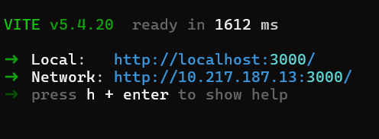
4
Frontend - User Interface Layer
Technology Stack:
  • React 18 - Component-based UI library
  • Vite - Next-generation frontend tooling
  • Axios - Promise-based HTTP client
  • CSS3 - Modern styling with responsive design
Key Features:
  • Responsive design for all devices
  • Dark mode interface with gradient accents
  • Interactive components with hover effects
  • Real-time updates and token-based authentication
📸
IMAGE
PLACEHOLDER
Frontend Technology Stack
CineMaster Pro - Technical Architecture

Slide 5
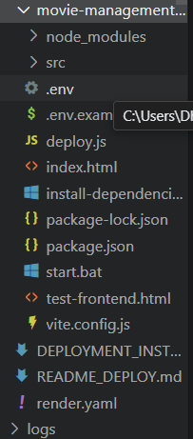
5
Frontend Component Structure
Main Components:
  • App.jsx - Main application with tab navigation
  • MovieCard.jsx - Movie display with hover effects
  • MovieDetailsModal.jsx - Detailed movie information
  • LoadingSkeleton.jsx - Loading placeholders for UX
State Management:
  • React useState hooks for component state
  • useEffect for side effects and data fetching
  • LocalStorage for data persistence
  • Axios interceptors for authentication
📸
IMAGE
PLACEHOLDER
Component Hierarchy Diagram
CineMaster Pro - Technical Architecture

Slide 6
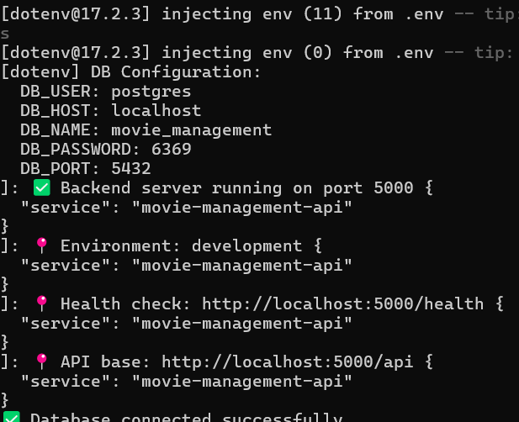
6
Backend - API & Business Logic Layer
Technology Stack:
  • Node.js - JavaScript runtime environment
  • Express.js - Web application framework
  • PostgreSQL - Relational database
  • JWT - Authentication tokens
  • Helmet - Security middleware
API Architecture:
  • RESTful endpoints with JSON data format
  • Standard HTTP methods (GET, POST, PUT, DELETE)
  • Comprehensive error handling middleware
📸
IMAGE
PLACEHOLDER
Backend Technology Stack
CineMaster Pro - Technical Architecture

Slide 7
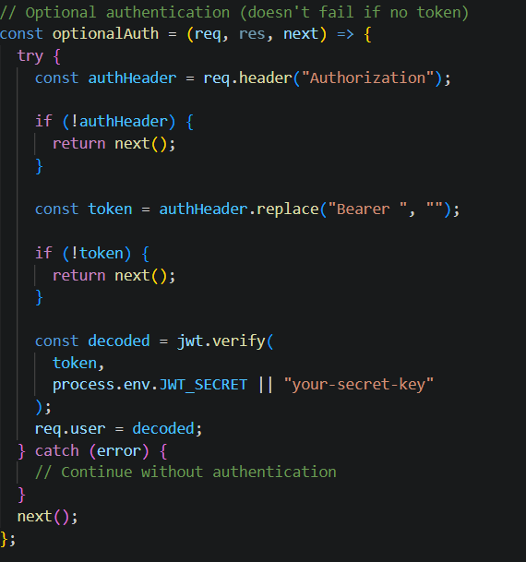
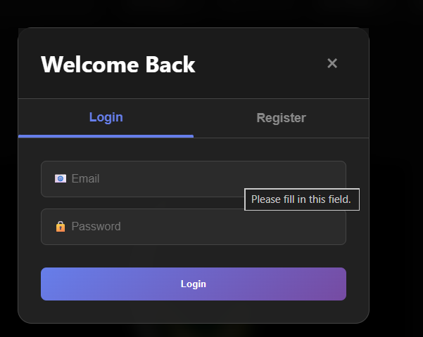
7
Backend API Endpoints
Main API Routes:
  • /api/auth - User registration and login
  • /api/movies - Movie management (CRUD)
  • /api/collections - Collection management
  • /api/reviews - Movie reviews system
  • /api/stats - Statistics and analytics
  • /api/users - User account management
Security Features:
  • JWT token authentication for protected routes
  • Request rate limiting to prevent abuse
  • Input validation and sanitization
📸
IMAGE
PLACEHOLDER
API Endpoint Structure
CineMaster Pro - Technical Architecture

Slide 8
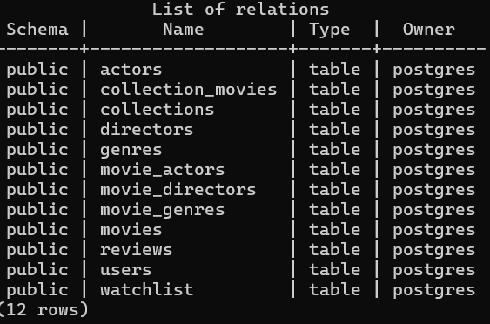
8
Database - Data Storage Layer
Technology Stack:
  • PostgreSQL - Advanced open-source relational database
  • Relational Structure - Normalized data model
  • ACID Compliance - Data integrity and consistency
  • JSON Support - Flexible data storage
Database Features:
  • Movie information storage with rich metadata
  • User account and session management
  • Collection system with many-to-many relationships
  • Review system with ratings
📸
IMAGE
PLACEHOLDER
Database Technology Stack
CineMaster Pro - Technical Architecture

Slide 9
9
Database Schema Design
Core Tables
Reference Tables
• genres - Movie genre classification
• actors - Actor information
• directors - Director information
• movies - Core movie information
• users - User account data
• collections - Collection metadata
• reviews - User movie reviews
Relationship Tables
• collection_movies - Collection-movie relationships
• movie_genres - Movie-genre relationships
• movie_actors - Movie-actor relationships
• movie_directors - Movie-director relationships
CineMaster Pro - Technical Architecture

Slide 10
10
Core Features of CineMaster Pro
Movie Management
Advanced Search
Collections
🎬
🔍
📚
Full CRUD operations with manual entry or TMDB auto-fetch
Filter by title, genre, year, rating with multiple sort options
Create and manage custom movie collections with privacy controls
User Authentication
Analytics Dashboard
Responsive Design
👤
📊
📱
Secure JWT-based registration and login system
View statistics and insights about your movie collection
Works seamlessly across mobile, tablet, and desktop devices
CineMaster Pro - Technical Architecture

Slide 11
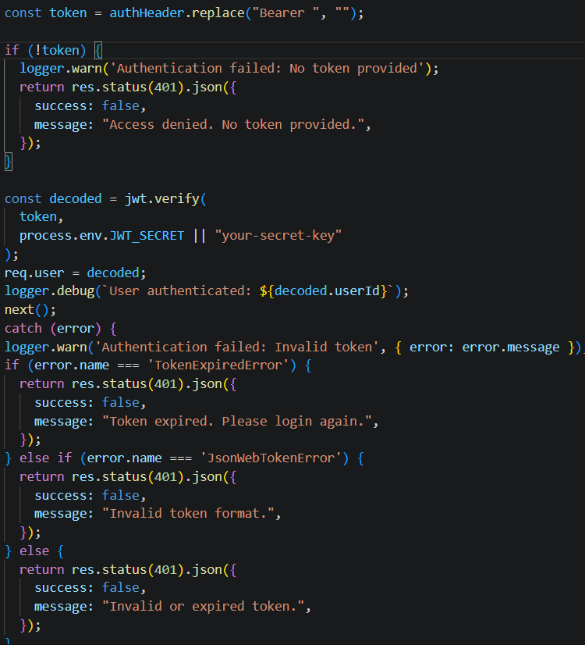
11
Security Architecture
Frontend Security:
  • Token storage in LocalStorage
  • HTTPS communication
  • Input validation
  • XSS protection
Backend Security:
  • Helmet - HTTP header security
  • CORS - Cross-origin resource sharing
  • Rate Limiting - Request throttling
  • JWT Authentication - Token-based auth
  • Input Sanitization - Data validation
📸
IMAGE
PLACEHOLDER
Security Layers Diagram
CineMaster Pro - Technical Architecture

Slide 12
12
Performance Optimization
Frontend Optimization:
  • Code Splitting - Lazy loading components
  • Image Optimization - Responsive images
  • Caching - LocalStorage for data
  • Bundle Optimization - Vite build process
Backend Optimization:
  • Database Indexing - Query performance
  • Connection Pooling - Database efficiency
  • Pagination - Large dataset handling
  • Query Optimization - Efficient SQL
Performance Optimization Diagram
CineMaster Pro - Technical Architecture

Slide 13
13
Deployment Architecture
Production Deployment:
  • Frontend - Netlify (Static hosting)
  • Backend - Render (Node.js hosting)
  • Database - Neon (PostgreSQL hosting)
  • CDN - Content delivery network
  • SSL - Secure connections
Development Environment:
  • Frontend - Vite development server (port 3000)
  • Backend - Node.js with nodemon (port 5000)
  • Database - Local PostgreSQL
Deployment Architecture Diagram
CineMaster Pro - Technical Architecture

Slide 14
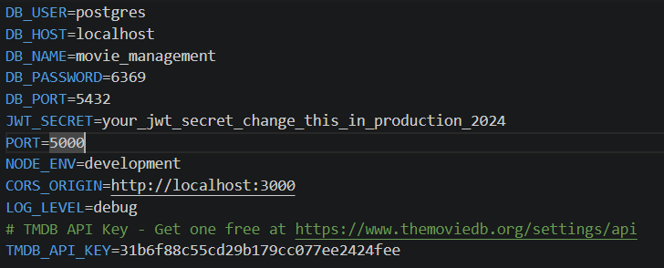
14
System Integration Points
External APIs:
  • TMDB API - Movie data fetching
  • OAuth Providers - Social login (future)
  • Payment Gateways - Premium features (future)
Internal Integrations:
  • Frontend ↔ Backend - REST API
  • Backend ↔ Database - PostgreSQL driver
  • Authentication - JWT token system
  • File Storage - Poster images (future)
📸
IMAGE
PLACEHOLDER
Integration Diagram
CineMaster Pro - Technical Architecture

Slide 15
15
Technical Architecture Summary
CineMaster Pro demonstrates:
  • Modern Full-Stack Development with React and Node.js
  • Relational Database Design with PostgreSQL
  • Secure Authentication with JWT
  • Responsive User Interface with CSS
  • Scalable Architecture ready for growth
Key Takeaways:
  • Clean separation of concerns
  • Robust error handling
  • Performance optimization
  • Security-first approach
Architecture Summary Diagram
CineMaster Pro - Technical Architecture

Slide 16
Questions & Discussion
16
Thank you for your attention!
Contact Information:
• Email: [sprasannan07@gmail.com]
• GitHub: [prasannan]
• Phone_No: [9123525715]
Any technical questions or feedback?
Discussion Illustration
CineMaster Pro - Technical Architecture

