Slide 1
Impact of Body Mass Index on Life span, Health factors and disease
Selva Maran

Slide 2
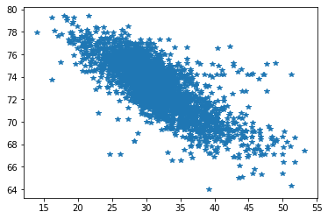
BMI versus Life Expectancy (IHME data)
Life Expectancy
BMI

Slide 3

https://mimic.mit.edu/

Slide 4
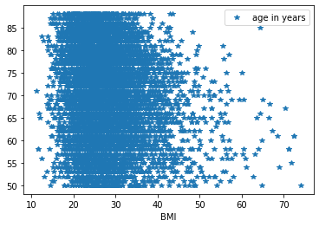
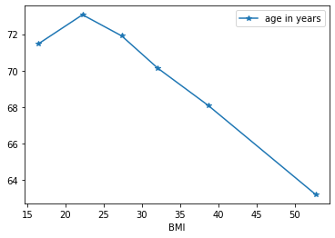
Life Expectancy versus BMI

Slide 5
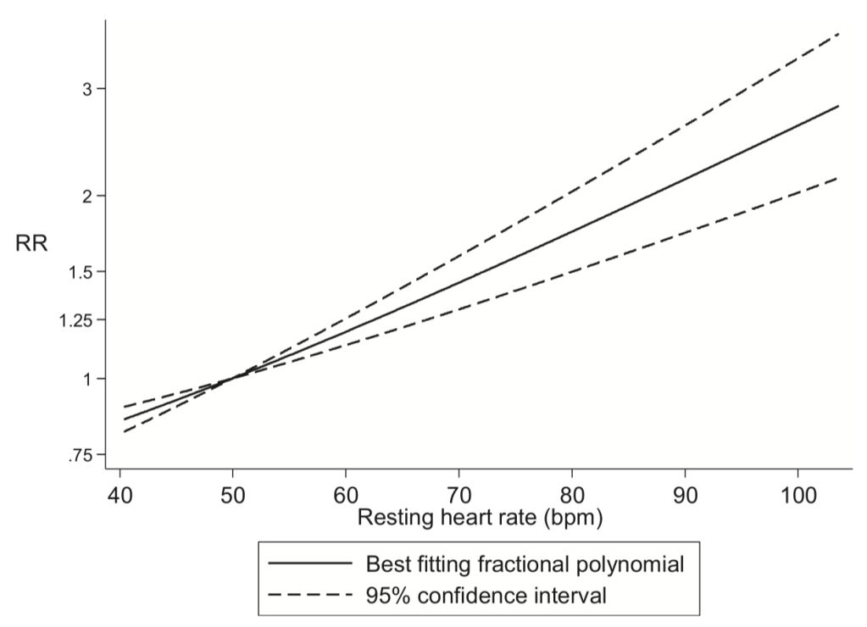
Resting Heart rate
High Heart rate is independent risk factor
Same BMI
With and without physical activity
Difference in heart rate
Low BMI but high fat mass
Sepsis mortality rate
Data results
High HR – high Mortality rate
Resting heart rate and the risk of cardiovascular disease, total cancer, and all-causemortality – a systematic review and dose-response meta-analysis of prospectivestudies.
Dagfinn Aune, PhD, Abhijit Sen, PhD, Bríain ó’Hartaigh, PhD, Imre Janszky, PhD, PålR. Romundstad, PhD, Serena Tonstad, MD, Lars J. Vatten

Slide 6
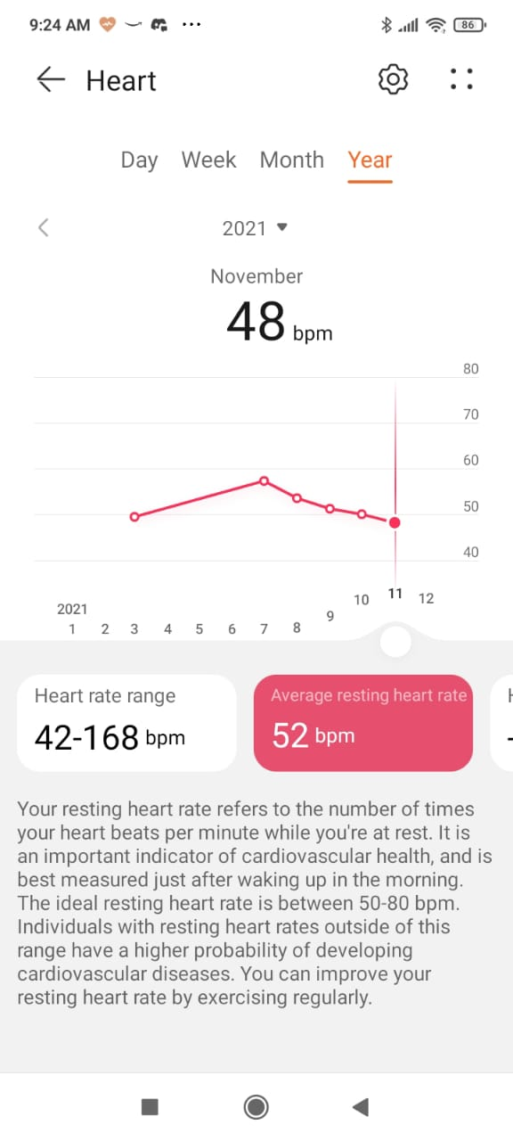
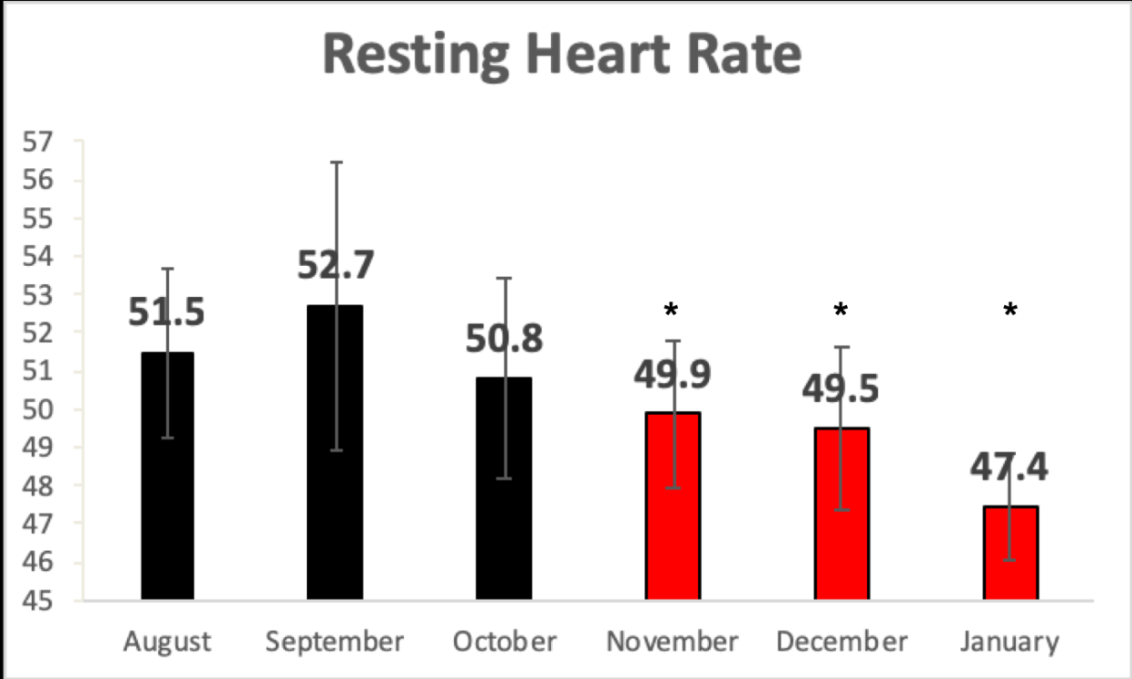
Resting Heart Rate Tracking

Slide 7
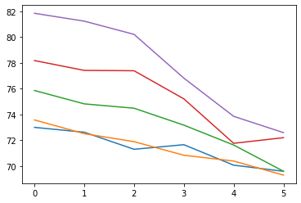
Aging related Resting Heart Rate changes across different BMI (NHANES data)
High BMI
Heart rate
Low BMI
Age group: 0->20-30 yrs; 1 -> 30-40 yrs; 1 -> 30-40 yrs;
2 -> 40-50 yrs; 3 -> 50-60 yrs; 4 -> 60-70 yrs;5 -> 70-80 yrs;

Slide 9
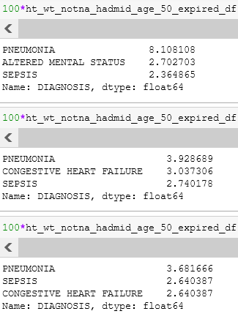
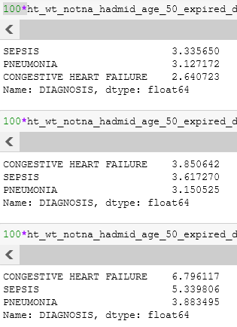
Congestive Heart Failure – Obesity as major risk factor

Slide 12
Reducing heart rate as goal not body weight and loss of resilience with Aging
With Aging recovery ability is gradually lost

Slide 13
Accelerated Ageing with High BMI (Dynamic models)
Second order differential equation
Acceleration

Slide 14
Lifestyle – BMI –vital parameter changes with ageing – how BMI accelerate the process (plus loss of resilience with Aging) – Early disease – reduction in life expectancy;

