Slide 1
MultiModular ScaleFree Nonlinear realistic computational dynamic Biological Models to overcome complex diseases
MM SF NL RCD BM

Slide 2
Computation and Dynamics of Normal and Disease state
Realistic modeling
Identifying dynamical and computational defects and role in precision medicine.
Multitimescale interaction
Positive and negative feedforward and feedbacks
Pathways
Sepsis; stress; neurons; diabetes
vasoregulation in sepsis; Inflammatory dynamics; Ageing (science paper)

Slide 3
Human Lifestyle
Incremental slow development of changes happening in the body before the disease
Tracking
Dynamic competitive stability ?
For example: Driven to become diabetic unless we balance it with enough physical activity

Slide 4
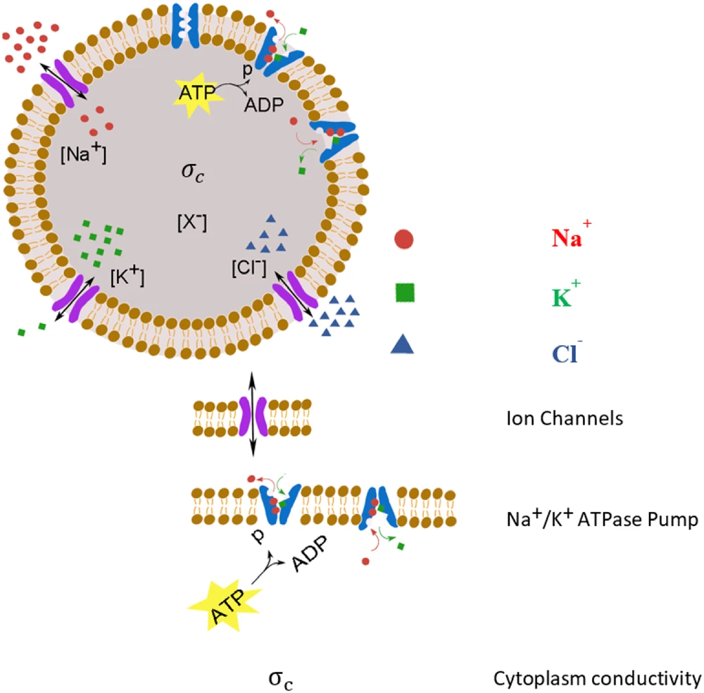
Biological systems exhibit nonlinear dynamic properties
Fazelkhah, A., Braasch, K., Afshar, S. et al. Quantitative Model for Ion Transport and Cytoplasm Conductivity of Chinese Hamster Ovary Cells. Sci Rep 8, 17818 (2018)
https://creativecommons.org/licenses/by/4.0/

Slide 5
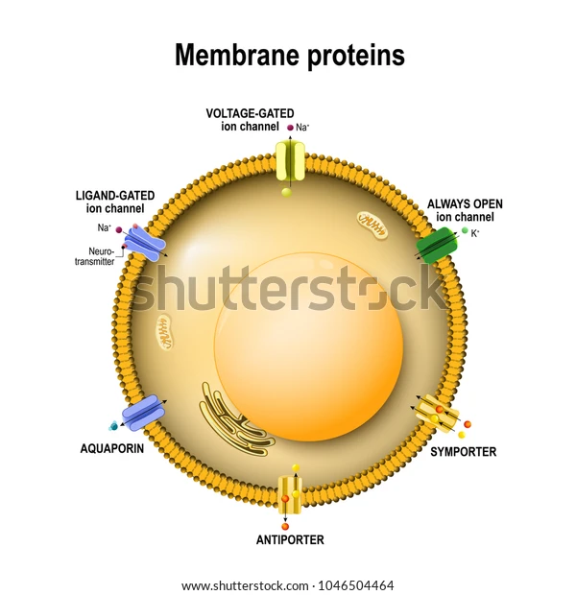
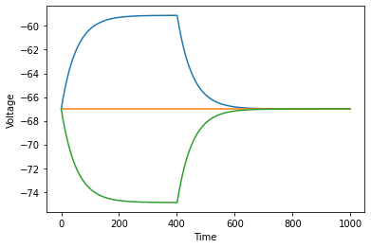
C dv/dt = I – gL* (V-EL)

Slide 6
Stable and Unstable fixed points

Slide 7
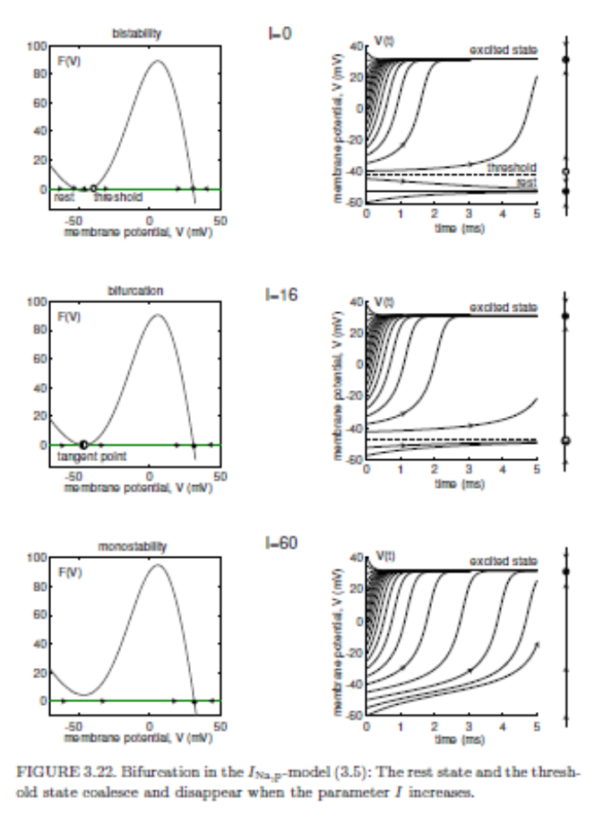
Bifurcation

Slide 8
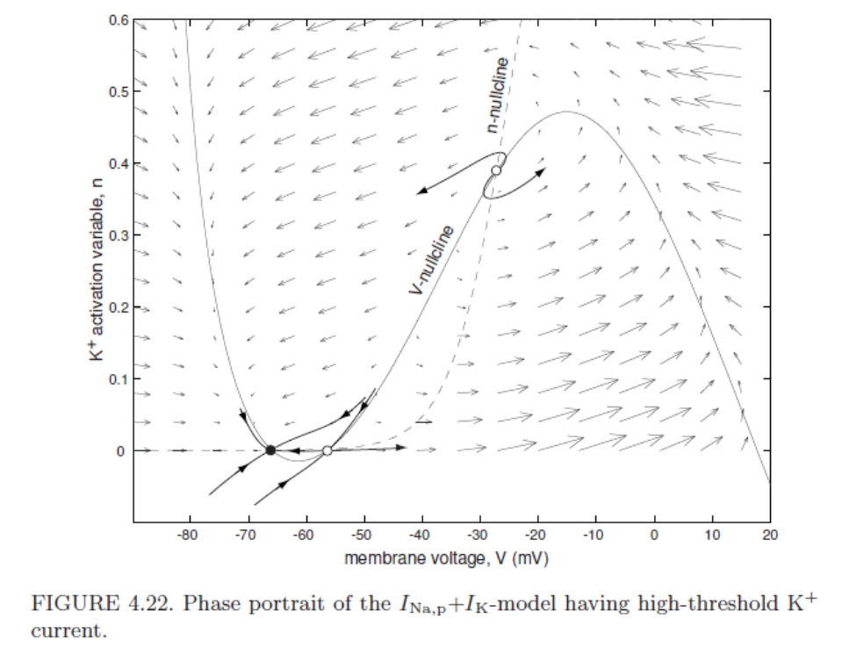
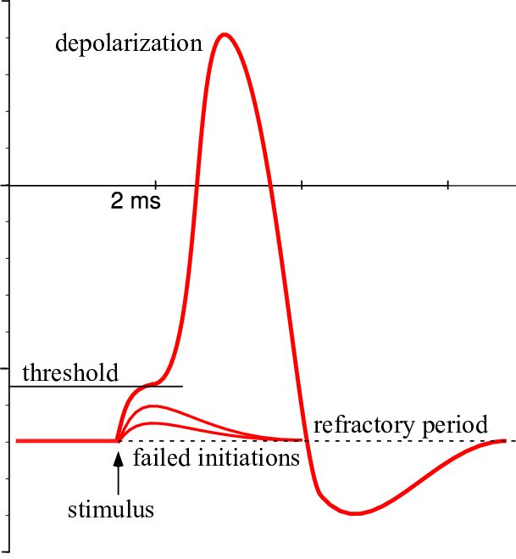
Two Dimension Systems

Slide 10
Dynamic models predicting cardiovascular changes during sepsis

