Slide 1
Biochemical Factors influencing Body Mass Index

Slide 2
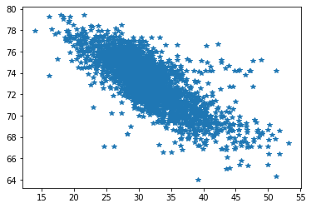
BMI versus Life Expectancy (IHME data)
Life Expectancy
BMI

Slide 3

NHANES

Slide 4
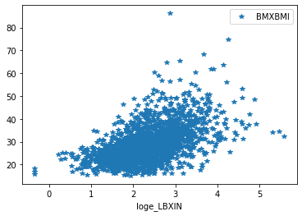
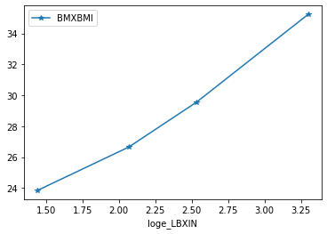
Reducing Insulin can reduce BMI

Slide 5
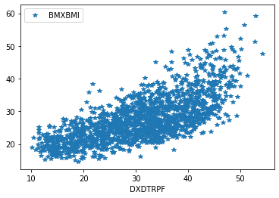
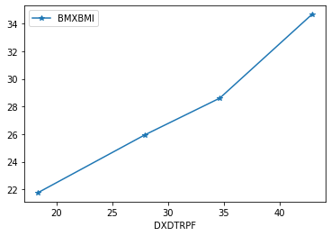
Reducing TRPF can reduce BMI especially at higher end

Slide 6
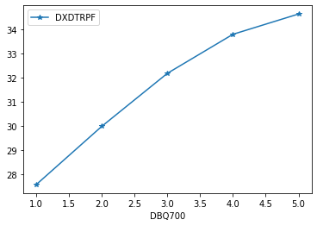
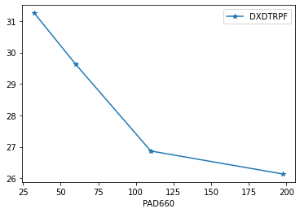
Healthy Life style Vs TRPF
Healthy Diet Vs TRPF
Minutes vigorous recreational activities Vs TRPF
Roughly 1-2 hours per day

Slide 7
Caution while interpreting correlation
Correlation doesn’t meant causation
Spurious correlation
Normalization can reduce spurious correlation

Slide 8
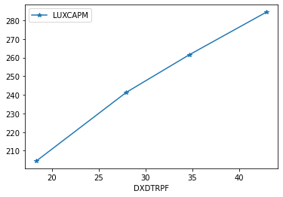
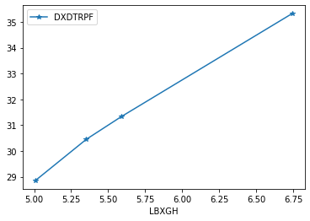
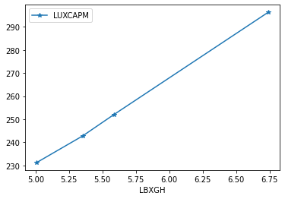
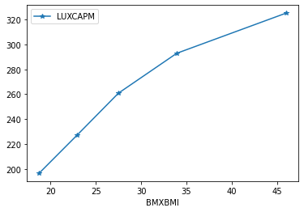
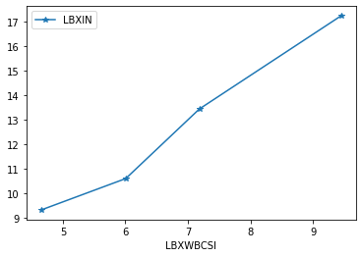
Factors influencing BMI

Slide 9
Correlation Analysis
Age
Bmxwaist,capm,trpf,xtc,ldl,ghb
Positive correlation
Insulin
Nil
BMI
Highly With Trpf than rest (Insulin)
Insulin
highly with BMI than rest
Capm, SMED (<capm)
HDD, TRPF
BMI increases with Insulin but more so with Trpf
LUXCAPM
highly with BMI than with insulin
highly with trpf
LUXSMED
More with BMI Not so with trpf
With Insulin only at higher level Insulin

Slide 10
Correlation Analysis(Contd.)
HDD
More strong with Insulin
XTC
More strong with LDL and TGLY
Also with Age
Focus on two things
BMI
Insulin
For myself

Slide 11
AI model Prediction
X = df_merge_age_35_dropna[['RIDAGEYR','LUXSMED', 'LUXCAPM','DXDTRPF', DXDTOPF','LBXHSCRP','LBXWBCSI','LBXTC', 'LBDHDD','LBDLDL', 'LBXTR','loge_LBXIN', 'LBXGLU', 'LBXGH']]
y = df_merge_age_35_dropna['BMXBMI']
train_X, val_X, train_y, val_y = train_test_split(X, y, random_state=1)
X_train.shape,train_y.shape
((396, 14), (396,))
val_X.shape,val_y.shape
((132, 14), (132,))

Slide 12
AI model Prediction (Contd.)
from sklearn.ensemble import RandomForestRegressor
# create regressor object
regressor = RandomForestRegressor(n_estimators = 100, random_state = 0)
# fit the regressor with x and y data
my_model =regressor.fit(train_X, train_y)
y_pred = my_model.predict(val_X)

Slide 13
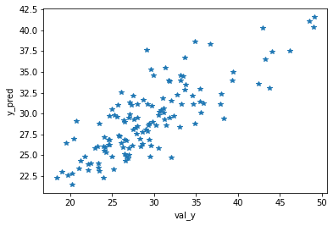
AI model Prediction (Evaluation)
from sklearn.metrics import mean_squared_error
mse = mean_squared_error(val_y, y_pred)**(0.5)
mse
3.7752144269825227
Factors are reliably good in predicting what the BMI of person is.
Contribution estimation through removal and measuring accuracy;
Longitudinal Study required

Slide 14
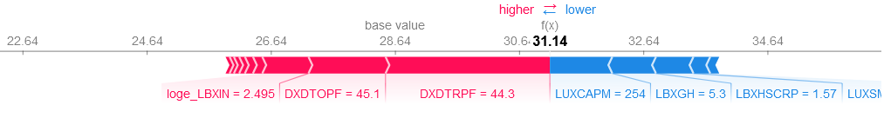
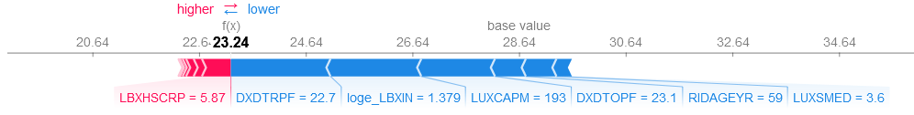
AI model Prediction (SNAP tool)

Slide 15
Computational Model

Slide 16
The trajectories of LCHF, HCLF, MCMF etc. to health and disease and other states (fat mass accumulation, change in metabolism type).

Slide 19
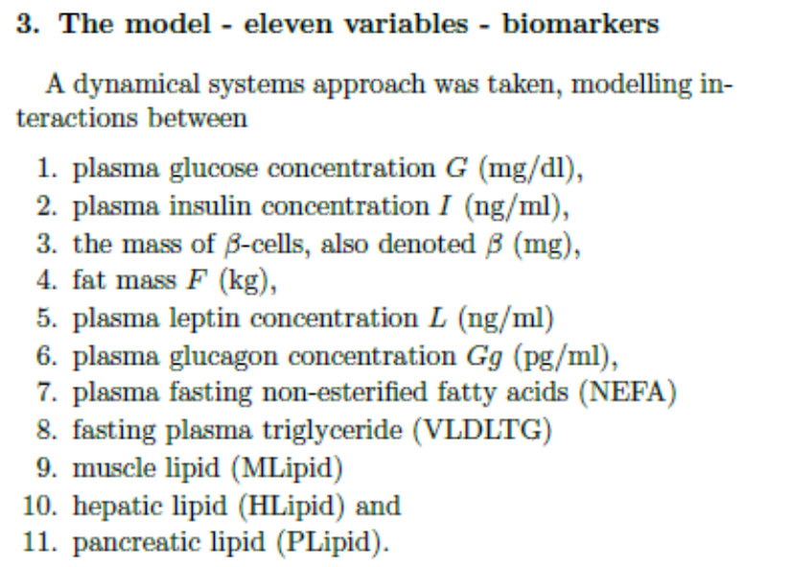
Rate of change over time
Different time scales in dynamics

Slide 20
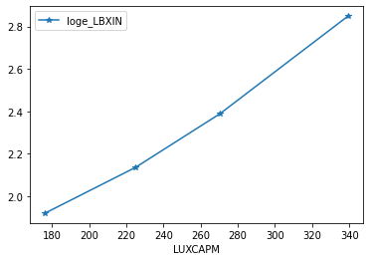
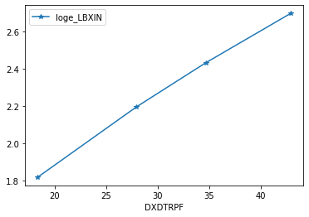
Factors influencing Insulin level

Slide 21
Results (Summary) – Mechanism and Reasons?
The model predicts isocaloric high carbohydrate low fat (HCLF) diet and low carbohydrate high fat (LCHF) diet trajectories to health which vary in fat mass by at most a few kilograms at steady state.
The LCHF trajectories to health are faster than isocaloric HCLF trajectories with respect to fat mass loss, although these trajectories may be slower initially if parameters are adjusting from HCLF values.
On LC diets, leptin sensitivity and VLDLTG clearance are thought to increase.
Increasing leptin sensitivity and VLDLTG clearance is predicted to lower lipids including fat mass and VLDLTG.
The model predicts that changes in VLDLTG due to a change in diet happen rapidly, approaching steady state values after a few weeks, reflecting leptin sensitivity and VLDLTG clearance which are much harder to measure.
The model predicts that if only insulin sensitivity increases on a LC diet, steady state fat mass would increase slightly. If leptin and insulin sensitivities increase concurrently, the combined effect could be a decrease in fat mass, consistent with the fact that increasing insulin sensitivity is often associated with fat mass loss in trials.

Slide 22
Results (Summary) – Mechanism and Reasons?
The model predicts trajectories to fat Type II diabetes with hypertriglyceridemia due to high carbohydrate moderate fat diets, on which insulin rises before falling, as ectopic fat deposits increase; made fatter and more diabetic by higher lipid consumption.
It predicts trajectories to non-diabetic states with raised fat mass, VLDLTG and muscle, hepatic and pancreatic lipids due to moderate carbohydrate high fat diets.
The model predicts paths to lean Type II diabetes, on a diet of moderate energy but low beta-cell replication rate or high death rate.

Slide 23
A model of diabetes is applied to predict the effects on biomarkers of various diets.
Low carbohydrate high fat diets and high carbohydrate low fat diets are considered.
Weight loss is predicted to be faster on a LCHF diet than on an isocaloric HCLF diet.
Changes in VLDLTG due to diet change are predicted to stabilise over a few weeks.
Increasing VLDLTG clearance and leptin sensitivity is predicted to lower lipids.

Slide 24
Food ratio and its impact
The LCHF trajectories to health are faster than isocaloric HCLF trajectories with respect to fat mass loss, although these trajectories may be slower initially if parameters are adjusting from HCLF values.

Slide 25
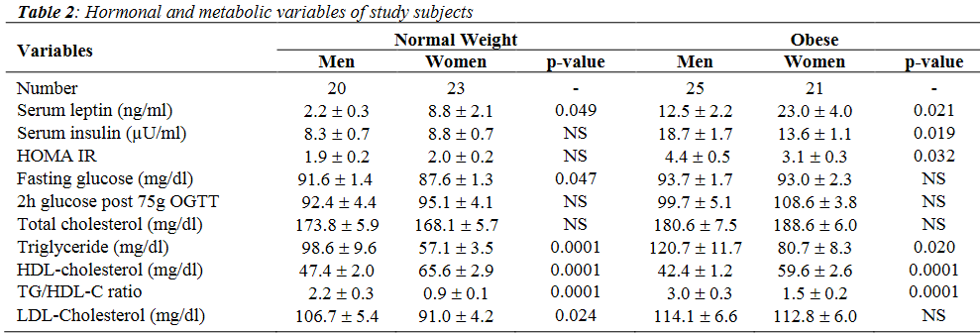
LEPTIN LEVELS IN NORMAL WEIGHT AND OBESE SAUDI ADULTS Ali I. Al-Sultan, MD, FRCPC, Abdulmohsen H. Al-Elq, MD, FACEDepartment of Internal Medicine, College of Medicine, King Faisal University, Dammam, Saudi Arabia

Slide 26
Leptin, appetite and weight rebound in overweight/obesity individuals undertook weight loss program using a low calorie diet with or without exercise

