Slide 1

SPRING BOOT 2.1

Slide 2
EXTERNALIZE THE CONFIGURATION

Slide 3
Externalize the configuration
@ConfigurationProperties
  provides a very clean way to load properties for an application.
  It provides an easy and manageable way to externalized configurations
@PropertySource
  Declared at the same level, either directly on the configuration class or as meta-annotations within the same

Slide 4
application.properties
  app.error.code=800
  app.name=ConfigurationPropertiesDemoApp
  app.error.message=value not bound properly from ${app.name}
  #Mapping single properties
  app.mail.to=sunil@example.com
  app.mail.host=mail.example.com
  #Mapping list or array
  app.mail.cc=mike@example.com,david@example.com
  app.mail.bcc=sumit@example.com,admin@example.com

Slide 5
Binding from property file
  @PropertySource("classpath:application.properties")
  public class ExtConfigComponent {
  @Value("${app.error.code}")
  private String code;
  @Value("${app.error.message}")
  private String message;
  }
  }

Slide 6
Binding from property file
  @PropertySource("classpath:application.properties")
  public class MailComponent {
  @Value("${app.mail.to}")
  private String to;
  @Value("${app.mail.host}")
  private String host;
  @Value("${app.mail.cc}")
  private String[] cc;
  @Value("${app.mail.bcc}")
  private List<String> bcc;
  }

Slide 7
Configuration
  @Bean
  @ConfigurationProperties(prefix="app.error")
  public ExtConfigComponent comp() {
  return new ExtConfigComponent();
  }
  @Bean
  @ConfigurationProperties(prefix="app.mail")
  public MailComponent mailComp() {
  return new MailComponent();
  }

Slide 8
JDBC

Slide 9
Working With SQL
Has extensive support for working with SQL databases
  Direct JDBC access using JdbcTemplate
  Using “object relational mapping” like Hibernate.
  Has Number of Starters for Working with data sources
Has a functionality for creating Repository implementations
  From interfaces using conventions to generate queries from method names.

Slide 10
Spring JDBC
Spring Task
  Connection Management
  Statement Management
  ResultSet Management
  Transaction Management
  Exception Handling
Developer Task
  SQL
  Row Data Retrieval
  Parameter Setting

Slide 11
Spring JDBC – Template pattern
Defines the skeleton of an algorithm in an operation, deferring some steps to subclasses.
Template Method lets subclasses redefine certain steps of an algorithm without letting them to change the algorithms structure.
In Spring JDBC development, it’s always recommended to use JdbcTemplate and JdbcDaoSupport
Register the Dao Implementation class and add the JdbcTemplate as Dependency

Slide 12
Configuring a Data Source
spring.datasource.*.
  Configurations are controlled by external configuration properties
  Defined application.properties:
  spring.datasource.jdbc-url=jdbc:mysql://localhost:3306/test
  spring.datasource.driver-class-name=com.mysql.cj.jdbc.Driver
  spring.datasource.username=root
  spring.datasource.password=srivatsan
Should specify the URL else Spring Boot tries to auto-configure an embedded database.
Specifying the driver-class-name is optional

Slide 13
spring.datasource.jdbc-url
If Hikari Data Source is on the classpath should this property
  spring.datasource.jdbc-url=jdbc:mysql://localhost:3306/test
Hikari has no url property but has a jdbcUrl property
Alternatively can use the following path
  spring.datasource.url=jdbc:mysql://localhost:3306/test

Slide 14
Entity Class & DAO Interface
  @Data
  @NoArgsConstructor
  public class Customer {
  private long id;
  private String first_name;
  private String last_name;
  }
    public interface Crud<T> {
    public List<T>findAll();
    }

Slide 15
@Repository
A repository is a mechanism for encapsulating storage, retrieval, and search behavior which emulates a collection of objects.
@Repository
  Indicates that the decorated class is a repository.
  A specialization of the @Component annotation
  Will be auto detected through classp ath scanning.

Slide 16
@Repository
There are three repository in Spring Data
Every repository extends the generic Repository
  And they have different functionality.
CrudRepository
  provides CRUD functions
JpaRepository
  provides JPA related methods such as flushing the persistence context and delete records in a batch
  Querying methods return List's instead of Iterable's
PagingAndSortingRepository
  provides methods to do pagination and sort records

Slide 17
DAO Implementation
  @Repository
  public class CustomerDAOImpl implements Crud<Customer> {
  @Autowired
  private JdbcTemplate template;
  @Override
  public List<Customer> findAll() {
  List < Customer > customers = new ArrayList <> ();
  List < Map < String, Object >> rows = template.queryForList("SELECT * FROM CUSTOMER");

Slide 18
DAO Implementation … contd
  for (Map < String, Object > row: rows) {
  Customer customer = new Customer();
  customer.setId((long) row.get("Id"));
  customer.setFirst_name((String) row.get("first_name"));
  customer.setLast_name((String) row.get("last_name"));
  customers.add(customer);
  }
  return customers;
  }
  }

Slide 19
Data Source Builder
Data Source Builder
  Used for building a DataSource with common implementations and properties.
  If HikariCP, Tomcat or Commons DBCP are on the classpath one of them will be selected (in that order with Hikari first).
  @ConfigurationProperties(prefix = "spring.datasource")
  public DataSource dataSource() {
  return DataSourceBuilder.create().build();
  }

Slide 20
Configuration
  @Configuration
  public class AppConfig {
  @Bean
  @Primary
  @ConfigurationProperties(prefix = "spring.datasource")
  public DataSource dataSource() {
  return DataSourceBuilder.create().build();
  }
  @Bean
  public JdbcTemplate jdbcTemplate(DataSource dataSource) {
  return new JdbcTemplate(dataSource);
  }

Slide 21
Application
  @SpringBootApplication
  public class BootJdbcTemplateApplication {
  public static void main(String[] args) {
  ConfigurableApplicationContext ctx =SpringApplication.run(BootJdbcTemplateApplication.class, args);
  CustomerDAOImpl dao = ctx.getBean(CustomerDAOImpl.class);
  List<Customer> custList = dao.findAll();
  custList.forEach(System.out::println);
  }
  }

Slide 22
JPA

Slide 23
CrudRepository Interface
An interface and extends Repository interface.
Provides generic CRUD operation on a repository for a specific type.
It has generic methods for CRUD operation.
We need not to implement our interface, its implementation will be created automatically at runtime.
  <S extends T> S save(S entity):
  Optional<T> findById(ID primaryKey)
  Iterable<T> findAll()
  void delete(T entity)

Slide 24
CRUD Repository
Create an Interface extending CrudRepository
  public interface BookRepository extends CrudRepository<Book, Long> {}
Need to create an implementation class
  Spring will automatically create its implementation class at runtime.
The Repository class will be auto detected if suitably placed in the scan path

Slide 25
Custom Repository Methods
Can add custom methods to the interface that extendsCrudRepository
find...By,
read...By,
query...By,
count...By,
get...By
Before By
To get data on the basis of more than one property can concatenate property names using And , Or
Can completely custom name our method, and use @Query

Slide 26
Custom Query Method
  public interface BookRepository extends CrudRepository<Book, Long> {
  List<Book> findByAuthor(String author);
  List<Book> findDistinctByCategory(String category);
  List<Book> findByAuthorAndCategory(String author, String category);
  @Query("SELECT a FROM Book a WHERE a.author=:authore and a.price>:price")
  List<Book> fetchBooks(@Param("author") String author, @Param("price") double price);
  }

Slide 27
Using CRUD Repositor
  @Repository
  public class BookService {
  @Autowired
  private BookRepository repo;
  public Iterable<Book> getBooks(){
  return repo.findAll();
  }
  public Book addBook(Book book) {
  return repo.save(book);
  }
  }

Slide 28
Properties
spring.datasource.url=jdbc:mysql://localhost:3306/test
spring.datasource.username=root
spring.datasource.password=srivatsan
spring.datasource.hikari.connection-timeout=20000
spring.datasource.hikari.minimum-idle=5
spring.datasource.hikari.maximum-pool-size=12
spring.datasource.hikari.idle-timeout=300000
spring.datasource.hikari.max-lifetime=1200000
spring.jpa.properties.hibernate.dialect = org.hibernate.dialect.MySQLDialect
spring.jpa.properties.hibernate.id.new_generator_mappings = false
spring.jpa.properties.hibernate.format_sql = true
spring.jpa.hibernate.ddl-auto: update
logging.level.org.hibernate.SQL=DEBUG
logging.level.org.hibernate.type.descriptor.sql.BasicBinder=TRACE

Slide 29
HIBERNATE

Slide 30
Hibernate
ORM helps in representing relations of database in terms of java objects.
ORM consists of two concepts object-oriented and relational programming.
Hibernate is an ORM framework where programmer describes the way objects are represented in database.
Hibernate handles the conversion automatically.
Hibernate provides implementation of JPA interfaces EntityManagerFactory and EntityManager.

Slide 31
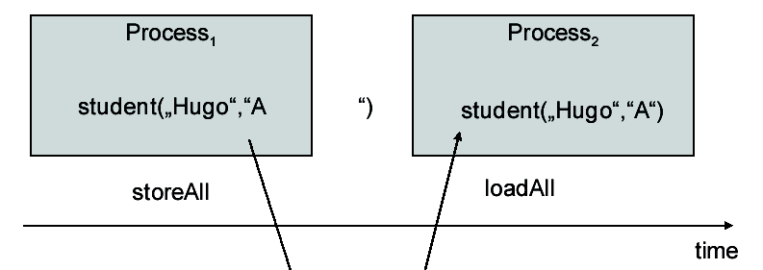
What is Persistence ?
Ability of an object to survive even current session or program terminate.
The ability of an object to remain in existence past the lifetime of the program that creates it.
Its Achieved by
  Relational Databases
  Serialization
  EJB (entity beans)

Slide 32
Hibernate Core Interfaces & Classes
Session Factory Interface
  Used to create Session objects, created during application initialization, caches generated SQL and other metadata
Session Interface
  Primary interface, used to store & retrieve objects
Transaction Interface
    May not be used by applications
Query & Criteria Interface
    Query interface is used to run queries in HQL or SQL
    Criteria interface is also very similar

Slide 33
SessionFactory
Represented by org.hibernate.SessionFactory
A factory for Session and a client of ConnectionProvider
  Typically one for each database
  Maintains a cache of compiled mappings for a single database
  Might hold an optional (second-level) cache of data that is reusable between transactions, at a processor cluster-level

Slide 34
Session
Session
  Represented by org.hibernate.Session
  The life of a Session is bounded by the beginning and end of a logical transaction.
  A session represents a persistence context
  Handles life-cycle operations- create, read and delete operations - of persistent objects
  A single-threaded, short-lived object representing a conversation between the application and the persistent store
  Wraps a JDBC connection
  Factory for Transaction

Slide 35
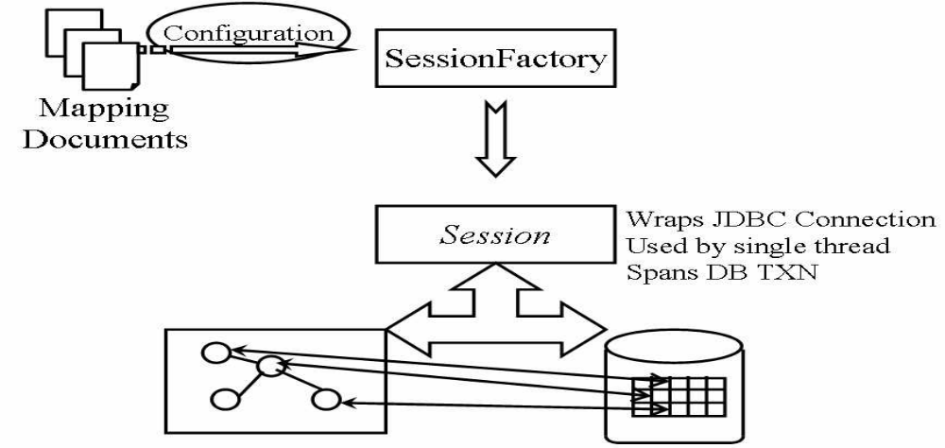
Hibernate Mapping
Hibernate uses runtime reflection to determine persistent properties of classes.
A mapping property or configuration file is used to generate database schema and provide persistence

Slide 36
Entity Manager Factory
SessionFactory and Session are hibernate-specific.
JPA provides a EntityManagerFactory
  Its used to get an instances of EntityManager for connecting to database.
The EntityManager invokes the hibernate session under the hood.
Can obtain the session by calling:
  Session session = entityManager.unwrap(Session.class);

Slide 37
Criteria Builder
Criteria queries are an object graph, where each part of the graph represents an increasing atomic part of query.
It’s a factory for all individual pieces of the criteria.
Obtained by calling getCriteriaBuilder() on EntityManagerFactory
  CriteriaBuilder builder = session.getCriteriaBuilder();

Slide 38
CriteriaQuery
<T> CriteriaQuery<T> createQuery( Class<T> resultClass )
  T indicates the expected types in the query result.
  Can an entity, an Integer, or any other object.
  Obtained by calling createQuery method on Criteria Builder
  CriteriaQuery criteria = builder.createQuery(UserDetails.class);

Slide 39
Roots
Roots define the basis from which all joins, paths and attributes are available in the query.
A root is always an entity type.
Roots are defined and added to the criteria
<X> Root<X> from( Class<X> );
  CriteriaBuilder builder = entityManager.getCriteriaBuilder();
  CriteriaQuery<Person> criteria =
  builder.createQuery( Person.class );
  Root<Person> root = criteria.from( Person.class );

Slide 40
Roots
  Root<Person> root = criteria.from( Person.class );
  criteria.select( root.get( Person_.nickName ) );
  criteria.where( builder.equal( root.get( Person_.name ), "John Doe" ) );
MultiSelect
  Path<Long> idPath = root.get( Person_.id );
  Path<String> nickNamePath = root.get( Person_.nickName);
  criteria.select( builder.array( idPath, nickNamePath ) );
  criteria.where( builder.equal( root.get( Person_.name ), "John Doe" ) );
  List<Object[]> idAndNickNames = entityManager.createQuery( criteria ).getResultList();

Slide 41
Entity Class
  @Entity
  @Table
  public class UserDetails {
  @Id
  @Column
  @GeneratedValue(strategy = GenerationType.IDENTITY)
  private int id;
  @Column
  private String firstName;
  @Column
  private String lastName;
  @Column
  private String email;
  @Column
  private String password;
  }

Slide 42
User DAO
  public interface UserDao {
  List<UserDetails> getUserDetails();
  }

Slide 43
DAO Implementation
  @Repository
  public class UserDaoImp implements UserDao {
  @Autowired
  private EntityManagerFactory entityManagerFactory;
  public List getUserDetails() {
  Session session = entityManagerFactory.unwrap(SessionFactory.class).openSession();
  CriteriaBuilder builder = session.getCriteriaBuilder();
  CriteriaQuery criteria = builder.createQuery(UserDetails.class);
  Root contactRoot = criteria.from(UserDetails.class);
  return session.createQuery(criteria).getResultList();
  }

Slide 44
application.properties
  spring.datasource.url = jdbc:mysql://localhost:3306/test
  spring.datasource.username = root
  spring.datasource.password = srivatsan
  spring.jpa.show-sql = true
  spring.jpa.hibernate.naming.physical-strategy=org.hibernate.boot.model.naming.PhysicalNamingStrategyStandardImpl
  spring.jpa.properties.hibernate.dialect = org.hibernate.dialect.MySQL5InnoDBDialect
  server.port=4040

Slide 45
MVC

Slide 46
Spring MVC
Web application framework that takes advantage of design principles of Spring framework
  Dependency Injection – Simplified Testing
  Interface-driven design
  POJO without being tied up with a framework
Flexible and extensible via component’s interfaces
Simplifies form handling through its parameter binding, validation and error handling
Abstracts view technology (JSP, Velocity, FreeMarker Excel , PDF)

Slide 47
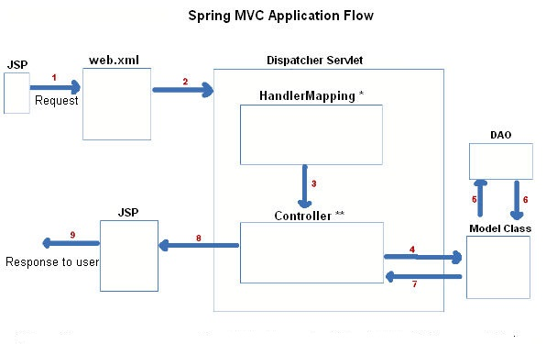
The requesting processing workflow

Slide 48
ModelAndView object
Encapsulates both model and view that is to be used to render model
Model is represented as a java.util.Map
Objects can be added to without name:
  addObject(String, Object) – added with explicit name
  addObject(Object) – added using name generation (Convention over Configuration)
View is represented by String or View object
Analogous to Struts Action

Slide 49
@Controller
Used to indicates that a particular class serves the role of a controller.
The dispatcher scans such annotated classes for mapped methods and detects @RequestMapping annotations
Autodetection by detecting component classes in the classpath and auto-registering bean definitions for them.

Slide 50
Controller
  @Controller
  public class FirstController {
  @RequestMapping("/first.htm")
  public ModelAndView execute()
  {
  String message = "Welcome to Spring 3.0!";
  return new ModelAndView("Success", “msg",message);
  }
  }

Slide 51
View Resolver
Treats view name as a application-relative path to a JSP file.
InternalResourceViewResolver
  The default view resolver
  It creates view of type JstlView.
Application.properties
spring.mvc.view.prefix=/WEB-INF/views/
spring.mvc.view.suffix=.jsp

Slide 52
Static Resources
src/main/resources/static/css
<link href="css/style.css"
rel="stylesheet">
src/main/resources/static/images
<img src="images/logo.png">

Slide 53
SpringBootServletInitializer
SpringBootServletInitializer
  Configures Spring servlet
  overrides theconfigure() method to point to itself, so Spring can find the main configuration.
  Can create REST Main application by extend this class
Main Method
  Not required when deployed to a standalone servlet container
  Required when run as an executable war
  To run it directly in IDE,

Slide 54
ServletInitializer
public class ServletInitializer extends SpringBootServletInitializer {
@Override
protected SpringApplicationBuilder configure(SpringApplicationBuilder application) {
return application.sources(BootMvcWithJspApplication.class);
}
}

Slide 55
Model
A model is a map object that is used to store attribute value pairs
A model is created before invoking a handler method if the method has an argument type Model.
The handler uses the model to store attribute values that convey information to render dynamic views such as JSP.
The method Model.addAttribute(String name, Object obj) is used to map attribute names to object as attribute vales.

Slide 56
@ModelAttribute
When Used as method parameter, maps a model attribute to the specific, annotated method parameter
The controller gets a reference to the object holding the data entered in the form.
When used at method level provides reference data for the model
The @ModelAttribute annotated methods are executed before the chosen @RequestMapping annotated handler method.
This helps in pre-populating the implicit model with specific attributes,

Slide 57
@RequestMapping
Used to map URLs onto an entire or a class or a particular handler method.
Class-level annotation maps a specific request path or pattern to a controller
Method-level annotations are used to narrow the primary mapping or HTTP request ("GET"/"POST") or to HTTP request parameters.

Slide 58
Controller
  @Controller
  public class TripController {
  @Autowired
  TripDetail detail;
  @GetMapping("/")
  public String init() {
  return "index";
  }
  @ModelAttribute("location")
  public String[] loadPlaces() {
  return new String[]{"Bessy Beach","Mahabs","Mayajal"};
  }

Slide 59
Controller
    @GetMapping("/addTrip")
    public String initForm(Model model) {
    model.addAttribute("command",detail);
    return "addTripDetails";
    }
    @PostMapping("/addTrip")
    public String onSubmit(@ModelAttribute("data") TripDetail details) {
    System.out.println(details);
    return "success";
    }
    }

Slide 60
Model
  @Data
  @AllArgsConstructor
  @NoArgsConstructor
  @ToString
  public class TripDetail {
  private long tripId;
  private String source;
  private String destination;
  private double amount;
  }

Slide 61
Using Spring's form tag library
Spring's form tag library gives the tags access to the command object and reference data of the controller
The form tag library comes bundled in spring-webmvc.jar.
The library descriptor is called spring-form.tld.
<%@ taglib prefix="form" uri="http://www.springframework.org/tags/form" %>
A Form tag puts the command object in the PageContext

Slide 62
View
  <form:form action="/addTrip" method="post">
  <form:input path="tripId"/>
  <form:select path="source" items="${location}">
  </form:select>
  <form:input path="destination"/>
  <form:input path="amount"/>
  <input type="submit" value="Add">
  </form:form>

