Slide 1
C.SELVAPRIYA 821721243049 B.TECH-ARTIFICIAL INTELLIGENCE AND DATA SCIENCE SIR ISSAC NEWTON COLLEGE OF ENGINEERING AND TECHNOLOGY

Slide 2
PROJECT TITLE
Handwriting Recognition tool
Using Autoencoder

Slide 3


AGENDA
Problem statement
Project overview
Who are the end users ?
Your solution and its value proposition
The wow in your solution
Modelling
Results
3/21/2024 Annual Review

Slide 4

PROBLEM STATEMENT
we will use natural language processing techniques to transcribe the recognized text into digital format. The problem statement for the Handwritten text recognition project can be defined as follows: To accurately recognize and transcribe handwritten text into digital format.

Slide 5

PROJECT OVERVIEW
Offline handwriting recognition, often referred to as optical character recognition, is performed after the writing is completed by converting the handwritten document into digital form. The advantage of offline recognition is that it can be done at any time after the document has been written, even years later.

Slide 6

WHO ARE THE END USERS?
Students
Teachers and Educators
Researchers
Professionals
General users
Developers

Slide 7

YOUR SOLUTION AND ITS VALUE PROPOSITION
Improve accuracy
Adaptability to varied handwriting styles
Reduced Data Dependency
Privacy Preservation
Real-time Processing
Customization and Personalization
Integration with Existing Systems

Slide 8

THE WOW IN YOUR SOLUTION
The "wow" factor in this solution comes from the ability of the autoencoder to learn a compact representation of handwritten images, capturing the essential features necessary for recognition. By leveraging the power of deep learning and unsupervised feature learning, the system can achieve impressive accuracy in recognizing handwritten text, even when dealing with variations in handwriting styles and quality.
3/21/2024 Annual Review
8

Slide 9
MODELLING
Using autoencoders for handwriting recognition is an interesting approach. Here's a general outline of how you could go about building a handwriting recognition tool using a neural network based on autoencoders:
1. Data Collection and Preprocessing
2. Autoencoder Architecture
3. Training the Autoencoder
4. Feature Extraction
5. Classification Model
6. Evaluation
7. Fine-tuning and Optimization
8. Deployment
9

Slide 10
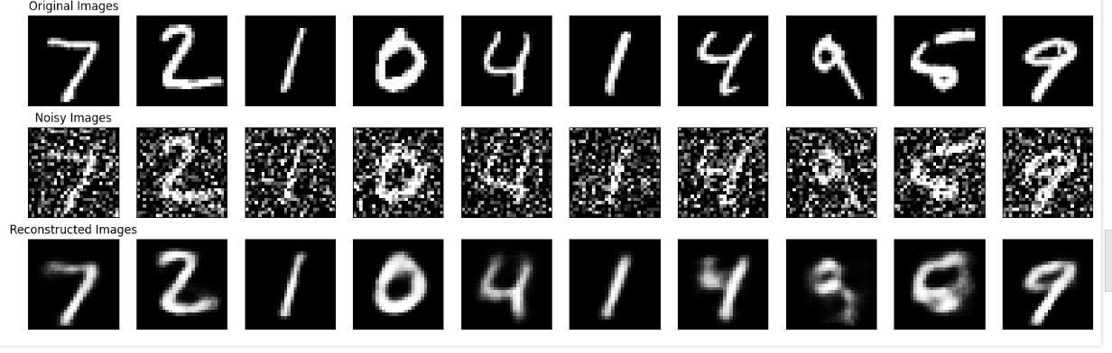
RESULTS
10

