Slide 1
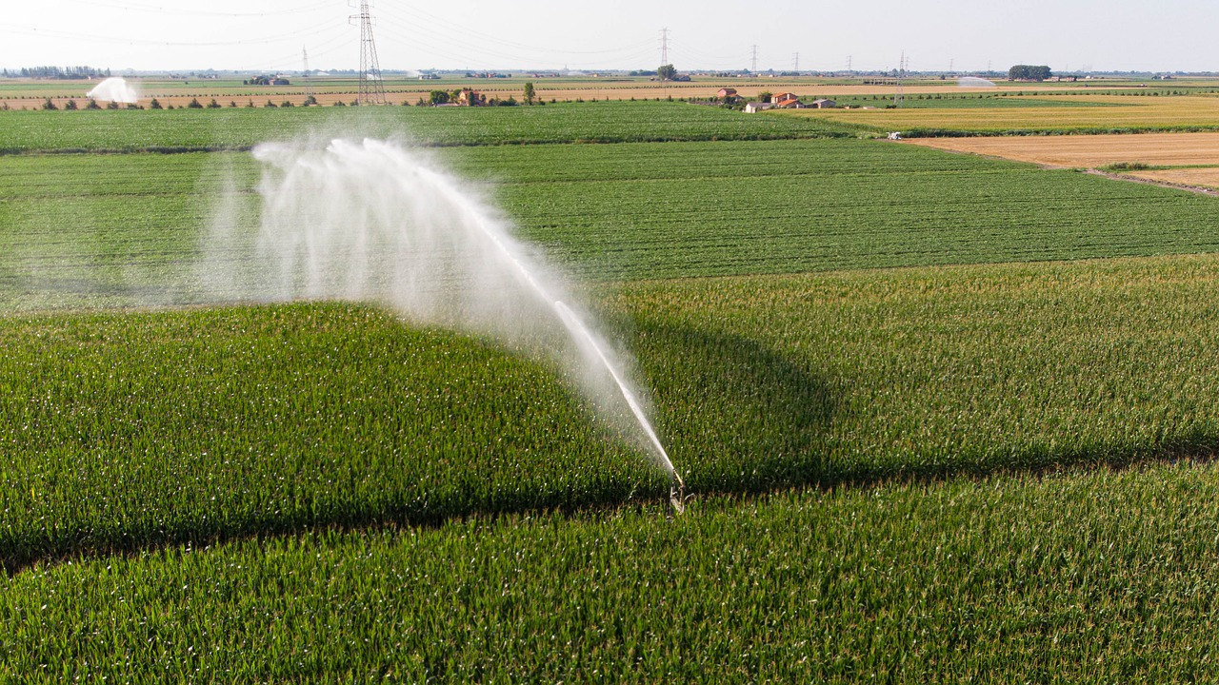
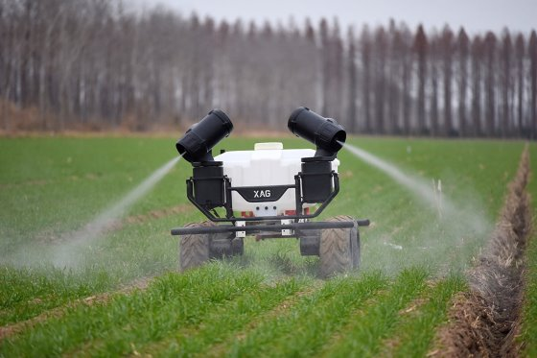
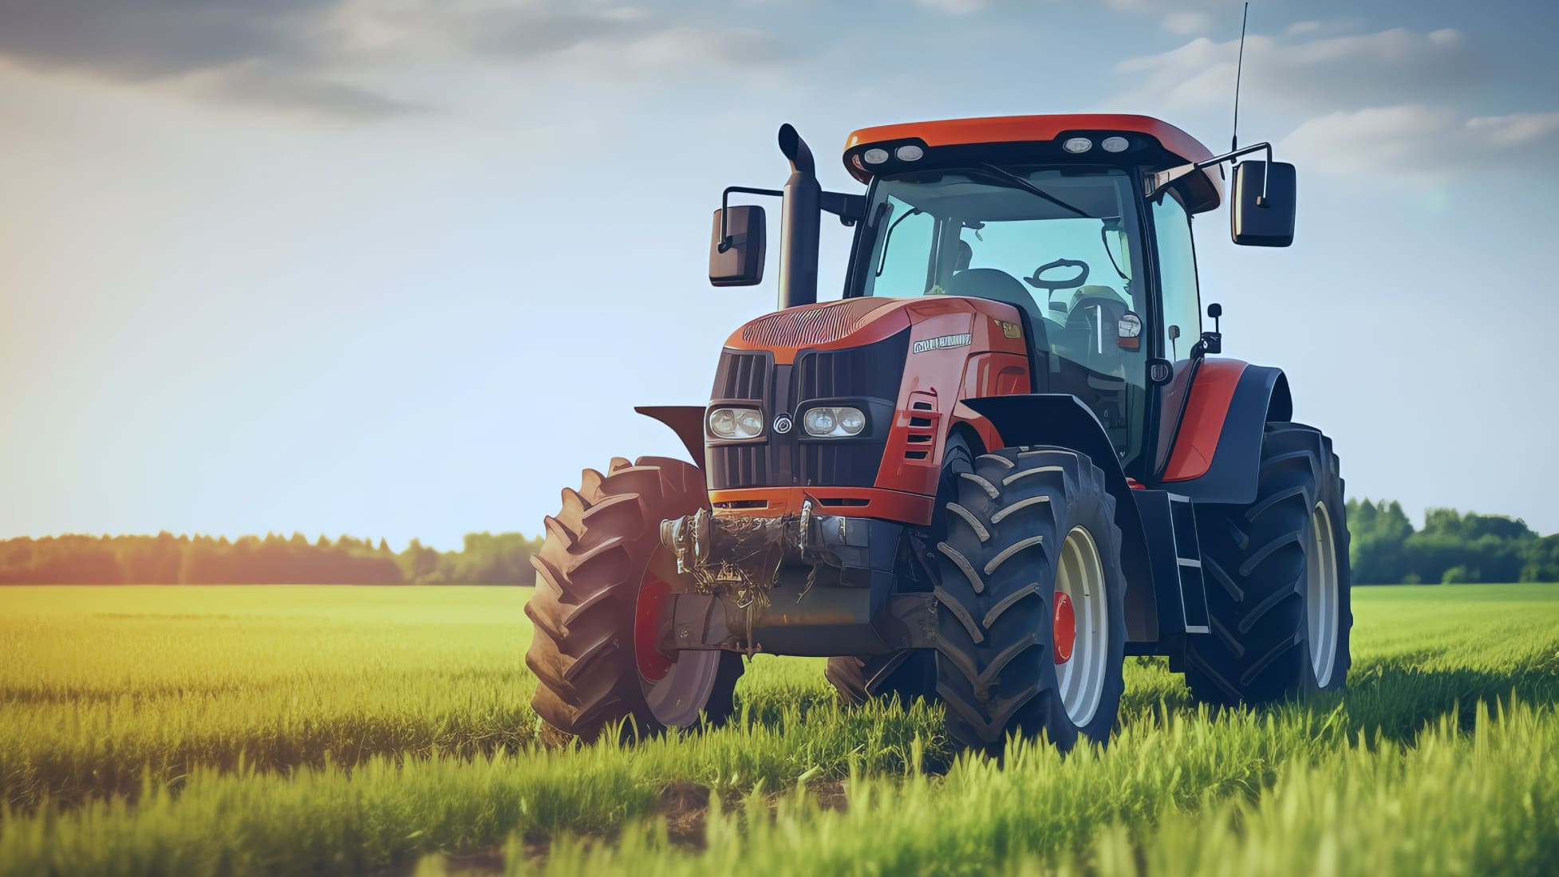
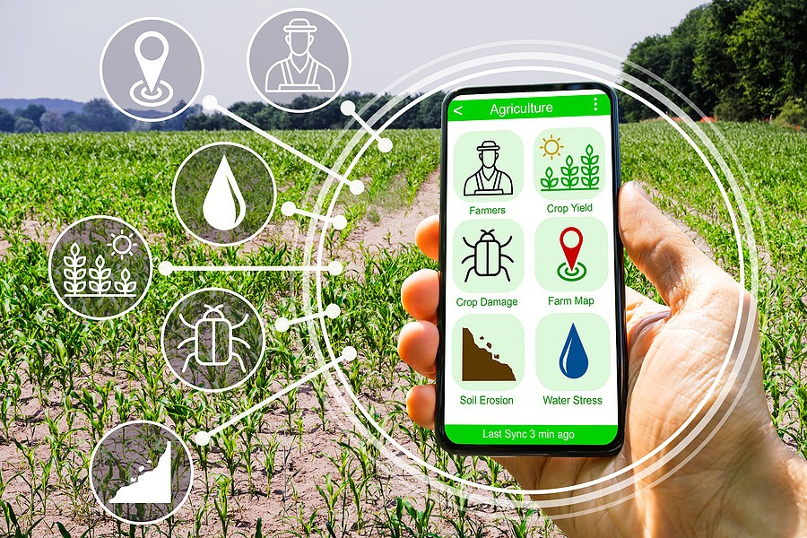
Smart Irrigation System for Precision Farming
Agri-bot Innovators
This rover identifies the growing challenges related to water scarcity, crop health, blanket spraying and to increase the productivity with minimal resources.
It collects various data from soil moisture sensors, temperature sensors, and humidity sensors to asses the soil moisture and weather condition which can affect water evaporation & crop requirement.
In additition, the rover is facilitated with various attachments which can be used for distinct tasks like seed sowing, ploughing, pesticide spraying and plant monitoring.
On average a farmer spend around 15 to 18 lakhs per yield including high cost labor which can be reduced by this rover with its ability to do autonomous tasks ,in addition with solar sustainable energy .
It’s user-friendly model helps the farmer to control and swap between different attachments quickly to perform various farming activities.

Slide 2
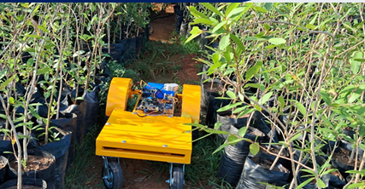
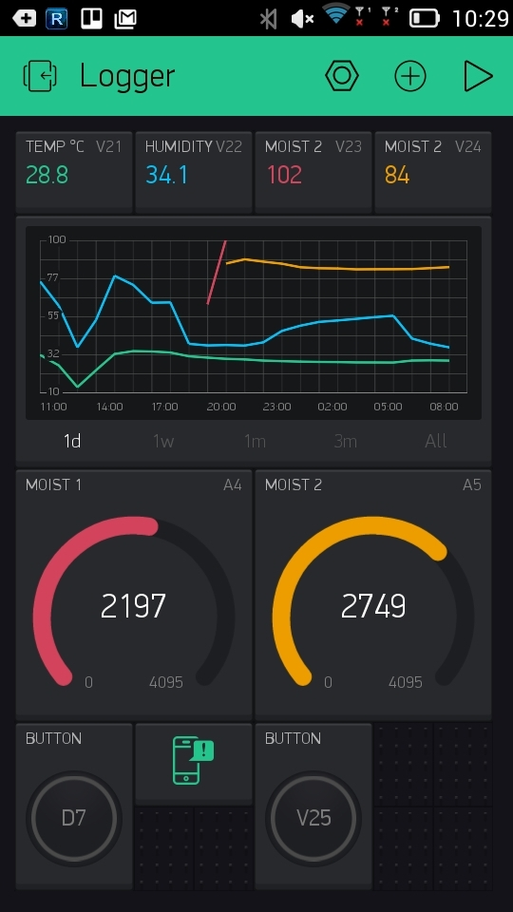
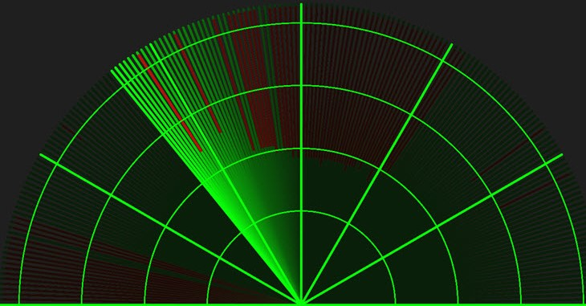
TECHNICAL APPROACH
Agri-bot Innovators
AGRI-BOT
SOFTWARE
HARDWARE
Feature | Raseberry pi zero | Orange pi zero | Banana pi zero | Arduino due
GPIO pins | 40 | 26 | 40 | 54
Wireless | Wifi & Bluetooth | wifi | wifi | Nil
Cam | Yes | Yes | Yes | No
Storage | MicroSD | MicroSD | MicroSD | Flash (512KB)
Price | 1650 | 2300 | 2500 | 3100
Aspects | Python | C/C++ | Java
Learn | Easy | Moderate | Moderate
Speed | Fast | Slow | Moderate
Intergration | Excellent | Good | Good
Python language is used due its extensive libraries and simplicity.
Farmer understandable interface to show real-time data.
This user friendly interface allows farmers to remotely control the rover.
It has 12V rechargeable lithium-ion battery which powers the rover and has a solar panel as sustainable energy.
And integrated with soil moisture, temperature and humidity sensor to collect real time data.
Uses ultrasonic sensors,camera and lidar sharp for its anti-fall ability to track its path and identifying dry leaves.

Slide 3
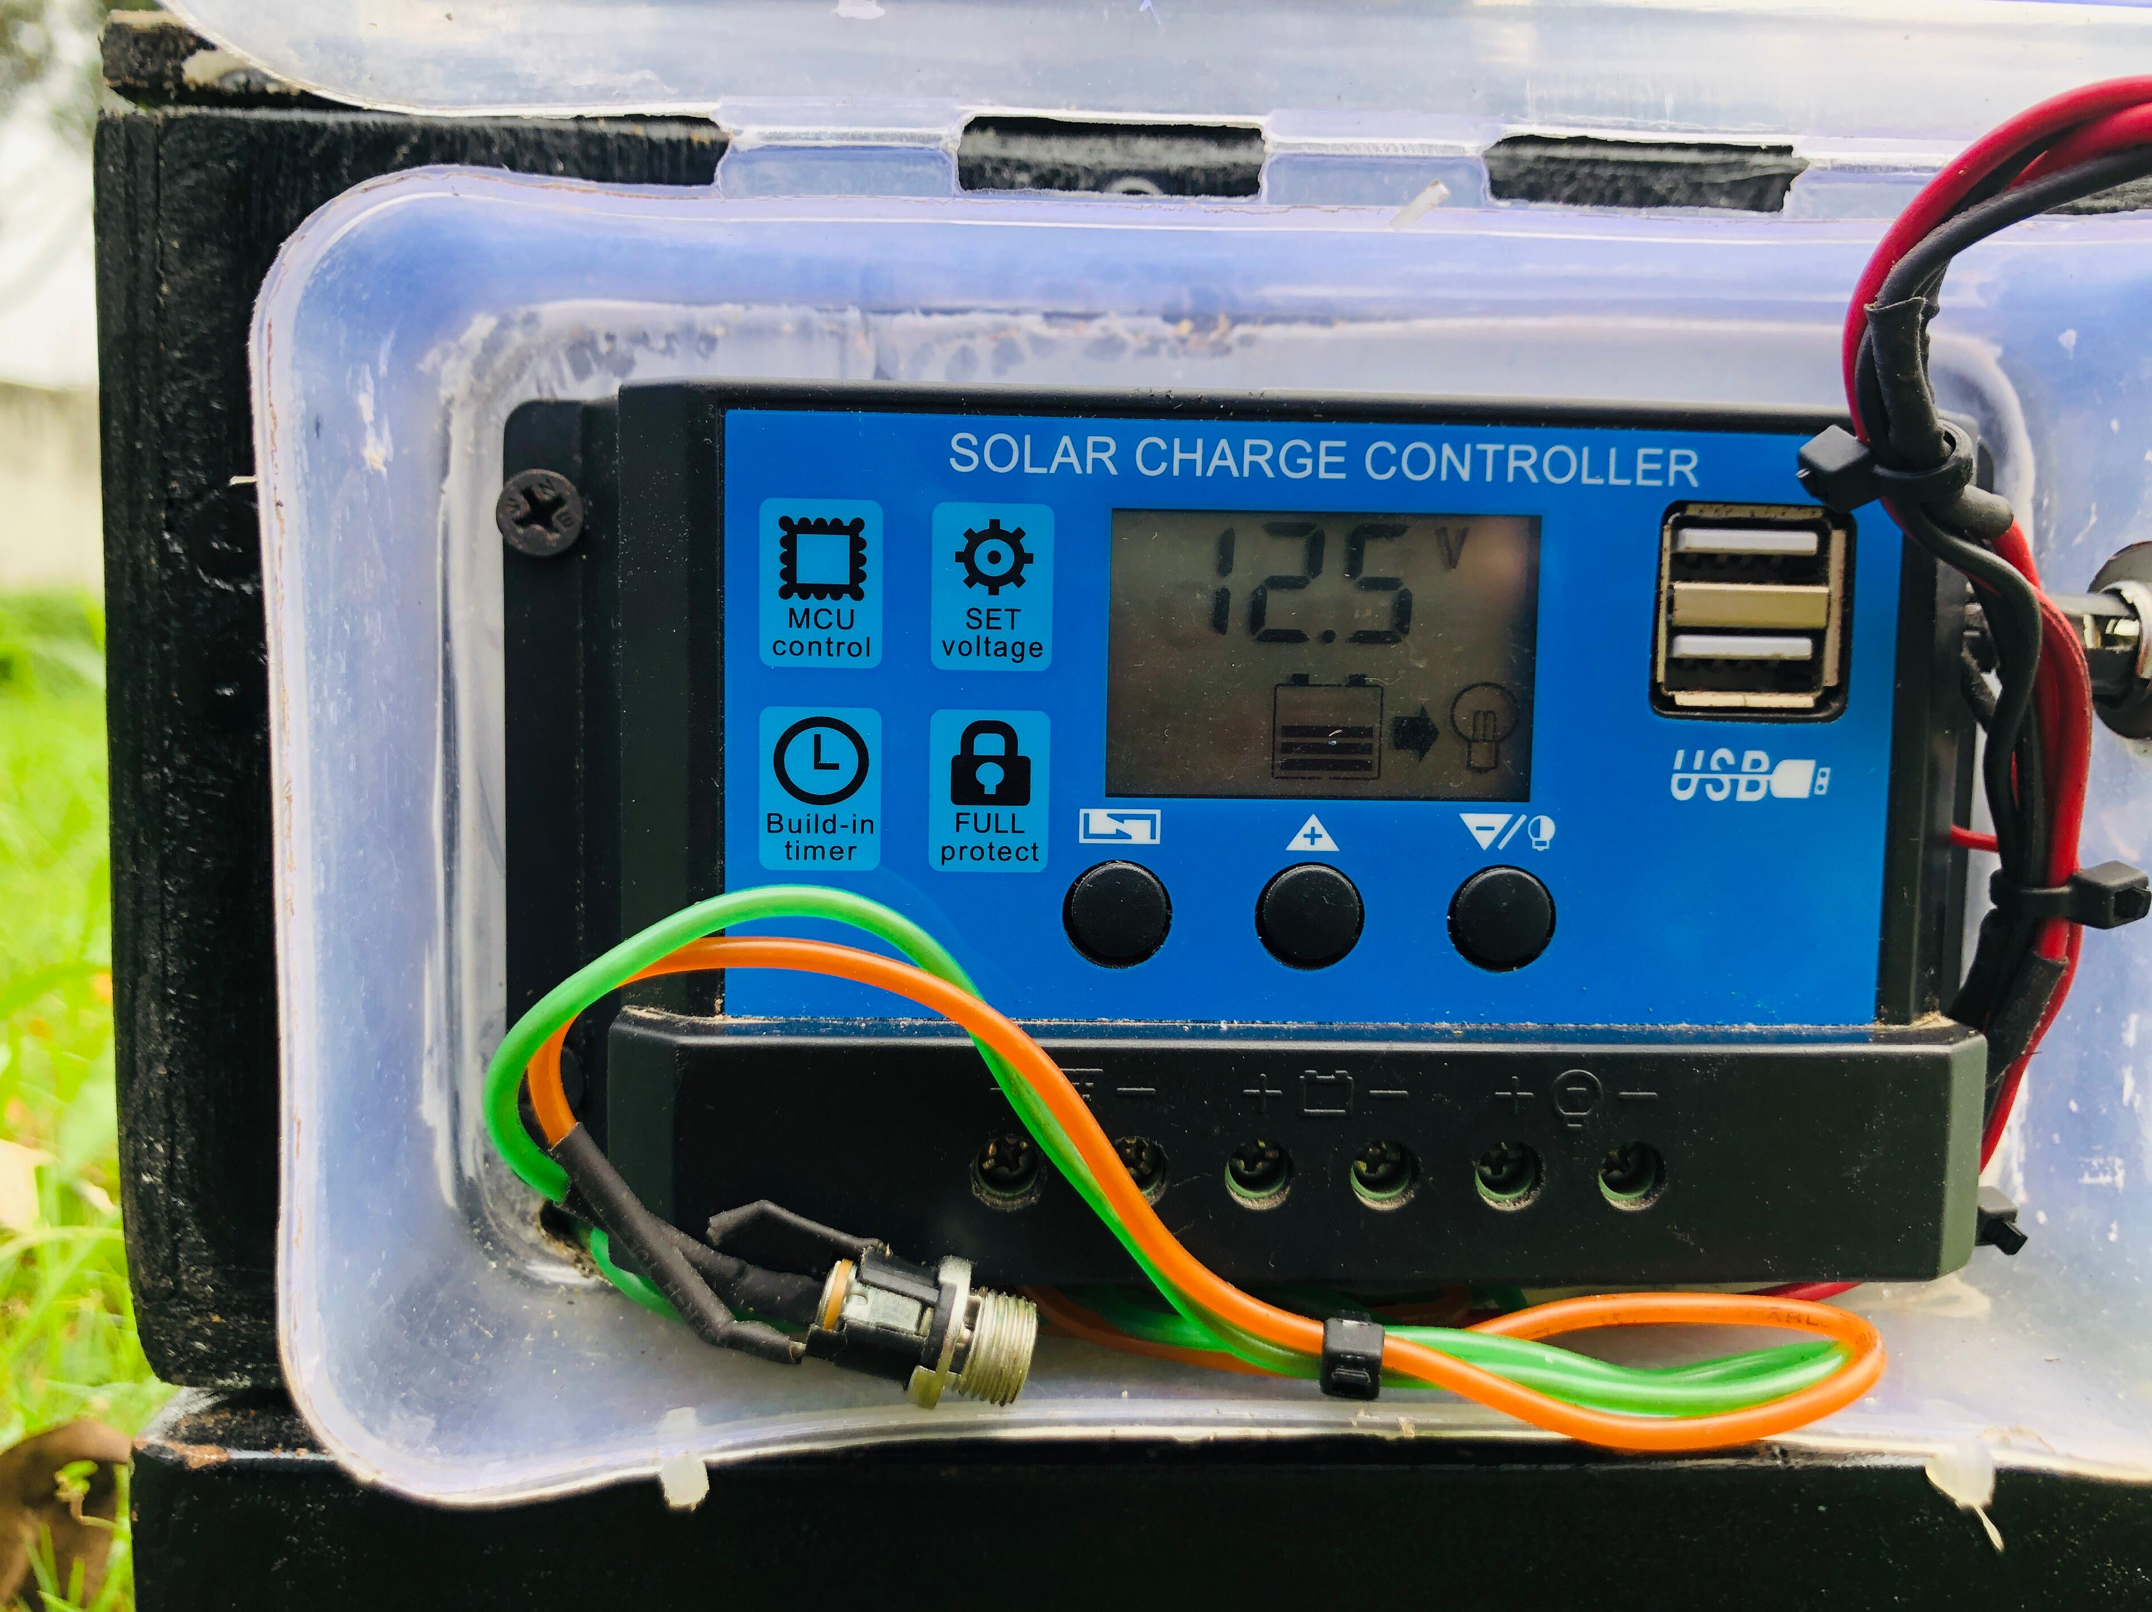
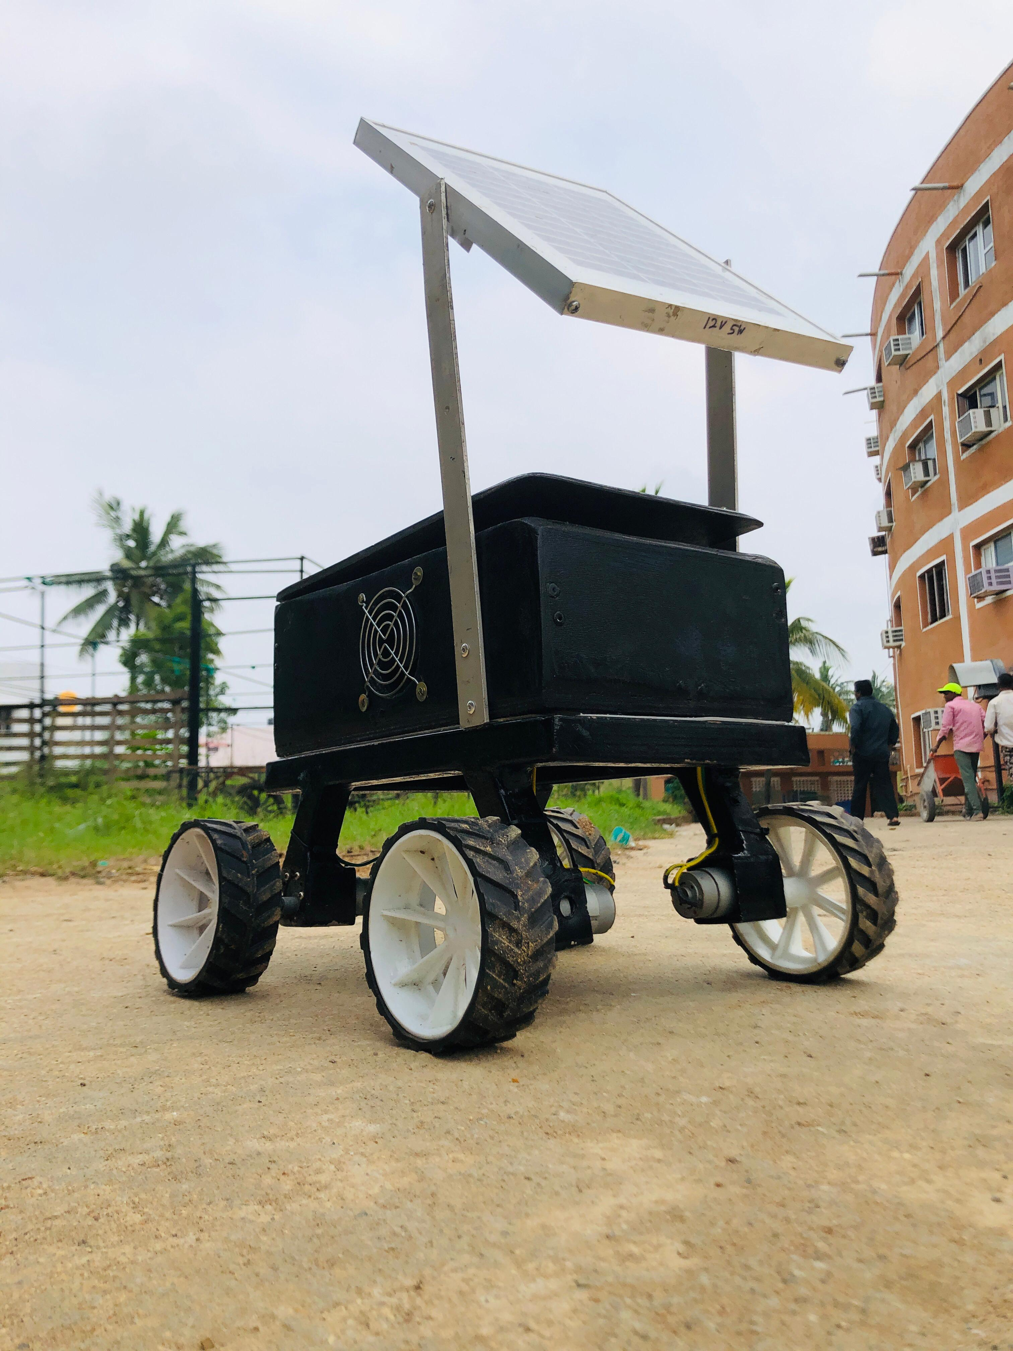
FEASIBILITY AND VIABILITY
Agri-bot Innovators
Analysis of the feasibility of the idea :
All soil moisture sensors, weather condition analyzing sensors are ready available and can be integrated with the controllers.
Has a simple and intuitive HMI interface for accessing real-time data on soil moisture,temperature, and humidity.
There are demands for precise farming solution and for reducing water usage.
Solar panel can be used as a sustainable resource.
And this can be scaled from small-scale farmers to large scale farmers according to their needs, in the way to reduce water usage and labor costs, providing a good return profit.
Potential challenges and risks :
The anti-fall mechanism is designed to prevent the rover from falling into obstacles like pits, trenches, water bodies, or steep inclines, ensuring smooth navigation across the field.
In the high temperatures of agricultural fields, the rover may overheat, but this can be effectively tackled by equipping components with heat sinks ,thermal insulation and cooling systems.
Weather change conditions can severely affect their accuracy and durability lead to inaccurate data,which can be avoided by giving a protective Shields made of transparent, waterproof, and dust-resistant materials.
In areas with limited internet access, allowing data to sync when connectivity is restored. This ensures farmers can still view data while in the field.

Slide 4
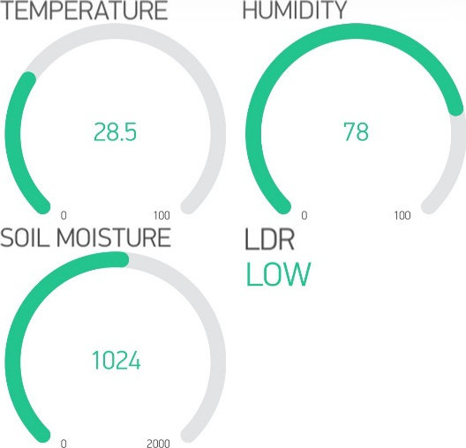
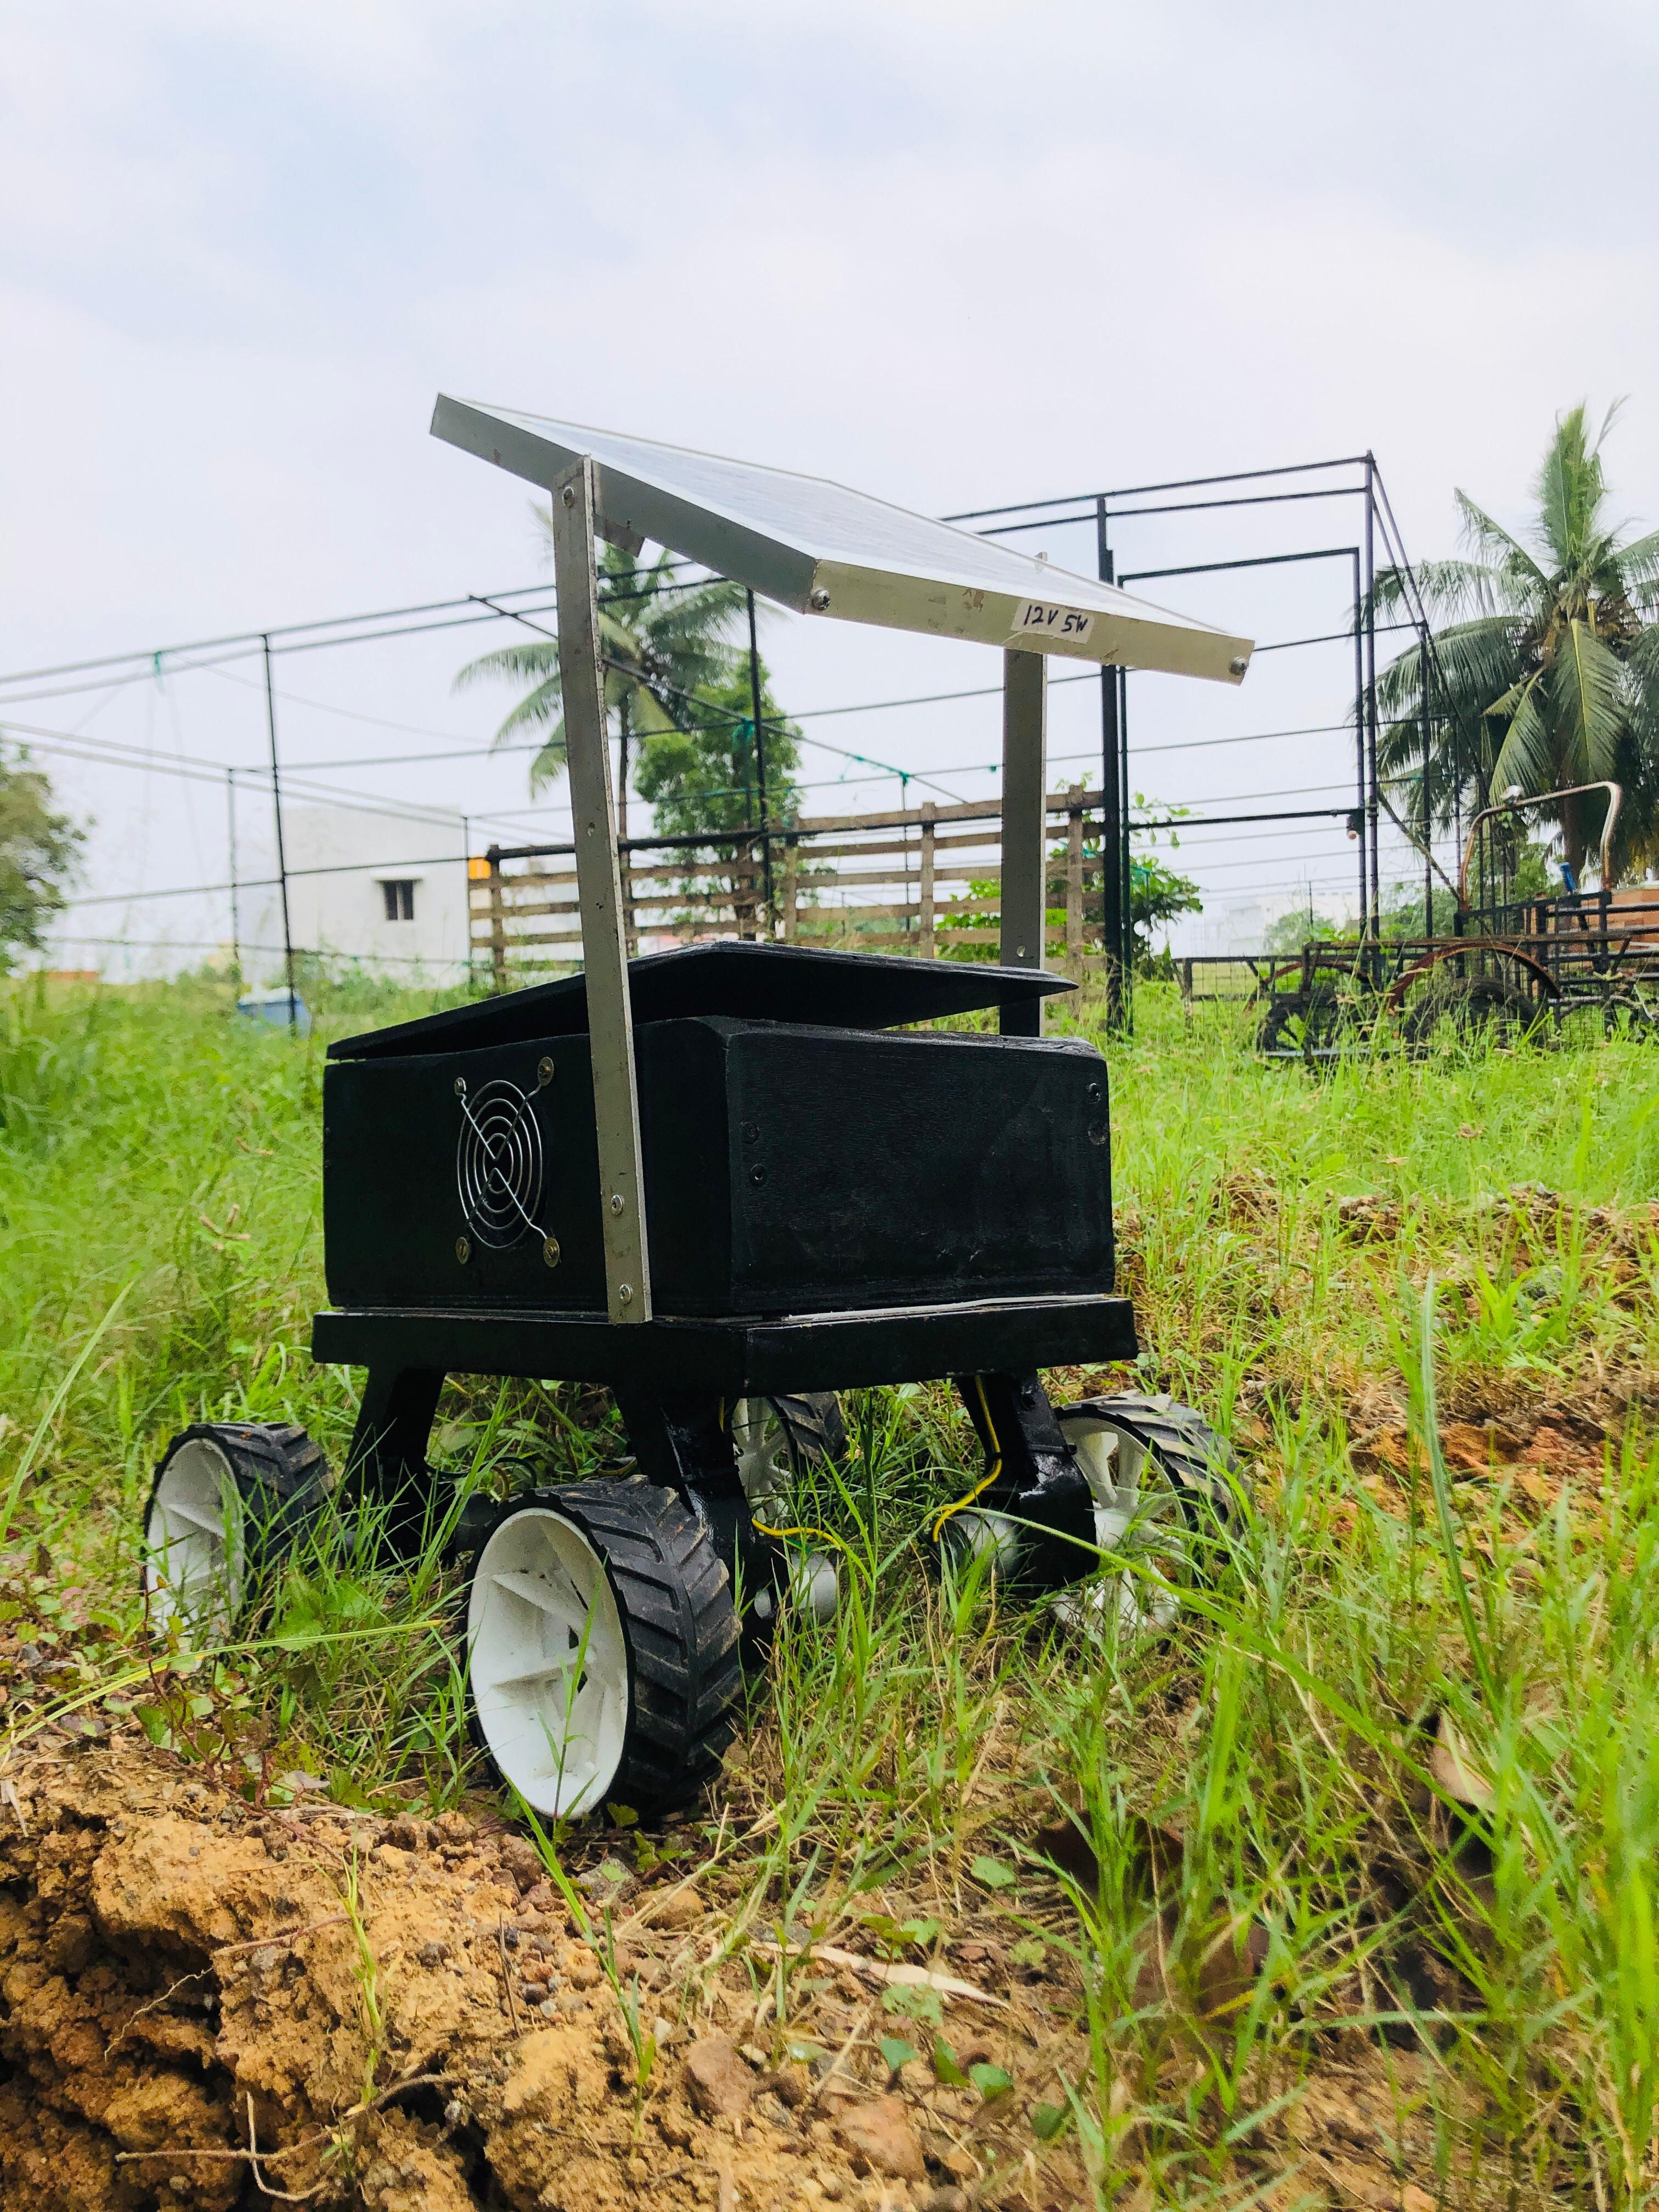
IMPACT AND BENEFITS
Agri-bot Innovators
Potential impact on the target audience :
This is a cost efficient product to invest on which gives effectively select only the features they need.
The system provides farmers with data-driven insights into their farming practices, empowering them to make more informed decisions like moisture level, weather conditions,mapping, plant monitoring.
By covering the major tasks, some tasks needed by the owner can be performed by the labors.
Reduce damaging of crops and wastage of water, chemical,and pesticides used.
Reduce physical burden of doing all the tasks like irrigating, seed sowing, ploughing and pesticide spraying.
Benefits of the solution :
The solution provides a scalable foundation for launching a startup.
This benefits all farmers from small scale to large scale agriculture to make their system autonomous and reduce water usage ,labor usage.
This reduces the cost for the cultivation by reducing the water usage and labor
Provide more crop yeild inverse good profit rate.

Slide 5
RESEARCH AND REFERENCES
Agri-bot Innovators
Ranjan, S.; Sow, S. Drip Irrigation System for Sustainable Agriculture. Agric. Food 2020, 2, 67–69.
Mangi, N. Performance and evaluation of drip irrigation system, and its future advantages. Sch. Rep. 2020, 4, 27–41.
Prachi Kamble, Yogendra Parihar, "Smart plant monitoring system," International Journal of Emerging Technologies and Innovative Research (JETIR), vol. 1, no. 2, 2003.
“Command Based Self-Guided Digging and Seed Sowing Rover," in Proceedings of the International Conference on Emerging Trends in Science and Humanities (ICETSH), 2015.
J. K. S. Lokanadam, S. Ganesh, M. N. Raate, and N. T. N. Pavan, "Precision Agriculture Robot for Seeding Function and Leaf Disease Detection," International Journal of Recent Trends in Engineering & Research (IJRTER), vol. 4, no. 6, pp. 50-55, 2018.
P. Rajesh Kanna and R. Vikram, "Agricultural Robot – A pesticide spraying device," in Proceedings of the International Conference on Machine Vision (ICMV), 2019.
X. Zhao, “The main application of intelligent robot in the field of agriculture automation”, Chinese Agricultural Science Bulletin,
vol. 26, no. 10, pp. 360-364, 2010.
Akash Patil, Shashank Pathmudi, and Gaurav Patil, "Plant Monitoring System," Journal of Future Technologies and Research (JFTR), vol. 2, no. 1, pp. 12-18, 2020.
S. I. Cho and N. H. Ki, "Autonomous speed sprayer guidance using machine vision and fuzzy logic," Transactions of the ASAE, vol. 42, no. 4, pp. 1137-1143, 1999.
Carvalho, J. P., Silva, M. F., & Rocha, S. (2023). Advances in robotic systems for automated planting and harvesting. Journal
of Agricultural Engineering Research, 31(2), 215-228

