Slide 1


AI-Based Personalized Skill-Gap Learning Planner
PRESENTED BY
RENGANAYAKI G | 2403811724322091
ROHIT KRISHNA J | 2403811724321095
SANTHOSH KUMAR S | 2403811724321098
SELVARANI S | 2403811724322103

Slide 2

PROBLEM STATEMENT
Students face difficulties in identifying career-required skills, assessing their existing skills, and recognizing skill gaps.
Existing platforms lack a fully personalized learning sequence, requiring a system that integrates learning resources and generates an optimized learning path based on individual skill gaps.

Slide 3
OBJECTIVE
To identify career-specific technical skills.
To assess the student's existing skills.
To identify missing skills through skill-gap analysis.
To calculate the student's career readiness percentage.
To track the student's learning progress.

Slide 4
LITERATURE SURVEY
https://docs.google.com/spreadsheets/d/1khbUJvwRU88kzro2bLubuzCfsCb7C7yEehYhB338Mrw/edit?usp=sharing

Slide 5
EXISTING SYSTEM
The existing learning system mainly relies on general online courses, tutorials, and learning platforms.
These systems often require students to manually identify their skill gaps and select suitable learning resources.

Slide 6
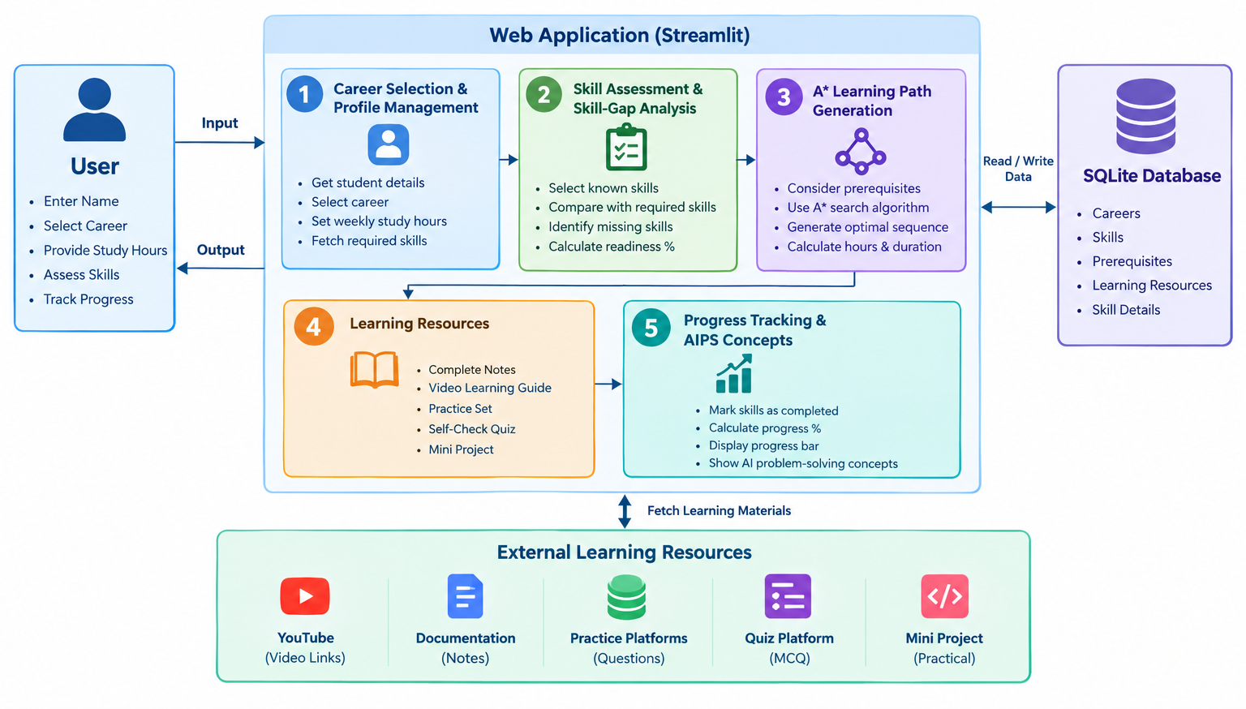
SYSTEM ARCHITECTURE

Slide 7
PROPOSED SYSTEM
The proposed SkillPath AI system uses skill-gap analysis and the A Search Algorithm to identify missing career skills and generate a personalized learning path based on prerequisites and learning requirements
It provides structured learning resources such as notes, videos, practice sets, self-check quizzes , and mini projects.

Slide 8
LIST OF MODULES
Career Selection & Student Profile Module
Skill Assessment & Skill-Gap Analysis Module
A*-Based Personalized Learning Path Module
Interactive Learning Resources Module
Learning Progress Tracking Module

Slide 9
MODULE DESCRIPTION
1.Career Selection & Student Profile Module:
Collects student details such as name and study hours.
Allows the student to select the desired career.
Retrieves the required skills for the selected career.
Provides the input needed for further skill assessment.

Slide 10
MODULE DESCRIPTION
2. Skill Assessment & Skill-Gap Analysis Module:
Identifies the student’s existing skills.
Compares existing skills with the career-required skills.
Identifies the missing skills or skill gaps.
Calculates the student’s career readiness percentage.

Slide 11
MODULE DESCRIPTION
3. A*-Based Personalized Learning Path Module:
Takes the identified skill gaps as input.
Considers skill prerequisites and learning cost.
Uses the A Search Algorithm* to find an optimized learning sequence.
Generates a personalized path from current skills to career-required skills

Slide 12
MODULE DESCRIPTION
4. Interactive Learning Resources Module:
Provides learning materials for each required skill.
Includes Complete Notes and Video Learning Guides.
Includes Mini Projects for practical skill development.

Slide 13
MODULE DESCRIPTION
5. Learning Progress Tracking Module:
Allows students to mark completed skills.
Tracks the student’s learning progress.
Calculates and displays the progress percentage.
Helps students monitor their progress towards career readiness.

Slide 14
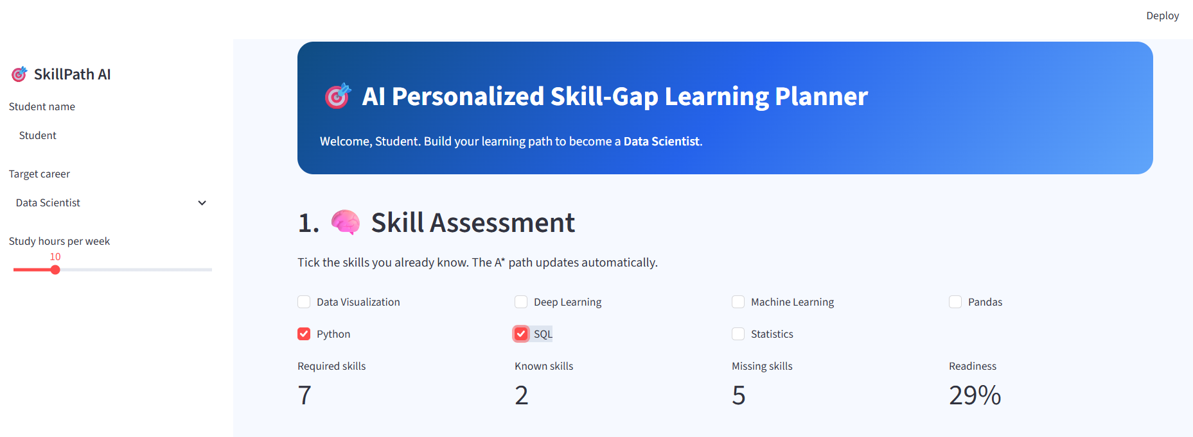
IMPLEMENTATION OF PROPOSED SYSTEM

Slide 15
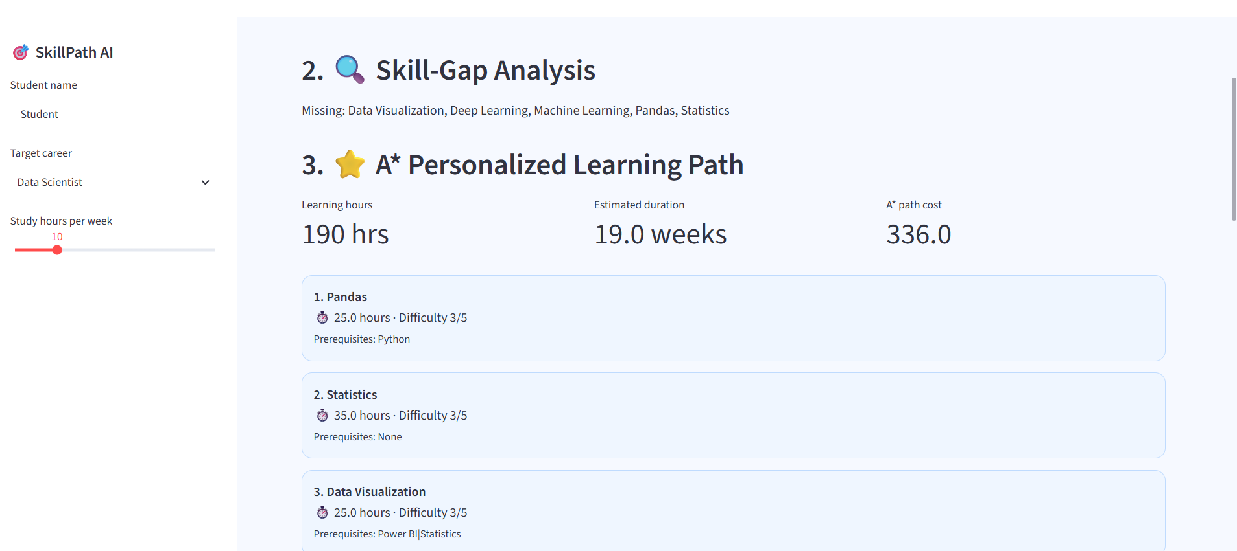
IMPLEMENTATION OF PROPOSED SYSTEM

Slide 16
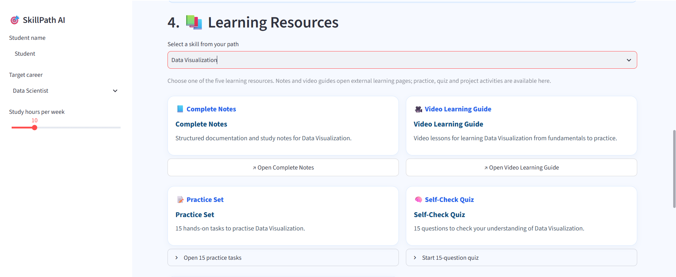
IMPLEMENTATION OF PROPOSED SYSTEM

Slide 17
CONCLUSION
SkillPath AI provides a personalized learning path by identifying skill gaps and using the A* Search Algorithm. It helps students learn required skills systematically and track their progress towards career readiness.

Slide 18
THANK YOU !!!

