Slide 1
PRESENT STATUS AND CONSERVATION OF MEDICINAL PLANTS IN THE VICINITY OF KALAIYOODAI KANNAKI AMMAN KOVIL,IN NAVAALY,JAFFNA DISTRICT-A FIELD SURVEY
PRESENT BY: SUVARNAA.S
UNIT OF SIDDHA MEDICINE,
UNIVERSITY OF JAFFNA

Slide 2
INTRODUCTION
Indigenous system of medicine consists of Siddha,Ayurvedic,Unani and traditional medicine.
In practice, generally medicinal plants are used often in compound form to which either herbs,metals,minerals and animal’s products are added,but mostly herbs are used in treatment of diseases.

Slide 3
GENERAL OBJECTIVE
Present status and conservation of Medicinal plants in the vicinity of Kalaiyoodai Kannaki Amman Kovil in Navaaly,Jaffna district- A Field Survey

Slide 4
SPECIFIC OBJECTIVES
*To identify the total Medicinal plants with botanical,Tamil name and Family in this study area.
*To classify the Medicinal plants according to the taxonomical morphology.
*To find the Lifespan of the medicinal plants in the study area.
*To determine of the Medicinal plants either common nor rare in this study area.
*To record the medicinal plant’s habitat natural or cultivated in this study area.
*To classify the medicinal plants according to the it’s pharmocological actions.
*To classify the medicinal plants according to the main curable diseases.

Slide 5
MATERIAL AND METHODS
-Study area was Kalaiyoodai Kannaki Amman kovil located in Navaaly of Jaffna district.
-Province is Northern and DS Division is Valikamam South west.

Slide 6
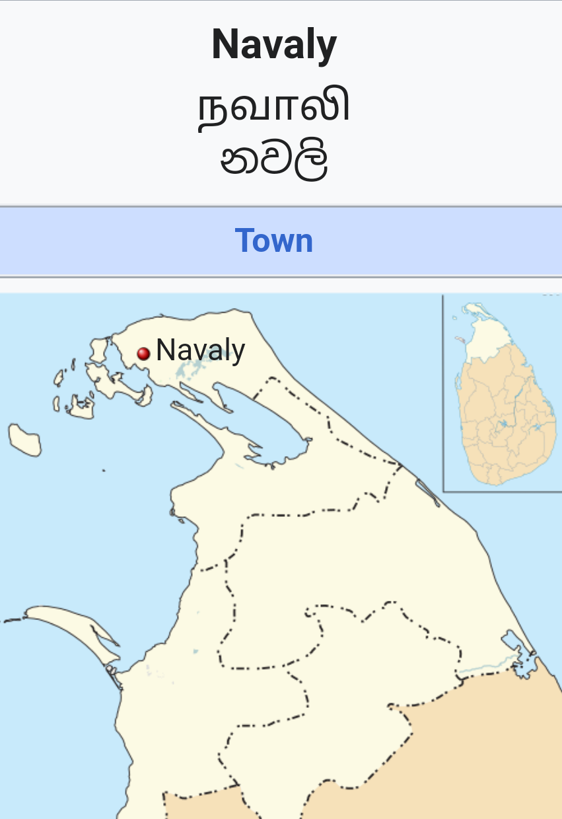
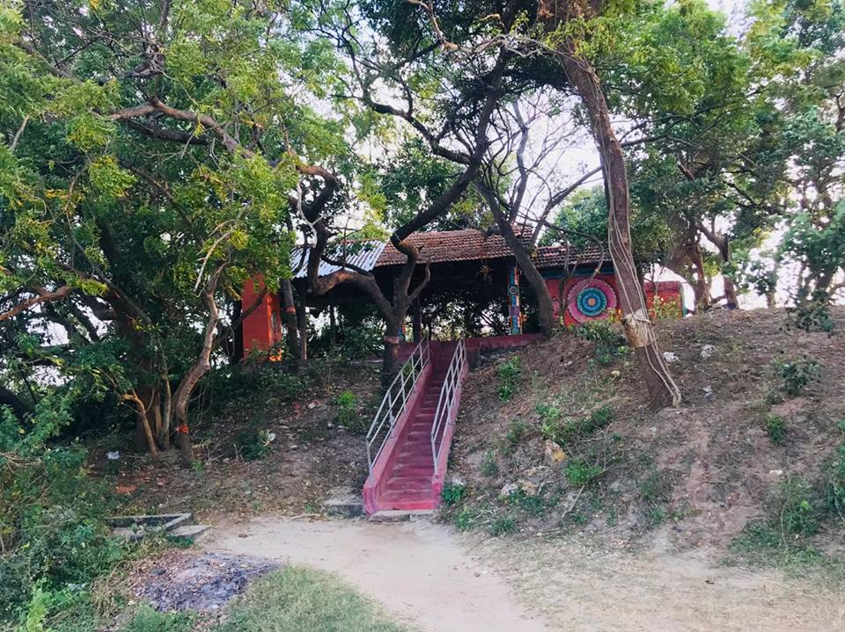
MATERIAL AND METHODS
Study area:
Study area was Kalaiyoodai Kannaki Amman kovil located in Navaaly of Jaffna district.
Province is Northern and DS Division is Valikamam South west.

Slide 7
DATA COLLECTION
Survey was carried out during year 2019 in the area of Kalaiyoodai Kannaki Amman Kovil,Navaaly,Jaffna.
The area map was used to record the medicinal plants and other data were collected from the records of department of Gunapadam,Unit of Siddha Medicine,University of Jaffna for the identification of the Medicinal plants in the study.

Slide 8
RESULTS AND DISCUSSION
The recorded information 98 Medicinal plant species were listed with their Family and Local Ecological status in the Kalaiyoodai Kannaki Amman Kovil,Navaaly,Jaffna.Some of the most important medicinal plants vicinity of Kalaiyoodai Kannaki Amman Kovil in Navaaly,Jaffna.
Hydrophyla spinosa,Barleria mysorensis,Ruelia tuberosa,Alangium salviifolium,Areva lanata,Achyranthes aspera,Amaranthus gangetius,Partulaca olefacea,Amaranthus paniculatus,Carissa corundus,Aristolachia bracteolata,Hemidesmus indicus,Asclepias vormitoria,Eclipta alba,Vernonia zeylonica,Trichodesma indicum,Commiphora mukul,Cactus indicus,Capparis zeylanica,Crateva religiosa,Cassia auriculata,

Slide 10
In Madhumega Diseases
MEDICINAL PLANT | PART USED
Alangium salviifolium | Seeds
Cassia auriculata | Leaves
Cassia fistula | Resin
Coccinea grandis | Tuberroot
Tinospora cordifolia | Maturedstem
Ficus bengalensis | Bark
Ficus reliosa | Bark
Mimosa pudica | Wholeplant
Eugenia jambolana | Seeds

Slide 11
IN SKIN DISEASE
MEDICINAL PLANT | USED PART
Ruelia tuberosa | Leaves
Aristolachia bracteolata | Leaves
Euphorbia hirta | Whole plant
Ammonia baccifera | Whole plant
Thespesia populnea | Leaves
Sida vernonicaefolia | Leaves
Azadiracta indica | Bark
Clitoria turnatea | Leaves
Cyperus rotundus | Whole plant

Slide 12
NO | CULTIVATED PLANT
1 | Amaranthus paniculatus
2 | Musa sapientum
3 | Solanum trilobatum
4 | Cocos nucifera

Slide 13
NO | PHARMACOLOGICAL ACTION | NO | MEDICINAL PLANTS | PARTS USED
1 | EXPECTORANT | 1 | Barleria mysorensis | Root
 |  | 2 | Trichodesma indicum | Leaves
 |  | 3 | Ocimum album | Leaves
 |  | 4 | Abrus precatoris | Leaves
 |  | 5 | Erythrina indica | Leaves
 |  | 6 | Oldenlandia umbellae | Leaves
 |  | 7 | Solanum trilobatum | Leaves
 |  | 8 | Leucas zeylanica | Leaves

Slide 14
2 | ANTI-PYRETIC | 1 | Tinospora cordifolia | Matured stem
 |  | 2 | Azadiracta indica | Bark
 |  | 3 | Toddalia asiatica | Rootbark
 |  | 4 | Vitex negundo | Root
 |  | 5 | Calophyllum inophyllum | Seed

Slide 15
3 | ANDI MAANDHA | 1 | Vitex negundo | Root
 |  | 2 | Morinda tinctoria | Root

Slide 16
4 | DIURETIC | 1 | Hydrophyla spinosa | Whole plant
 |  | 2 | Areva lanata | Whole plant
 |  | 3 | Hemidesmus indicus | Root
 |  | 4 | Decalepis hamiltonii | Root
 |  | 5 | Cyperus rotundus | Whole plant
 |  | 6 | Boerhavia diffusa | Leaves
 |  | 7 | Clitoria turnatea | Tuber
 |  | 8 | Musa sapientum | Whole plant
 |  | 9 | Tribulus longinosus | Root

Slide 17
5 | ANTI VATHA OR ANTI INFLAMMATORY | 1 | Amaranthus gangetius | Wholeplant
 |  | 2 | Calotrophis gigantea | Root
 |  | 3 | Asclepias vormitoria | Root
 |  | 4 | Enicostema axillare | Wholeplant
 |  | 5 | Pavonia odorata | Root
 |  | 6 | Sida cordifolia | Root
 |  | 7 | Pavetta indica | Leaves
 |  | 8 | Dodonaea viscosa | Root
 |  | 9 | Cardiospermum microcarpum | Leaves
 |  | 10 | Jatropha circus | Root

Slide 18
6 | ASTRINGENT | 1 | Ficus bengalensis | Bark
 |  | 2 | Ficus reliosa | Bark
 |  | 3 | Streblus aspera | Bark
 |  | 4 | Eugenia jambolana | Bark
 |  | 5 | Zizyphus jujuba | Bark
 |  | 6 | Phyla nodiflora | Leaves
 |  | 7 | Feronia elephantum | Pod

Slide 19
7 | TONIC | 1 | Alangium salviifolium | Fruit
 |  | 2 | Amaranthus gangetius | Leaves
 |  | 3 | Partulaca olefacea | Leaves
 |  | 4 | Amaranthus paniculatus | Leaves
 |  | 5 | Celosia europium | Leaves
 |  | 6 | Amaranthus angustifolia | Leaves
 |  | 7 | Terminalia arjuna | Bark
 |  | 8 | Rivea ornata | Leaves
 |  | 9 | Ipomoea aquata | Leaves
 |  | 10 | Phyllanthus frataenus | Wholeplant
 |  | 11 | Sesamum indicum | Seeds
 |  | 12 | Eugenia jambolana | Fruit

Slide 20
8 | VERMIFUGE | 1 | Capparis zeylanica | Pod
 |  | 2 | Cassia fistula | Resin
 |  | 3 | Azadiracta indica | Leaves
9 | STYPTIC | 1 | Pogostemon heyneanus | Leaves
 |  | 2 | Borreria hispida | Leaves
 |  | 3 | Oldenlandia umbellae | Wholeplant
10 | ANTIDOTE | 1 | Alangium salviifolium | Rootbark
 |  | 2 | Cynodon dactylon | Wholeplant
 |  | 3 | Azadiracta indica | Bark
 |  | 4 | Ocimum album | Leaves

Slide 21
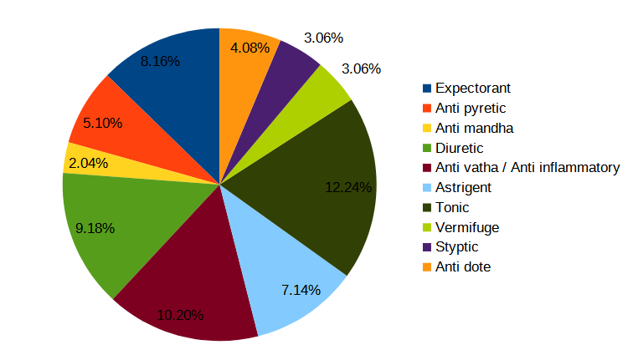

Slide 23
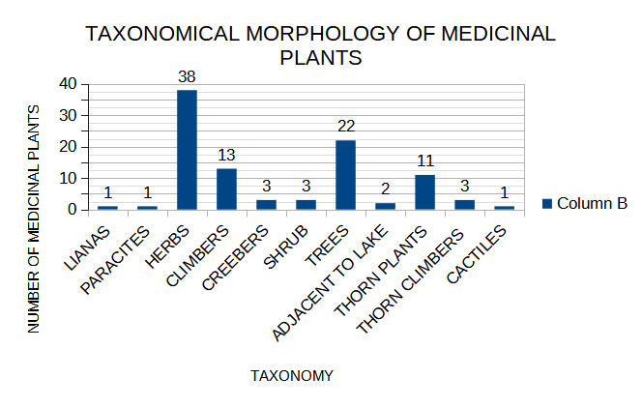

Slide 24
CONCLUSION
This study area revealed a considerable Medicinal plants diversity of Kalaiyoodai Kannaki Amman Kovil,Navaaly,Jaffna district.
Study area has a rich soil that mostly natural habitat wild plants 94(95.91%) and 04(4.08%) of cultivated plants.
According to the lifespan,most of the medicinal plants were perennial(68.36%) and 31 plants were annual(31.63%) in the study area.
In distribution of the Medicinal plants were 52(53.06%) common and 46(46.93%) were rare in this area.So that we should be product and conservate them on their natural habitat.
According to the taxonomicalmorphology,38 herbs(38.77%) were most of the Medicinal plants also had 22 trees(22.04%).Besides, had 13 climbers(13.26%),11thorn plants(11.22%) in the study area.This area has a tropical climates according to the taxonomicalmorphology.
According to the Pharmocological actions,Medicinal plants act as tonic(12.24%),diuretic(9.18%),expectorant(8.16%),antivatha(10.20%). It may create a healthy people without diseases while this Medicinal plants are used to respiratory related problems such as sputum,cough in children,Vatha diseases and other diseases.
This study area of distribution of the Medicinal Plants are used 09(9.18%) of the Medicinal plants on management of Skin diseases and 09(9.18%) of the Medicinal plants on management of Madhumega.Therefore,this diseases may control by using this Medicinal plants.
According to these findings,we should be protect and conserve from destroying these valuable Medicinal plants on their natural habitat and this area.

Slide 25
REFERENCE
1.Nadkarni,K.M,Indian Meteria medica.
2.Sathiyaseelan,V(2003)Gunapadam Mooligaiyiyal, pp.2- 33
3.Sanmugaraja,S(1997)Sudhesa Maruththua Mooligaiyagaradhipp.52-143
4.Murugesa muthaliyaar,K,Gunapadam Mooligai akuppu
5.Jayaweera,D.M.A,(2006),Medicinal plants,Part 1,pp.7-209
6.Ramanathan,Pon(2002 )Mooligai seiyalthokuppu,pp.27-117
7.Sathiyaseelan,V (2008)Materia medica II pp.20-218
8.Jayaweera,D.M.A,(2006),Medicinal plants,Part 2,pp.15-231
9.Jayaweera,D.M.A,(1981),Medicinal plants,Part 3,pp.177
10.Jayaweera,D.M.A,(1982),Medicinal plants,Part 4,pp.23-301
11.Jayaweera,D.M.A,(1982),Medicinal plants,Part 5,pp.21-223
12.https://en.wikipedia.org/wiki/Navaly
13.https://maps.app.goo.gl/JXaHVK4FisBGwF4k7

Slide 26


