Slide 1
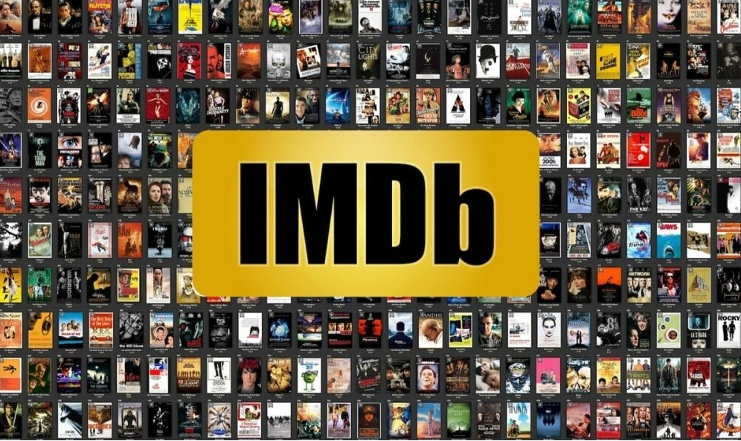
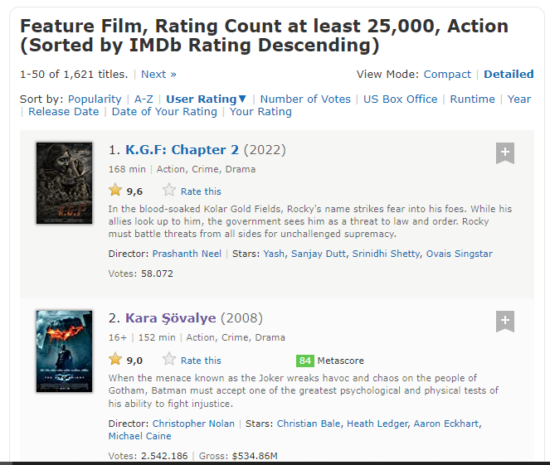


PROJECT 2
web scrappıng and lınear regressıon
- ımdb DATA -
Vildan TELLİOĞLU
Taha Yasin YILMAZ
Birsen BAŞ
Selva TAŞ

Slide 2

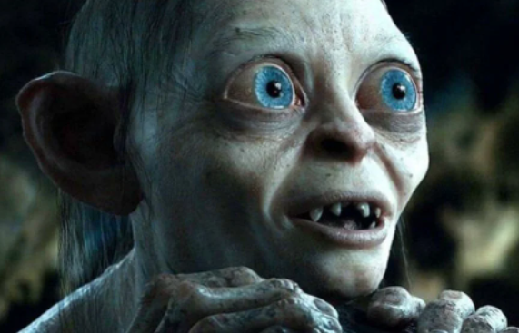
Contents
Web Scrapping
Data Cleaning
EDA
Linear Regression
Feature Engineering

Slide 3

Introduction
PROBLEM DEFINITION
SOLUTION RECOMMENDATION
OBJECTIVE
There is a request from the WARNER BROS that is the one of the biggest film company, what is the points to focus on making a popular action film
To get some datas with WebScrapping method from IMDB site and to predict IMDB rating with Linear Regression for a new film with new paramaters
To analyse the most effecting parameters for the IMDB all action films and to see their relationship with the IMDB rating

Slide 4








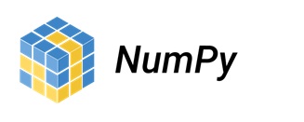



Methodology
Data Source
IMDB: action films
Tools

Slide 5
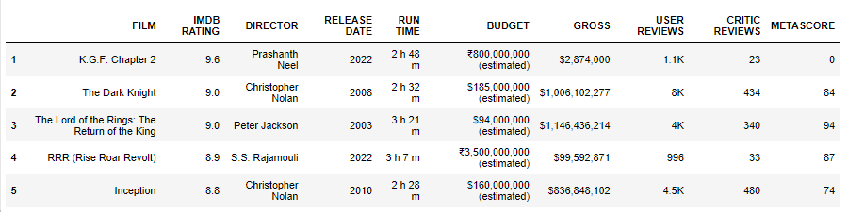
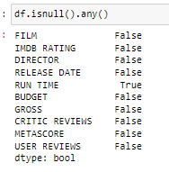
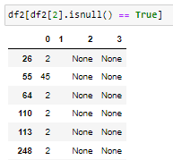

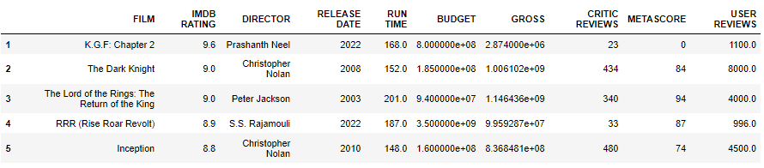


About Data
WebScrapping
Data Convert

Slide 6
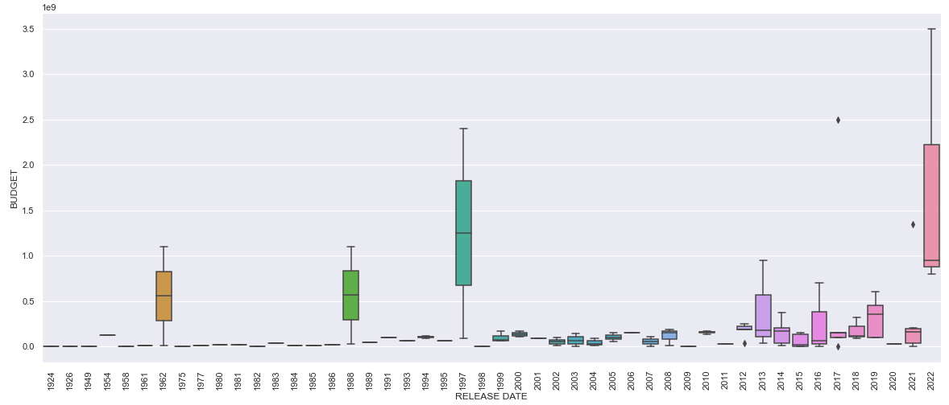
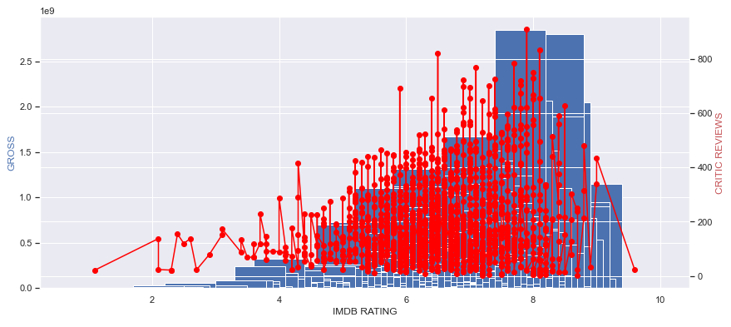
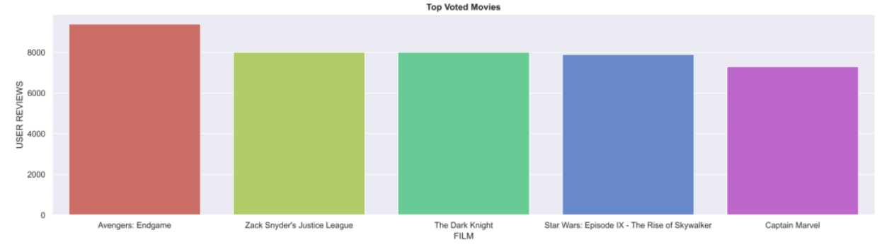
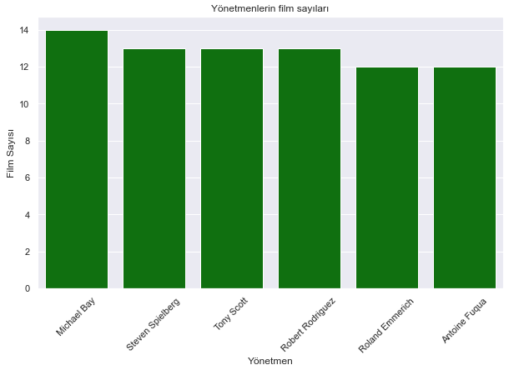
About Data
EDA

Slide 7
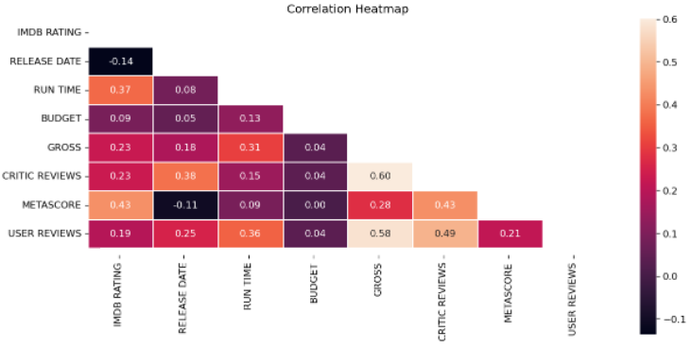
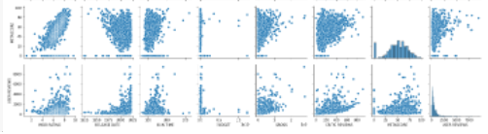
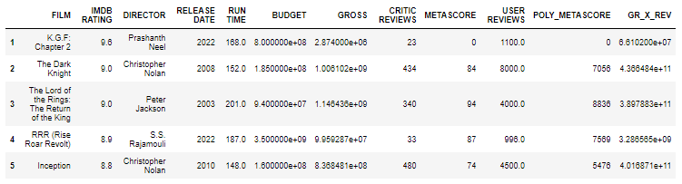
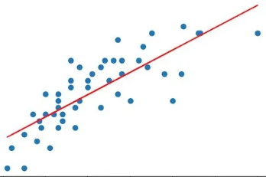
Feature Engineering

Slide 8
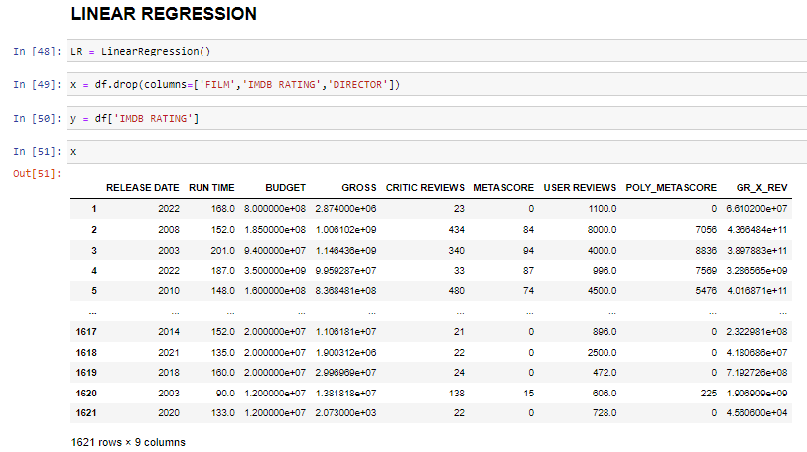

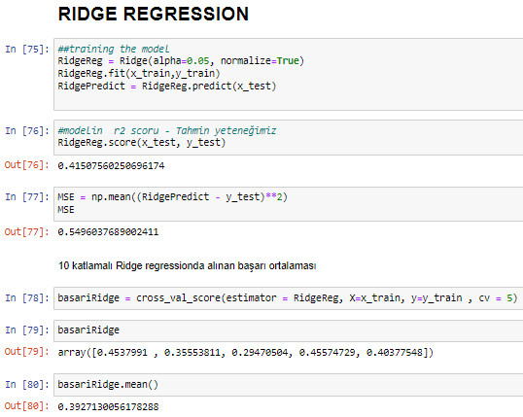
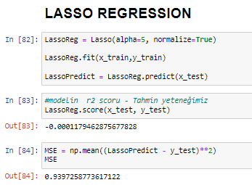


Regression

Slide 9

Conclusion
Using Linear ‘’Regression Model’’ to predict film’s IMDB Rating
Gross and Critic Reviews inputs have high correlation on IMDB Rating
Metascore is an effective input for IMDB Rating

Slide 10
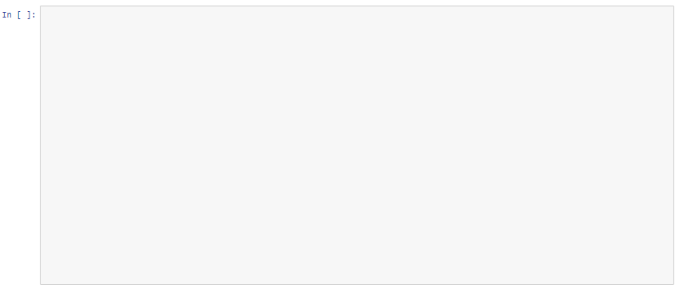




Future Work
Desired to use ‘’dummy function’’ to increase our score
Having more inputs and more data related to output
Adding more new inputs to use Lasso and Ridge Models efficiently
Using ‘’Plotly’’ library to see the correlation between variables with more details

Slide 11
Thank you for listening…

