Slide 1

PROJECT 3
CITIBIKE DATA ANALYSIS WITH CLASSIFICATION MODEL
Vildan TELLİOĞLU
Taha Yasin YILMAZ
Birsen BAŞ
Selva TAŞ

Slide 2


Contents
Create Dataframe at PostgreSQL
Data Cleaning & EDA
Feature Engineering
Classification Model
Streamlit

Slide 3






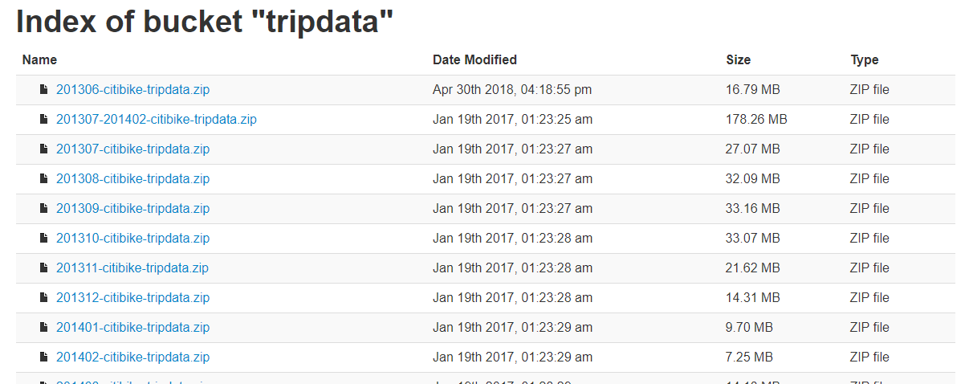








Methodology
Data Source
Tools

Slide 4
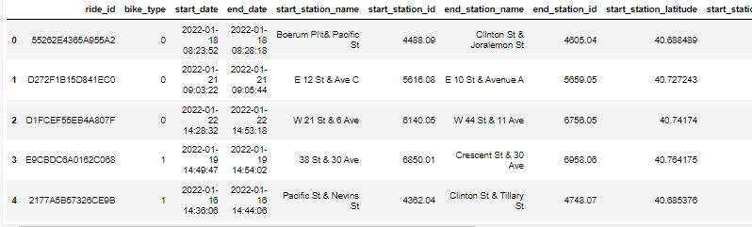
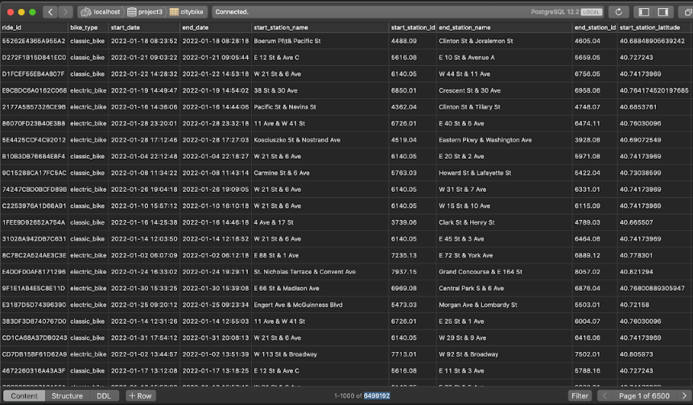
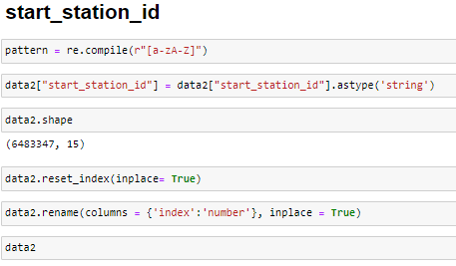
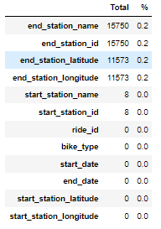
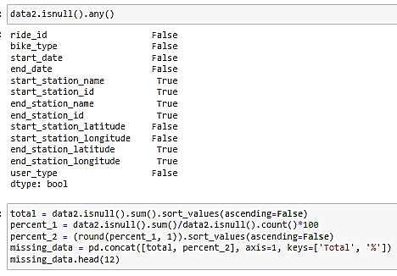
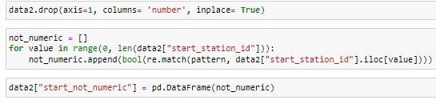
About Data
Creating Dataset
Data Cleaning

Slide 5
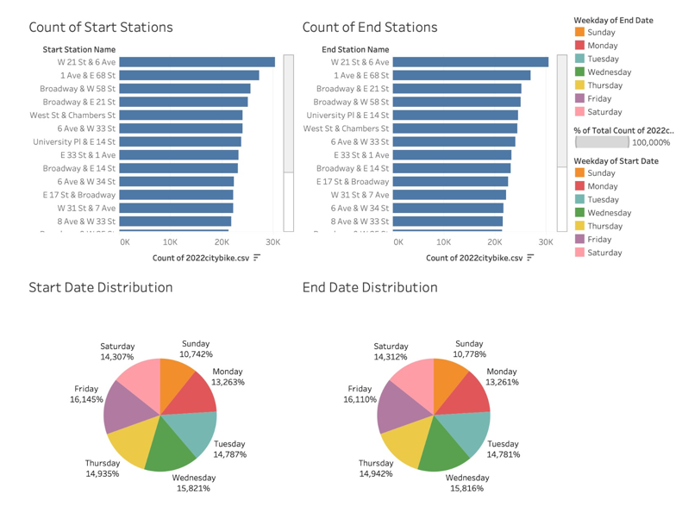
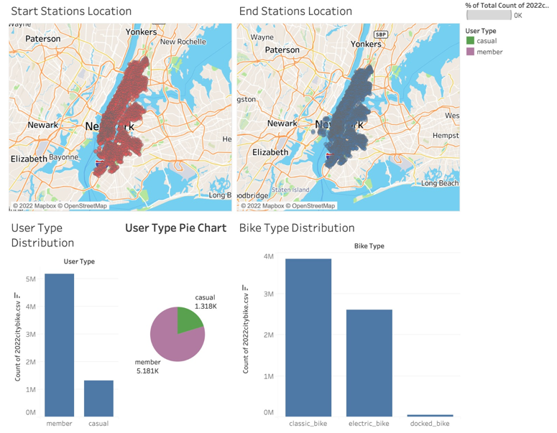
About Data
EDA

Slide 6

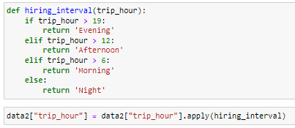




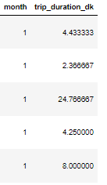
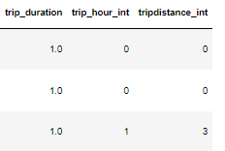



Feature Engineering
Trip hour(interval)
Trip duration, month
Trip distance
Grouping

Slide 7
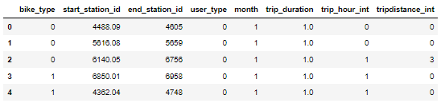
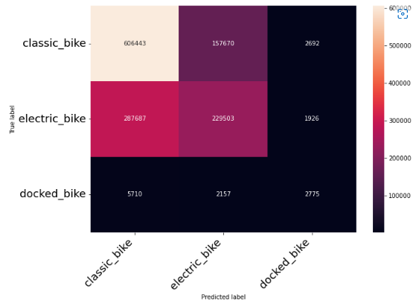
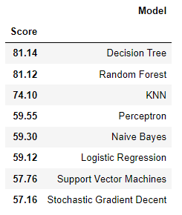
Classification

Slide 8




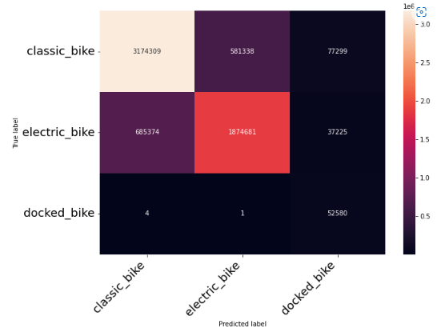
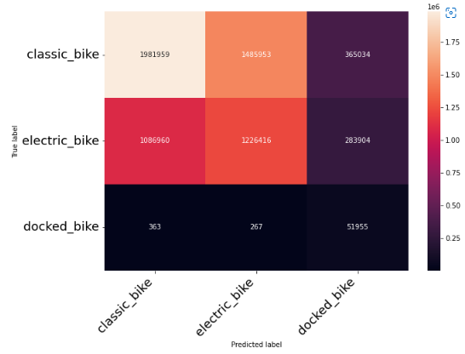
Classification
Oversampling
Undersampling

Slide 9

Conclusion
Create dataset at PostgreSQL and get our dataset from database
Using ‘’Classification Models’’ to predict bike type
Show our results with streamlit ….

Slide 10
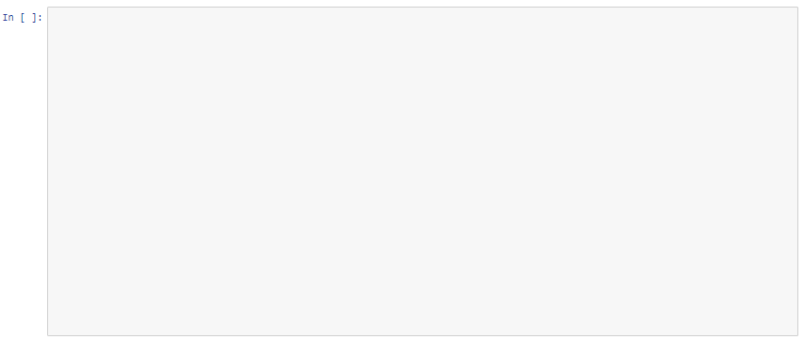




Future Work
Flask
Encoding features ??
Precision, recall, and f1 calculation ??

Slide 11
Thank you for listening…

