Slide 1
Informatica PowerCenter 9
Training

Slide 2
Course Objectives
Understand how to use Informatica Power Center 9 components for development
Be able to build basic ETL mappings using the common transformations
Be able to create, run and monitor workflows & sessions
How to reuse Objects: Mapplets & reusable Transformation
Mapping Parameters and Variables
Advanced topics on Workflows
Good Design Practices
Basic Performance Tuning

Slide 3
DAY 1

Slide 4
Introduction and Product Overview

Slide 5
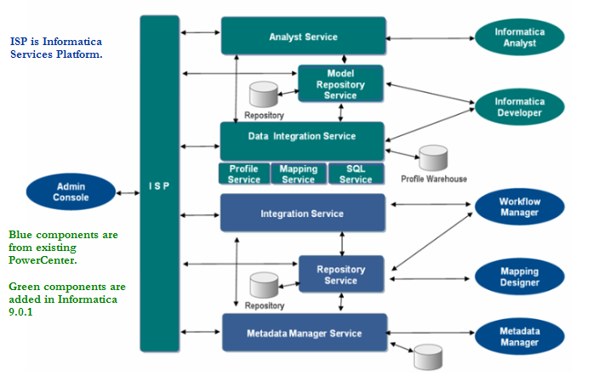
Informatica 9.1.0 Architecture
Notes:
© 2006 Capgemini - All rights reserved
SOA : Scale and Share resources

Slide 6
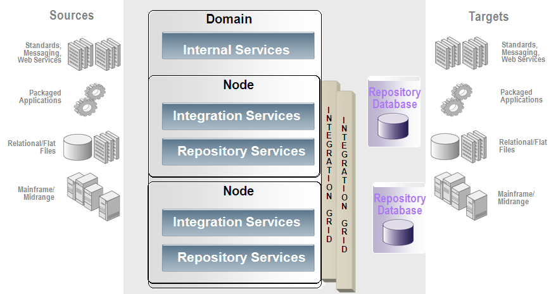
PowerCenter Architecture

Slide 7
Informatica Administration
Notes:
© 2006 Capgemini - All rights reserved

Slide 8
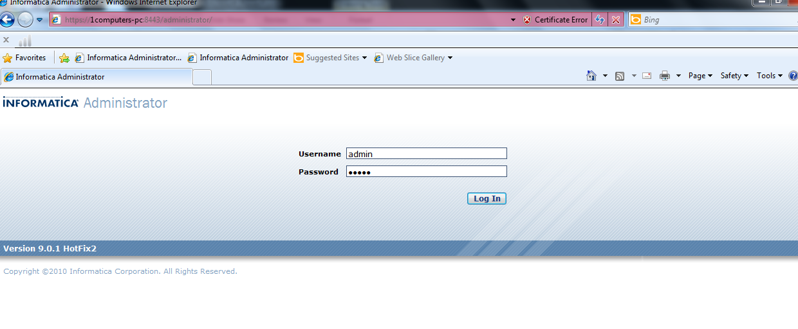
Informatica Administrator Log in
http://<host>:<port>/administrator
August 2011© 2008 Capgemini - All rights reserved
Notes:
© 2006 Capgemini - All rights reserved

Slide 9
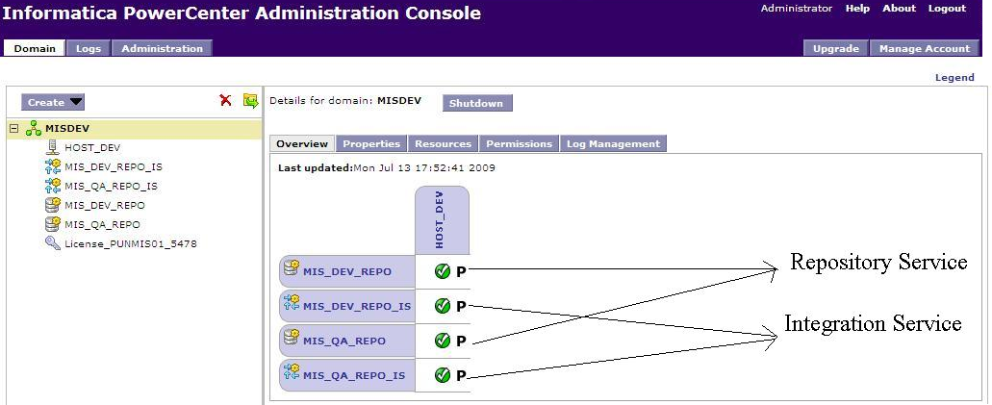
Admin Console

Slide 10
Informatica Architecture Terminologies
Domain:
  The fundamental administrative unit in PowerCenter.
  Supports the administration of the distributed services.
A domain is a collection of nodes and services that you can group in folders based on administration ownership.
Node - is the logical representation of a machine in a domain
Gateway Nodes
Worker Nodes
Service manager - Manages all domain operations
Integration Service:
The Integration Service is
  An application service that runs sessions and workflows.

Slide 11
Contd.
Repository:
A PowerCenter repository is a collection of database tables containing metadata.
The PowerCenter repository can be installed on:-
  Oracle
  Sybase
  DB2
  SQL Server
Repository Service:
A Repository Service manages the repository. It performs all metadata transactions between the repository database and repository client applications.

Slide 12
Designer Overview

Slide 13
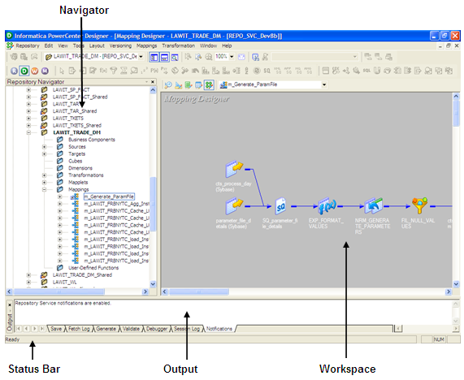
Designer Interface
  Designer Windows:
    Navigator
    Workspace
    Status bar
    Output
    Overview

Slide 14
Designer Interface
  Designer Tools: The Designer provides the following tools:
    Source Analyzer: Use to import or create source definitions for flat file, XML, COBOL, Application, and relational sources
    Target Designer: Use to import or create target definitions
    Transformation Developer: Use to create reusable transformations
    Mapplet Designer: Use to create mapplets
    Mapping Designer: Use to create mappings
  Navigator: Use to connect to and work in multiple repositories and folders. You can also copy and delete objects and create shortcuts using the Navigator.
  Workspace: Use to view or edit sources, targets, mapplets, transformations, and mappings. You can work with a single tool at a time in the workspace. You can use the workspace in default or workbook format.

Slide 15
Designer Interface
  Status bar: Displays the status of the operation you perform.
  Output: Provides details when you perform certain tasks, such as saving your work or validating a mapping. Right-click the Output window to access window options, such as printing output text, saving text to file, and changing the font size.
  Overview: An optional window to simplify viewing workbooks containing large mappings or a large number of objects. Outlines the visible area in the workspace and highlights selected objects in color. To open the Overview window, choose View-Overview Window.

Slide 16

Lab 1 - Setting Connections
  This is a demonstration which has to be followed by the participants.
  This lab briefs about connections to Informatica Client’s and other necessary configurations

Slide 17
Working With Sources and Targets

Slide 18
Design Process Overview
  Create Source definition(s)
  Create Target definition(s)
  Create a Mapping
  Create a Session Task
  Create a Workflow with Task components
  Run the Workflow and verify the results

Slide 19
Methods of Analyzing Sources
  To extract data from a source, you must first define sources in the repository.
    You can import or create the following types of source definitions in the Source Analyzer:
      Relational database
      Flat file
      COBOL file
      XML object

Slide 20
Working with Relational Sources
  You can add and maintain relational source definitions for tables, views, and synonyms:
    Import source definitions: Import source definitions into the Source Analyzer.
    Creating new source definitions: Manually create source definitions in Source Analyzer.
    How you will Update source definitions?
    Update source definitions manually
    re-importing the definition.

Slide 21
Importing Relational Source Definitions
  You can import relational source definitions from database tables, views, and synonyms.
  When you import a source definition, you import the following source metadata:
    Source name
    Database location
    Column names
    Datatypes
    Key constraints
Note: When you import a source definition from a synonym, you might need to manually define the constraints in the definition.
  To import a source definition, you must be able to connect to the source database from the client machine using a properly configured ODBC data source or gateway. You may also require read permission on the database object.
  You can also manually define key relationships, which can be logical relationships created in the repository that do not exist in the database.

Slide 22
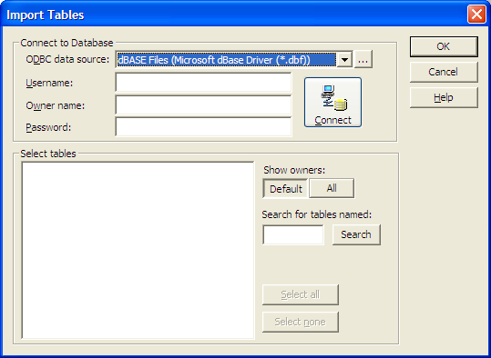
Importing Relational Source Definitions
To import a source definition:
1. In Source Analyzer, choose Sources-Import from Database.

Slide 23
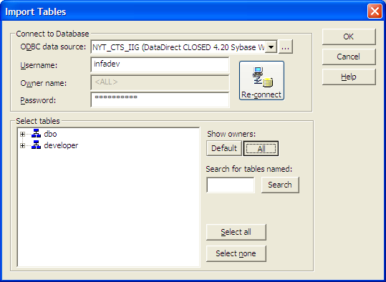
Importing Relational Source Definitions
If no table names appear or if the table you want to import does not appear, click All.

Slide 24
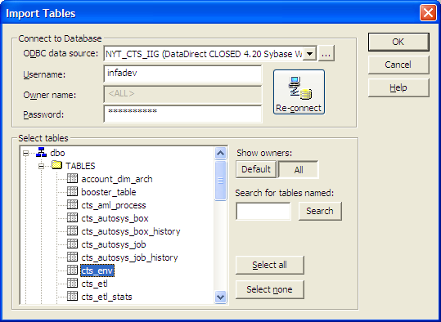
Importing Relational Source Definitions
6. Click OK.

Slide 25
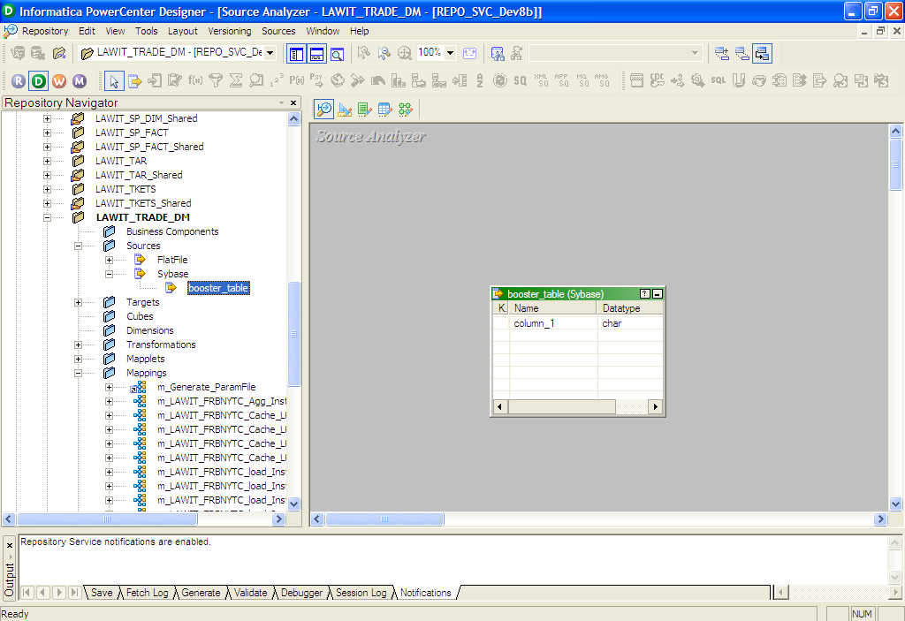
Importing Relational Source Definitions
7. Choose Repository-Save

Slide 26
Creating Target Definitions
  You can create the following types of target definitions in the Warehouse Designer:
    Relational: You can create a relational target for a particular database platform. Create a relational target definition when you want to use an external loader to the target database.
    Flat File: You can create fixed-width and delimited flat file target definitions.
    XML File: You can create an XML target definition to output data to an XML file.

Slide 27
Working with Relational Targets
  You can add and maintain relational Target definitions:
  Import Target definitions: Import target definitions into the target designer.
  Creating new Target definitions: Manually create target definitions in target designer.
  Automatic Target Creation: Drag-and-drop a Source Definition into the target Designer Workspace
  How you will Update source definitions?
    Update source definitions manually
    re-importing the definition

Slide 28
Importing a Relational Target Definition
  When you import a target definition from a relational table, the Designer imports the following target details:
    Target name.
    Database location.
    Column names.
    Datatypes.
    Key constraints.
    Key relationships.

Slide 29
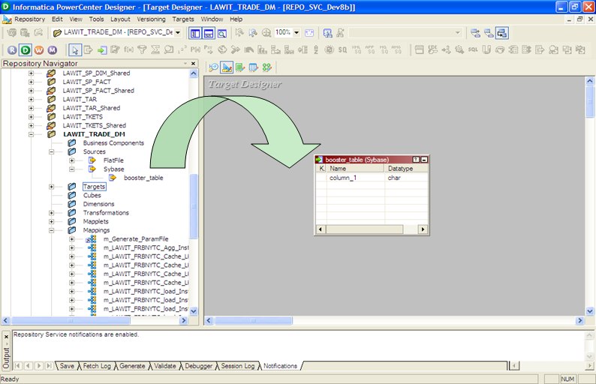
Automatic Target Creation
  Drag-and-drop a Source Definition into the Target Designer Workspace

Slide 30
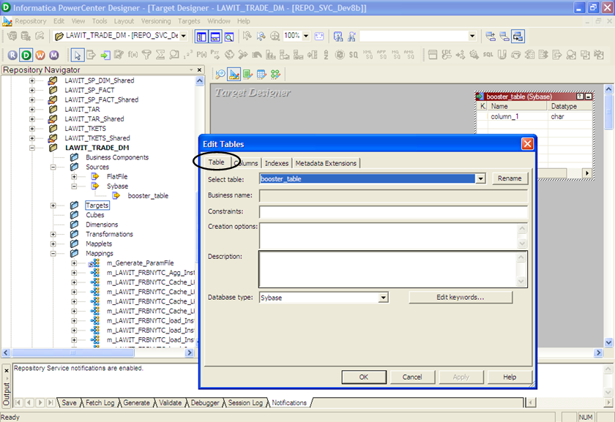
Target Definition properties

Slide 31
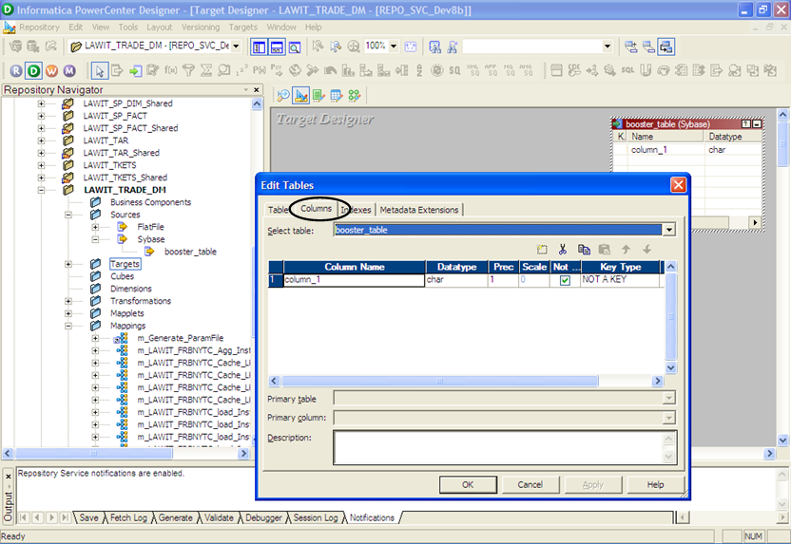
Target Definition properties

Slide 32
Data Previewer
  Preview data in
    Relational Sources
    Flat File Sources
    Relational Targets
    Flat File Targets
  Data Preview Option is available in
    Source Analyzer
    Target Designer
    Mapping Designer
    Mapplet Designer

Slide 33
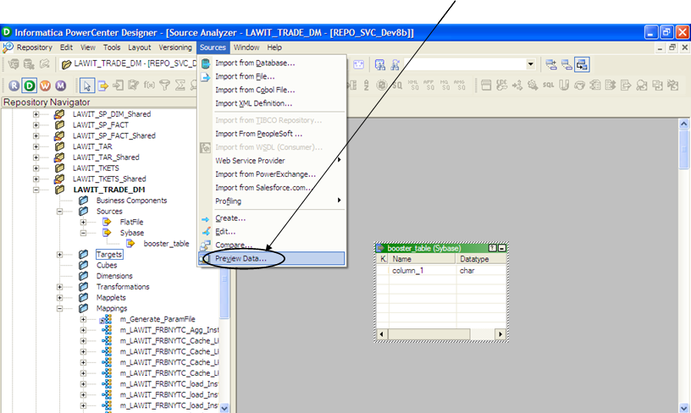
Data Previewer Source Analyzer
From Source Analyzer Select Source drop down Menu, then preview data

Slide 34
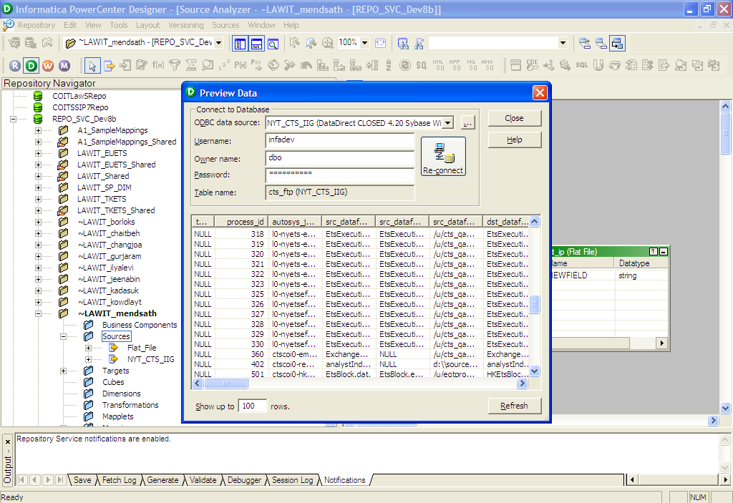
Data Previewer Source Analyzer
A right mouse click can also be used to preview data

Slide 35
LAB 2 - Creating Source Definitions
  Connect to Oracle Database using the Train_Ora_Src connection
  Import the following Source Tables
    Employees
    Customers
    EmployeeTerritories
    Territories
    Region
    Orders
    OrderDetails

Slide 36
LAB 3 - Creating Target Definitions
  Connect to Oracle Database using the Train_Ora_Tgt connection
  Import the following Target Tables:-
    DIM_EMPLOYEE
    DIM_CUSTOMER
    FACT_ORDERS

Slide 37
Mappings Overview

Slide 38
Overview
  “A mapping is a set of source and target definitions linked by transformation objects that define the rules for data transformation.”
  Mappings represent the data flow between sources and targets.
  When the PowerCenter Server runs a session, it uses the instructions configured in the mapping to read, transform, and write data.
  Every mapping must contain the following components:
    Source instance: Describes the characteristics of a source table or file.
    Transformation: Modifies data before writing it to targets. Use different transformation objects to perform different functions.
    Target instance: Defines the target table or file.
    Links: Connect sources, targets, and transformations so the PowerCenter Server can move the data as it transforms it.
    Note:
      A mapping can also contain one or more Mapplets. A mapplet is a set of transformations that you build in the Mapplet Designer and can use in multiple mappings.

Slide 39
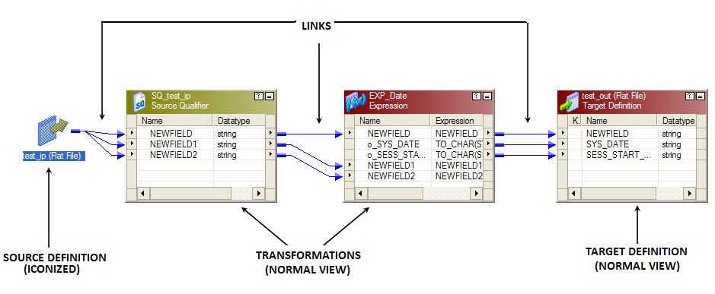
Sample Mapping

Slide 40
Developing a Mapping
  When you develop a mapping, use the following procedure as a guideline:
    1. All source, target, & reusable objects are created.
    2. Create a new mapping.
    3. Add sources and targets.
    4. Add transformations and transformation logic.
    5. Connect the mapping.
    6. Validate the mapping.
    7. Save the mapping.

Slide 41
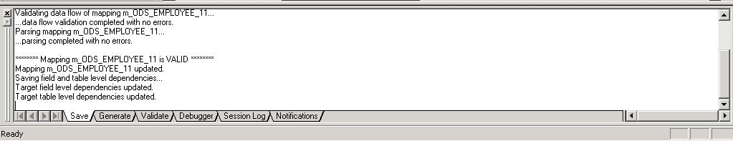
Mapping Validation
  Mappings must
    Be valid for a session to run
    Be end-to-end complete and contain valid expressions
    Pass all data flow rules
  Mappings are always validated when saved; can be validated without saving
  Output window will always display reason for invalidity

Slide 42
Transformation Concepts

Slide 43
Transformation Concepts
  “A Transformation is a repository object that generates, modifies, or passes data.”
  The Designer provides a set of transformations that perform specific functions.
  Transformations can be active or passive.
  Transformations can be connected to the data flow, or they can be unconnected.
  An Unconnected transformation is called within another transformation, and returns a value to that transformation.
  Transformations in a mapping represent the operations the PowerCenter Server performs on the data.
  Data passes into and out of transformations through ports that you link in a mapping or mapplet.

Slide 44
Active Vs Passive Transformation
Active | Passive
Number or rows input may not equal number of rows output | Number or rows input always equals number of rows output
Can operate on groups of data rows | Operates on one row at a time
May not be re-linked into another data stream (except into a sorted join where both flows arise from the same source qualifier) | May be re-linked into another data stream
e.g. Aggregator, Filter, Joiner, Rank, Normalizer, Source Qualifier, Update Strategy, Custom | e.g. Expression, Lookup, External Procedure, Sequence Generator, Stored Procedure

Slide 45
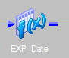
Transformation Views
  A transformation has three views :
    Iconized
    Normal
    Edit
Iconized: shows the transformation in the relation to the rest of the mapping

Slide 46
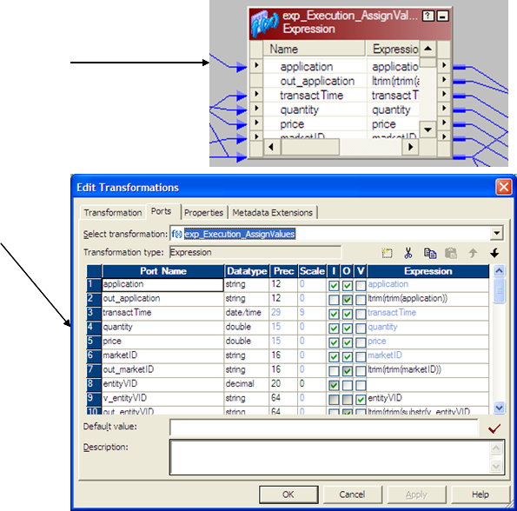
Transformation Views
Normal: shows the flow of data through the transformation
Edit: shows the transformation ports and the properties; allows editing

Slide 47
Ports & Expressions
  Ports are present in each transformation and are used to propagate the field values from the source to the target via the transformations.
  Ports are basically of 3 types:-
    Input
    Output
    Variable
  Ports evaluation follows the Top-Down Approach
  An Expression is a calculation or conditional statement added to a transformation.
  An Expression can be composed or Ports, Functions, operators, variables, literals, return values & constants.

Slide 48
Ports - Evaluation
  The best practice recommends the following approach for port evaluation
  Input Ports:
    Should be evaluated first
    There is no evaluation ordering among input ports (as they do not depend on any other ports)
  Variable Ports:
    Should be evaluated after all input ports are evaluated (as variable ports can reference any input port)
    Variable ports can reference other variable ports also but not any output ports.
    Ordering of variables is also very important as they can reference each other’s values.

Slide 49
Ports - Evaluation
  Output Ports:
    Should be evaluated last
    They can reference any input port or any variable port.
    There is no ordered evaluation of output ports (as they cannot reference each other)

Slide 50
Using Variable Ports
  Also known as Local variables.
    Used for temporary storage
  Used to simplify complex expressions
    E.g. – create and store a depreciation formula to be referenced more than once
  Used in another variable port or output port expression
  A variable port cannot also be an input or output port.
  Available in the Expression, Aggregator and Rank.
  Variable ports are NOT visible in Normal view, only in Edit view

Slide 51
Using Variable Ports
  The scope of variable ports is limited to a single transformation.
  Variable ports are initialized to either ‘zero’ (for numeric values) or ‘empty string’ (for character & date variables) when the Mapping logic is processed.
  They are not initialized to ‘Null’
  Variable ports can remember values across rows (useful for comparing values) & they retain their values until the next evaluation of the variable expression.
  Thus we can effectively use the order of variable ports to do procedural computation.

Slide 52
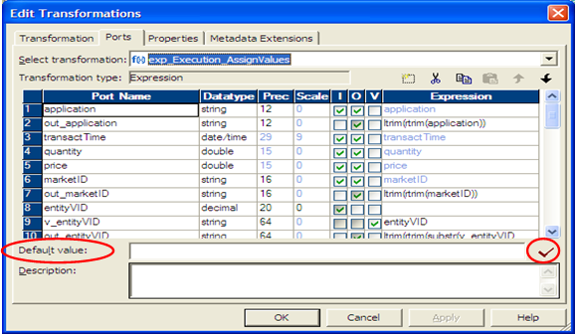
Default Values – Two Usages
For Input and I/O ports
      Used to replace null values
For Output ports
      Used to handle transformation calculation errors (not-null handling)

Slide 53
Expressions
  Expressions can be entered at the row-level (port) or field-level (transformation level)
  Expressions can be used in the following transformations:-
      Expression: - Output Port Level
      Aggregator - Output Port Level
      Rank - Output Port Level
      Filter - Transformation Level
      Router - Transformation Level
      Update Strategy - Transformation Level
      Transaction Control - Transformation Level

Slide 54
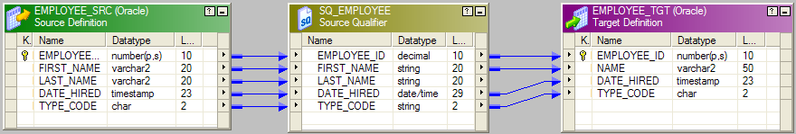
Informatica Data Types
Native Data types | Transformation Data Types
Specific to the source and target database types | PowerCenter internal database types based on ANSII SQL-92
Display in source and target tables within Mapping Designer | Display in transformations within Mapping Designer
Note:
a) Transformation data types allow mix-n-match of source and target database types
b) When connecting ports, native and transformation data types must be either compatible or explicitly converted

Slide 55
Questions??

Slide 56
Thank You!
From
Informatica-CoE

