Slide 1
Informatica PowerCenter 9
Training

Slide 2
DAY 2

Slide 3
Source Qualifier Transformation

Slide 4
What does it do?
  When you add a relational or a flat file source definition to a mapping, you need to connect it to a Source Qualifier transformation.
  The Source Qualifier transformation represents the rows that the PowerCenter Server reads when it runs a session.
  You cannot directly connect sources to targets.
  You need to connect them through a Source Qualifier transformation for relational and flat file sources, or through a Normalizer transformation for COBOL sources.
  Can also be used for Homogeneous Joins.

Slide 5
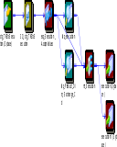
Source Qualifier Transformation
  Active Transformation
  Connected
  Port
    All Input/Output
  Usage ( only applicable for relational sources)
    Modify SQL statements
    User defined Join
    Source Filter
    Sorted ports
    Select Distinct
    Pre/Post SQL
    Convert Data Types

Slide 6
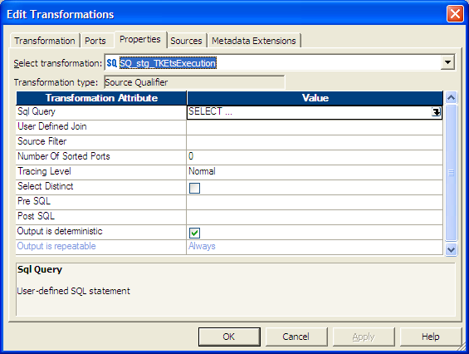
Source Qualifier Transformation
Represents the source record set queried by the server. Mandatory in Mappings using relational or flat file sources

Slide 7
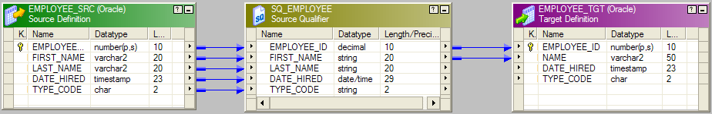
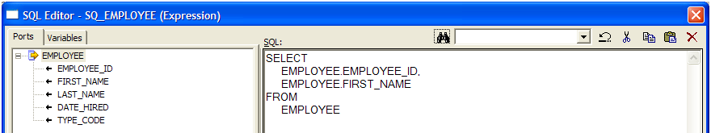
Default Query
  For relational sources, the PowerCenter Server generates a query for each Source Qualifier transformation when it runs a session.
  The default query is a SELECT statement for each source column used in the mapping. Thus, the PowerCenter Server reads only the columns that are connected to another transformation.
  Although there are many columns in the source definition, only three columns are connected to another transformation.
  In this case, the PowerCenter Server generates a default query that selects only those three columns:

Slide 8
Joining Multiple sources
  You can use one Source Qualifier transformation to join data from multiple relational tables.
  These tables must be accessible from the same instance or database server.
  When a mapping uses related relational sources, you can join both sources in one Source Qualifier transformation.
  Default join is inner equi-join (where Src1.col_nm = Src2.col_nm) if the relationship between the tables is defined in the Source Analyzer
  This can increase performance when source tables are indexed.
  Tip: Use the Joiner transformation for heterogeneous sources and to join flat files.

Slide 9
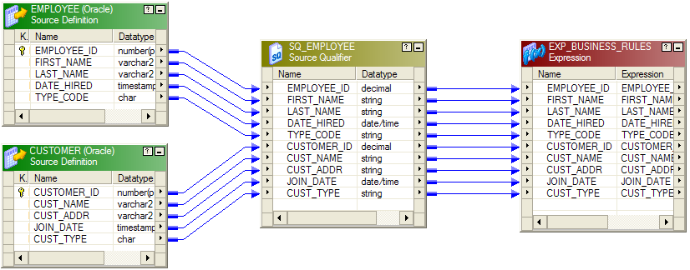
Joining Multiple sources

Slide 10

LAB 4 - Source Qualifier (Simple Mapping)
  Create a Mapping using Employees as the Source and Employees as the Target instance
  No other transformations are required.
  Ensure target name is user specific (e.g.: Participant user1 should use user1.Employees)

Slide 11
Workflow Manager Overview

Slide 12
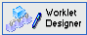
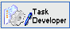

Workflow Manager Tools
Workflow Designer
  Maps the execution order and dependencies of Sessions, Tasks & Worklets, for the Informatica Server
Task Developer
  Create Session, Shell Command and Email Tasks
  Tasks created in the Task Developer are reusable
Worklet Designer
  Creates objects that represent a set of tasks
  Worklet objects are reusable

Slide 13
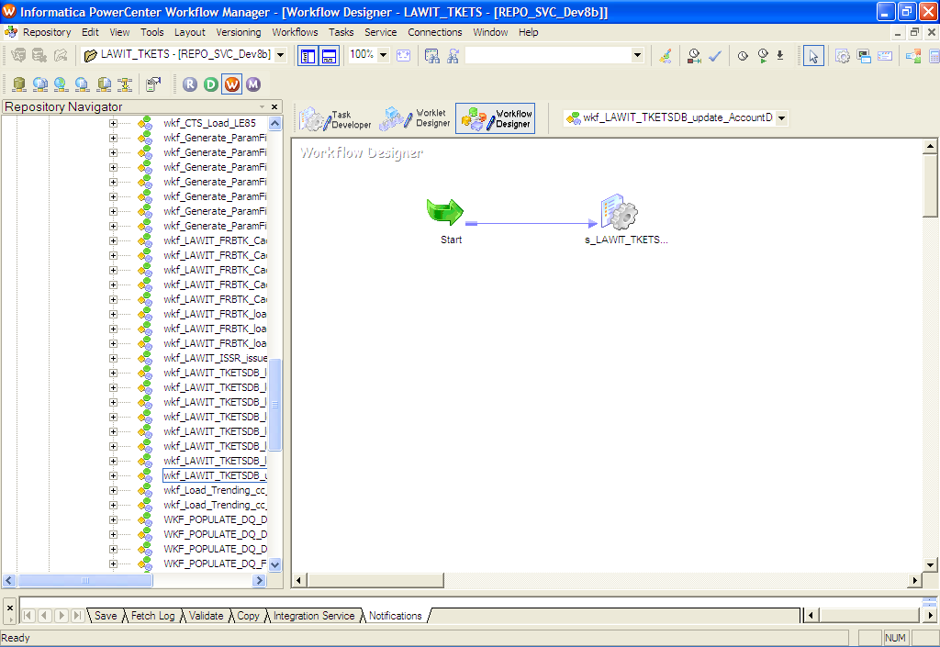
Workflow Manager Interface
e.g. The simplest Workflow

Slide 14
Workflow - Overview
  A workflow is a set of instructions that describes how and when to run tasks related to extracting, transforming, and loading data.
  The PowerCenter Server runs workflow tasks according to the conditional links connecting the tasks.
  Workflow Manager is used to develop and manage workflows.
  Workflow Monitor is used to monitor workflows and stop the PowerCenter Server.
  When a workflow starts, the PowerCenter Server retrieves mapping, workflow, and session metadata from the repository to extract data from the source, transform it, and load it into the target.
  You can run as many sessions in a workflow as you need.
  You can run the Session tasks sequentially or concurrently, depending on your needs.

Slide 15
Session Overview
  A session is a set of instructions that tells the PowerCenter Server how and when to move data from sources to targets.
  A mapping is a set of source and target definitions linked by transformation objects that define the rules for data transformation.
  To run a session, you must first create a workflow to contain the Session task.

Slide 16
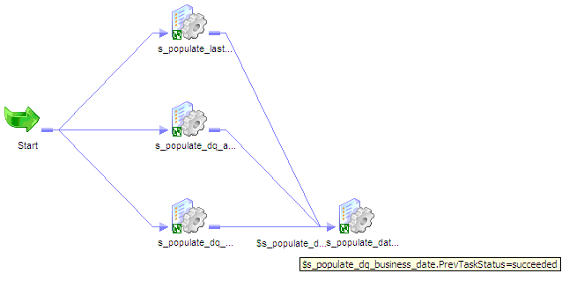
Link Task
  Required to connect Workflow Tasks
  Can be used to create branches in a Workflow
  All links are executed-unless a link condition is used which makes a link false
  Links connecting the tasks in a workflow are not allowed to form a closed loop

Slide 17
Session Task

Slide 18
Session Task
  Server Instructions to run the logic of ONE specific Mapping
    E.g- source and target data location specifications, memory allocation, optional Mapping overrides, scheduling, processing and load instructions
  Becomes a component of a Workflow or Worklet
  If configured in the Task Developer, the Session Task is reusable
  When a session is to be created, valid mappings are displayed in the dialog box

Slide 19
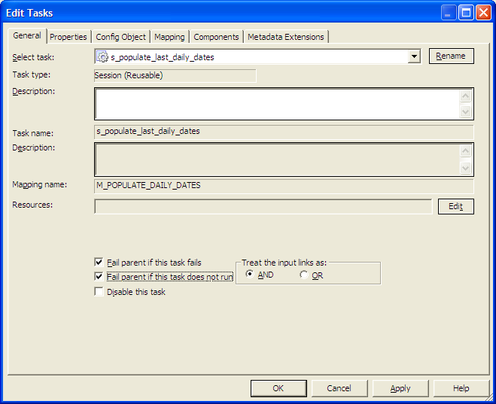
Session Task
  Session Task Tabs :
    General
    Properties
    Config Object
    Mapping
    Components
    Metadata Extensions

Slide 20
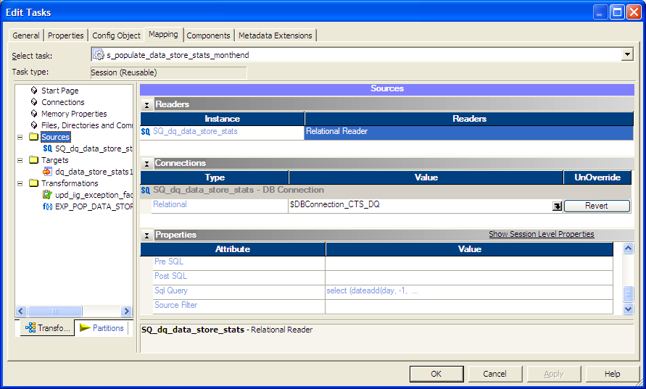
Session Task

Slide 21
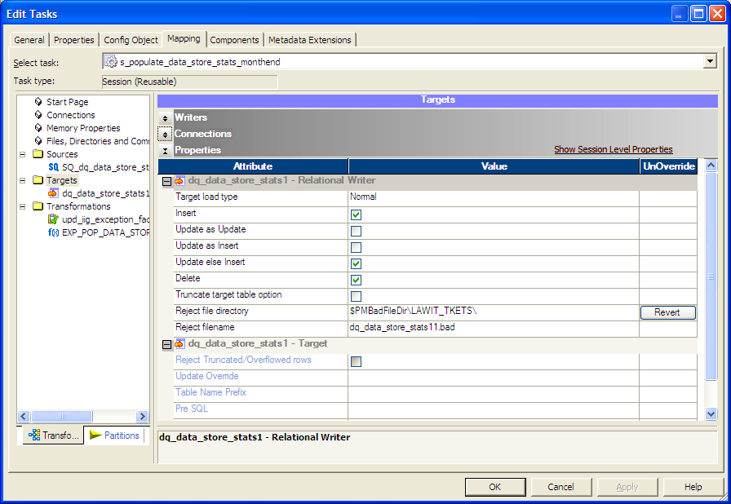
Session Task

Slide 22
Workflows Monitor Overview

Slide 23
Monitor Workflows
  The Workflow Monitor is the tool for monitoring Workflows and Tasks
  Review details about a Workflow or Tasks in two views:
    Gantt Chart view
    Task view
  The Workflow Monitor displays Workflows that have been run at least once

Slide 24
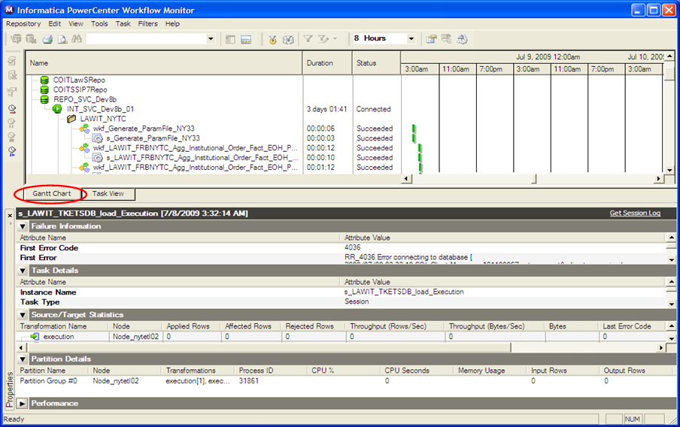
Gantt Chart View

Slide 25
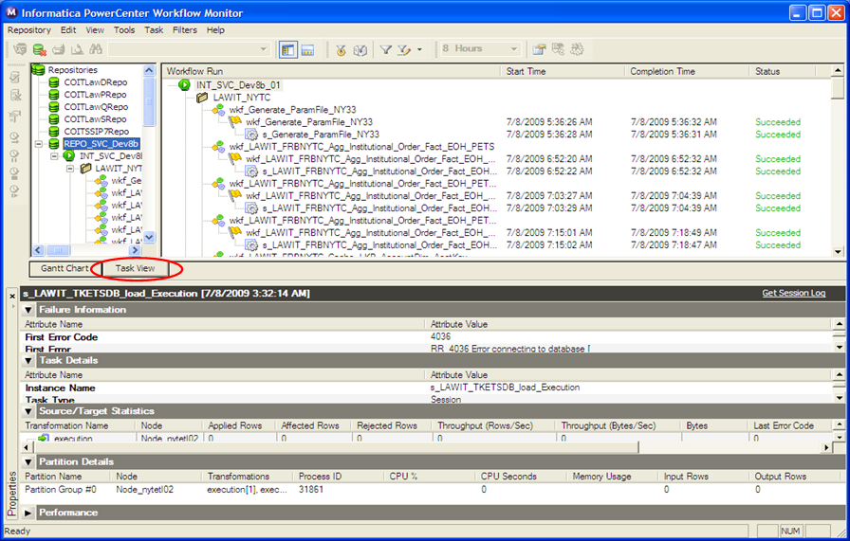
Task View

Slide 26
Monitoring Workflows
  Perform operations in the Workflow Monitor
    Restart: restart a Task, Workflow or Worklet
    Stop: stop a Task, Workflow or Worklet
    Abort: abort a Task, Workflow or Worklet
    Recover: Start a failed workflow or task that has recovery enabled without processing the recovery data.
    Cold Start: Restart a workflow or task without recovery, start the workflow or task in cold start mode.
    Schedule: schedule a workflow to run continuously, run at a given time or interval
    UnSchedule: You can schedule and unschedule workflows in the Workflow Monitor
  View Session and Workflow logs
  Abort has a 60 second timeout
    If the Server has not completed processing and committing data during the timeout period, the threads and processes associated with the Session are killed.

Slide 27
Sequence Generator Transformation
Chapter 11

Slide 28
What does it do?
  The Sequence Generator transformation generates numeric values.
  You can perform the following tasks with a Sequence Generator transformation:
    Create keys.
    Replace missing values.
    Cycle through a sequential range of numbers.

Slide 29

Sequence Generator Transformation
  Generates unique keys for any port on a row
  Passive Transformation / Connected
  Ports
    Two predefined output ports
      NEXTVAL
      CURRVAL
    No input ports allowed
  Usage
    Generate Sequence numbers
    Shareable across mappings

Slide 30
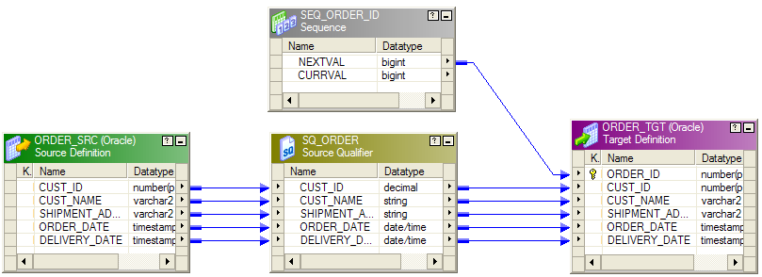
Sequence Generator Transformation
Connecting NEXTVAL Port to a Target

Slide 31
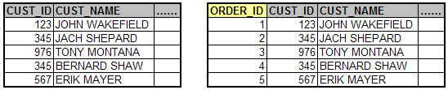
Example
Input
Output
The rows in the Source have to be loaded into the target with a Unique ID generated for each record.
Here the Sequence generator helps in creating the IDs for each record in the target.

Slide 32
Sequence Generator Properties
  Properties
    Start value
    End Value
    Increment By
    Number of cached values
    Reset
    Cycle
  Design tip: Set Reset property and Increment by 1. Use in conjunction with lookup. Lookup to get max(value) from target. Add NextVal to it to get the new ID.

Slide 33
Key Points to Remember
By default, “start value” will be zero.
“Cycle” option is used to generate a repeating sequence.
“Increment By” is the integer the Power Center Server adds to the existing value to create the new value in the sequence. By default, the “Increment By” is set to 1.
Only a reusable Sequence Generator can be used in Mapplet.
If we select Reset for a non-reusable Sequence Generator transformation, the Power Center Server generates values based on the original current value each time it starts the session.

Slide 34
LAB 5 - Sequence Generator (1)
  Create copy of mapping created in LAB 4
  Use Sequence Generator to Populate Employee_wk
  Set Properties for Reset, Cycle, Range should be 1 to 100

Slide 35
LAB 6 - Sequence Generator (2)
  Use Employees as the source.
  Get the distinct values of Country and load it to Country.
  Use Employees as the source again.
  Get the distinct values of City and load it to City.
  For both these tables, generate the ID values using a sequence generator where ID values start from 1 for both these tables.
  Use a Sequence Generator
    Start value = 1
    Increment value = 1

Slide 36
Expression Transformation
Chapter 12

Slide 37
What does it do?
  You can use the Expression transformation to calculate values in a single row before you write to the target.
    For example, you might need to adjust employee salaries, concatenate first and last names, or convert strings to numbers.
  You can use the Expression transformation to perform any non-aggregate calculations.
  You can also use the Expression transformation to test conditional statements before you output the results to target tables or other transformations.

Slide 38

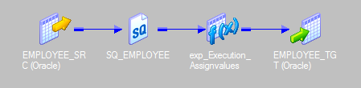
Expression Transformation
  Passive Transformation
  Connected
  Ports
      Mixed
      Variables allowed
  Create expression in output or variable port
  Used to perform majority of data manipulation

Slide 39
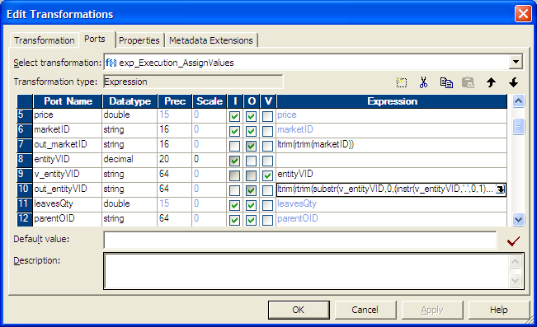
Expression Transformation
Perform calculations using non-aggregate functions (row level)

Slide 40
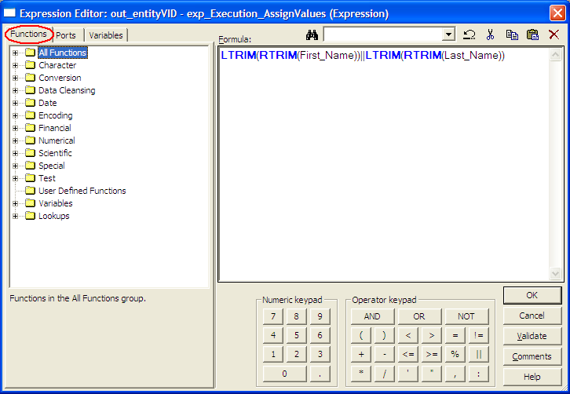
Expression Editor
  An expression formula is a calculation or conditional statement for a specific port in a transformation
  Performs calculation based on ports, functions, operators, variables, constants, and return values from other transformations

Slide 41
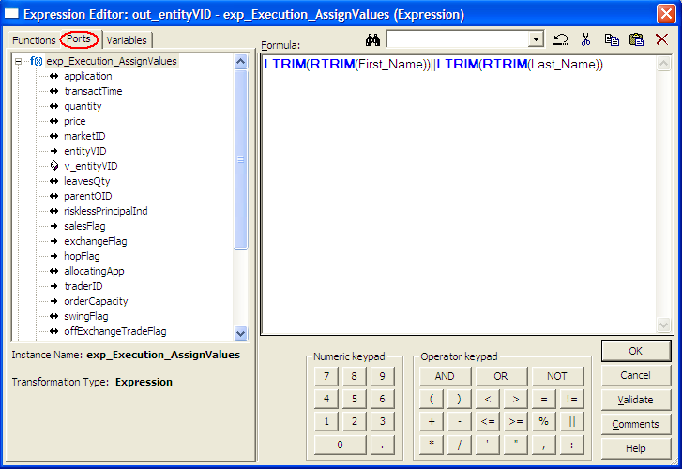
Expression Editor

Slide 42
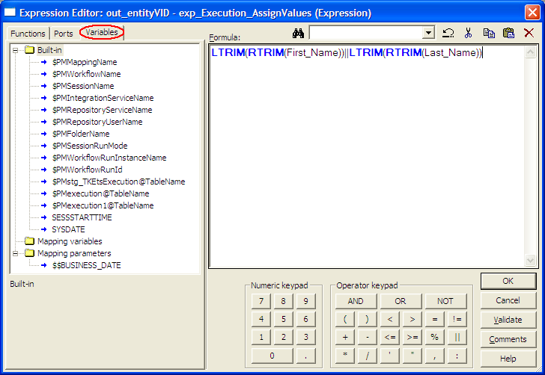
Expression Editor

Slide 43
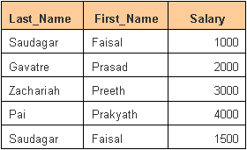
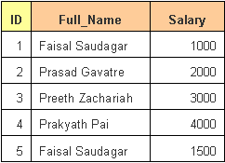
Example
Source
Target
We are making use of an Expression transformation to concatenate the “First_Name” and “Last_Name” fields of the source into a single “Full_Name” field in the target.
We use the available functions in the Expression Editor to get the required output.

Slide 44
Key Points to Remember
The Procedural Computation is possible in Expression Transformation.
Order of Ports – Input, Variable, Output.
The Variable port can be inter dependent.
Uncheck the unwanted Columns that are not passed to next Transformation.
We can hold values using Variable port based on condition.
The non-aggregate functions (row level) can be nested to many levels.
  SUBSTR(LTRIM(RTRIM(NAME)),1,5)

Slide 45
LAB 7 - Expression Transformation (1)
  Create a mapping using the Employee flat file as source, DIM_EMPLOYEE as the target
  Concatenate First Name and Last Name to get Employee Name
  Ensure all leading and trailing spaces are removed for character columns
  Use NEXTVAL of Sequence Generator transformation to connect to Employee_wk
  Target load will be truncate / load.
  Do not connect geography_wk, region_nk, region_name and direct_report_wk

Slide 46
LAB 8 - Expression Transformation (2)
  Create a mapping using DIM_EMPLOYEE as source and a flat file as target
  The target definition should have only 5 fields
    First_Name
    Last_Name
    Fname_size
    Lname_size
    Title
  Employee Name has to be split into “First Name” and “Last Name”
  Calculate length of “First_Name” and “Last_Name”
  Directly connect the Title to the target

Slide 47
LAB 9 - Expression Transformation (3)
  Source:- Employees
  Target:- Employee_LAB_9 File
  In the target file we need
    First name should have the first alphabet in upper case and the rest in lower case
    Last name should be in upper case
    Also compute the employees Age in years

Slide 48
Filter Transformation
Chapter 13

Slide 49
What does it do?
  The Filter transformation allows you to filter rows in a mapping.
  You pass all the rows from a source transformation through the Filter transformation, and then enter a filter condition for the transformation.
  All ports in a Filter transformation are input / output, and only rows that meet the condition pass through the Filter transformation.

Slide 50

Filter Transformation
  Active Transformation Connected
  Ports
    All Input/Output
  Usage
    Filter rows from mapping/mapplet pipeline

Slide 51
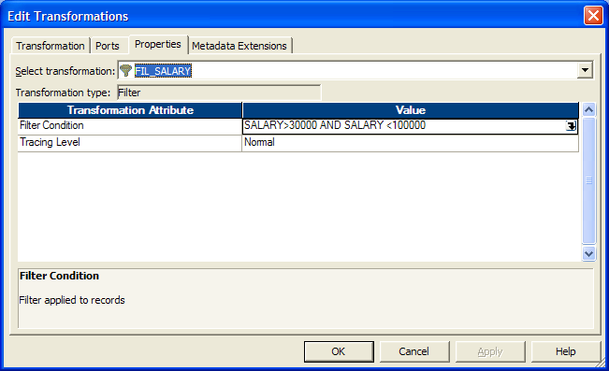
Filter Transformation
Drops rows conditionally
Use of logical operators makes the filter very effective (e.g. SALARY > 30000 AND SALARY < 100000)

Slide 52
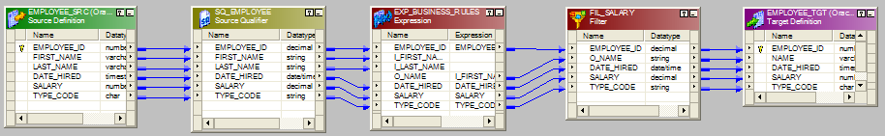
Filter Transformation in a Mapping

Slide 53

Example
Input
Output
We are making use of a Filter transformation with a condition to pass only the records with salary > 2500

Slide 54
Key Points to Remember
A filter condition returns TRUE or FALSE for each row that passes through the transformation, depending on whether a row meets the specified condition. Only rows that return TRUE pass through this transformation.
Discarded rows do not appear in the session log or reject files.
You cannot concatenate ports from more than one transformation into the Filter transformation.
  The input ports for the filter must come from a single transformation.
The Filter transformation does not allow setting output default values.
The Filter condition is case-sensitive
The Filter transformation should be placed as early as in mapping to avoid processing unwanted records in the mapping.

Slide 55
LAB 10 - Filter Transformation (1)
  Create copy of LAB 7 mapping
  Add a Filter Transformation to the mapping to filter out all records having either
    Region as NULL
    TitleOfCourtesy = “Dr.”
  Set audit_id = 0
  Target load will be truncate / load

Slide 56
LAB 11 - Filter Transformation (2)
  Source:- Orders
  Load data to the 3 target tables which should contain only for the months of October, November and December respectively
    Orders_Oct
    Orders_Nov
    Orders_Dec

Slide 57
Questions??

Slide 58
Thank You!
From
Informatica-CoE

