Slide 1
Informatica PowerCenter 9

Slide 2
DAY 3

Slide 3
Router Transformation

Slide 4
What does it do?
  A Router transformation is similar to a Filter transformation because both transformations allow you to use a condition to test data.
  A Filter transformation tests data for one condition and drops the rows of data that do not meet the condition.
  However, a Router transformation tests data for one or more conditions and gives you the option to route rows of data that do not meet any of the conditions to a default output group.
  If you need to test the same input data based on multiple conditions, use a Router transformation in a mapping instead of creating multiple Filter transformations to perform the same task.

Slide 5

Router Transformation
Rows sent to multiple filter conditions
  Active Transformation Connected
  Ports
    All input/output
    Specify filter conditions for each Group
  Used to Link source data in one pass to multiple filter conditions

Slide 6
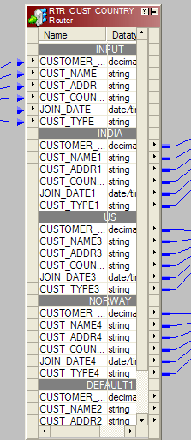
Router Groups
  Input group (always one)
  User-defined groups
  Each group has one condition
  All group conditions are evaluated for each row
  One row can pass multiple conditions
  Unlinked group outputs are ignored
  Default group (always one) can capture rows that fail all Group conditions

Slide 7
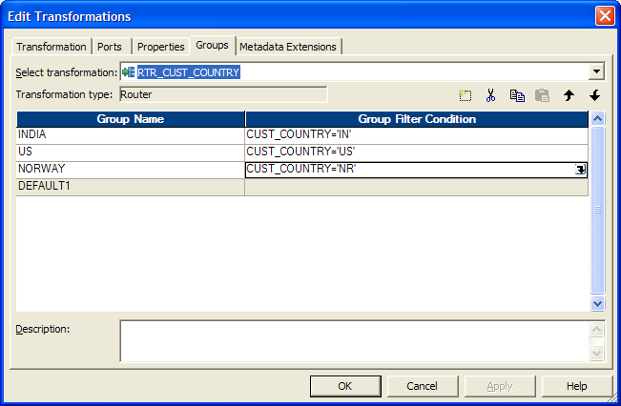
Router Group Filter Conditions

Slide 8
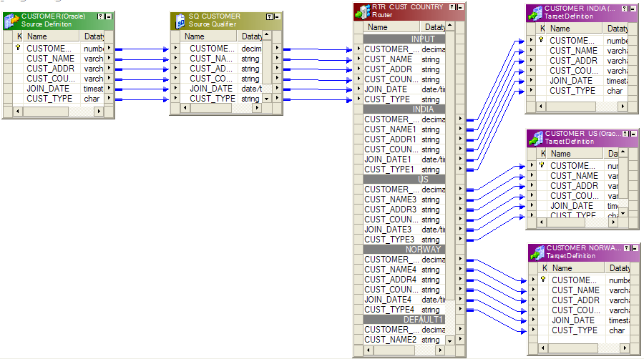
Using Router in a mapping

Slide 9
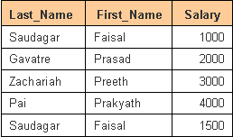


Example
Source
Targets
We are making use of a Router transformation to separate records into 2 groups:-
1. The records with Salary > 2500
2. The records with Salary <= 2500 AND Salary >1250
What happens if condition Salary <= 2500 not given in second condition?

Slide 10
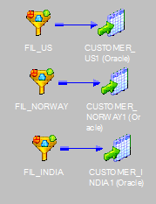
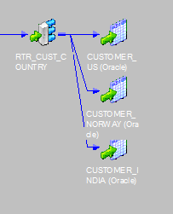
Filter Vs Router

Slide 11
Key Points to Remember
Router transformation tests data for one or more conditions and gives you the option to route rows of data that do not meet any of the conditions to a default output group.
  If we want the Power Center Server to drop all rows in the default group, do not connect it to a transformation or a target in a mapping.
The Designer creates the default group after we create one new user-defined group.
  The Designer deletes the default group when you delete the last user-defined group from the list – the Router Transformation needs at least 1 user defined group.
If all of the conditions evaluate to FALSE, the Power Center Server passes the row to the default group.

Slide 12
LAB 12 - Router Transformation (1)
  Create a mapping using Customer as Source
  Add a Router to have groups by Customer, based on Country = ‘USA’, Country = ‘Germany’ and all others
  Load to 3 instances of the DIM_CUSTOMER table

Slide 13
LAB 13 - Router Transformation (2)
  Create a copy of LAB 11
  Source:- Orders
  Load data to the 3 target tables which should contain only for the months of October, November and December respectively
    Orders_Oct
    Orders_Nov
    Orders_Dec
  Make use of Router transformation

Slide 14
Aggregator Transformation

Slide 15
What does it do?
  The Aggregator transformation allows you to perform aggregate calculations, such as averages and sums.
  The Aggregator transformation is unlike the Expression transformation, in that you can use it to perform calculations on groups.
  The Expression transformation permits you to perform calculations on a row-by-row basis only.
  When using the transformation language to create aggregate expressions, you can use conditional clauses to filter rows, providing more flexibility than SQL language.
  The PowerCenter Server performs aggregate calculations as it reads, and stores necessary data group and row data in an aggregate cache.
  The PowerCenter Server typically returns the last row’s value for all the non-aggregated fields with the result of the aggregation.

Slide 16
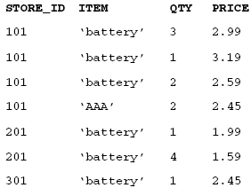
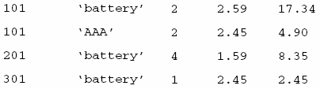
Example
Input records:- Group by STORE_ID and ITEM
Output records:- Calculate Total Sales per store

Slide 17

Aggregator Transformation
  Active Transformation Connected
  Ports
    Mixed
    Variables allowed
  Group by allowed
Used for Standard aggregations
Can also be used to get distinct records

Slide 18
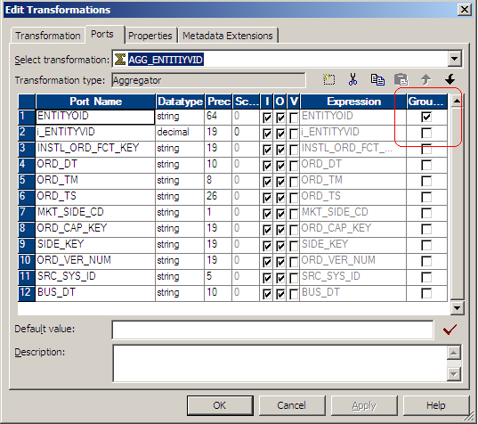
Aggregator Transformation
Performs aggregate calculations

Slide 19
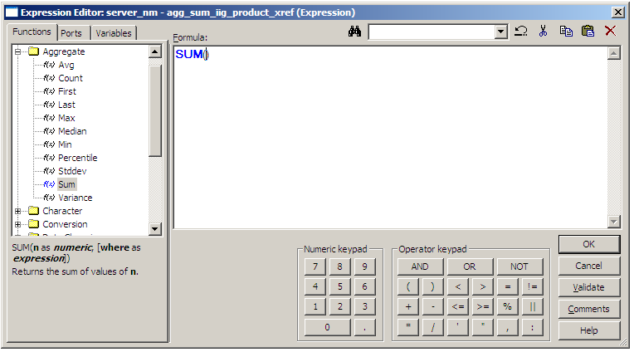
Aggregate Expressions
Aggregate functions are supported only in the Aggregator Transformation
  Conditional Aggregate Expressions are supported
    Ex : Conditional SUM format
        SUM (value, condition)

Slide 20
Aggregator Transformation
  Aggregate Functions
    Return summary values for non-null data in selected ports
    Used only in Aggregator Transformations
    Used only in Output ports
    Calculate a single value(and row) for all records in a group
    Nested aggregate functions are allowed
    Ex : AVG(), COUNT(), MAX(), SUM()
    Conditional statements can be used with these functions

Slide 21
Aggregate Properties
  Sorted Data (can be aggregated more efficiently)
    The Aggregator can handle sorted or unsorted data
    The Server will cache data from each group and release the cached data - upon reaching the first record of the next group
    Data must be sorted according to the order of the Aggregator “Group By” ports
    Performance gain will depend upon varying factors
  Sorted Input property
    Instructs the Aggregator to expect the data to be sorted
    If you use sorted input and do not presort data correctly, you receive unexpected results.

Slide 22
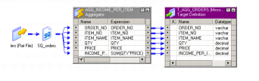
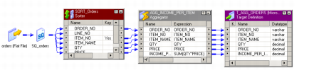
Sorted Vs Unsorted Input
Unsorted data
Group by Store, Department date
No rows are released from aggregator until all rows are aggregated
Sorted data
Group by Store, Department date
For each separate group, one row is released as soon as the last row in the group is aggregated

Slide 23
Key Points to Remember
Try to use Sorted Inputs to improve the performance based on the requirements.
The Aggregator returns the Last row, when no column is selected as “group by” port.
The nesting level of aggregate function is One.
  Eg: COUNT(MAX(SAL))
We can use conditional clauses to filter rows along with the Aggregate function, providing more flexibility.
  Eg :SUM( COMMISSION, SAL >20000)
Aggregator Transformation stores group values in an index cache and row data in the data cache.
If you need a Filter transformation in the mapping, place it before the Aggregator transformation to reduce unnecessary aggregation.

Slide 24
LAB 14 - Aggregator Transformation (1)
  Create a mapping with Sources as Orders, OrderDetails
  Source & Target connection is Train_Ora_Tgt
  Target is Fact_Orders
  Aggregate at Order_ID level
  Formulae:
    lead_time_days = requireddate - orderdate,
    internal_response_time_days = shippeddate - orderdate,
    external_response_time_days = requireddate - shippeddate
    total_order_item_count = SUM(Quantity)
    total_order_discount_dollars = SUM((Quantity * UnitPrice) * Discount)
    total_order_dollars = SUM((Quantity * UnitPrice) - ((Quantity * UnitPrice) * Discount))
  DEFAULT to -1 for customer_wk, employee_wk, order_date_wk, required_date_wk, shipped_date_wk, ship_to_geography_wk, shipper_wk

Slide 25
LAB 15 - Aggregator Transformation (2)
  Source:- Products table
  Target:- Category_details
  Find the total UnitsInStock for each category.
  In addition, for each category find the number of products whose price is greater than $20 as well as the total number of products.
  Do the above problem with just one aggregator

Slide 26
Joiner Transformation
Chapter 15

Slide 27
What does it do?
  You can use the Joiner transformation to join source data from two related heterogeneous sources residing in different locations or file systems.
  The Joiner transformation joins two sources with at least one matching port.
  The Joiner transformation uses a condition that matches one or more pairs of ports between the two sources.
  If you need to join more than two sources, you can add more Joiner transformations to the mapping.
  The Joiner transformation requires input from two separate pipelines or two branches from one pipeline.

Slide 28

Joiner Transformation
  Active/Connected
  Ports
    Input
    Output
    Master

Slide 29
Joins Types
  Homogeneous Joins
  Joins that can be performed with a SQL SELECT statement
  Source Qualifier contains a SQL join
  Tables on same database server(or are synonyms)
  Database server does the join “work”
  Multiple Homogeneous joins can be joined
  Heterogeneous Joins
  Examples of joins that cannot be done with an SQL statement :
    An Oracle table and a DB2 table
    Two flat files
    A flat file and a database table

Slide 30
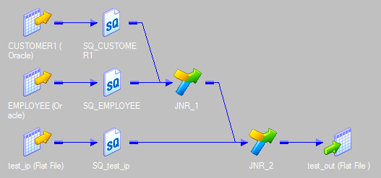
Heterogeneous Joins
JNR 1 : JOINS PIPE LINE 1 AND 2
PIPE LINE 1
PIPE LINE 2
PIPE LINE 3
JNR 2: JOINS THE RESULT SET WITH PIPE LINE 3

Slide 31
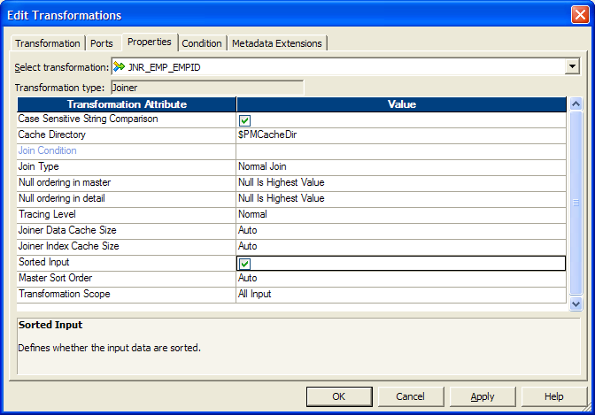
Joiner Properties
  Join Types:
    Normal (inner)
    Master Outer
    Detail Outer
    Full Outer
  Joiner can accept sorted data (configure the join condition to use the sort origin ports)
  Joiner Conditions & Nested Joins:
    Multiple Join conditions are supported
    Used to join three or more heterogeneous sources

Slide 32
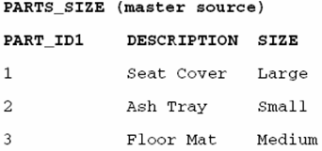
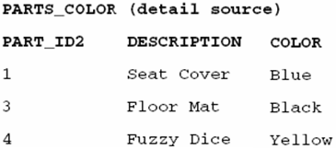

Join Types – 1. Normal Join
With a Normal join, the PowerCenter Server discards all rows of data from the master and detail source that do not match, based on the condition.
Source tables
Result after Normal Join

Slide 33

Join Types – 2. Master Outer Join
A master outer join keeps all rows of data from the detail source and the matching rows from the master source. (It discards the unmatched rows from the master source.)
Source tables
Result after Master Outer Join

Slide 34

Join Types – 3. Detail Outer Join
A detail outer join keeps all rows of data from the master source and the matching rows from the detail source. (It discards the unmatched rows from the detail source.)
Source tables
Result after Detail Outer Join

Slide 35
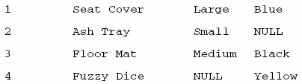
Join Types – 4. Full Outer Join
A full outer join keeps all rows of data from both the master and detail sources.
Source tables
Result after Full Outer Join

Slide 36
Key Points to Remember
Use Joiner Transformation only for Heterogeneous Sources.
To improve performance for an unsorted Joiner transformation, use the source with fewer rows as the Master source.
To improve performance for a sorted Joiner transformation, use the source with fewer duplicate key values as the Master source.
For n number of heterogeneous sources, (n-1) Joiner transformation(s) is required.
Only equality operators can be used in joiner transformation, non-equi join is not possible in this transformation.

Slide 37
LAB 16 - Joiner Transformation (1)
  Use Employee table created in LAB 4 as source.
  Add another source that is a combination of EmployeeTerritories, Territories, Region tables
  Join to the Employee table by doing an inner join on EmployeeID to get RegionID, RegionDescription, TerritoryID and TerritoryDescription from the tables
  Target:- Emp_Details

Slide 38
LAB 17 - Joiner Transformation (2)
  Sources:- Oracle.Part_Type, Oracle.Part_Color tables
  Target:- Part_Details
  Join the tables using a joiner on column part_id and load to target.

Slide 39
LAB 18 - Joiner Transformation (3)
  Sources:- Oracle.Part_Type, Oracle.Part_Color tables
  Target:- Oracle.Part_Details
  Join the tables using a joiner on column part_id and load to target.
  All records from Oracle.Part_Type should be present in the target. (Use an appropriate join type)

Slide 40
LAB 19 - Joiner Transformation (4)
  Sources:- Oracle.Part_Type, Oracle.Part_Color tables
  Target:- Oracle.Part_Details
  Join the tables using a joiner on column part_id and load to target.
  All records from Oracle.Part_Color should be present in the target. (Use an appropriate join type)

Slide 41
Lookup Transformation
Chapter 16

Slide 42
What does it do?
  Use a Lookup transformation in a mapping to look up data in a flat file or a relational table, view, or synonym.
  You can import a lookup definition from any flat file or relational database to which both the PowerCenter Client and Server can connect.
  You can use multiple Lookup transformations in a mapping.
  The PowerCenter Server queries the lookup source based on the lookup ports in the transformation.
  It compares Lookup transformation port values to lookup source column values based on the lookup condition and passes the result (of the lookup) to other transformations and a target.

Slide 43
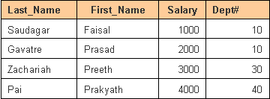
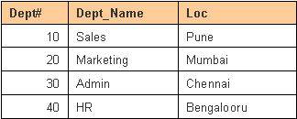

Example
Input
Lookup Table
How to find the department name for each employee by using a Lookup transformation?
This is determined by matching the Dept# from Input & Lookup tables
Output

Slide 44

Lookup Transformation
  Passive Transformation
  Connected/Unconnected
  Ports
    Mixed
    “L” indicates Lookup port
    “R” indicates port used as a return value
  Usage
    Get related values
    Verify if records exist or if data has changed
    Multiple conditions are supported
  Lookup SQL override is allowed

Slide 45
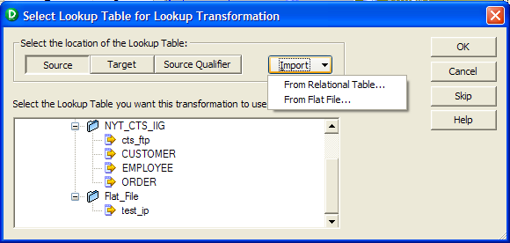
Lookup Transformation
Create LOOKUP definition using
1.From existing SOURCE DEFINITION
2.From existing TARGET DEFINITION
3.From existing MQ Series SQ DEFINITION
4.Import for DATA BASE or FLAT FILE
5.Create our OWN definition

Slide 46
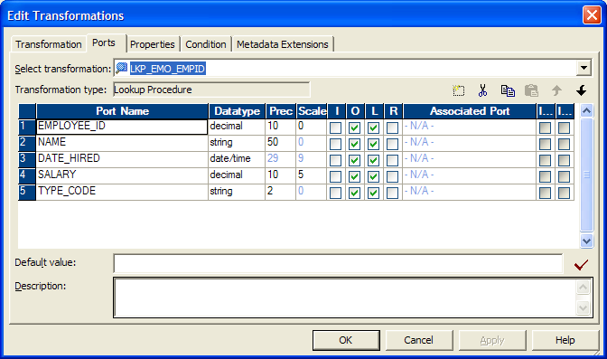
Lookup Transformation
Looks up values in a database table and provides data to other components in a mapping

Slide 47
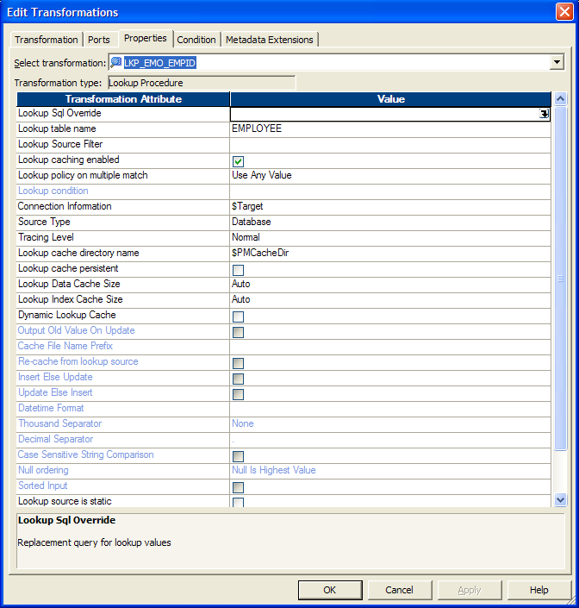
Lookup Properties
  Lookup conditions
    Lookup Table Name
    Lookup SQL
    Native Database connection Object name

Slide 48
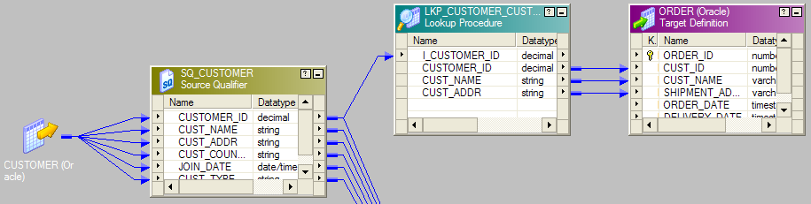
How a Lookup Transformation works
  For each mapping row, one or more port values are looked up in a database table
  If a match is found, one or more table values are returned to the mapping. If no match is found, default value is returned

Slide 49
Lookup Caching
  Caching can significantly impact performance
    Cached
      Lookup table data is cached locally on the server
      Mapping rows are looked up against the cache
      Only one SQL SELECT is needed
      Cache is indexed based on the order by clause
    Uncached
      Each Mapping row needs one SQL SELECT
  If the data does not fit in the memory cache, the PowerCenter Server stores the overflow values in the cache files.
  When the session completes, the PowerCenter Server releases cache memory and deletes the cache files unless you configure the Lookup transformation to use a persistent cache.
Rule of thumb: Cache if the number (and size) of records in the lookup table is small relative to the number of mapping rows requiring the lookup

Slide 50
Lookup Caches
  When configuring a lookup cache, you can specify any of the following options:
    Static cache:
    Dynamic cache:
    Persistent cache:
    Shared cache:

Slide 51
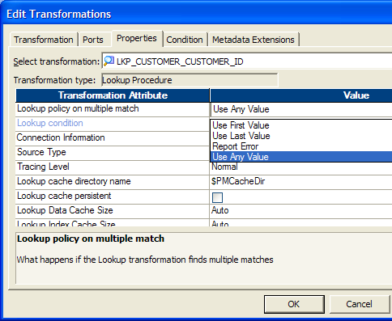
Lookup Policy on Multiple Match
Options are
  Use First Value
  Use Last Value
  Report Error
  Use Any Value
Note: When Dynamic Cache is enabled Multiple match will report error.

Slide 52
LAB 20 - Using Connected Lookup (1)
  Source:- Emp table
  Lookup:- Dept Table
  Target:- Emp_Dept table
  Add a Lookup transformation for Dept
  Lookup the Dept table to get the Dname for each employee’s Dept_id

Slide 53
LAB 21 - Using Connected Lookup (2)
  Use Mapping in LAB 14
  Add 2 Lookup transformation for DIM_EMPLOYEE and DIM_SHIPPER
  Target: Fact_Orders
  Populate using lookups with natural keys, default = -1
  employee_wk:
      Orders.EmployeeID = DIM_EMPLOYEE.employee_nk
  shipper_wk:
      Orders.ShipVia = Dim_Shipper.Shipper_nk
  Populate the other keys with Default = -9

Slide 54
LAB 22 - Using Connected Lookup (3)
  Source:- Employees
  Target:- Emp_Manager
  Use a lookup transformation to find the manager for each employee
  Load the employee name and manager name into the target
  If a person does not have a manager then do not load that record to the target

Slide 55
Unconnected Lookups
Chapter 17

Slide 56
Unconnected Lookup
  Will be physically “unconnected” from other transformations
    There can be NO data flow arrows leading to or from an unconnected Lookup
    Lookup function can be set within any transformation that supports expression

Slide 57
Conditional Lookup Technique
Two requirements:
  Must be Unconnected(or “function mode”) Lookup
  Lookup function used within a conditional statement
  E.g - IIF(ISNULL(cust_id), :lkp.MYLOOKUP(order_no)
    Conditional statement is evaluated for each row
    Lookup function is called only under the pre-defined condition

Slide 58
Conditional Lookup Advantage
  Data lookup is performed only for those rows which require it.Substantial performance can be gained
    E.g.- A Mapping will process 500,000 rows. For two percent of those rows(10,000) the item_id value is NULL. Item_id can be derived from the SKU_NUMB
    IIF(ISNULL(item_id),:lkp.MYLOOKUP(sku_numb))
    Net Savings=490,000 lookups

Slide 59
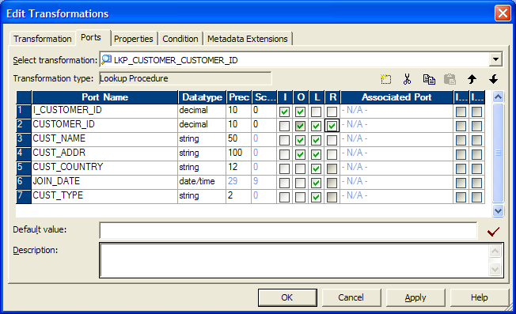
Unconnected Lookup Functionality
One Lookup port value (Return Port) may be returned for each Lookup
WARNING:
If the Return port is not defined, you may get unexpected results.

Slide 60
Connected Vs Unconnected Lookups
Connected LOOKUP | Unconnected LOOKUP
Part of the mapping data flow | Separate from the mapping data flow
Returns multiple values (by linking output ports to another transformation | Returns one value (by checking the Return port option for the output port that provides the return value)
Executed for every record passing through the transformation | Only executed when the lookup function is called
More visible, shows where the lookup values are used | Less visible, as the lookup is called from an expression within another transformation
Default values are used | Default values are ignored

Slide 61
Key Points to Remember
Where applicable, try to use small tables as Lookup table and minimize the cache – We should consider using the bigger table as a Source
  If feasible, try to replace lookup transformation with Joiner transformation.
Non-equi join is possible using Lookup transformation.
If a Lookup transformation specifies several conditions, you can improve lookup performance by placing all the conditions that use the equality operator first in the list of conditions that appear under the Condition tab.
When Looking upon a table, uncheck Lookup port(s) for unwanted columns to minimize the cache – never delete those ports from the transformation.

Slide 62
LAB 23 - Using Unconnected Lookup (1)
  Use the Mapping in LAB 21
  Add two Unconnected Lookups for
    DIM_CUSTOMER
    DIM_CALENDER (Empty table)
  The unconnected lookups can be called from the aggregator

Slide 63
LAB 24 - Using Unconnected Lookup (2)
  Use LAB 18 and do the same assignment by replacing the connected lookup with unconnected lookup.
  Return dept_name alone from the Unconnected lookup.

Slide 64
Questions??

Slide 65
Thank You!
From
Informatica-CoE

