Slide 1
Informatica PowerCenter 9

Slide 2
DAY 4

Slide 3
Using Shared Objects: Mapplets

Slide 4
Overview
  Useful for repetitive tasks / logic
  Represents a set of transformations
  Mapplets are reusable (Use an “instance” of a Mapplet in a Mapping)
  Changes to a Mapplet are inherited by all instances
  Server expands the Mapplet at runtime
  Mapplets help simplify mappings in the following ways:
    Include source definitions
    Accept data from sources in a mapping
    Include multiple transformations
    Pass data to multiple transformations
    Contain unused ports

Slide 5
Components
  A mapplet has the following components:
    Mapplet input:
      You can pass data into a mapplet using source definitions and / or Input transformations.
      When you use an Input transformation, you connect it to the source pipeline in the mapping.
    Mapplet output:
      Each mapplet must contain one or more Output transformations to pass data from the mapplet into the mapping.
    Mapplet ports:
      Mapplet ports display only in the Mapping Designer.
      Mapplet ports consist of input ports from Input transformations and output ports for Output transformations.
      If a mapplet uses source definitions rather than Input transformations for input, it does not contain any input ports in the mapping.

Slide 6
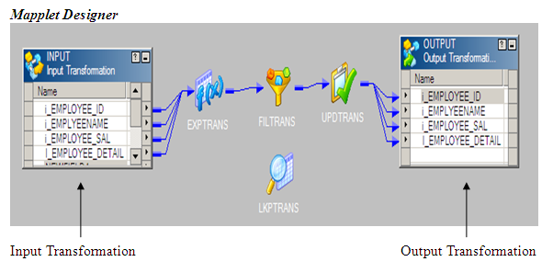
Example: Viewing Mapplet Input and Output

Slide 7
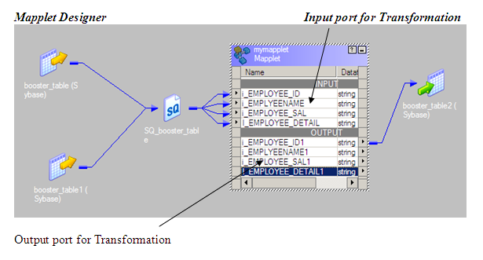
Example - Sample Mapplet in a Mapping

Slide 8
Mapplet Input Transformation
  Used for data sources outside a Mapplet
  Passive Transformation Connected
  Ports
    Output ports only
  Usage
    Only those ports connected from an Input transformation to another transformation will display in the resulting Mapplet
    Connecting the same port to more than one transformation is disallowed
    Pass to an Expression transformation first

Slide 9
Mapplet Output Transformation
  Used to contain the results of a mapplet pipeline.
  Multiple Output transformations are allowed.
  Passive Transformation Connected
  Ports
    Input ports only
  Usage
    Only these ports connected to an Output transformation (from another transformation) will display in the resulting Mapplet
    One (or more) Mapplet Output transformations are required in every Mapplet

Slide 10
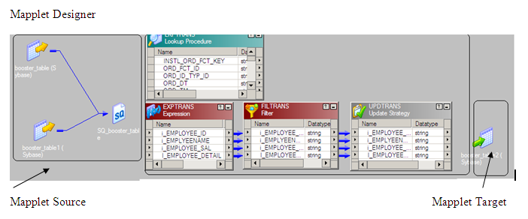
Example - Sample Mapplet in a Mapping

Slide 11
Mapplet Source Options
  Internal Sources
    One or more Source definitions / Source Qualifiers within the Mapplet
  External Sources
    Mapplet contains a Mapplet Input Transformation
    Receives data from the Mapping it is used in
  Mixed Sources
    Mapplet contains one or more of either of a Mapplet Input transformations AND one or more of Source Qualifiers
    Receives data from the Mapping it is used in, AND from the Mapplet

Slide 12
Mapplet Data Sources
  Data Source Outside a Mapplet
  Source data is defined OUTSIDE the Mapplet logic
  Resulting Mapplet HAS input ports
  When used in a Mapping, the mapplet may occur at any point in mid-flow
  Data Source Inside a Mapplet
  Source data is defined WITHIN the Mapplet logic
  No Input transformation is required (or allowed)
  Use a Source Qualifier instead
  Resulting Mapplet has NO input ports
  When used in a Mapping, the Mapplet is the first object in the data flow

Slide 13
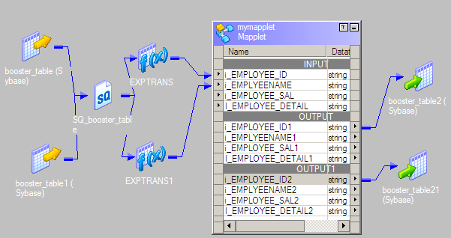
Mapplet with Multiple Output Groups
  Can output to multiple instances of the same target table

Slide 14
Unmapped Mapplet Output Groups
  Disallowed:
    Mapplet Output Group NOT linked
    Link at least one port

Slide 15
Unsupported Transformations
  Use any transformation in a Mapplet except:
    XML source definitions
    COBOL source definitions
    Normalizer
    Pre- and Post-Session stored procedures
    Target definitions
    Other Mapplets
  Sequence Generator transformations must be reusable in mapplets.

Slide 16
Key Points to Remember
Enter comments for Input and Output transformations.
  In a mapping, you can view comments associated with an Input or Output transformation by holding the pointer over the transformation name in the mapplet.
  You can clarify the use of a mapplet and its ports by creating descriptive comments or instructions in the Description field of Input and Output transformations.
  You can even include links to business documentation.
Create an Output transformation for each output group you need.
  You can pass data from each mapplet output group to a different mapping pipeline. Create an Output transformation for each output group you need.
To create mapplets from existing mappings, copy the objects from the mapping into the Mapplet Designer.

Slide 17
Key Points to Remember
Configure Sequence Generator caches appropriately.
  You can include a reusable Sequence Generator transformation in a mapplet. If you use the mapplet in several mappings and each mapping expends a large number of values in a session, you might want to configure the cache size for reusable Sequence Generator to limit the number of unused values.
When you edit a mapplet used in a mapping:
  Do not delete connected ports in an Input or Output transformation.
  Do not change the data type, precision, or scale of connected ports in an Input or Output transformation.
  Do not change a passive mapplet to an active mapplet or an active mapplet to a passive mapplet.

Slide 18
LAB 25 - Creating a Mapplet
  Create a Mapplet in the Mapplet Designer
  The mapplet should have the following Input Port:-
    Designation
  The mapplet should return the following Output Ports:-
    Designation
    Count (of Designations)
  The mapplet should find the counts of the designations
  If this count is < 2, discard; else, pass

Slide 19
LAB 26 - Using a Mapplet in a Mapping
  Use Customers, Suppliers, Employees tables as relational source
  Use Cust_Counts, Emp_Counts, Sup_Counts files as target files
  Use the available Mapplet for calculating the count of Designations
    ContactTitle for Customers & Suppliers
    Title for Employees
  We need to have 3 disconnected Flows in the same Mapping.

Slide 20
File List Option

Slide 21
File List Basics
  You can create a session to run multiple source files for one source instance in the mapping.
  You might use this feature if, for example, your company collects data at several locations which you then want to move through the same session.
  When you create a mapping to use multiple source files for one source instance, the properties of all files must exactly match the source definition.
  To use multiple source files, you create a file containing the names and directories of each source file you want the PowerCenter Server to use.
  This file is referred to as a “File list”.
  When the session starts, the PowerCenter Server reads the file list, then locates and reads the first file source in the list.
  After the PowerCenter Server reads the first file, it locates and reads the next file in the list.

Slide 22
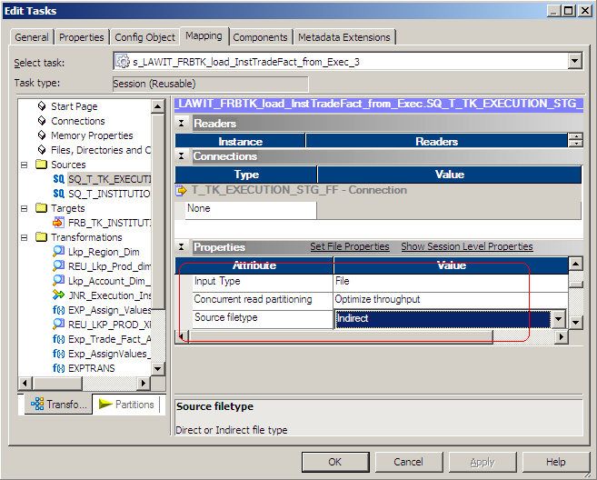
File List - Session Properties

Slide 23
Target Instances

Slide 24
Target Instances
A single mapping can have more than one instance of the same target
The data would be loaded into the instances in a pipeline
Usage of multiple instances of the same target for loading is dependant on the RDBMS in use. Multiple instances may not be used if the underlying database locks the entire table while inserting records

Slide 25
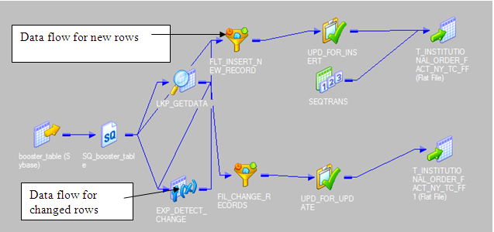
Target Instances - example

Slide 26
Update Strategy Transformation

Slide 27
What does it do?
  Update Strategy transformations are essential if you want to flag rows destined for the same target for different database operations (insert / update / delete), or if you want to reject rows.
  An Update strategy is generally used when we have determined whether we want to keep the historical data or just the most recent changes. Extensively used in SCD implementations.
  In PowerCenter, you set your update strategy at two different levels:
    Within a mapping: Within a mapping, you use the Update Strategy transformation to flag rows for insert, delete, update, or reject.
    Within a session: When you configure a session, you can instruct the PowerCenter Server to either treat all rows in the same way (for example, treat all rows as inserts), or use instructions coded into the session mapping to flag rows for different database operations.

Slide 28

Update Strategy Transformation
  Active Transformation Connected
  Ports
    All input/output
  Usage
    To mark a record for insert / update / delete or rejection
    IIF or DECODE logic determines how to handle the record

Slide 29
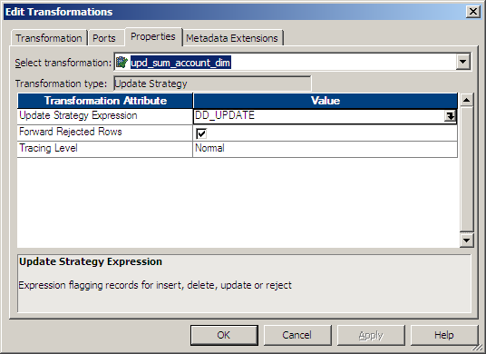
Update Strategy Transformation
Specifies how each individual row will be used to update target tables (insert, update, delete, reject)

Slide 30
Update Strategy expressions
Operations | Constant | Numeric Value
INSERT | DD_INSERT | 0
UPDATE | DD_UPDATE | 1
DELETE | DD_DELETE | 2
REJECT | DD_REJECT | 3
  IIF ( score>69, DD_INSERT, DD_DELETE)
  Expression is evaluated for each row
  Rows are “tagged” according to the logic of the expression
  Appropriate SQL (DML) is submitted to the target database: insert, delete or update
  DD_REJECT means the row will not have SQL written for it.
  Target will not “see” the row
  “Rejected” rows may be forwarded through Mapping to a reject file

Slide 31
Key Points to Remember
One design approach is to perform different database operations with different rows destined for the same target table one Update Strategy Transformation
  Add an Update Strategy transformation to the mapping.
  Use either the DECODE or IIF function to flag rows for different operations (insert, delete, update, or reject).
  When you configure a session that uses this mapping, select Data Driven for the Treat Source Rows As session property.
  Make sure that you select the Insert, Delete, or one of the Update options for each target table
When you configure the session only for a particular DML operation, select “Treat Source Rows As” appropriately.
  For pure updates “Treat Source Rows As Update” and have the Target instance only set for “Update as Update”
  Uncheck all unwanted options at the Target Instance

Slide 32
LAB 27 - Update Strategy (1)
  Insert data into the existing DEPT table as
  shown in the figure (Right hand corner).
  Create a Flat file (pipe delimited) as shown
  below.
  Use the above flat file as Source to Update the DEPT table (Location Field) using Update Strategy Transformation.
  Create a Lookup on Target (DEPT) table and If the DEPT_NO already exists, Then Update else Do Nothing
  NOTE: If DEPT_NO is not defined as a KEY, Please change it as PRIMARY_KEY
DEPT_NO | DEPT_NAME | LOCATION
101 | BIM | PUNE
102 | TDI | MADRAS
103 | IP | HYDERABAD
104 | BIM | BOMBAY
105 | TDI | BANGALORE
DEPT_NO|DEPT_NAME|LOCATION
102|TDI|CHENNAI
104|BIM|MUMBAI
105|TDI|BENGALURU
106|IP|KOLKATTA
107|BIM|GUDGAON

Slide 33
LAB 28 - Update Strategy (2)
  Use problem statement in LAB 28 and solve the same by NOT using the Update strategy transformation in the mapping.
  HINT: Use session level properties to achieve this.

Slide 34
Sorter Transformation

Slide 35
What does it do?
  The Sorter transformation allows you to sort data.
  You can sort data in ascending or descending order according to a specified sort key.
  You can also configure the Sorter transformation for case-sensitive sorting, and specify whether the output rows should be distinct.
  You can sort data from relational or flat file sources.
  You can specify more than one port as part of the sort key.
  When you specify multiple ports for the sort key, the PowerCenter Server sorts each port sequentially.

Slide 36

Sorter Transformation
  Active Transformation Connected
  Ports
    Input / Output
    Define one or more sort keys
    Define sort order for each key
  Usage
    Sort data in mapping / mapplet pipeline
    Before Aggregator

Slide 37
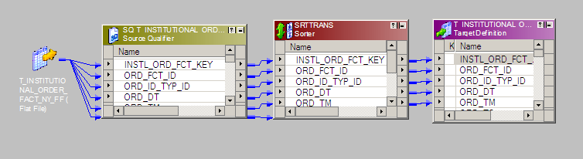
Sorter Transformation
  Can sort data from relational tables or flat files
  Sort takes place on the Informatica Server machine
  Multiple sort keys are supported

Slide 38
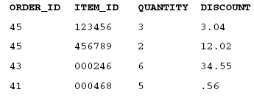
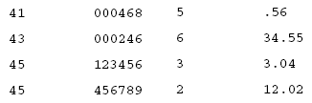
Example
Input
We need to sort By ORDER_ID asc and ITEM_ID asc
Output

Slide 39
Sorter Transformation
  Sorter Properties
    Cache size
      Can be adjusted. [Default is 16MB]
      Server uses twice the cache listed
      If cache size is unavailable, Session Task will fail

Slide 40
Key Points to Remember
We can also remove duplicates by sorter transformation using distinct property.
  Preferred for Flat Files
  Relational Tables should use Source Qualifier
It is recommended to use Sorter transformation before Aggregator /Joiner Transformation for Sources with high volume (greater than 250K records) to improve the performance.
Avoid Sorter wherever possible as it costs more cache.
  Source is Database → make use of “Order By” Clause
  Source is a big file → make use of the Unix “sort” command

Slide 41
Questions??

Slide 42
Thank You!
From
Informatica-CoE

