Slide 1
Informatica PowerCenter 9
Training

Slide 2
DAY 5

Slide 3
Mapping Parameters and Variables

Slide 4
Mapping Parameters & Variables
  Defined under the Mappings-Parameters & variables menu option.
  A parameter or variable defined in a mapplet is not visible in any parent mapping.
  A parameter or variable defined in a mapping is not visible in any child mapplet.
  When you use a mapping parameter, you declare and use the parameter in a mapping or mapplet.
  Then define the value of the parameter in a parameter file.
  During the session, the PowerCenter Server evaluates all references to the parameter to the value in the parameter file.
  Applies to all transformations within one Mapping / Mapplet.
  Format is $$VariableName or $$ParameterName.

Slide 5
Mapping Parameters & Variables
  Variables can change in value during run-time.
  Parameters remain constant during run-time.
  Provides increased developmental flexibility.
  If you declare mapping parameters and variables in a mapping, you can reuse a mapping by altering the parameter and variable values of the mapping in the session. (This can reduce the overhead of creating multiple mappings when only certain attributes of a mapping need to be changed)

Slide 6
Mapping Variables
  When you use a mapping variable, you declare the variable in the mapping or mapplet, and then use a variable function in the mapping to change the value of the variable.
  At the beginning of a session, the PowerCenter Server evaluates references to a variable to its start value.
  At the end of a successful session, the PowerCenter Server saves the final value of the variable to the repository.
  The next time you run the session, the PowerCenter Server evaluates references to the variable to the saved value.
  You can override the saved value by defining the start value of the variable in a parameter file.

Slide 7
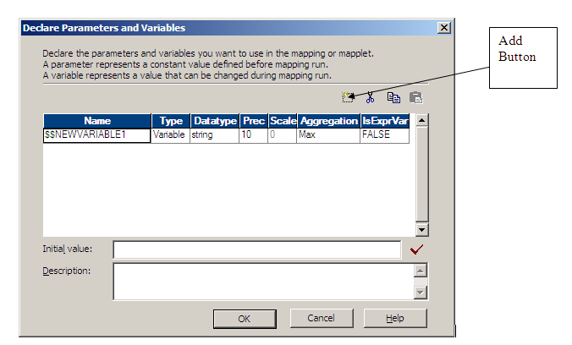
Declarations
  Declare Variables / Parameters in the Mappings / Mapplets menu
  Properties that can be set :
    User-defined Names
    Appropriate aggregation type (count, min etc)
    Optional initial value
  Apply Parameter / Variable in formula

Slide 8
Functions to Set Mapping Variables
  SetCountVariable:
    Counts the number of evaluated rows and increments or decrements a mapping variable for each row
  SetMaxVariable:
    Evaluates the value of a mapping variable to the higher of two values
  SetMinVariable:
    Evaluates the value of a mapping variable to the lower of two values
  SetVariable:
    Sets the value of a mapping variable to a specified value

Slide 9
Using in mappings & mapplets
  When you create a reusable transformation in the Transformation Developer, you can use any mapping parameter or variable.
  The Designer validates the usage of any mapping parameter or variable in the expressions of reusable transformation.
  When you use the reusable transformation in a mapplet or mapping, the Designer validates the expression again.
  When the Designer validates a mapping variable in a reusable transformation, it treats the variable as an Integer datatype.
  You cannot use mapping parameters and variables interchangeably between a mapplet and a mapping.
    Mapping parameters and variables declared for a mapping cannot be used within a mapplet.
    Similarly, you cannot use a mapping parameter or variable declared for a mapplet in a mapping.

Slide 10
Session and workflow parameter files
  You can use a parameter file to define the values for parameters and variables used in a workflow, worklet, or session.
  You can create a parameter file using a text editor.
  You list the parameters or variables & their values in the parameter file.
  Parameter files can contain the following types of parameters and variables:
    Workflow variables
    Worklet variables
    Session parameters
    Mapping parameters and variables.
  When you use parameters or variables in a workflow, worklet, or session, the PowerCenter Server checks the parameter file to determine the start value of the parameter or variable.
  You can use a parameter file to initialize workflow variables, worklet variables, mapping parameters, and mapping variables.

Slide 11
Session and workflow parameter files
  You can place parameter files on the PowerCenter Server machine or on a local machine.
  You can include parameter or variable information for more than one workflow, worklet, or session in a single parameter file by creating separate sections for each object within the parameter file.
  You can also create multiple parameter files for a single workflow, worklet, or session and change the file that these tasks use as needed.

Slide 12
Parameter File Format
  When you enter values in a parameter file, you must precede the entries with a heading that identifies the workflow, worklet, or session whose parameters and variables you want to assign.
  You assign individual parameters and variables directly below this heading, entering each parameter or variable on a new line.
  You can list parameters and variables in any order for each task.

Slide 13
Parameter File Format
  You can define the following heading formats:
    Workflow variables:
    [folder name.WF:workflow name]
    Worklet variables:
    [folder name.WF:workflow name.WT:worklet name]
    Worklet variables in nested worklets:
    [folder name.WF:workflow name.WT:worklet name.WT:worklet name...]
    Session parameters, plus mapping parameters and variables:
    [folder name.WF:workflow name.ST:session name]
    or
    [folder name.session name]
    or
    [session name]

Slide 14
Parameter File Format
  Below each heading, you define parameter and variable values as follows:
      parameter1 name=value
      parameter2 name=value
      variable1 name=value
      variable2 name=value
  The parameter file for the session includes the folder and session name, as well as each parameter and variable:
      [Production.s_MonthlyCalculations]
      $$State=MA
      $$Time=10/1/2000 00:00:00
      $InputFile1=sales.txt
      $DBConnection_target=sales
      $PMSessionLogFile=D:/session logs/firstrun.txt

Slide 15
Sample Parameter File
  The following text is an excerpt from a parameter file:
[HET_TGTS.WF:wf_TCOMMIT_INST_ALIAS]
$$platform=unix
[HET_TGTS.WF:wf_TGTS_ASC_ORDR.ST:s_TGTS_ASC_ORDR]
$$platform=unix
$DBConnection_ora=qasrvrk2_hp817
[ORDERS.WF:wf_PARAM_FILE.WT:WL_PARAM_Lvl_1]
$$DT_WL_lvl_1=02/01/2000 00:00:00
$$Double_WL_lvl_1=2.2
[ORDERS.WF:wf_PARAM_FILE.WT:WL_PARAM_Lvl_1.WT:NWL_PARAM_Lvl_2]
$$DT_WL_lvl_2=03/01/2000 00:00:00
$$Int_WL_lvl_2=3
$$String_WL_lvl_2=ccccc

Slide 16
LAB 29 - Using Mapping parameters
  Use Order_Details (from MIKONTR db) as the source
  Use Sales as your target file
  Use the following formula for calculating Sales revenue:-
  Sales revenue = UnitPrice * Quantity * (1 – Discount)
  Declare a mapping parameter (USD_to_EUR) which represents the USD/EUR conversion rate
  Specify the value for this mapping parameter in your parameter file
  Use this value to calculate the Sales revenue in Euros

Slide 17
LAB 30 - Using Mapping Variables
  Use the mapping in Lab 29
  Define two mapping variables “Total_revenue” and “Total_orders” in the mapping
  Initialize these variables to zero in your parameter file
  Formulae:-
  Total_revenue = ∑ Sales_revenue for each transaction
  Total_orders = COUNT of all distinct orders

Slide 18
Workflow Variables

Slide 19
Workflow Variables
  Usage: Create and use variables in a workflow to reference values and record information
  Ex: use a variable in a Decision task to determine whether the previous task ran properly. If it did, you can run the next task. If not, you can stop the workflow.
  Defined under the Workflows->Edit->Variables menu option.
  Types of Workflow variables
  Predefined Workflow Variables
  User-defined

Slide 20
Predefined Workflow variables
  Used to evaluate workflow and task conditions
  Task Specific
    set of task-specific variables for each task in the workflow
    control the path the Integration Service when running the workflow
    available under the task name in the Expression Editor
  Built –in
    to return run-time or system information such as folder name, Integration Service Name, system date, or workflow start time
    available under the Built-in node in the Expression Editor
  All predefined workflow variables except Status have a default value of null

Slide 21
Task-Specific Workflow variables
Task Specific Variables | Task Type | Data Type
Condition | Decision | Integer
EndTime | All Tasks | Date/Time
ErrorCode | All Tasks | Integer
ErrorMsg | All Tasks | Nstring
FirstErrorCode | Session | Integer
FirstErrorMsg | Session | Nstring*
PrevTaskStatus | All tasks | Integer
SrcFailedRows | Session | Integer
SrcSuccessRows | Session | Integer
StartTime | All tasks | Date/Time
Status | All tasks | Integer
TgtFailedRows | Session | Integer
TgtSuccessRows | Session | Integer
TotalTransErrors | Session | Integer

Slide 22
Built in variables that provide Run time information
$PM<SourceName>@TableName
$PM<TargetName>@TableName
$PMFolderName
$PMIntegrationServiceName
$PMMappingName
$PMRepositoryServiceName
$PMRepositoryUserName
$PMSessionName
$PMSessionRunMode
$PMWorkflowName
$PMWorkflowRunId
$PMWorkflowRunInstanceName

Slide 23
Built-in System Variables
  SYSDATE: Provides current datetime on the Informatica Server machine
    Not a static value
  $$$SessStartTime: Returns the system date value as a String. Uses system clock on Informatica Server machine.
    String format is database type dependent
    Used in SQL override
    Has a constant value
  SESSSTARTTIME: Returns the system date value on the Informatica Server
    Used with any function that accepts transformation date / time data types
    Not to be used in SQL override
    Has a constant value

Slide 24
User-Defined Workflow variables
  It is valid only in that workflow
  Use the variable in tasks within that workflow.
  You can edit and delete user-defined workflow variables.
  Used when need to make a workflow decision based on criteria.
  Integration Service uses a default value for the variable based on its datatype.
Datatype | Workflow Manager Default Value
Date/Time | 1/1/1753 00:00:00.000000000 A.D
Double | 0
Integer | 0
Nstring | Empty string

Slide 25
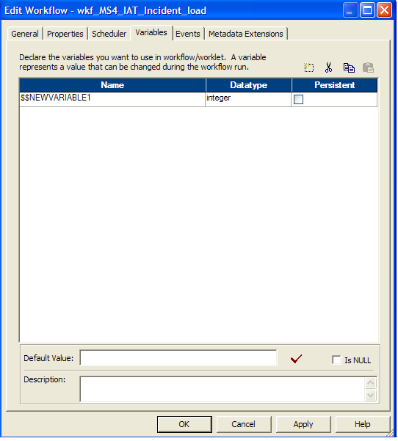
Creating User-Defined Workflow Variables
In the Workflow Designer, create a new workflow or edit an existing one.
Select the Variables tab ->Add
Add new variable

Slide 26
Example for User-Defined Workflow Variables
You create a workflow to load data to an orders database nightly.
You also need to load a subset of this data to headquarters periodically, every tenth time you update the local orders database.
Create separate sessions to update the local database and the one at headquarters.

Slide 27
Workflow variables
    Can be used in :-
    Assignment Tasks
    Decision Tasks
    Links
    Timer Tasks

Slide 28
Worklets

Slide 29
Worklets
  A worklet is an object that represents a set of tasks.
  It can contain any task available in the Workflow Manager.
  Use the Worklet Designer to create and edit Worklets.
  You can run Worklets inside a workflow.
  The workflow that contains the worklet is called the parent workflow.
  You can also nest a worklet in another worklet.
  Create a worklet when you want to reuse a set of workflow logic in several workflows.
  The worklet does not contain any scheduling or server information.
  To run a worklet, include the worklet in a workflow.
  The PowerCenter Server writes information about worklet execution in the workflow log.

Slide 30
Nesting Worklets
  You can nest a worklet within another worklet.
  When you run a workflow containing nested worklets, the PowerCenter Server runs the nested worklet from within the parent worklet.
  You might choose to nest worklets to simplify the design of a complex workflow.
  You can group several worklets together by function or simplify the design of a complex workflow when you nest worklets.
  You might choose to nest worklets to load data to fact and dimension tables.
    Create a nested worklet to load fact and dimension data into a staging area.
    Then, create a nested worklet to load the fact and dimension data from the staging area to the data warehouse.

Slide 31
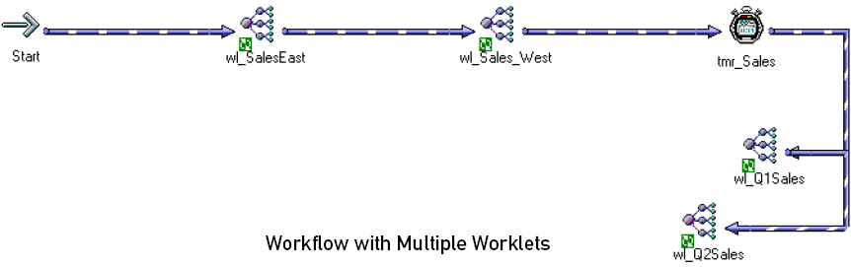

Multiple Worklets Vs Nesting Worklets

Slide 32
Workflows – Additional Tasks
Chapter 23

Slide 33
Additional Workflow Tasks
  Eight additional Tasks are available in the Workflow Designer
      Command
      Email
      Decision
      Assignment
      Timer
      Control
      Event Wait
      Event Raise

Slide 34
Reusable Tasks
  Three types of reusable tasks
    Session: Set of instructions to execute a specific Mapping
    Command: Specific shell commands to run during any Workflow
    Email: Sends email during the Workflow
  Use the Task Developer to create a reusable tasks
  These tasks will then appear in the Navigator and can be dragged & dropped into any workflow

Slide 35
Command Task
  Specify one or more Unix shell or DOS commands to run during the Workflow
    Runs in the Informatica Server (Unix or Windows) environment
  Shell command status (successful completion or failure) is held in the pre-defined variable “$command_task_name.STATUS”
  Each command Task shell command can execute before the Session begins or after the Informatica Server executes a Session
  Specify one or more Unix shell or DOS (NT, WIn2000) commands to run at a specific point in the Workflow
  Becomes a component of a Workflow (or Worklet)

Slide 36
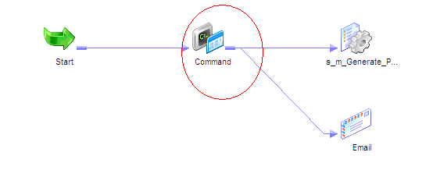
Command Task
  If configured in the Task Developer, the Command Task is reusable (optional)
  You can use a Command task in the following ways:
    Standalone Command task.
    Pre- and post-session shell command.

Slide 37
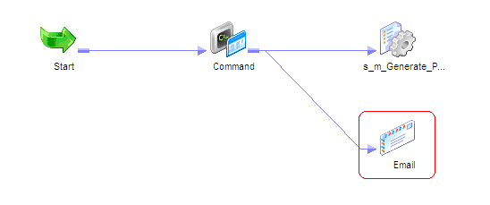
Email Task
  Configure to have the Informatica Server to send email at any point in the Workflow
  Becomes a component in a Workflow (or Worklet)
  If configured in the Task Developer, the Email Task is reusable(optional)

Slide 38
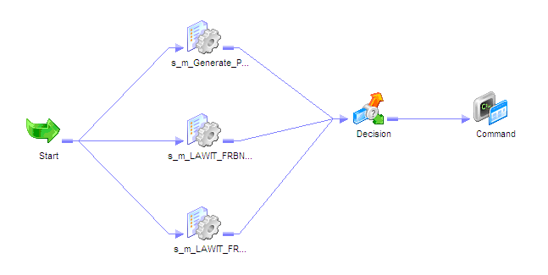
Decision Task
  Specifies a condition to be evaluated in the Workflow
  Use the Decision Task in branches of a Workflow
  Provides additional functionality over a Link

Slide 39
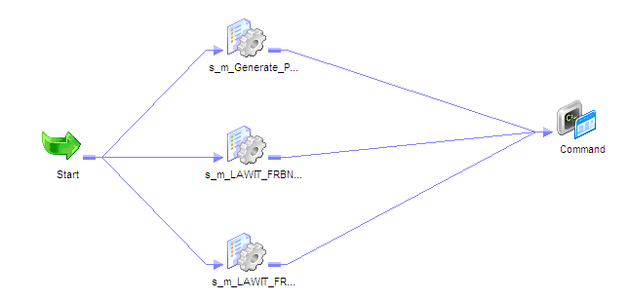
Decision Task
  Example Workflow without a Decision Task

Slide 40
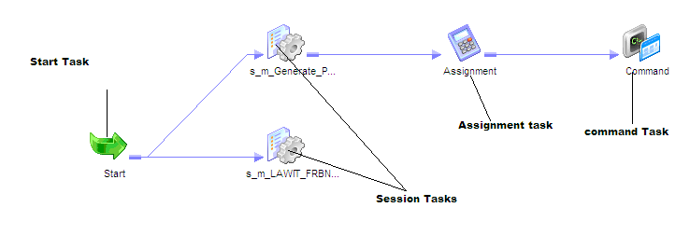
Assignment Task
  Assigns a value to a Workflow variable
  Variables are defined in the Workflow object

Slide 41
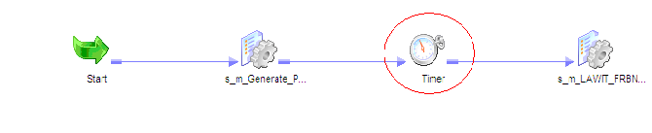
Timer Task
  Waits for a specified period of time to execute the next Task
    Absolute Time
    Datetime variable
    Relative Time

Slide 42
Control Task
  Used to stop, abort, or fail the top-level workflow or the parent workflow based on an input link condition.
  A parent workflow or worklet is the workflow or worklet that contains the Control task.

Slide 43
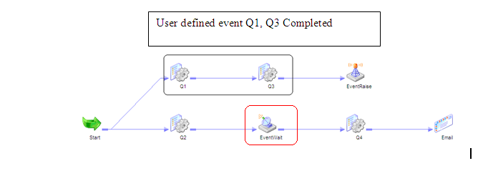
Event Wait Task
  Waits for a User-defined or a Pre-defined event to occur
  Once the Event occurs, the Informatica Server completes the rest of the Workflow
  Used with the Event Raise Task
  Events can be a file watch (indicator file) or User-defined
  User-defined events are defined in the Workflow itself

Slide 44
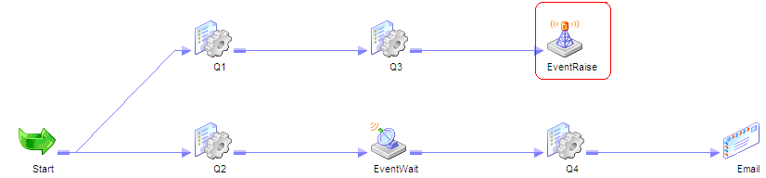
Event Raise Task
  Represents the location of a User-defined event
  The Event Raise Task triggers the User-defined event when the Informatica Server executes the Event Raise Task

Slide 45
Questions??

Slide 46
Thank You!
From
Informatica-CoE

