Slide 1
Informatica PowerCenter 9

Slide 2
DAY 6

Slide 3
Other Available Transformations
Chapter 25

Slide 4
Other Available Transformations [1/5]
Application Source Qualifier:
    Active/Connected
    Reads ERP object sources
Custom:
    [Active or Passive]/Connected
    Calls a procedure in a shared library or DLL.
External Procedure:
    Passive/[Connected or Unconnected]
    Calls a procedure in a shared library / the COM layer of Windows.
Rank:
    Active/Connected
    Filters the top or bottom range of records for selection.
Normalizer:
    Active/Connected
    Reorganizes records from VSAM, Relational and Flat file
Transaction Control:
    Active/Connected
    Defines commit and rollback transactions.

Slide 5
Other Available Transformations [2/5]
Union:
    Active/Connected
    Merges data from different databases or flat file systems.
XML Generator:
    Active/Connected
    Reads data from one or more input ports & outputs XML through a
    single output port.
XML Parser:
    Active/Connected
    Reads XML from one input port and outputs data to one or more output ports.
XML Source Qualifier:
    Active/Connected
    Represents the rows that the PowerCenter Server reads from an XML
    source when it runs a session
MQ Source Qualifier:
    Active/Connected
    MQ Source Qualifier reads all the message header fields and the message data
    field in a WebSphere MQ message.

Slide 6
Other Available Transformations [3/5]
SQL:
    [Active or Passive] /Connected
    The SQL transformation processes SQL queries midstream in a pipeline
Datamasking:
    Passive/Connected
    change sensitive production data to realistic test data for non-production
    environments
Flexible Target Key:
    Passive/Connected
    To address the case where a data target has its Primary Key mapped to
    a column in a PowerExchange Change Data Capture source, which may
    be subject to update.
HTTP:
    Passive/Connected
    The HTTP transformation enables you to connect to an HTTP server to use its
    services and applications.

Slide 7
Other Available Transformations [4/5]
Web Service Consumer:
    Active/Connected
    Web Services Consumer transformations perform any function a web service
    operation performs.
JAVA:
    Active/Passive/Connected
    Provides a simple native programming interface to define transformation
    functionality with the Java programming language.
Application Multi Group Source Qualifier:
    Passive/Connected
    When you use a TIBCO source definition in a mapping, the PowerCenter
    Designer includes a predefined Application Multi-Group Source Qualifier with the
    source definition. You cannot edit the Application Multi-Group Source Qualifier.
Unstructured Data:
    Active/Passive/Connected
    Transformation that processes unstructured and semi-structured file formats,
    such as messaging formats, HTML pages and PDF documents.

Slide 8
Other Available Transformations [5/5]
Salesforce Lookup:
    Active/Connected
    To look up data in a Salesforce object.
Salesforce PickList:
    Passive/Connected
    To generate a list of picklist values for a field in a Salesforce object.
    A Salesforce picklist is a list of valid values for a Salesforce field.
Salesforce Merge:
    Passive/Connected
    To merge duplicate records in one of the following Salesforce objects:
    Account, Contact, or Lead.

Slide 9
Designer Features
Chapter 26

Slide 10
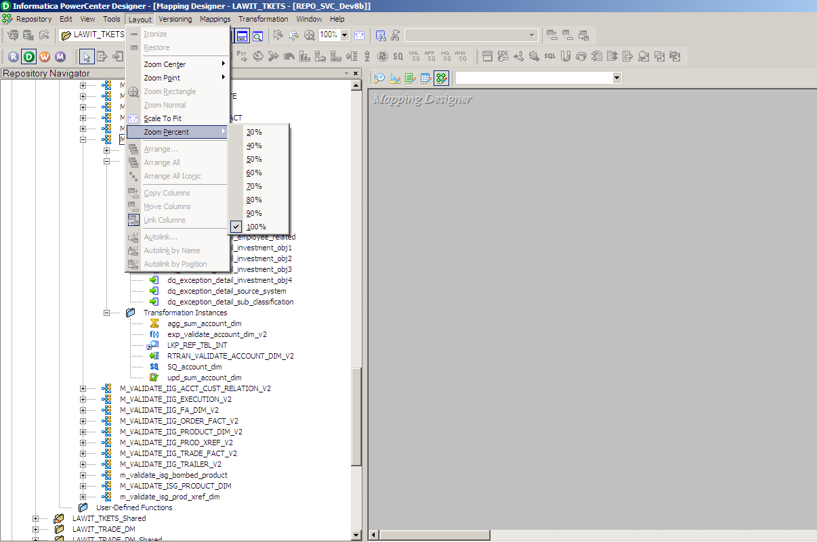
Arranging Workspace

Slide 11
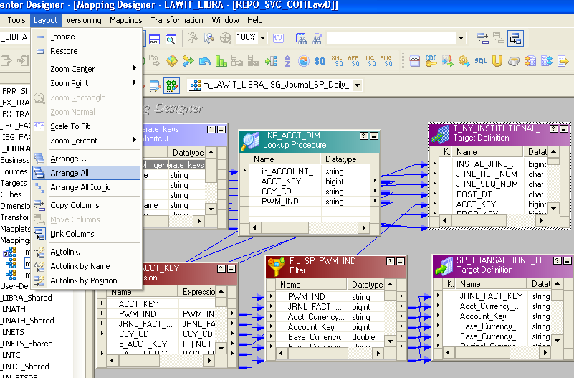
Arrange All

Slide 12
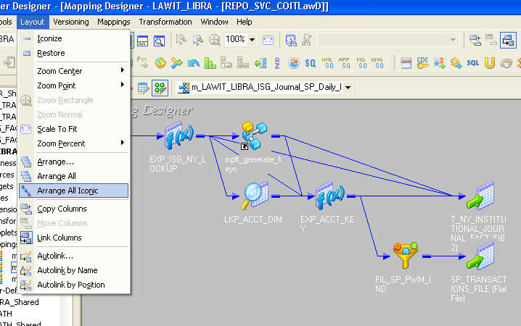
Arrange All Iconic

Slide 13
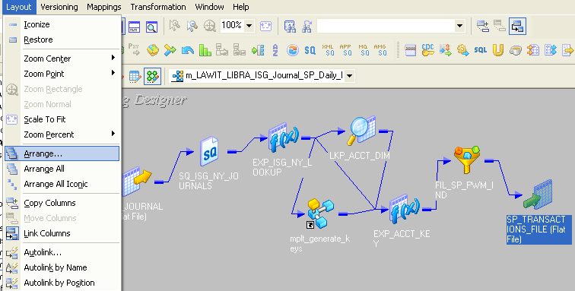
Arrange

Slide 14
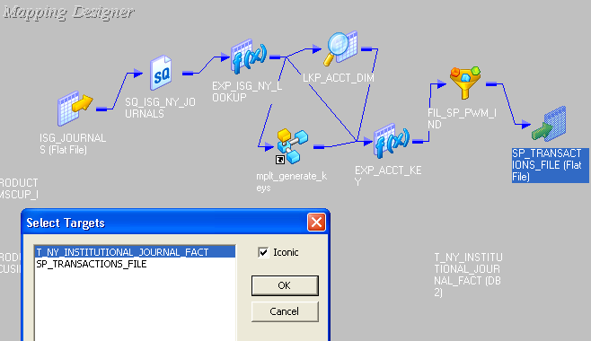
Arrange

Slide 15
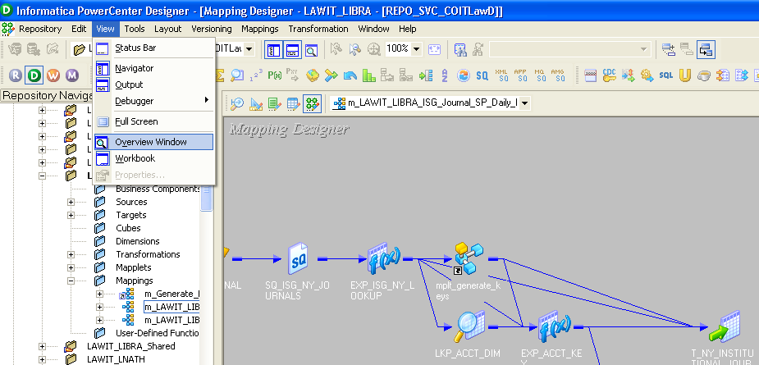
Over View Window

Slide 16
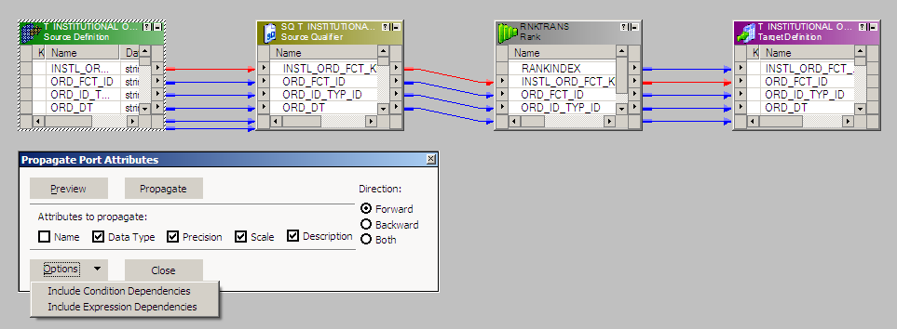
Propagating Changed Attributes

Slide 17
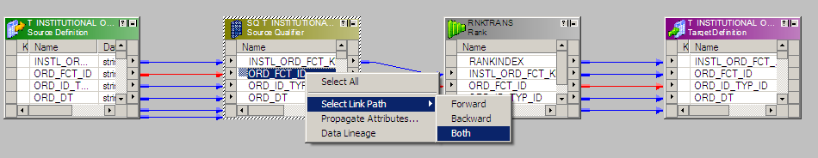
Link Paths

Slide 18
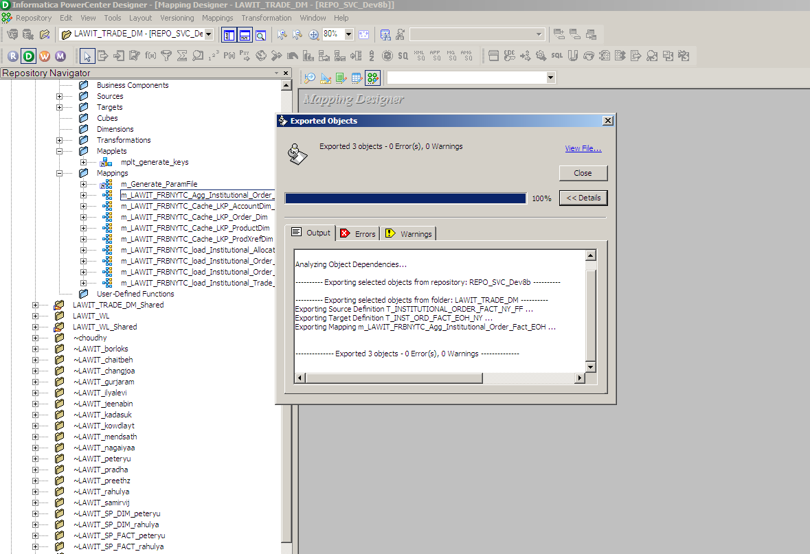
Exporting Objects to XML

Slide 19
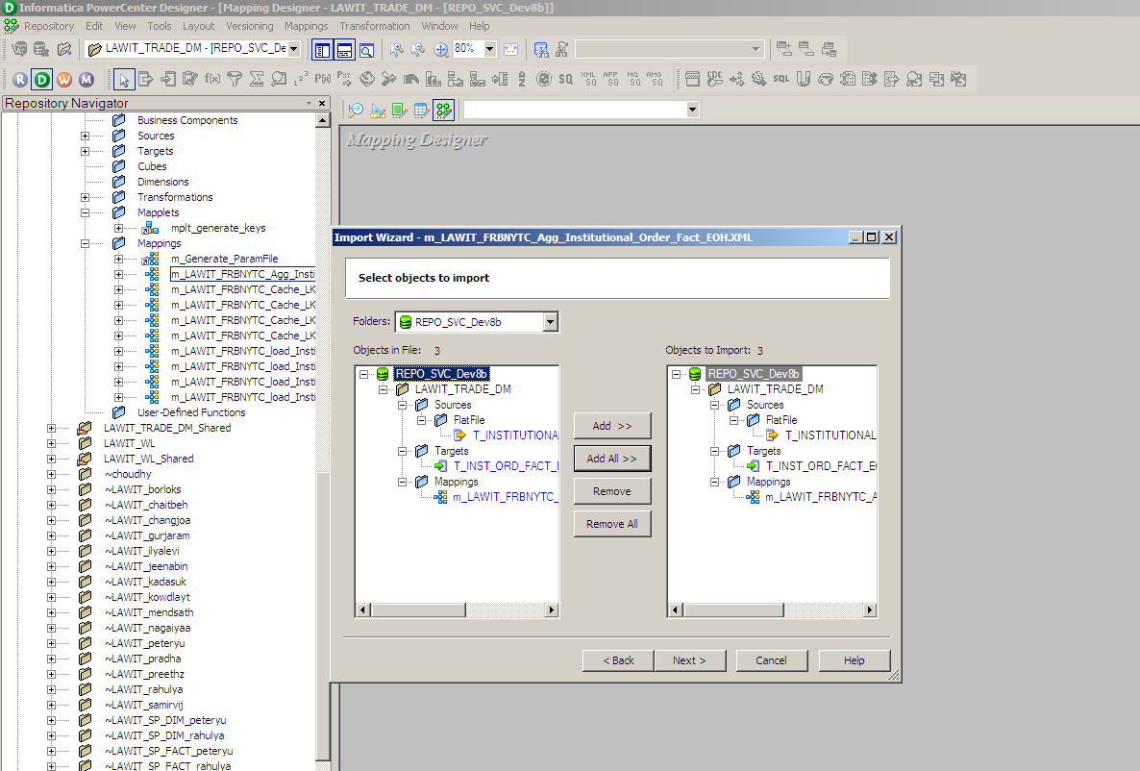
Importing Objects from XML

Slide 20
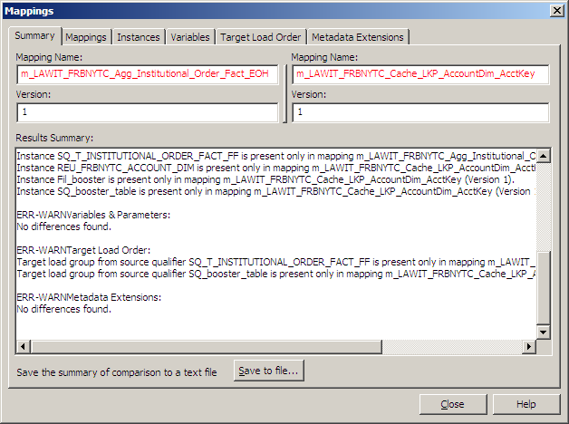
Comparing Objects

Slide 21
Naming Conventions
Chapter 3

Slide 22
Naming Conventions
  Good Practice to Follow Naming Conventions
  Can be project specific:-
    Workflow: wfl_ followed by workflow functionality
    Session: s_ followed by mapping name
    Mapping: m_ followed by mapping functionality
    Source: Table/File name
    Target: Table/File name
    Ports:
        Input & Output :- Column Names
        Variable:- v_ followed by functionality

Slide 23
Naming Conventions - Transformations:
Source Qualifier: sql_(followed by Source Name)
Stored Procedure: sp_(followed by purpose of transformation)
Sequence Generator: seq_
Expression: exp_
Joiner: jnr_
Lookup: lkp_
Filter: fil_
Rank: rnk_
Router: rtr_
Update Strategy: upd_
Aggregator: agg_
Normalizer: nrm_

Slide 24
Questions??

Slide 25
Thank You!
From
Informatica-CoE

