Slide 1
Informatica PowerCenter 9
Training

Slide 2
DAY 7

Slide 3
Course Objectives
Understand how to use Informatica Power Center 9 Debugger for testing
Basic Debugger functionalities
Steps of Debugging
Creation of a Breakpoint
‘Evaluate the Expression’ functionality
Debugger Window

Slide 4
Debugger

Slide 5
Debugger
  Informatica Debugger is used by Programmer for Test Data Loading into Target Database Tables
  Just to view the data without loading.
  Main purpose of debugger is to view the step-by-step Transformation-by-Transformation) to trace out logical error.
Pre-requisites for using Debugger:
  Repository Server must be defined for the repository using Workflow Manager Tool
  Informatica Service must be configured and started

Slide 6
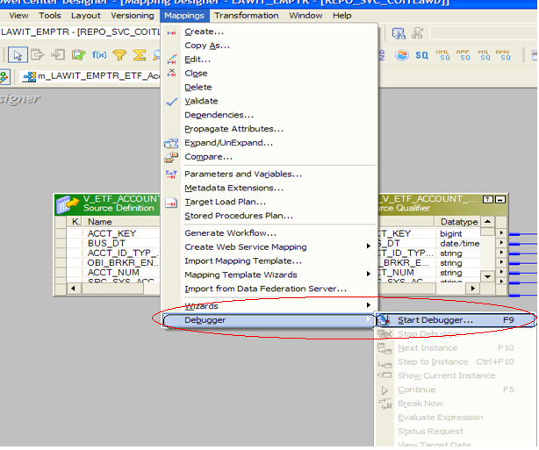
Steps for Debugging

Slide 7
Debugger
  When you run the Debugger, you can monitor the following information:
  Session status: Monitor the status of the session.
  Data movement: Monitor data as it moves through transformations.
  Breakpoints: Monitor data that meets breakpoint conditions.
  Target data: Monitor target data on a row-by-row basis.

Slide 8
Debugger
  Steps For Debugging:
  Open the Mapping Program
  Mappings->Debugger-> Start Debugger
  Select Repository Server from the list
  Select the session source. It can be:
    From a Workflow (first option)
    Reusable session (second option)
    Debug session (third option). Created temporarily by Debugger

Slide 9
Steps for Debugging

Slide 10
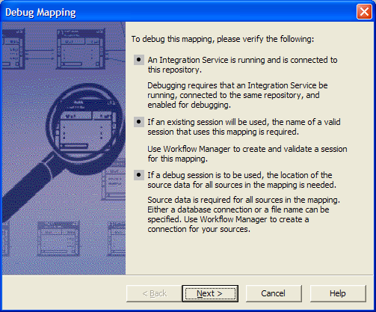
Steps for Debugging

Slide 11
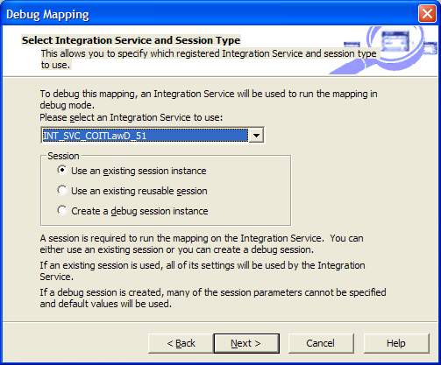
Steps for Debugging
  Select the session source
  Select Repository Server from the list

Slide 12
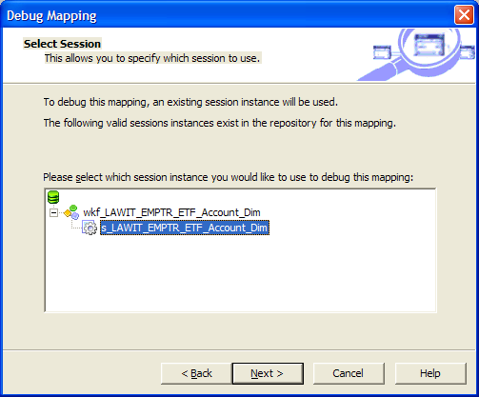
Steps for Debugging
  Select the session Which you need to debug

Slide 13
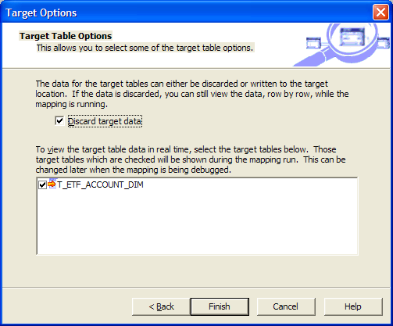
Steps for Debugging
  Disable option 'Discard target data' if you want to load data physically into Target Table(s).

Slide 14
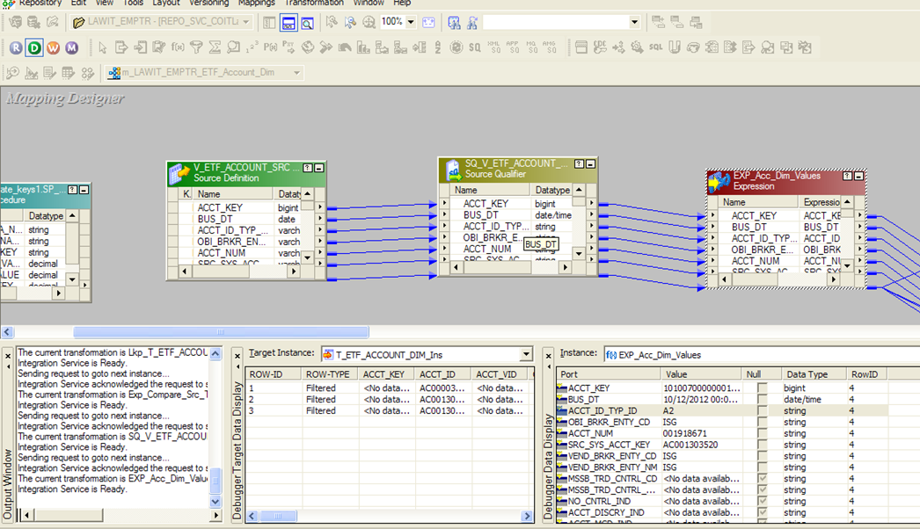
Steps for Debugging

Slide 15
Debugger
  The Mapping Designer displays windows and debug indicators that help you monitor the session:
  Debug indicators: Debug indicators on transformations help you follow breakpoints and data flow.
  Instance window: When the Debugger pauses, you can view transformation data and row information in the Instance window.

Slide 16
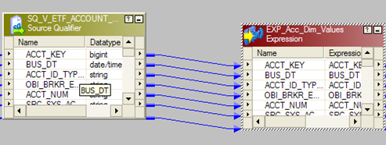
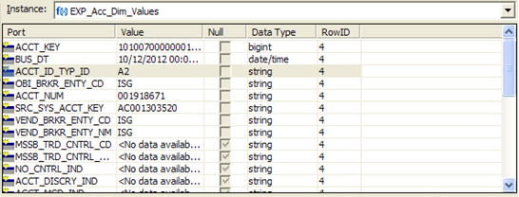
Debugger
  Debug indicator
  Instance Window

Slide 17
Debugger
  The Mapping Designer displays windows and debug indicators that help you monitor the session:
  Target window: View target data for each target in the mapping.
  Output window. The Integration Service writes messages to the following tabs in the Output window:
  - Debugger tab. The debug log displays in the Debugger tab.
  - Session Log tab. The session log displays in the Session Log tab.
  - Notifications tab. Displays messages from the Repository Service.

Slide 18
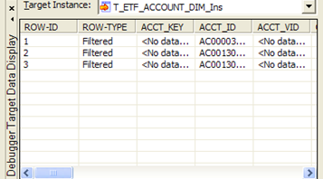
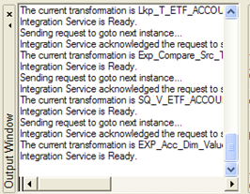
Debugger
  Target Instance
  Output Window

Slide 19
Breakpoint
  Before you run the Debugger, use the Breakpoint Editor in the Mapping Designer to create breakpoint conditions in a mapping.
  You can create data or error breakpoints for transformations or for global conditions.
  When you run the Debugger, the Integration Service pauses the Debugger when a breakpoint evaluates to true.
  You can review and modify transformation data, and then continue the session.
  You cannot create breakpoints for mapplet Input and Output transformations.

Slide 20
Breakpoint
  creation of a Breakpoint.:
  Open the Mapping Program
  Mappings->Debugger->Edit Breakpoints:
  This is to define different transformations as breakpoint where Debugger has to stop to show the Data or Error. We can add as many breakpoints as required.
  Select a transformation from the list
  Use 'Add' button
  Decide DATA or ERROR for stoppage
  Define number of records (for DATA) or number of errors (for ERROR) to be skipped before debugger stops to show the data.
  Use 'OK' button to complete
  Continue to the next break. To continue to the next break, click Continue on the toolbar or from the Mapping > Debugger menu option. The Debugger continues running until it encounters the next break.

Slide 21
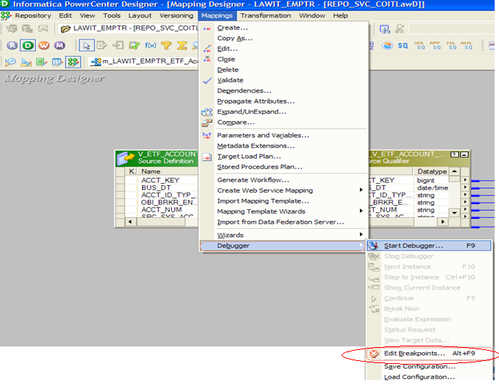
Breakpoint:

Slide 22
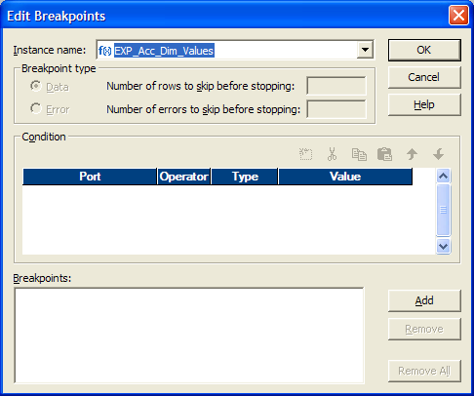
Breakpoint:
1) We have to Select a transformation from the list
2) Use Add Button to add the Transformation

Slide 23
Breakpoint
  A breakpoint can consist of an instance name, a breakpoint type, and a condition. When you enter breakpoints, set breakpoint parameters in the following order:
  Select the instance name. Choose to create a global breakpoint or a breakpoint against a single transformation within the mapping or mapplet.
  Select the breakpoint type. Choose to evaluate error or data conditions. You can also choose the number of rows to skip for the breakpoint type.
  Enter the condition. Enter data conditions for global or transformation data breakpoints. You cannot enter conditions for error breakpoints.

Slide 24
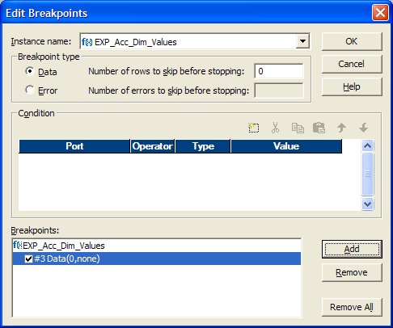
Breakpoint
5) Use ‘OK’ button to complete
3) Decide DATA or ERROR for stoppage
4) Define number of records (for DATA) or number of errors (for ERROR) to be skipped before debugger stops to show the data

Slide 25
Evaluate Expression:
  When the Debugger pauses, use the Expression Editor to evaluate expressions using mapping variables and ports in a selected transformation.
  You can evaluate expressions in the following transformations:
    Aggregator transformation
    Expression transformation
    Filter transformation
    Rank transformation
    Router transformation
    Update Strategy transformation

Slide 26
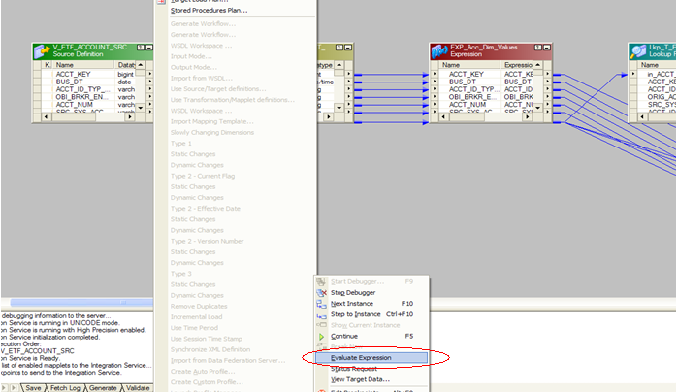
Evaluate Expression
  creation of a Evaluate Expression:
  Open the Mapping Program
  Mappings->Debugger->Edit Evaluate Expression

Slide 27
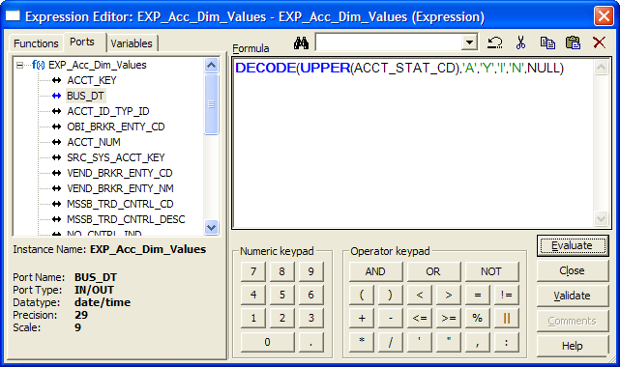
Evaluate Expression
Write expression to be evaluated

Slide 28
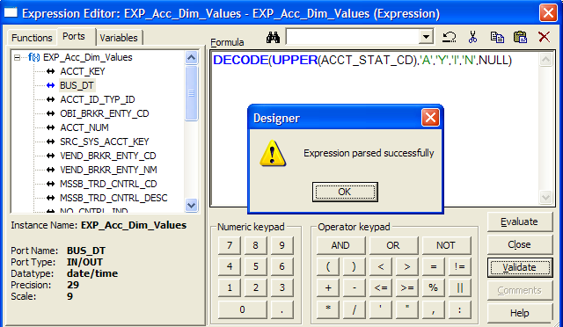
Evaluate Expression
Click validate to verify the expression

Slide 29
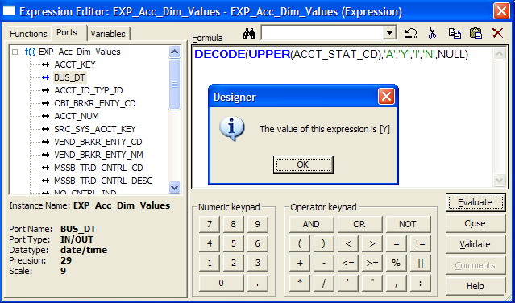
Evaluate Expression
Click Evaluate to get the value of the expression

Slide 30
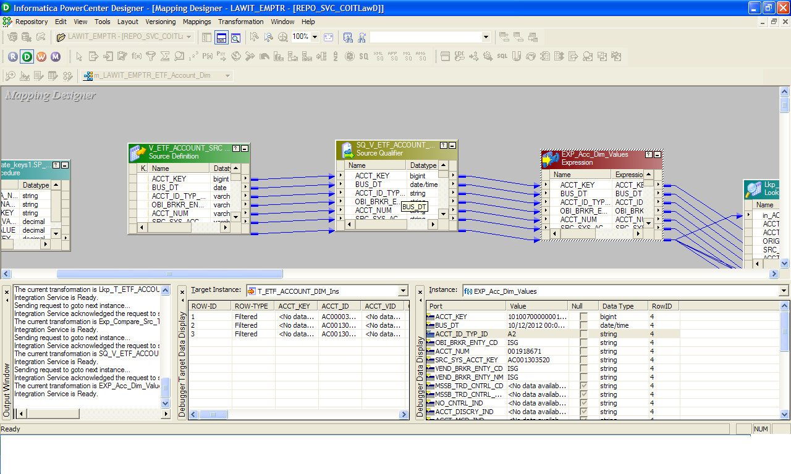
Debugger Window:

Slide 31
Thank You!
From
Informatica-CoE

