Slide 1
Informatica PowerCenter 9

Slide 2
DAY 8

Slide 3
Performance Tuning

Slide 4
Looking for bottlenecks in mapping design
  The goal of performance tuning is to optimize session performance by eliminating performance bottlenecks.
  To tune the performance of a session, first you identify a performance bottleneck, eliminate it, and then identify the next performance bottleneck until you are satisfied with the session performance.
  You can use the test load option to run sessions when you tune session performance.
  Performance bottlenecks can occur in the source and target databases, the mapping, the session, and the system.
  You can identify performance bottlenecks by the following methods:
    Running test sessions.
    Studying performance details.
    Monitoring system performance.

Slide 5
Looking for bottlenecks in mapping design
  Once you determine the location of a performance bottleneck, you can eliminate the bottleneck by following these guidelines:
    Eliminate source and target database bottlenecks: Have the database administrator optimize database performance by optimizing the query, increasing the database network packet size, or configuring index and key constraints.
    Eliminate mapping bottlenecks: Fine tune the pipeline logic and transformation settings and options in mappings to eliminate mapping bottlenecks.
    Eliminate session bottlenecks: You can optimize the session strategy and use performance details to help tune session configuration.
    Eliminate system bottlenecks: Have the system administrator analyze information from system monitoring tools and improve CPU and network performance.

Slide 6
The Golden Rules of Informatica Design

Slide 7
Why Use The Golden Rules?
  To show how the use of best practice benefits a development team
  There are many ways to produce the same results – some are more efficient than others.
  What might work well in one scenario may be inappropriate in another.
  A common standard means all members of a team can follow the logic
  Can produce reusable components
  Can ensure on a shared platform that the different teams do not impact each other
  Prevent outages – for example out of disk space errors
  Learn from others mistakes
  Reduced rework
  Complete projects on time and within budget

Slide 8
Golden Rule No. 1 – Set Out Standards
In other words…….. Create a great team!
  Naming standards
    Everyone knows what it does
    Easy to pick up someone else’s work
    Don’t end up with 100 connection objects to the same database
    Don’t end up with 100 lookups to the same table
  Development Standards
    Annotate Objects clearly
    Audit trail
  Shared Object Policy
    Object Stewardship
    Single version of the truth
    Use your shared folder!

Slide 9
Golden Rule No. 2 – Know Your Data!
In other words……..talk to the data owners AND see for yourself!
  Analyse, analyse and analyse again
    Don’t always accept the statement “there are no errors in this data”
  Verify actual values against permitted values
  Devise an error handling strategy
    Implement in all mappings
    Don’t rely on the .bad files
  Verify the business rules (and get sign off!)
  Design and unit test with real data – or at least as realistic as possible
  Will design of source and target help or hinder performance?
    Indexes
    Constraints

Slide 10
Golden Rule No. 3 – Plan Your Flows
In other words…….. Know where you’re going!
  Plan for reuse
    Common lookups
    Common expressions (e.g. date conversions)
    Mapplets
  Use appropriate Transformations
    Routers vs multiple filters
    SQ Override vs Joiner/Union
    Expression vs aggregator
  Make the most of the resources
    Push processing back to the database
    Why not stage files?
  Design for rerun

Slide 11
Golden Rule No. 4 – Reduce Data ASAP
In other words…….. Trash what you don’t need!
  Only connect ports that you need
    Reduces data passing through transformations
  Remove bad data early
    Route to your error handling
    Avoids excessive processing on bad data
    Complex Transforms only on verified data
  Filter / Aggregate ASAP
    If possible filter data in source qualifier
    Consider aggregation in SQL override
  Minimise Transformations
    Avoid using one expression for one calculation
    You’ll need more DTM if you have excessive transformations

Slide 12
Golden Rule No. 5 – Avoid Big Caches
In other words…….. Don’t be a waste of space!
  Pre Sort Joiners & Aggregators
    Use the order by in the source qualifier
  Only Use necessary ports
    Avoid caching large text ports if the data isn’t needed later
  Filter ASAP
    Don’t aggregate / join data you’ll trash later
  Utilise the Master / Detail properties
    Make the master the set with the fewest records
  Avoid the sorter - order by instead
  Need to sort a text file?
    Consider staging it instead!
  Size your caches for production

Slide 13
Golden Rule No. 6 – Remember It’s Shared
In other words…….. Be a good neighbour!
  Use Fewer concurrent sessions
    Running more may cause other teams to go into wait state (and in production this means missed deadlines)
  Use performance stats only when tuning
    Session requires twice the memory which may cause other sessions to fail

Slide 14
Don'ts - avoid where possible:
SQL Override
      Use source qualifier properties where possible
Multiple filters
      Try a router instead!
Sorters – Very inefficient
Field level stored procedures
      Get called for every row
Extracting more data than you need
      Filter in the source qualifier
      Only map required ports
Aggregator
      Try a SQL override
      Use sorted data where possible
      Create running sums in an expression instead
Use complex rules in filters and routers
Hardcode Values
Give connections environment specific names

Slide 15
The Good, the Bad & the Ugly
Informatica Design Examples

Slide 16
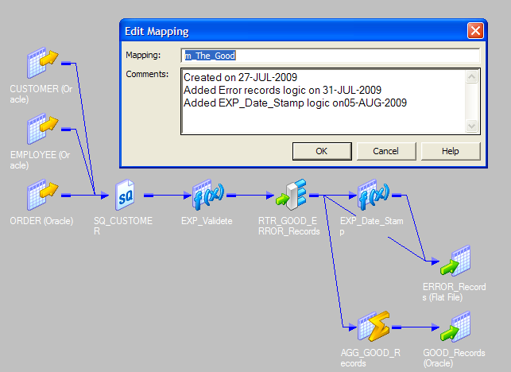
The Good………

Slide 17
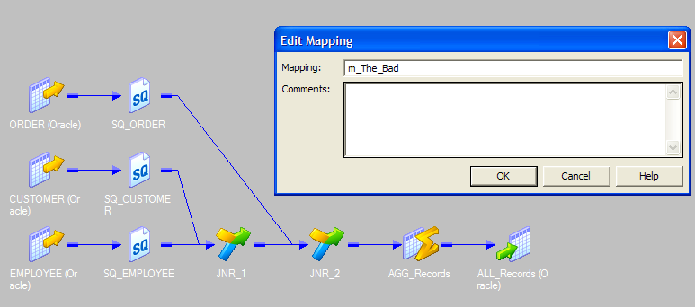
The Bad………..

Slide 18
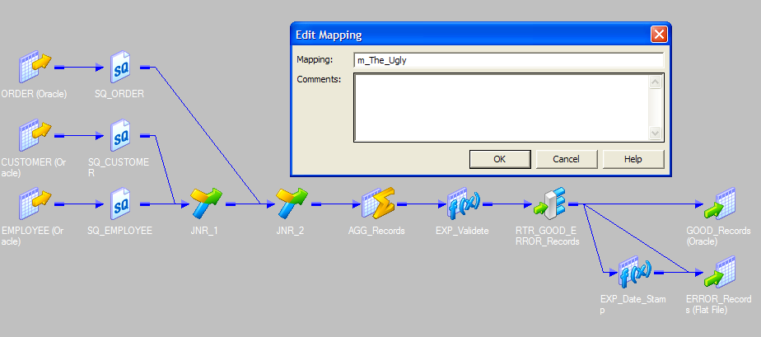
The Ugly…….

Slide 19
Scenario Questions - Teasers

Slide 20
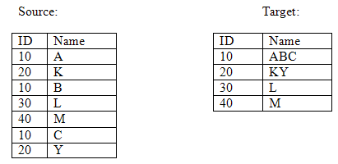
Scenario 1

Slide 21
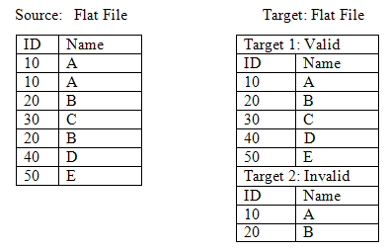
Scenario 2

Slide 22
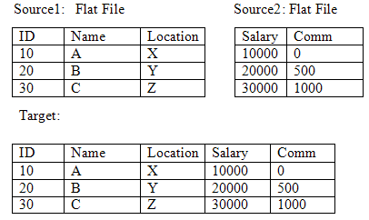
Scenario 3

Slide 23
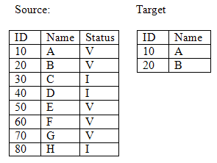
Scenario 4

Slide 24

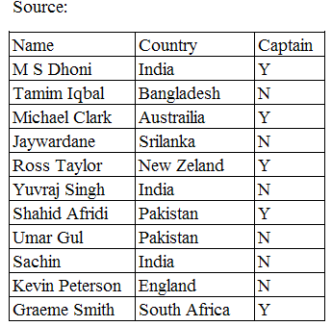
Scenario 5

Slide 25
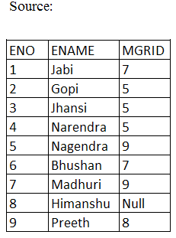
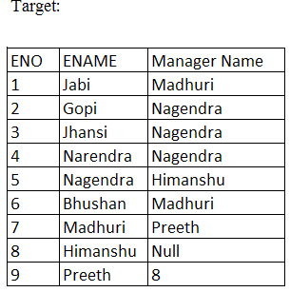
Scenario 6

Slide 26
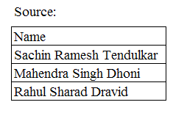
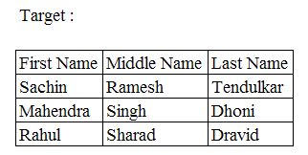
Scenario 7

Slide 27
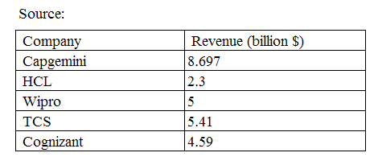
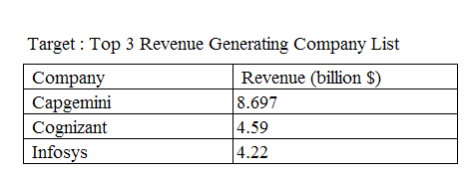
Scenario 8

Slide 28
Questions??

Slide 29
Thank You!
From
Informatica-CoE

