Slide 1
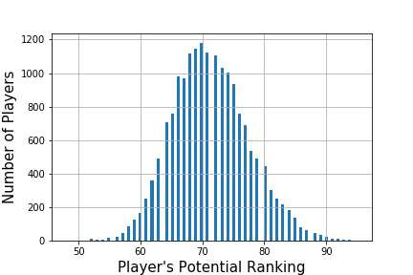
Histogram based on potential Scores

Slide 2
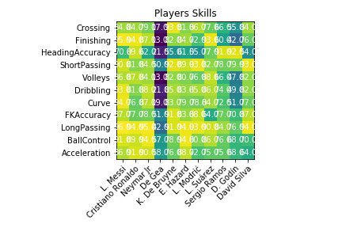
Heat map of top 11 Players

Slide 3

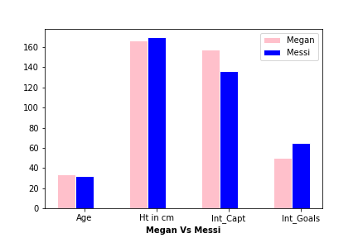
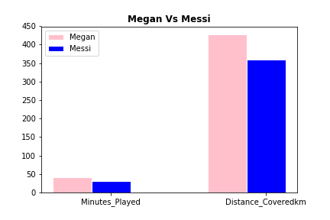
Fifa 2018 Men’s World Cup Vs Fifa 2019 Women’s World Cup CompariSon -general

Slide 4
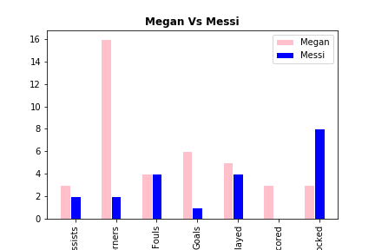
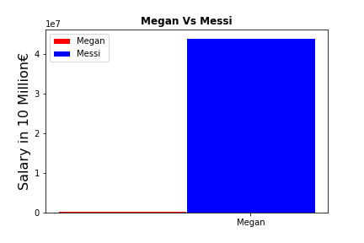
Goals, Assists …& SAlary

