Slide 1
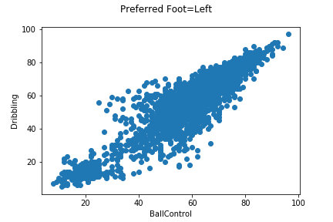
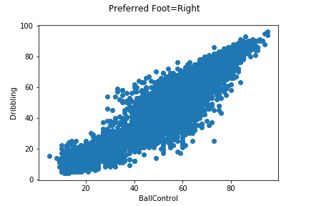
Relation between Dribbling & BallControl Analysis:
T
Number of Left Foot Players: 4211
Number of Right Foot Players: 13948

Slide 2
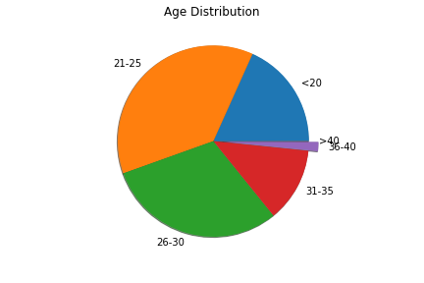
Most Players Ages between 21 to 25

Slide 3
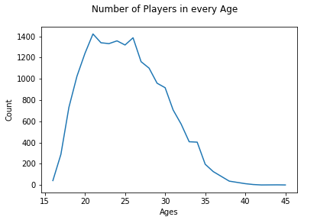
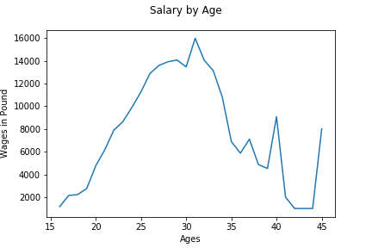
Number of Players & Salary by Age
It shows, although most of the players are in the range of 21 to 26,
best income is for players between 27 and 33, especially 31.

Slide 4
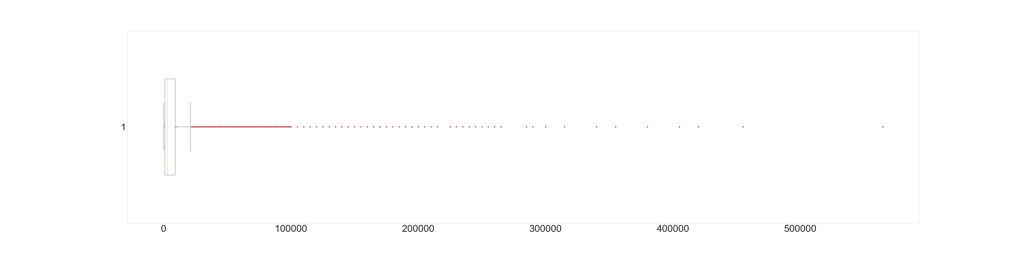
Wage Distribution BoxPlot

