Slide 1
M.E. CSE PROJECT REVIEW · MODULES 1 AND 2
Romanised Tamil queries break RAG retrieval and a 0.3 ms normaliser repairs most of it
Script-aware retrieval for Tanglish queries over a bilingual Tamil–English document base
STUDENT
GUIDE
REVIEW
Selvin PaulRaj K
________________
2 November 2026
SELVIN PAULRAJ K
Notes:
Kings Engineering College, Department of CSE, M.E. CSE 2025-2027. Register number 210825405017.

Slide 2
KINGS ENGINEERING COLLEGE · M.E. CSE
Module 1
Tanglish retrieval over bilingual documents is an open gap
Problem, motivation, literature, design
2

Slide 3
KINGS ENGINEERING COLLEGE · M.E. CSE
People ask in Tanglish while the answers sit in Tamil or English documents.
"scholarship ku last date enna?" A G.O. may exist only in Tamil and a circular only in English. RAG is tested in English.
3
Notes:
Problem statement. Tamil Nadu document bases are bilingual and not parallel. RAG retrieves documents and an LLM answers from them, so if retrieval misses, the answer is wrong. No prior study evaluates RAG retrieval components for Tamil–English romanised and code-mixed queries.

Slide 4
KINGS ENGINEERING COLLEGE · M.E. CSE
One question arrives in four forms that share almost no characters
FORM
EXAMPLE QUERY
English
Who is responsible for the Israel-Hamas conflict
Tamil script
இஸ்ரேல் ஹமாஸ் மோதலுக்கு யார் பொறுப்பு
Romanised Tamil
Israel Hamas mothalukku yaar poruppu
Code-mixed
Israel Hamas conflict ku yaar responsible
4
Notes:
Forms from the nlpctx/tamil-english-retrieval dataset. A romanised query shares neither the script of Tamil documents nor the vocabulary of English documents, and its spelling varies (kurithu, kuritthu, kuriththu).

Slide 5
KINGS ENGINEERING COLLEGE · M.E. CSE
ChatGPT reads Tanglish but still needs retrieval to find the right document
01
02
03
04
Thousands of G.O.s and circulars do not fit in one prompt
The retrieval step collapses on romanised Tamil: dense MRR@10 is 0.143
Translate-to-English pipelines never search Tamil-only documents
Paid APIs raise cost and privacy issues for citizen data
5
Notes:
Motivation / why not just ChatGPT. An LLM query rewriter is a Module 3 baseline and an LLM is the Module 4 generator. The question is what gets the right evidence in front of the LLM.

Slide 6
KINGS ENGINEERING COLLEGE · M.E. CSE
Six objectives take the study from baseline to public benchmark
OBJECTIVE
STATUS
O1 Four-form queries, Tamil + English docs
Started
O2 Measure the drop per form
Done
O3 Normalisation and its latency
Done
O4 Bilingual benchmark and chunking (M3)
Planned
O5 Router and answer quality (M4)
Planned
O6 Paper and release (M5)
Planned
6

Slide 7
KINGS ENGINEERING COLLEGE · M.E. CSE
Prior work covers Hindi or native Tamil but never Tanglish over bilingual documents
WORK
SETTING
WHAT IS MISSING
FIRE MSIR 2013–16
Hindi, Bengali IR
No Tamil retrieval
Chari et al. 2025
Latinised non-Indic
No Indic language
Amiraz et al. 2025
Arabic–English RAG
No Tamil; native script
Hira et al. 2026
Romanised Hindi, Bengali
Parallel docs; no Tamil
SchemeAI 2026
TN scheme chatbot
English index; no metrics
7
Notes:
Narrowed gap: language bias in mixed indices is shown for Arabic–English [Amiraz] and romanised Hindi/Bengali/Marathi/Urdu over machine-translated parallel documents [Hira]. Our claim: Tamil, native non-parallel documents where the answer exists in one language, and model-free lexical remedies on CPU. Rule normalisation and transliteration plus char n-grams were used at FIRE; we do not claim them as new.

Slide 8
KINGS ENGINEERING COLLEGE · M.E. CSE
The proposed system adds the script handling SchemeAI lacks
Existing (SchemeAI-style)
Proposed
English-only index. Query used as typed. English MiniLM embedder. Output translated to Tamil. No retrieval metrics.
Bilingual Tamil + English base. Token language ID and transliteration. Char 3-gram BM25 + multilingual dense. Fusion measured per form.
8
Notes:
SchemeAI (Rekha et al., IJARSCT 2026): all-MiniLM-L6-v2 + FAISS over one English CSV, GoogleTranslator for Tamil output, no retrieval metrics. Re-implemented as a Module 3 baseline.

Slide 9
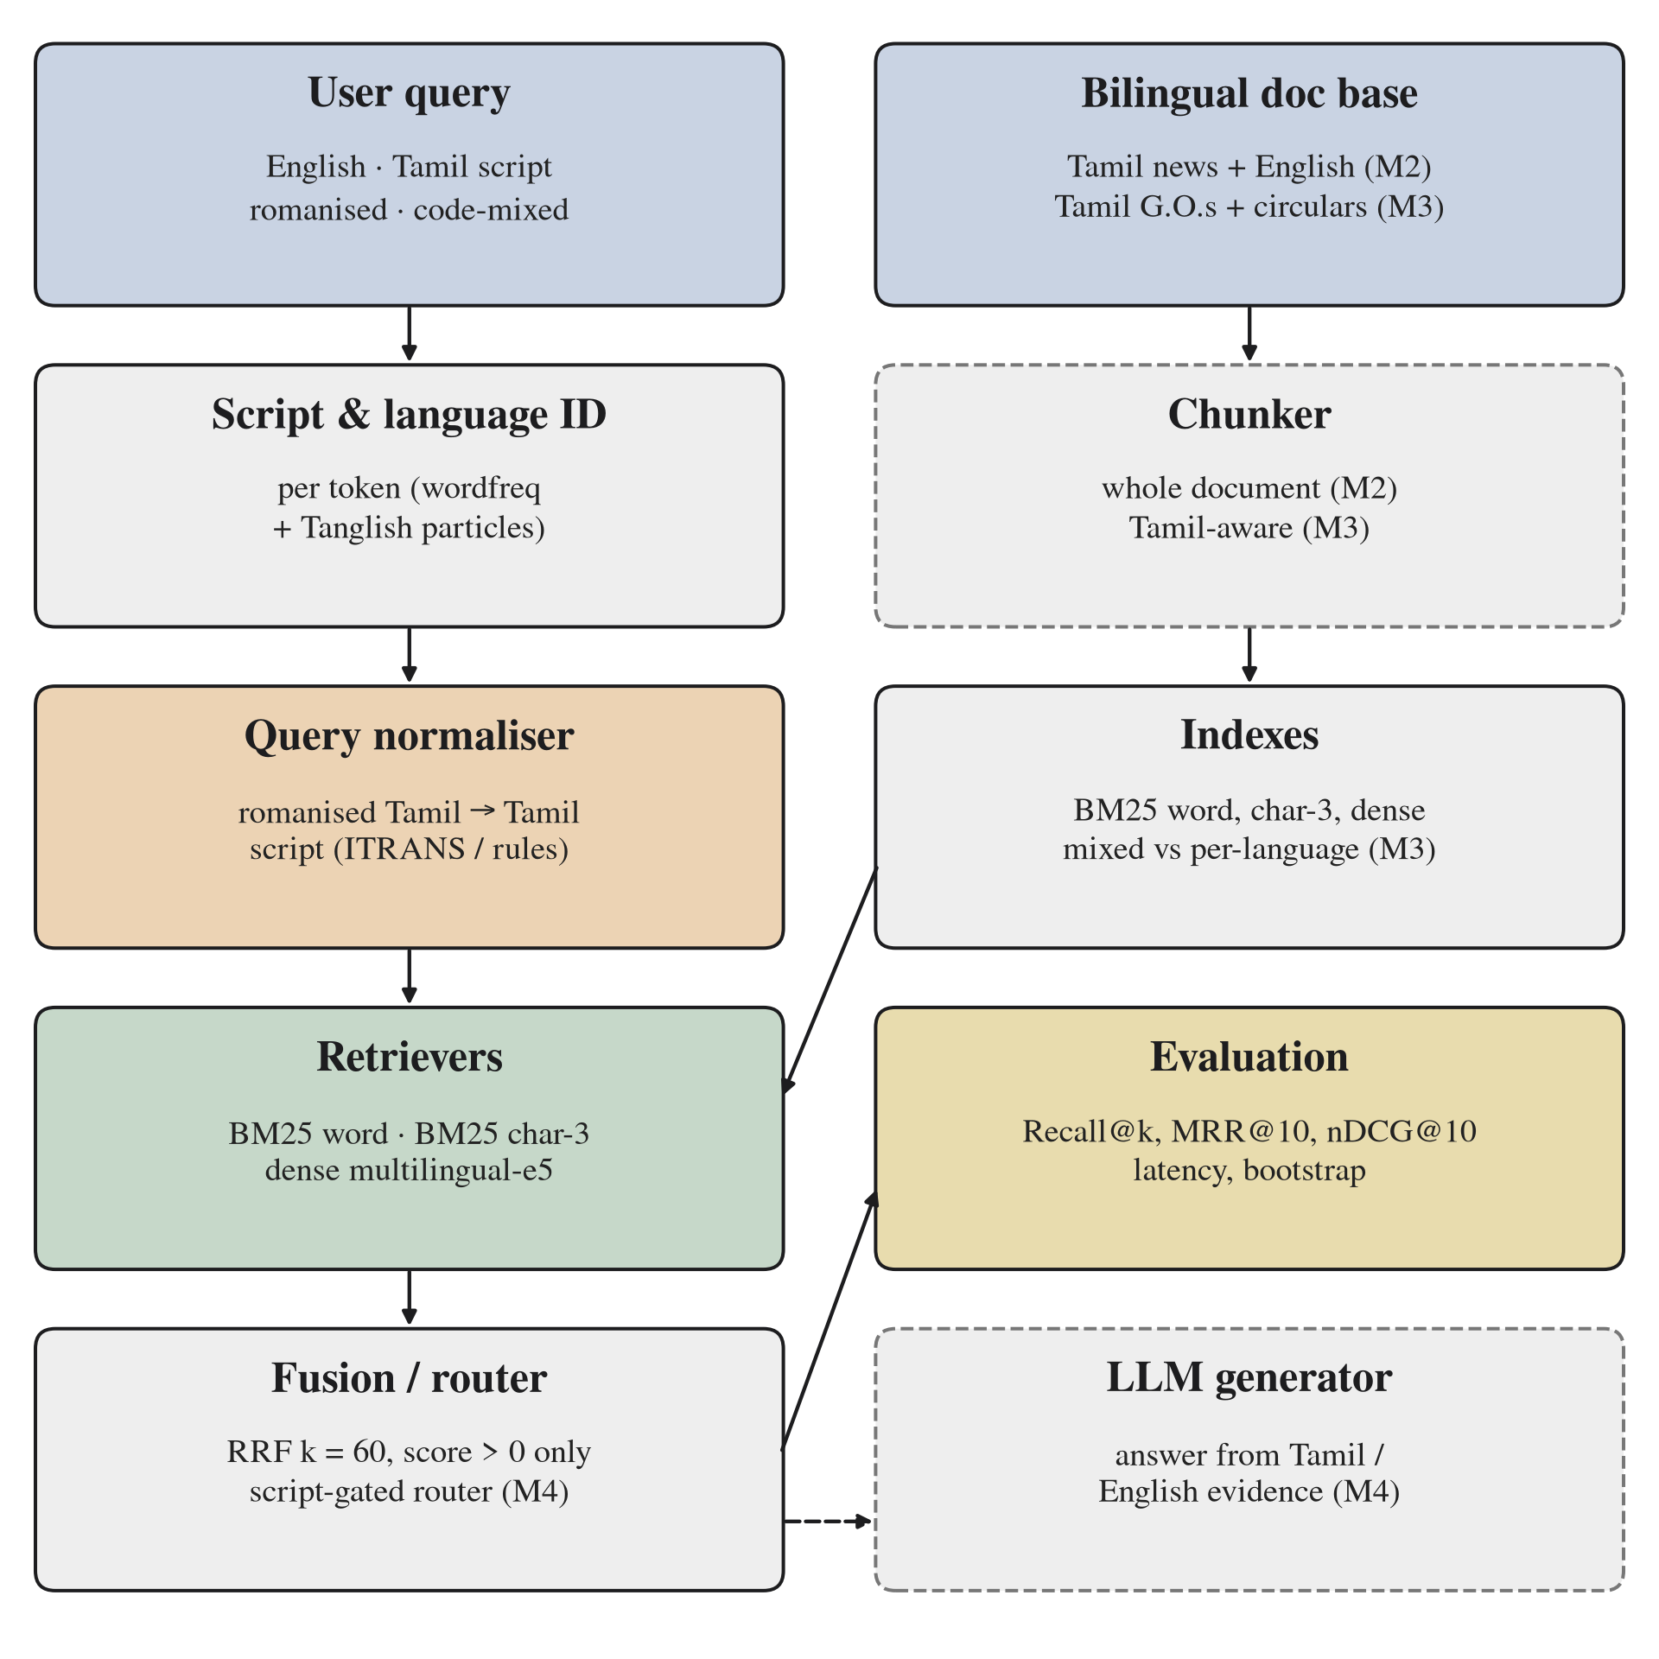
KINGS ENGINEERING COLLEGE · M.E. CSE
The query is normalised before three retrievers and rank fusion
Solid boxes are built in Module 2. Dashed boxes are the chunker, router and generator in Modules 3 and 4.
9
Notes:
Language ID: wordfreq Zipf >= 3.0 plus ~60 Tanglish particles. Retrievers: BM25 word, BM25 char 3-gram, multilingual-e5-small (118M, 384-d). RRF k = 60 over top-100 lists with zero-score BM25 documents removed.

Slide 10
KINGS ENGINEERING COLLEGE · M.E. CSE
Two modules are complete and three carry the thesis to May 2027
M1 · Done
M2 · Done
M3 · Dec–Jan
M4 · Feb–Mar
M5 · Apr–May
Problem, survey, gap and architecture
Data, normaliser, five retrievers and results
Bilingual human Tanglish benchmark and chunking
Router, generation and answer evaluation
Paper, public release and thesis
10

Slide 11
KINGS ENGINEERING COLLEGE · M.E. CSE
Module 2
Eighty-four retrieval runs on a 2-core CPU
500 Tamil news documents with English translations · 2,154 queries per form · 8 query sets · 5 retrievers
11

Slide 12
KINGS ENGINEERING COLLEGE · M.E. CSE
Every information need is tested in all four forms
500
2,154
8
180,936
Tamil documents
Queries per form
Query sets
Ranked lists
12
Notes:
nlpctx/tamil-english-retrieval (Apache-2.0), 500 documents sampled with seed 42, every query row kept. Median document 326 characters, so one chunk per document. Hardware: 2 ARM64 vCPUs, 7 GB RAM, no GPU.

Slide 13
KINGS ENGINEERING COLLEGE · M.E. CSE
Normaliser and character n-grams target the script mismatch
Normaliser
Retrievers
Evaluation
Token language ID keeps English words. Romanised Tamil goes to Tamil script by ITRANS or Tanglish rules.
Word BM25, char 3-gram BM25, mE5-small dense, RRF and RRF3 hybrids.
Recall@k, MRR@10, nDCG@10, latency, query and cluster bootstrap.
13
Notes:
Rules: zh→ழ, th/dh→த, tr→ற்ற, ndr→ன்ற, word-initial n→ந, doubled consonant → pulli, aa/ee/oo/ai → vowel signs. Written before evaluation, never tuned on test queries.

Slide 14
KINGS ENGINEERING COLLEGE · M.E. CSE
Results
Romanised queries fail and transliteration fixes most of it
Main results, normalisation, fusion and examples
14

Slide 15
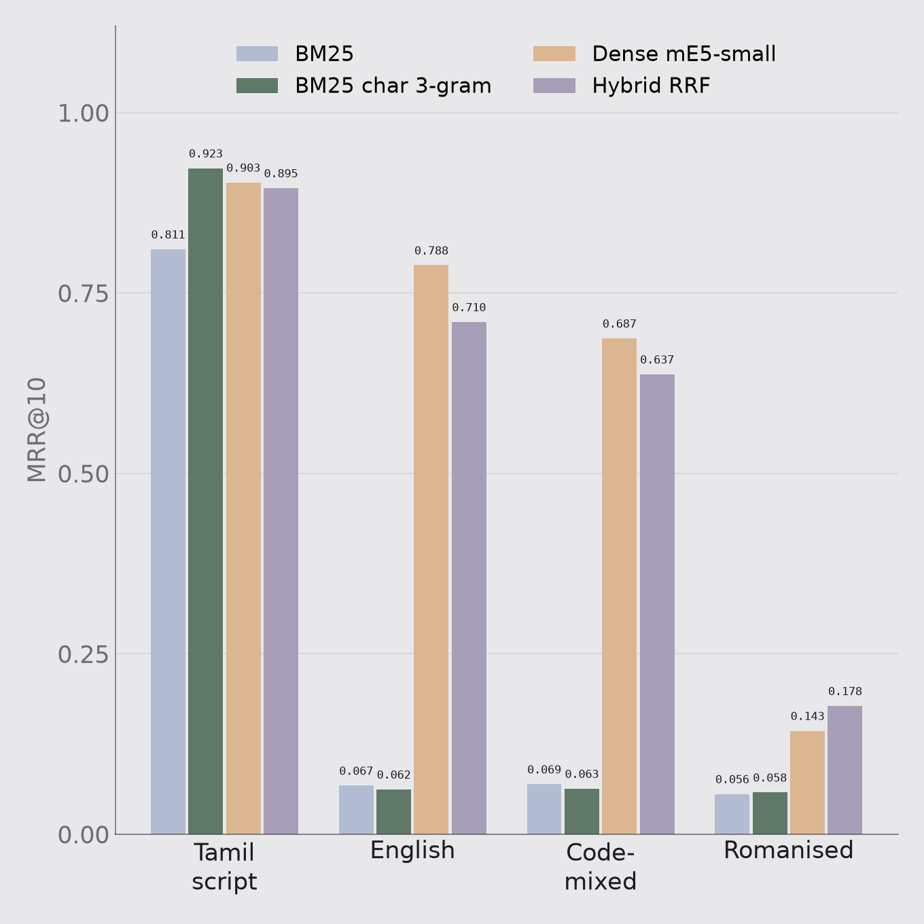
KINGS ENGINEERING COLLEGE · M.E. CSE
Romanised queries fall below MRR 0.18 while Tamil script reaches 0.92
Dense Recall@10 for romanised queries is 0.294. Seven in ten questions miss the top ten.
15
Notes:
Tamil corpus, no normalisation. Dense handles English (0.788) and code-mixed (0.687). Char 3-grams beat word BM25 on native Tamil (0.923 vs 0.811) because Tamil is agglutinative.

Slide 16
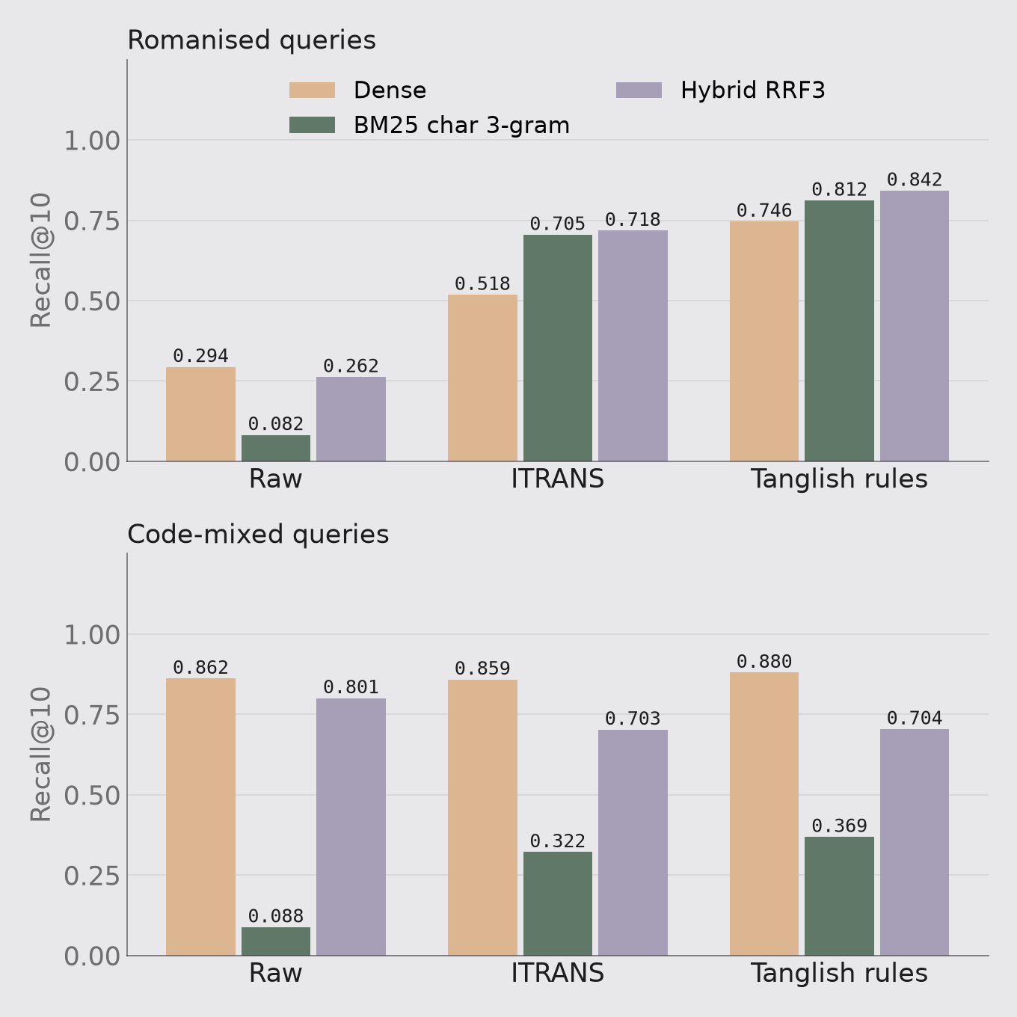
KINGS ENGINEERING COLLEGE · M.E. CSE
Tanglish rules lift romanised Recall@10 from 0.08 to 0.81
Rules + char 3-gram BM25: MRR 0.058 → 0.684 (p < 0.001) for 0.34 ms per query. Rules beat ITRANS everywhere.
16
Notes:
Significant under query and document-cluster bootstrap. Rules + RRF3 give the best Recall@10 (0.842). Code-mixed dense 0.687 → 0.692, p = 0.45. Latency: normaliser 0.34 ms median, char BM25 4.9 ms, dense encode 32 ms, full rules + RRF3 pipeline 38 ms.

Slide 17
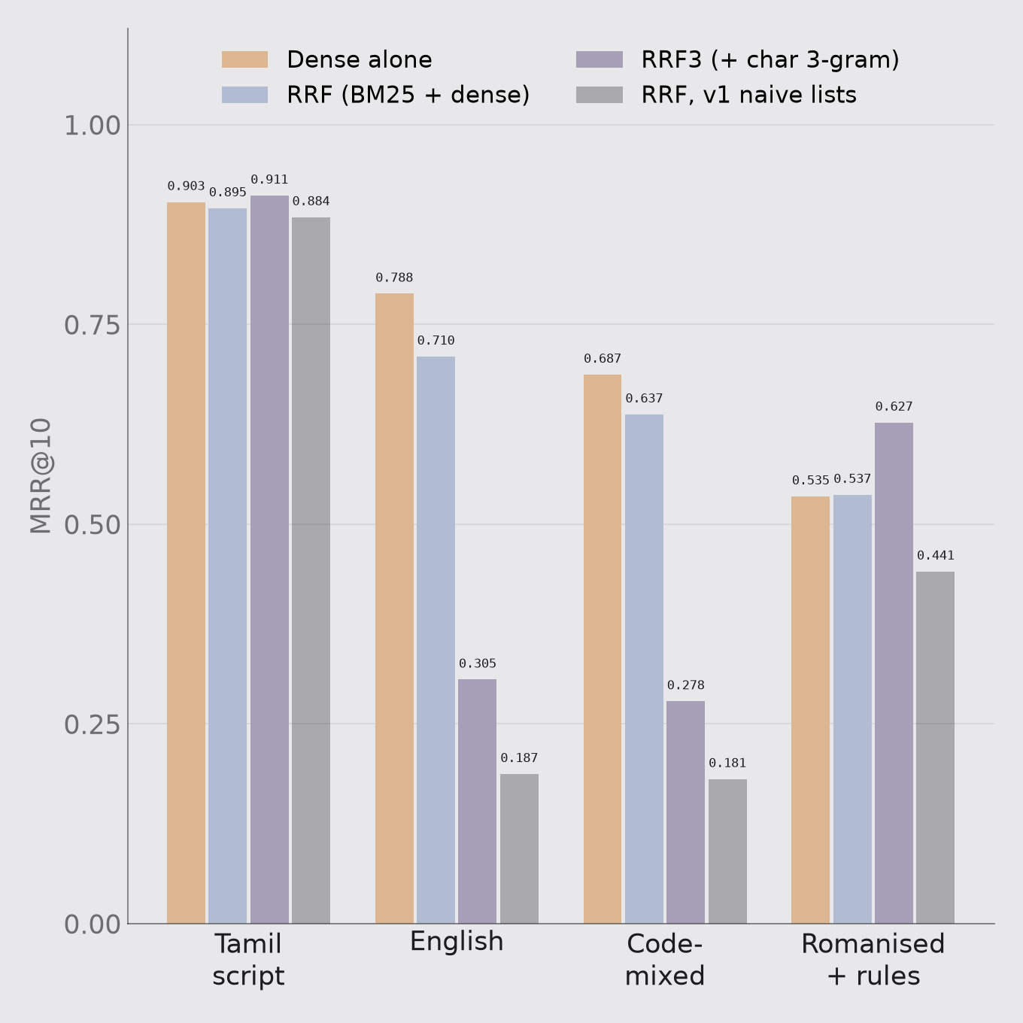
KINGS ENGINEERING COLLEGE · M.E. CSE
Equal-weight fusion cuts English-query MRR from 0.79 to 0.71
BM25 matches nothing across scripts yet RRF trusts it. Gate fusion by script and drop zero-score lists.
17
Notes:
Corrected numbers: English 0.788 → 0.710, code-mixed 0.687 → 0.637, both p < 0.001 (also cluster). RRF3 far worse (0.305). An earlier bug fused zero-score documents and overstated the loss as 0.187. Fusion helps raw romanised (0.143 → 0.178).

Slide 18
KINGS ENGINEERING COLLEGE · M.E. CSE
Transliteration rescues real queries but misses unmarked long vowels
QUERY GIVEN TO THE DENSE RETRIEVER
GOLD RANK
thakkudhalil Colombia raanuva thiraigal uyirizhappu
not in top 10
தக்குதலில் Colombia ரானுவ திரைகல் உயிரிழப்பு (rules)
1
Vadakku maagaana paadasaalai seerudai neelam korikkai
not in top 10
வடக்கு மாகான பாடசாலை சீருடை நீலம் கொரிக்கை (rules)
1
Muthalaq thadai masoda Rajyasabha
not in top 10
முதலக் தடை மசொட ரஜ்யசப (rules)
not in top 10
18
Notes:
Real outputs (results/examples.json). Third example: masoda should be மசோதா. Re-run for this review: char 3-gram BM25 on the same rule-normalised query ranks the gold document first, which supports routing romanised queries to character matching.

Slide 19
KINGS ENGINEERING COLLEGE · M.E. CSE
The dataset's code-mixed queries are mostly English
22%
13%
1.7
No Tamil word
Identical to English
Tamil tokens per query
19
Notes:
LLM-generated queries. Code-mixed results mostly measure English-to-Tamil retrieval. This is why Module 3 collects human-written Tanglish questions.

Slide 20
KINGS ENGINEERING COLLEGE · M.E. CSE
Four findings close Module 2
01
02
03
04
Romanised Tamil breaks retrieval: dense MRR@10 0.143 against 0.923 for Tamil script
Tanglish rules + char BM25 recover most of it: 0.684 at 0.34 ms
Equal-weight fusion hurts across scripts: 0.788 → 0.710
Public code-mixed queries are English-heavy, so human data is needed
20

Slide 21
KINGS ENGINEERING COLLEGE · M.E. CSE
Closest references anchor the claim and the baselines
Lewis et al. NeurIPS 2020: retrieval-augmented generation
Cormack et al. SIGIR 2009: reciprocal rank fusion
Sequiera et al. FIRE 2015: mixed-script IR overview
Chari, Ounis, MacAvaney SIGIR 2025: script gap in neural IR
Amiraz et al. ArabicNLP 2025: cross-lingual cost in bilingual RAG
Hira, Mire, Sap EMNLP 2026: language of evidence in code-switched RAG
Rekha et al. IJARSCT 2026: SchemeAI scheme chatbot
nlpctx 2026: tamil-english-retrieval dataset
21
Notes:
Full IEEE list (46 references) is in the Module 1–2 paper.

Slide 22
KINGS ENGINEERING COLLEGE · M.E. CSE
NEXT
Module 3 tests a bilingual human Tanglish benchmark and the mixed-index bias
About 500 human questions over Tamil G.O.s and English circulars, each tagged with its gold-document language.
DEC–JAN
FEB–MAR
APR–MAY
Benchmark, bias test, chunker, IndicXlit and SchemeAI baselines
Script-gated router and answer evaluation
Paper, thesis and public release
22
Notes:
Module 3 baselines: IndicXlit, LLM rewriter, SchemeAI-style translate-to-English, balanced per-language retrieval (Amiraz), BGE-M3, LaBSE, Morgan-Tanglish-v7. Phonetic-skeleton BM25 and entity-safe language ID.

