Slide 1
M.E. CSE PROJECT REVIEW · MODULES 1 AND 2
Romanised Tamil queries break RAG retrieval and transliteration repairs most of it
Code-mixed RAG: chunking, embedding and query normalisation for Tamil–English (Tanglish) queries
STUDENT
GUIDE
REVIEW
Selvin PaulRaj K
________________
2 November 2026
SELVIN PAULRAJ K
Notes:
Kings Engineering College, Department of CSE, M.E. CSE 2025-2027.

Slide 2
KINGS ENGINEERING COLLEGE · M.E. CSE
Module 1
Tanglish retrieval for RAG is an open gap
Problem, literature, objectives and design
2

Slide 3
KINGS ENGINEERING COLLEGE · M.E. CSE
Tamil users type Tanglish but RAG retrievers are built and tested in English.
"scholarship ku last date enna?" No prior study evaluates RAG retrieval components for Tamil–English code-mixed and romanised queries.
3
Notes:
RAG = retrieve documents, then let an LLM answer from them. If retrieval misses, the answer is wrong. Transliteration-based mixed-script IR has a history at FIRE (2013–2016), but its retrieval tasks were Hindi or Bengali; Tamil appeared only in word-level language labelling (Sequiera et al. 2015; Banerjee et al. 2016). Later code-mixed IR: Bengali (FIRE CMIR 2024/25), Chinese/Japanese (Zeng et al. 2026).

Slide 4
KINGS ENGINEERING COLLEGE · M.E. CSE
One question arrives in four forms that share almost no characters
FORM
EXAMPLE QUERY
English
Who is responsible for the Israel-Hamas conflict
Tamil script
இஸ்ரேல் ஹமாஸ் மோதலுக்கு யார் பொறுப்பு
Romanised Tamil
Israel Hamas mothalukku yaar poruppu
Code-mixed
Israel Hamas conflict ku yaar responsible
4
Notes:
English, romanised and code-mixed forms are from the nlpctx/tamil-english-retrieval dataset. Documents are in Tamil script, so a romanised query shares neither script nor vocabulary with them.

Slide 5
KINGS ENGINEERING COLLEGE · M.E. CSE
Prior work covers mixed-script Hindi or native Tamil but never Tanglish RAG
WORK
LANGUAGES
WHAT IS MISSING
FIRE MSIR 2013–16; Gupta et al. SIGIR 2014
Hindi, Bengali retrieval; Tamil in labelling only
No Tamil retrieval; pre-dense
Chandu et al. 2018 (W18-3204)
Tamlish, Hinglish, Tenglish
Factoid QA, not RAG
FIRE CMIR 2024–25
Bengali–English
Bengali social media
Zeng et al. 2026
Chinese, Japanese + English
Not Tamil or romanised
Balasubramaniyam 2026
Sinhala, Tamil → English
Native script only
nlpctx dataset 2026
Tamil, 4 query forms
No paper or baselines
5
Notes:
Full 19-work survey is Table 2.1 in the report. FIRE 2015 MSIR: language labelling for 8 languages incl. Tamil; ad hoc retrieval Hindi only (25 queries). One 2015 system already used transliteration + character n-grams. Gupta et al. 2014: Hindi lyrics, MRR 0.686 to 0.874. Also: Aksharantar/IndicXlit (Madhani et al. 2023) as the neural transliteration baseline for Module 3. Singh 2026 (English RAG factorial) is the methodological model.

Slide 6
KINGS ENGINEERING COLLEGE · M.E. CSE
Four objectives take the study from baseline to published benchmark
O1
O2
O3
O4
Build a four-form query set over Tamil documents
Measure the drop and test transliteration fixes (done in Module 2)
Compare a Tamil-aware chunker on longer documents (Module 3)
Measure generated-answer quality and publish (Modules 4–5)
6

Slide 7
KINGS ENGINEERING COLLEGE · M.E. CSE
The proposed pipeline adds the script handling existing RAG lacks
Existing RAG
Proposed
Query used as typed. Word BM25 plus dense. RRF fusion by default. Tested in English only.
Token language ID. Romanised Tamil transliterated to Tamil script. Char 3-gram BM25. Fusion measured per query form.
7
Notes:
Language ID: wordfreq English frequency (Zipf >= 3.0) plus a list of ~60 Tanglish particles such as ku, la, enna, pathi.

Slide 8
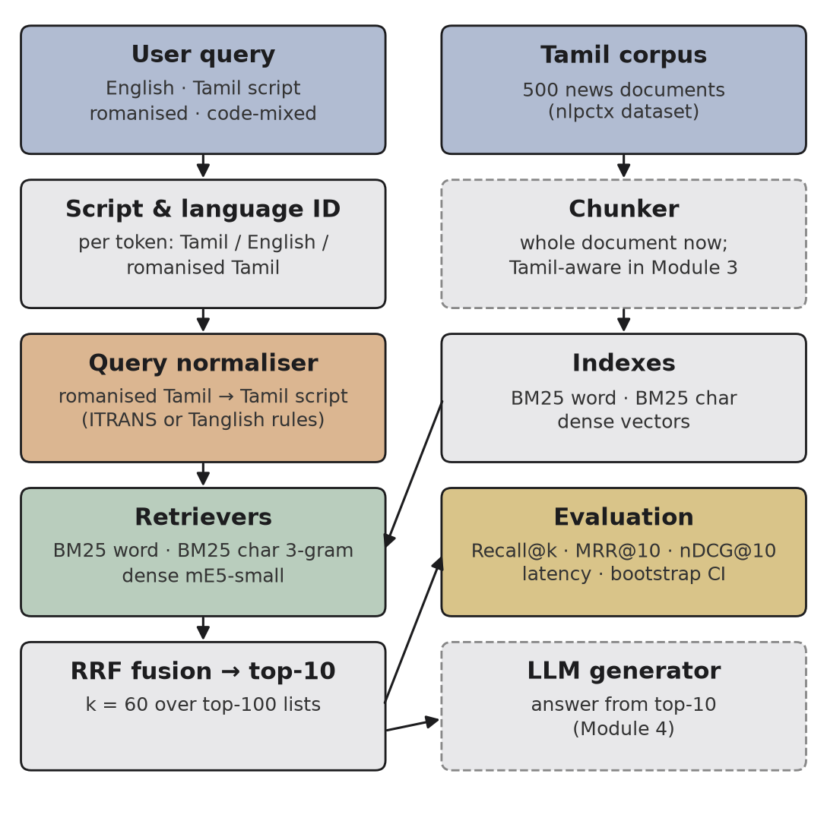
KINGS ENGINEERING COLLEGE · M.E. CSE
The query is normalised before three retrievers and rank fusion
Solid boxes are built in Module 2. Dashed boxes come in Modules 3 and 4.
8
Notes:
Retrievers: BM25 word, BM25 character 3-gram, multilingual-e5-small (118M, 384-d). RRF k = 60 over top-100 lists, as in ChunkLab.

Slide 9
KINGS ENGINEERING COLLEGE · M.E. CSE
Module 2
Sixty real retrieval runs on a 2-core CPU
500 Tamil news documents · 2,154 queries per form · 8 query sets · 60 main runs + 24 naive-fusion reruns
9

Slide 10
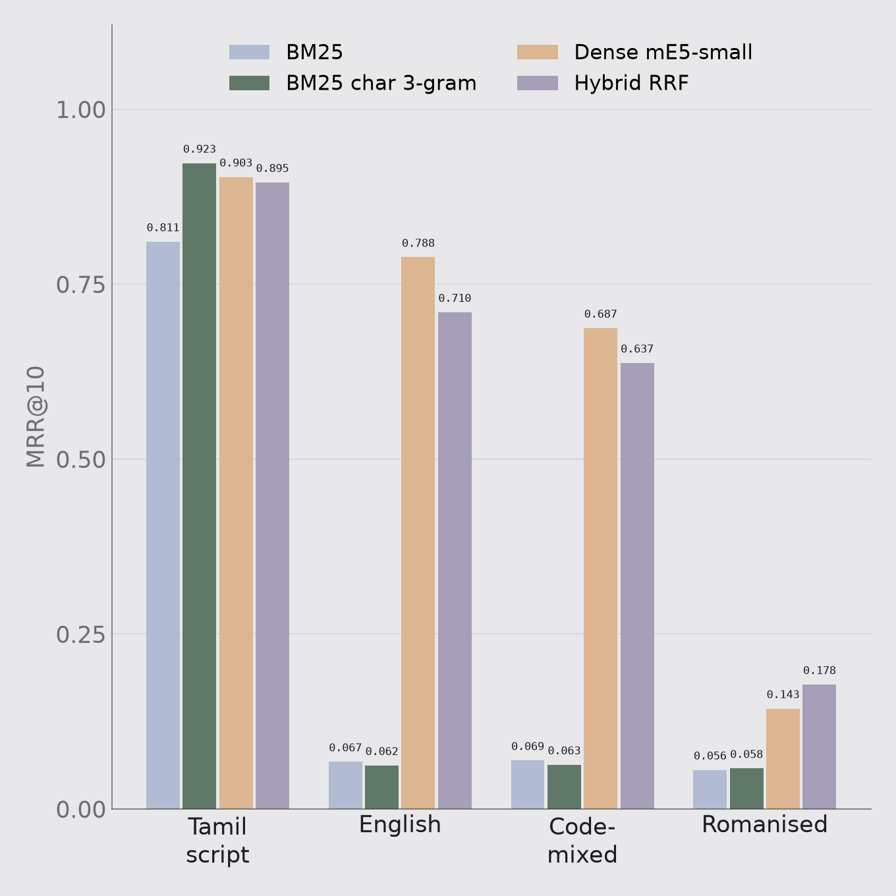
KINGS ENGINEERING COLLEGE · M.E. CSE
Romanised queries fall below MRR 0.18 while Tamil script reaches 0.92
Romanised Tamil: dense Recall@10 is only 0.294 and the best raw MRR 0.178. Seven in ten questions miss.
10
Notes:
Tamil corpus, no normalisation. Dense e5-small handles English (0.788) and code-mixed (0.687) queries; BM25 cannot cross scripts.

Slide 11
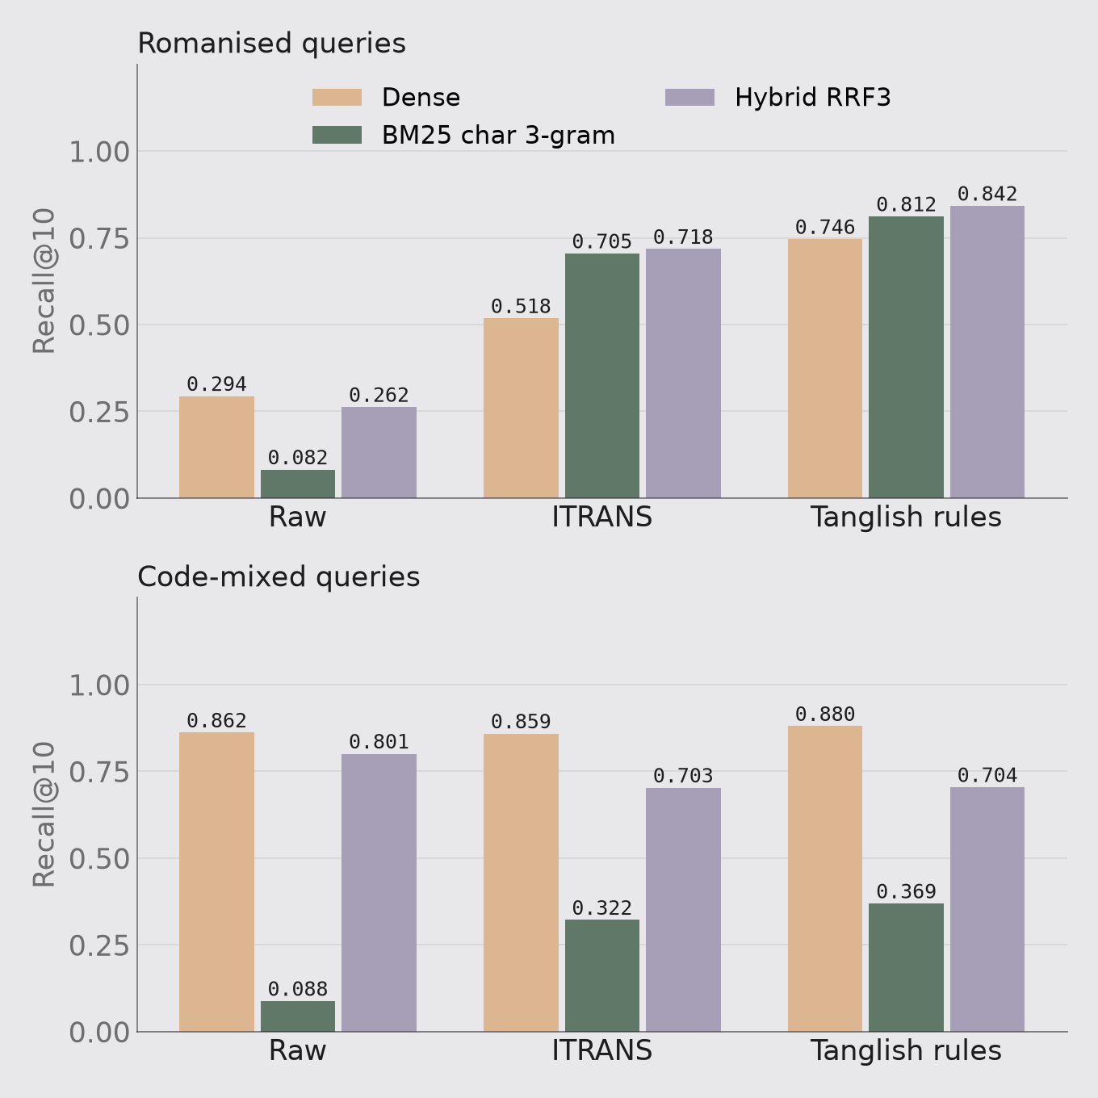
KINGS ENGINEERING COLLEGE · M.E. CSE
Tanglish rules lift romanised Recall@10 from 0.08 to 0.81
Rules + char 3-gram BM25: MRR 0.058 → 0.684 (p < 0.001, also under cluster bootstrap) for 0.3 ms per query.
11
Notes:
Rules beat ITRANS on every retriever for romanised queries. Gap to Tamil script remains (0.684 vs 0.923): Tanglish spelling loses l/L and n/N/n distinctions and t/T. Code-mixed dense: 0.687 → 0.692, p = 0.45 (cluster p = 0.57). Char 3-grams beat word BM25 even on native Tamil (0.923 vs 0.811) because Tamil is agglutinative and no stemmer was used.

Slide 12
KINGS ENGINEERING COLLEGE · M.E. CSE
Transliteration rescues real queries but misses unmarked long vowels
QUERY GIVEN TO THE RETRIEVER
RANK OF GOLD
thakkudhalil Colombia raanuva thiraigal uyirizhappu
not in top 10
தக்குதலில் Colombia ரானுவ திரைகல் உயிரிழப்பு (rules)
1
Vadakku maagaana paadasaalai seerudai neelam korikkai
not in top 10
வடக்கு மாகான பாடசாலை சீருடை நீலம் கொரிக்கை (rules)
1
Muthalaq thadai masoda Rajyasabha
not in top 10
முதலக் தடை மசொட ரஜ்யசப (rules)
not in top 10
12
Notes:
Dense retriever on the Tamil corpus. Third example: masoda should be மசோதா (bill); the romanised spelling does not mark the long vowels.

Slide 13
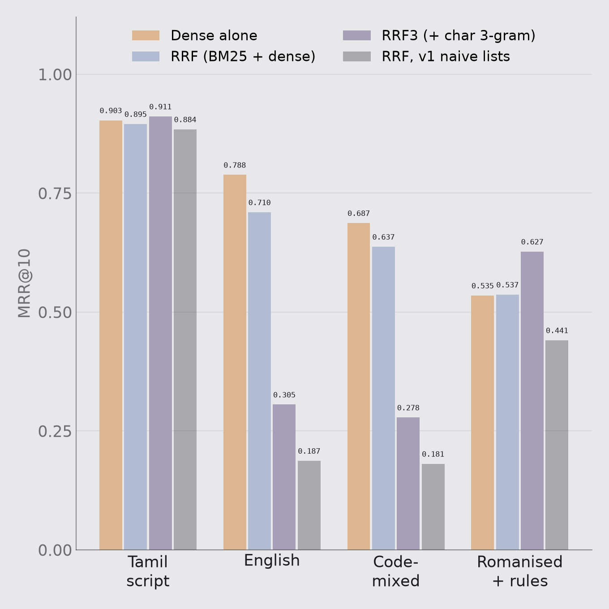
KINGS ENGINEERING COLLEGE · M.E. CSE
Equal-weight fusion still cuts English-query MRR from 0.79 to 0.71
Corrected after a bug: zero-score BM25 documents had entered RRF and overstated the loss as 0.79 → 0.19. Gate fusion by script.
13
Notes:
Corrected (zero-score docs removed): English 0.788 → 0.710 (−0.079), code-mixed 0.687 → 0.637 (−0.050), both p < 0.001 under query and cluster bootstrap. Three-way RRF3 is far worse cross-script (0.305, 0.278). Tamil script 0.903 → 0.895, not significant. Fusion helps raw romanised queries (0.143 → 0.178) where BM25 matches names and numbers. The naive v1 run (grey bars) fused documents 0–99 in index order whenever BM25 matched nothing: 72% of English and 77% of code-mixed queries.

Slide 14
KINGS ENGINEERING COLLEGE · M.E. CSE
The dataset's code-mixed queries are mostly English
22%
13%
1.7
No Tamil word at all
Identical to English
Tamil tokens per query
14
Notes:
LLM-generated queries. This is why Module 3 collects human-written Tanglish questions.

Slide 15
KINGS ENGINEERING COLLEGE · M.E. CSE
NEXT
Module 3 builds a script-gated router and tests it on 500 human Tanglish questions
Then Module 4 adds LLM answer evaluation and Module 5 the paper and public release.
DEC–JAN
FEB–MAR
APR–MAY
Human queries, G.O.s, IndicXlit and LLM baselines
Generation-side RAG evaluation
Paper, thesis and release
15
Notes:
Module 3 also: Tamil-aware chunker on longer real documents (TN scholarship notices, Government Orders), phonetic-skeleton BM25, entity-safe language ID (Talaq/Rajya were split across scripts), BGE-M3 and LaBSE.

