Slide 1


FINE 6200 X - Investments
Jaspreet Kaur Grewal (217211129)
Hugo Ingrouille (219368588)
Selvin Furtado (220990115)

Slide 2
Table of Contents
01
04
02
05
03
06
About Us
Low Volatility?
Our Team
Our Portfolio
Our Philosophy
Conclusion

Slide 3

About Us
Nimo Innocen Investments
Proudly Canadian
Based in Toronto, Canada
Established in 2001
$500M+ in Assets Under Management (AUM)
1,200+ Satisfied Investors

Slide 4



Meet The Team
Jaspreet Grewal
Hugo Ingrouille
Selvin Furtado
Managing Partner
Senior Risk Manager
Senior Portfolio Manager

Slide 5
Our Mission
At Nii our mission is to provide fund members with secure and consistent investment opportunities that prioritize capital preservation and stable returns. We specialize in low-volatility investments that remain resilient amidst market fluctuations, enabling our clients to achieve financial growth with confidence and peace of mind.

Slide 6
Our Philosophy
Covid 19 was a market shock to many and it economic as well as social effect are still being felt. Since the post Covid world the global trade market has becoming increasingly more volatile as once sound investments and supply lines were shown to be tenuous. While the cry of many that globalization is dead isn't not true we have seen it change and be put under increasing pressure as market adapt and nations evolve. One of these observed changes was that many large economic market are increasingly looking inwardly to expanding their own manufacturing base and economic systems.
Witnessing this we developed our philosophy that instead of betting on larger firms like technology we want to target the engines that provide the necessary services and minerals that exist in the North American Marketplace.
In doing so we are investing in sectors that are low risk and essential but provide the fund with enough breadth of diversification to be insulated.

Slide 7
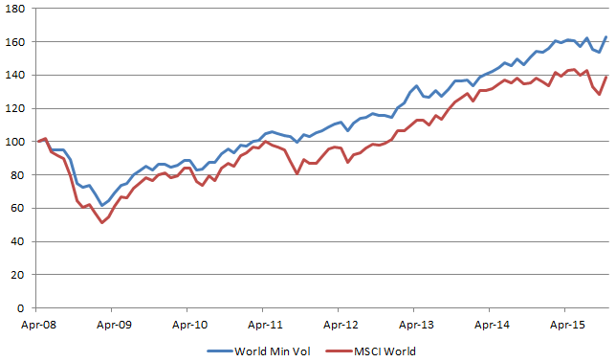
What is Low Volatility?
A fund built from stocks, securities, or bonds that have low market volatility wherein volatility is often measured by standard deviation of the beta of returns
A low volatility fund allows investors to have investments that are stable and give returns in both market downside and upside
While margin for profit can be less than higher risk investment engines, they often have more consistent risk adjusted returns compared to high volatility indexes

Slide 8
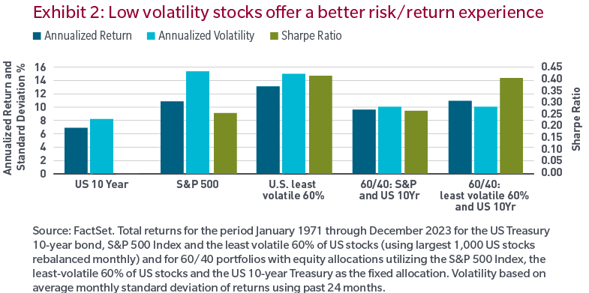
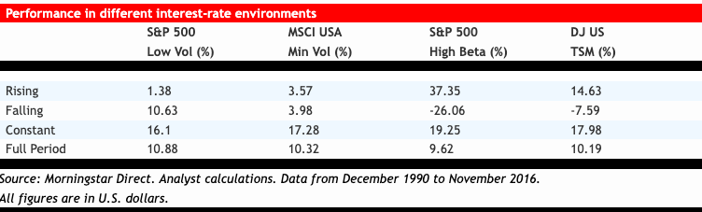
Why Low Volatility?

Slide 9

Fund Parameters
NII Low Vol Portfolio is a fund created to invest Globally.
The portfolio consists of 34 equities and 3 bonds.
56.12% of our portfolio is Canadian
27.27% is American
11.85% is Middle East
4.76% is Europe

Slide 10
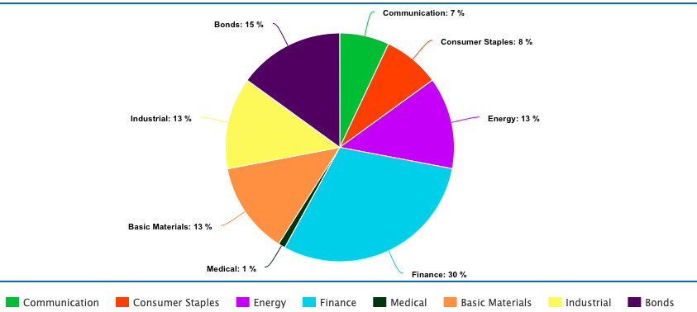
Sector Breakdown Q42024

Slide 11
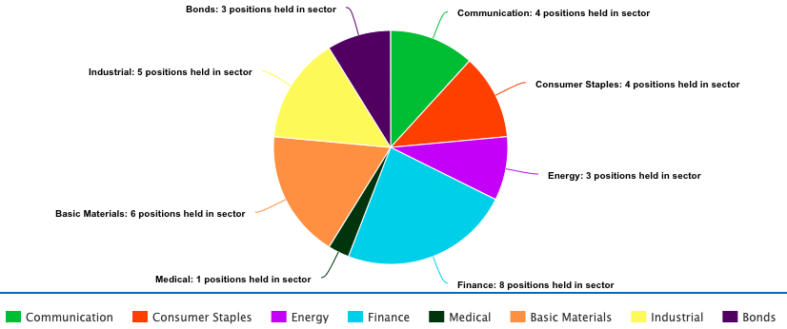
Sector Breakdown Q42024
by position

Slide 12
Funds Holdings
December 2024
TELUS 1.75% | TMX GROUP LIMITED 3.75% | BARRICK GOLD CORP 2.16%
VERIZON COMMUNICATIONS 1.75% | TORONTO-DOMINION BANK 3.75% | FREEPORT MCMORAN B 2.16%
ROGERS 1.75% | ROYAL BANK OF CANADA 3.75% | ANGLO AMERICAN PLC 2.16%
SAUDI TELECOM 2% | AL RAJHI BANKING & INVESTMENT CORP. 3.75% | WHEATON PRECIOUS METALS 2.16%
PEPSICO INC 2% | INTERMEDIATE CAPITAL GRP 3.75% | NUCOR CORP 2.16%
THE COCA-COLA COMPANY 2% | GREAT-WEST LIFECO INC 3.75% | RIYADH CEMENT CO. 2.6%
JOHNSON & JOHNSON 2% | MANULIFE 3.75% | CANADIAN PACIFIC KANSAS CITY LTD 2.6%
PROCTER & GAMBLE 2% | SUN LIFE FINANCIAL 3.75% | CANADIAN NATL RAILWAY CO 2.6%
ENBRIDGE 4.33% | RESMED INC 1% | WEIR GROUP 2.6%
FORTIS INC 4.34% | NEWMONT CORP 2.2% | WASTE CONNECTIONS INC 2.6%
EMERA INC 4.33% | CVS HEALTH CORP BOND 5% | CANADIAN TREASURY BONDS 5%
U.S. TREASURY BOND 5%

Slide 13
10 Lowest Beta Stock
STOCK | 5 - YEAR BETA | WEIGHT
SAUDI TELECOM | 0.13 | 1.75
RIYADH CEMENT CO. | 0.21 | 2.6
PEPSICO INC | 0.236 | 2
EMERA INC | 0.26 | 4.33
TMX GROUP LIMITED | 0.38 | 3.75
VERIZON COMMUNICATIONS | 0.388 | 1.75
PROCTER & GAMBLE | 0.418 | 2
FORTIS INC | 0.46 | 4.34
JOHNSON & JOHNSON | 0.468 | 2
BARRICK GOLD CORP | 0.51 | 2.16
Total |  | 26.68
Over 1/4 of our portfolio has a 5-Year beta ~ 0.5

Slide 14
10 Lowest Beta Stock
STOCK | 2020 BETA
PEPSICO INC | -0.09
SAUDI TELECOM | 0.13
RIYADH CEMENT CO. | 0.21
PROCTER & GAMBLE | 0.23
EMERA INC | 0.26
TMX GROUP LIMITED | 0.38
VERIZON COMMUNICATIONS | 0.43
THE COCA-COLA COMPANY | 0.44
ROGERS COMMUNICATIONS | 0.46
FORTIS INC | 0.46
STOCK | 2024 BETA
SAUDI TELECOM | 0.13
RIYADH CEMENT CO. | 0.21
EMERA INC | 0.26
VERIZON COMMUNICATIONS | 0.34
JOHNSON & JOHNSON | 0.34
TMX GROUP LIMITED | 0.38
PROCTER & GAMBLE | 0.4
FORTIS INC | 0.46
AL RAJHI BANKING & INVESTMENT CORP. | 0.48
BARRICK GOLD CORP | 0.51

Slide 15
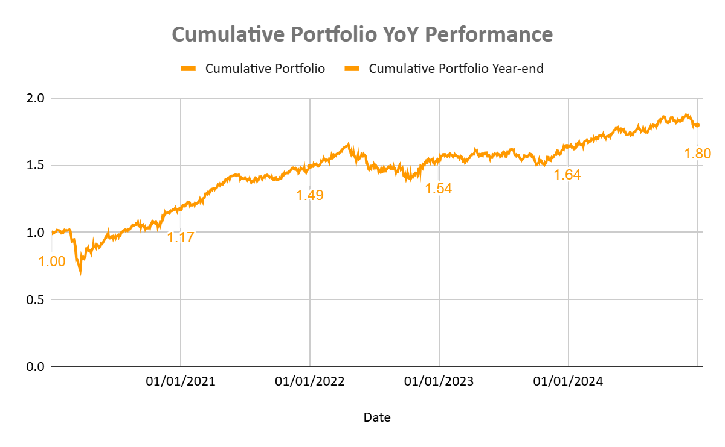
Historical performance of Low/Min Volatility Portfolio

Slide 16
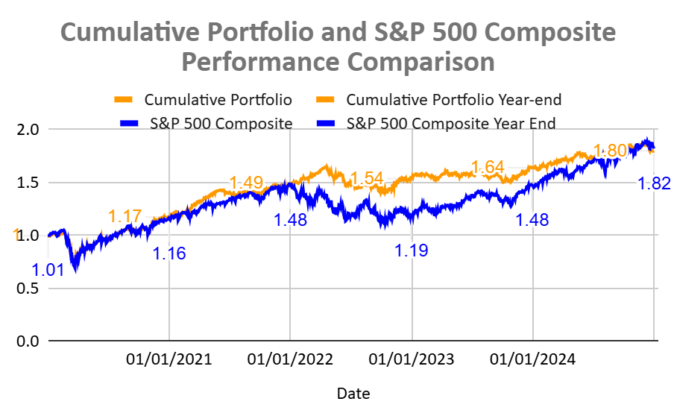
Cumulative Portfolio and S&P 500 Composite Performance

Slide 17
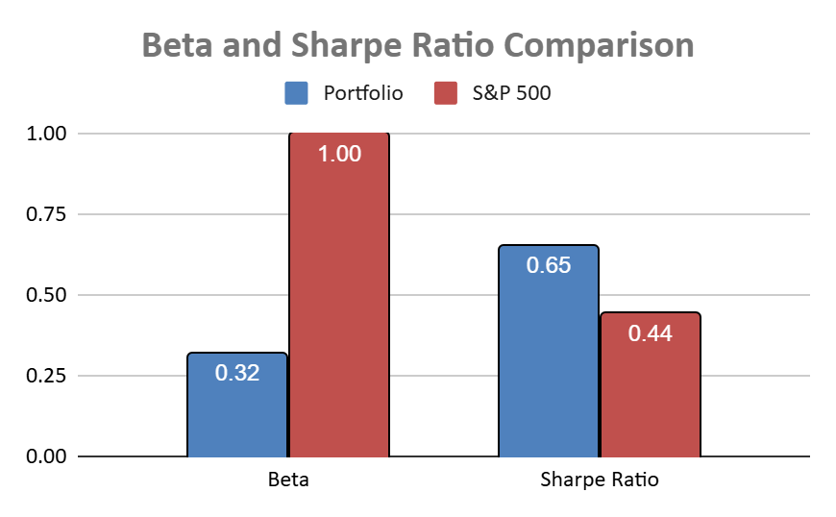
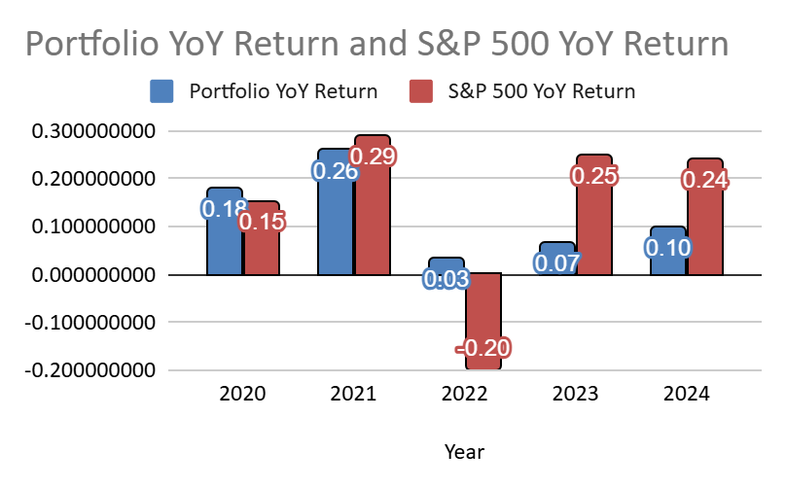
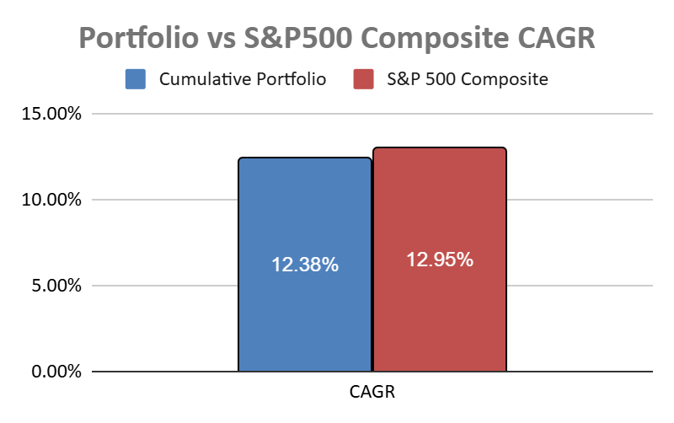
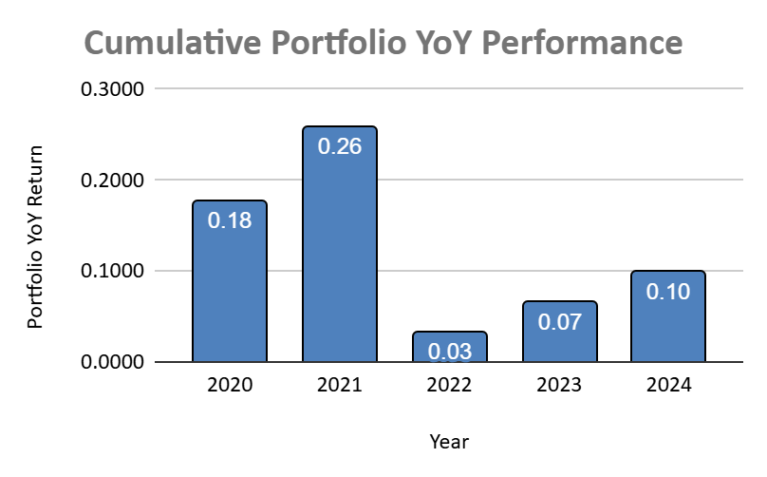
Performance Attributions
at 5 years

Slide 18
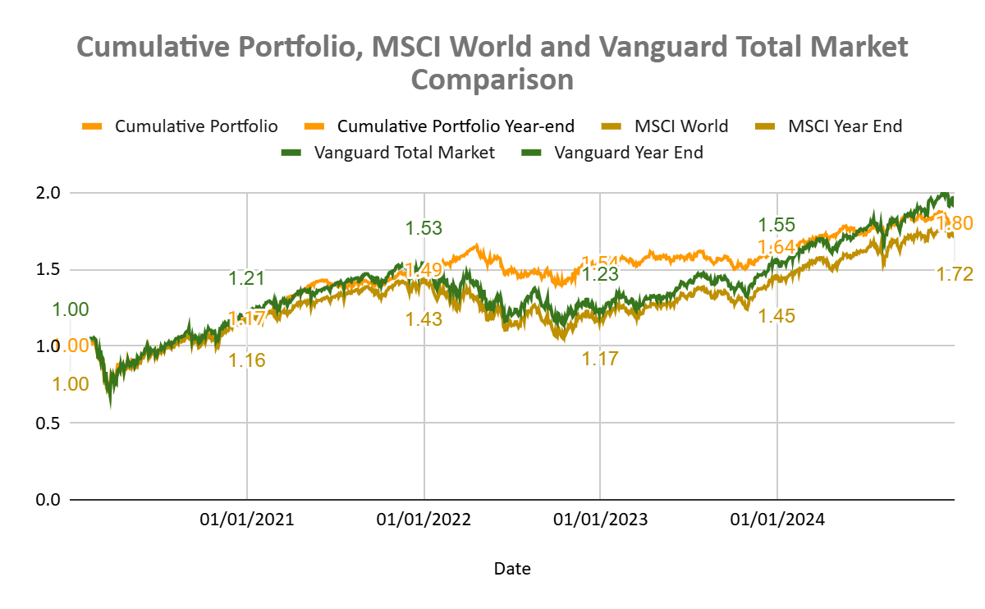
Cumulative Portfolio with Market Funds comparison

Slide 19
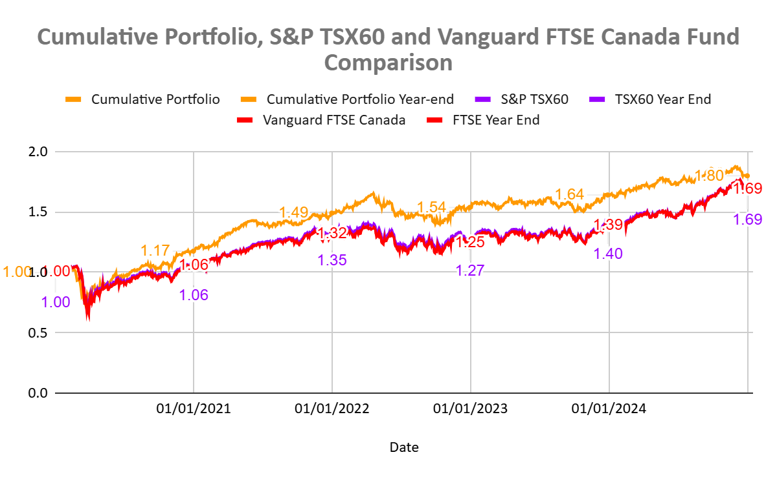
Cumulative Portfolio with Canadian Funds comparison

Slide 20
What Sets Us Apart?
Consistent Returns
Proven Track Record & Expertise
Client-Centric Philosophy
Our disciplined approach focuses on low-risk, stable investments that are resilient to market fluctuations, ensuring steady and predictable returns for our clients.
With over two decades of experience and a strong reputation in the Canadian financial landscape, we leverage deep market insights and strategic asset management
We prioritize trust, transparency, and long-term relationships, offering personalized investment solutions that align with our clients’ financial goals

Slide 21


Thank You
INVEST WITH US
Stability in Uncertain Markets
Proven Expertise and Reliability
Tailored Investment Solutions
Transparent and Trustworthy Management
Proudly Canadian, Globally Focused
invest@nii.ca
1000 Bay St., Toronto, Ontario
(416) - 123 - 4567
nii.ca / nii.com
@niinvest

Slide 22
References
Alex Bryan, “A framework for evaluating low-volatility funds”, 7 August 2018, Morningstar, https://www.morningstar.ca/ca/news/191021/a-framework-for-evaluating-low-volatility-funds.aspx.
David Elliott,”6 countries successfully growing their manufacturing – and what they are doing right”, January 20 2025, World Economic forum,https://www.weforum.org/stories/2025/01/6-countries-successfully-growing-their-manufacturing/.
James C. Fallon, Christopher Zani, CFA, “The Benefits of Low Volatility as a Strategic Allocation”, March 2024,MFS,https://www.mfs.com/en-us/investment-professional/insights/market-insights/the-benefits-of-low-volatility-as-a-strategic-allocation.html
Kai Schultz and Shruti Srivastava, “Developing Countries Can’t Count on Manufacturing to Supercharge Growth”, October 21 2024, BNN Bloomberg, https://www.bnnbloomberg.ca/investing/commodities/2024/10/21/developing-countries-cant-count-on-manufacturing-to-supercharge-growth/.
Stephanie Thompson, “Is globalization dying? An economic historian weighs up the evidence”, August 2 2024,
World Economic Forum, https://www.weforum.org/stories/2024/08/globalization-dying-economic-historian-evidence-adam-tooze/

